Slide 1

Bachelor Of Technology
Computer Science and Engineering (Data Science)
311 Program in collaboration with Virginia Tech. USA
Mini-Project Presentation
SVKM’s NMIMS
Mukesh Patel School of Technology Management and Engineering, JVPD, Vile Parle, West
Mumbai- 400056

Slide 2

A PRESENTATION ON
“Linear Programming: Supply Chain Logistics Problem”
By Krish Shah (L054), Avichal Sharma (L056), Krishna Sharma (L057)
Faculty Mentors:
Prof. Ami Munshi, Prof. Mahesh Mali and Prof. Khinal Parmar

Slide 3
Contents
Introduction
Problem Statement
System Description
Implementation
Data cleaning and exploration
Data visualization
Data modelling and conclusions
Conclusion

Slide 4
Introduction
The selected dataset depicts a supply chain logistics problem with multiple variables that control the costing and price of a product. The decision variables include manufacturing plants and destination ports. Other data like shipping charges, minimum cost, freight rates etc. is also available for further analysis using python and SAS Visual Analytics.
Using programming, analytics and visualization tools we hope to find the optimal solution for minimum transportation costing and formulate a program for the same along with visually depicting the problem using SAS.

Slide 5
Literature Survey
The transportation problem is a special type of linear programming problem where the objective is to minimize the cost of distributing a product from a number of sources or origins to a number of destinations.
Because of its special structure the usual simplex method is not suitable for solving transportation problems. These problems require a special method of solution. The origin of a transportation problem is the location from which shipments are dispatched.
The destination of a transportation problem is the location to which shipments are transported. The unit transportation cost is the cost of transporting one unit of the consignment from an origin to a destination.

Slide 6
Problem Statement
Supply Chain Logistics Problem

Slide 7
Problem Statement
This project aims at providing the optimal solution for minimum transportation costing based on two decision variables along with a pictorial overview of the problem.

Slide 8
System Description
Software Requirements
We downloaded the base dataset on excel 2019, where the data can be cleaned easily.
This implementation of the analysis is done on Google Colab notebooks since it is easier to share and modify on the cloud.
The OS used is Windows 11/10
The python kernel version on Google Colab is 3.7.13
The bit frame used is for windows-64 bit​.
Python libraries like pandas, numpy and pulp are installed for implementation of the code.​

Slide 9
Implementation
The Implementation to this problem consists of three parts:
Data Cleaning and Exploration
Data Visualization
Data Modelling and Conclusions

Slide 10
Implementation
Phase 1: Data Cleaning and Exploration
We sliced our dataset with the columns we want to use
We first opened the excel file and removed any blank values the dataset might have.
The demand for some origin plants was negligible compared to the others and we hence removed them.
To solve simplex on python using pulp, we first extracted the data from the csv file, cleaned it using functions of pandas dataframe on python and formulated our final simplex problem.
Explored data, created useful lists and dictionaries to ease coding.

Slide 11
Implementation
Phase 2: Data Visualization
This phase of Data Visualization is implemented using SAS Visual Analytics Software. We load the dataset into the SAS Lasr Server and then create a dashboard.
We can make meaningful graphs and charts to give us valuable insight into the transportation scenario of the company. We also need to keep in mind to implement the right color scheme to make the dashboard visually appealing.
Also, created prompts and new data categories for more insight into the dataset.

Slide 12
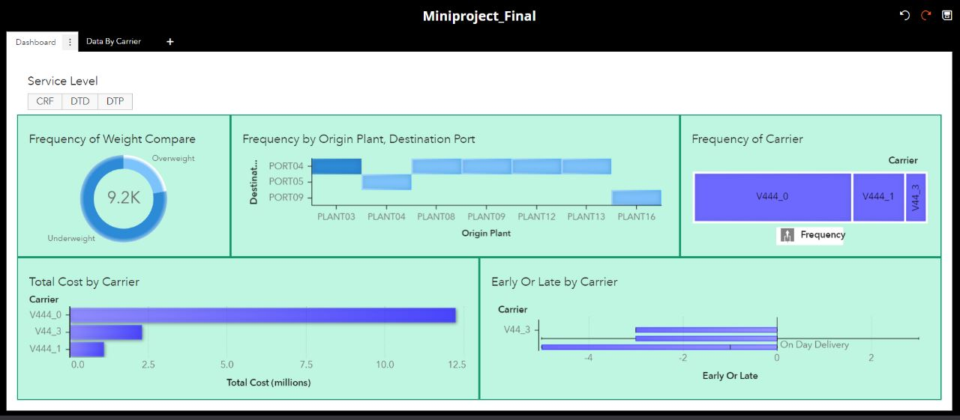
Implementation
Screenshots of Final Dashboard:

Slide 13
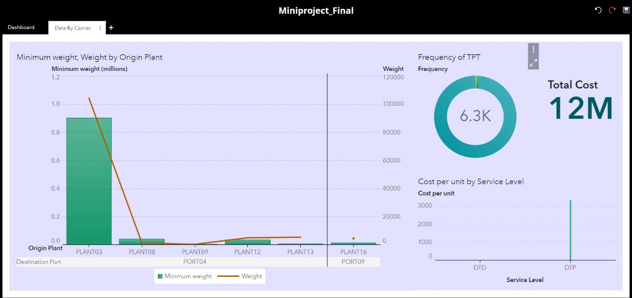
Implementation
Screenshots of Linked Dashboard V444_0:

Slide 14
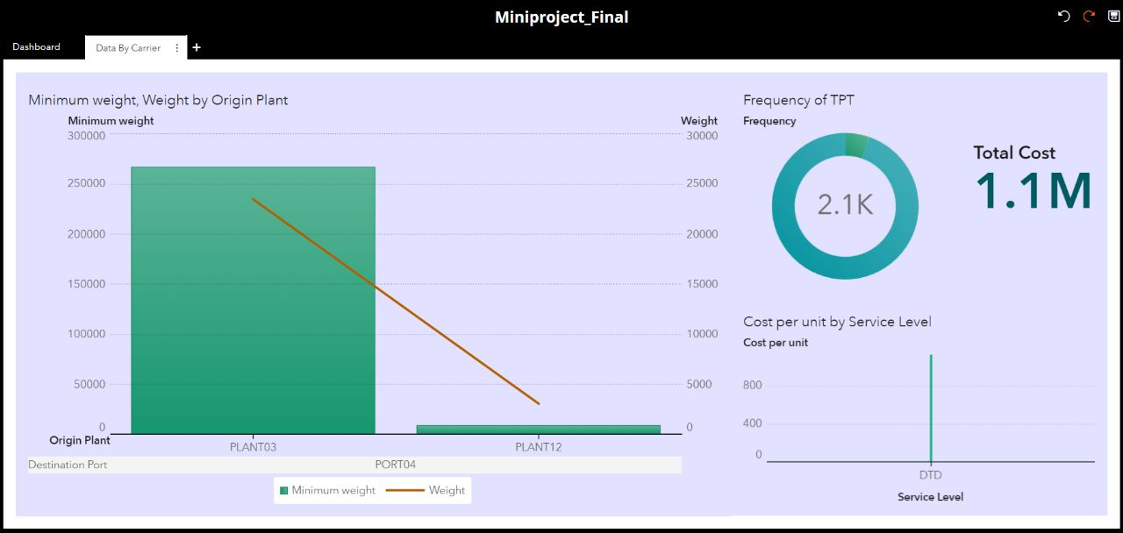
Implementation
Screenshots of Linked Dashboard V444_1:

Slide 15
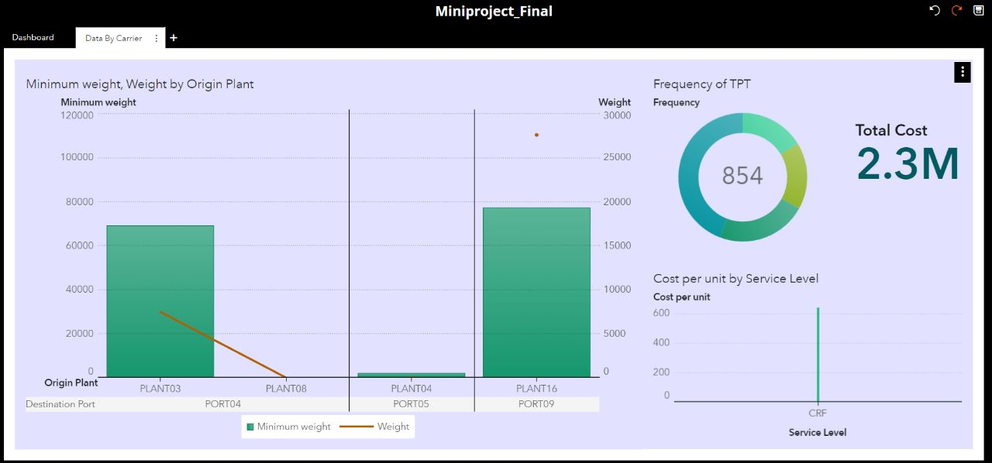
Implementation
Screenshots of Linked Dashboard V44_3:

Slide 16
Implementation
Phase 3: Data Modelling and drawing Conclusions
Finally, the data is analyzed and worked on before it gives us an optimal solution to our transportation problem using python programming and business analytics and modelling techniques.
Transportation problems are solved using linear programming concepts. We can conclude with the optimal solution for the given transportation problem.
Python libraries NUMPY and pandas were used for data manipulation and the library PuLP was used for solving the linear programming problem of transportation.

Slide 17
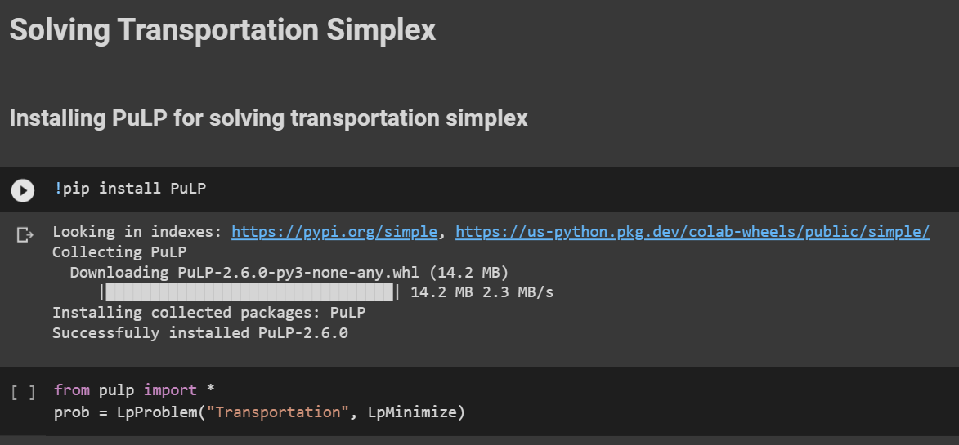
Implementation
Screenshots of python with output

Slide 18
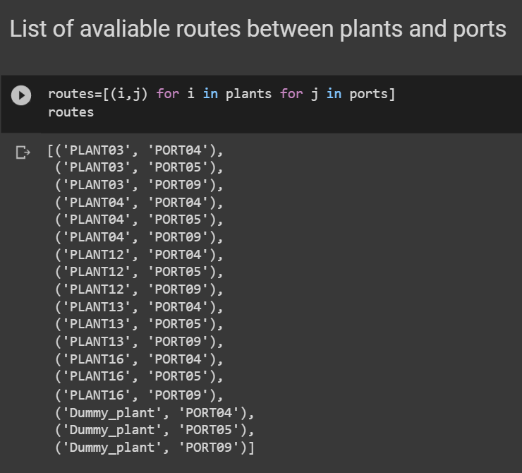
Implementation
Screenshots of python with output

Slide 19
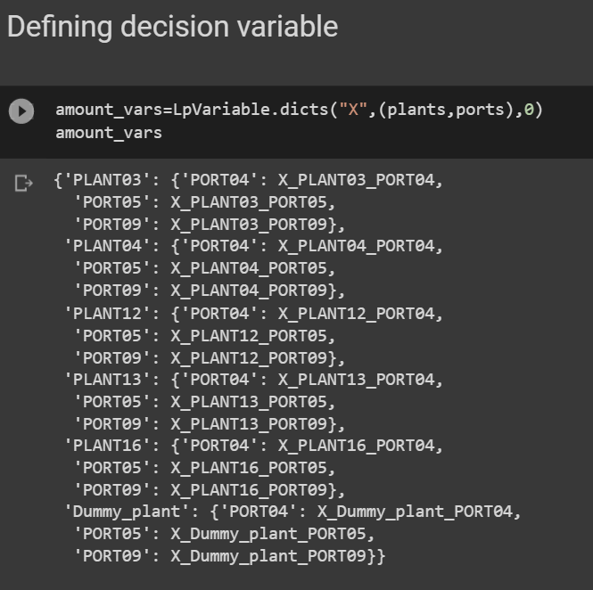
Implementation
Screenshots of python with output

Slide 20
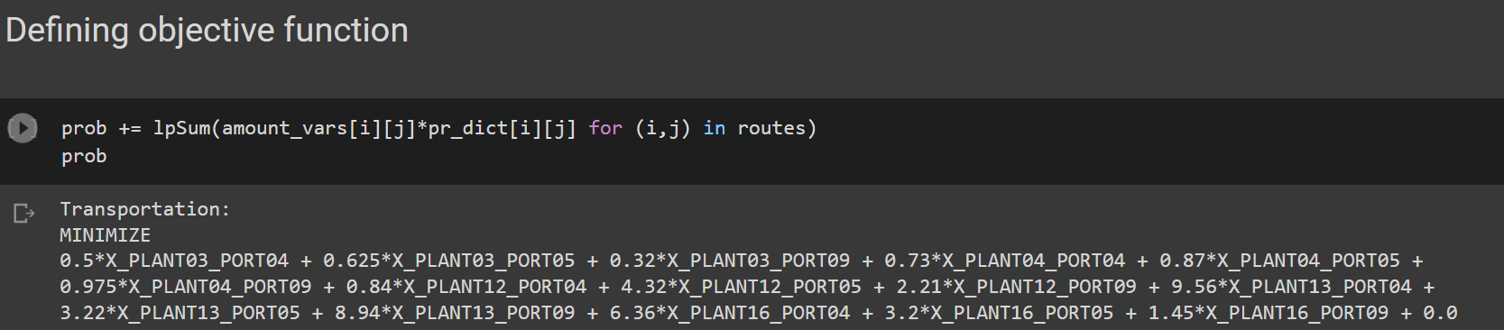
Implementation
Screenshots of python with output

Slide 21
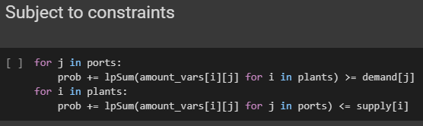
Implementation
Screenshots of python with output

Slide 22
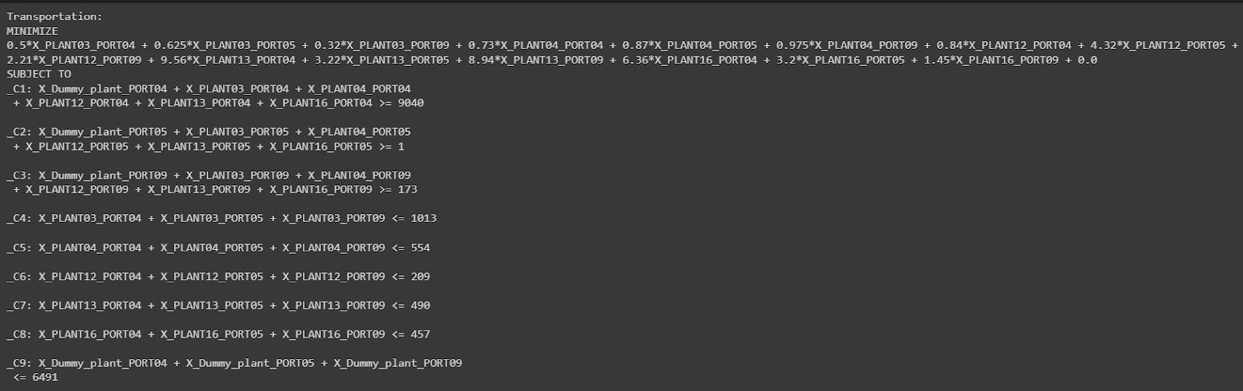
Implementation
Screenshots of python with output

Slide 23
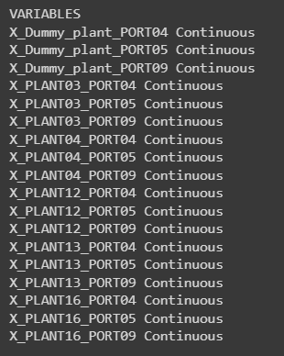
Implementation
Screenshots of python with output

Slide 24
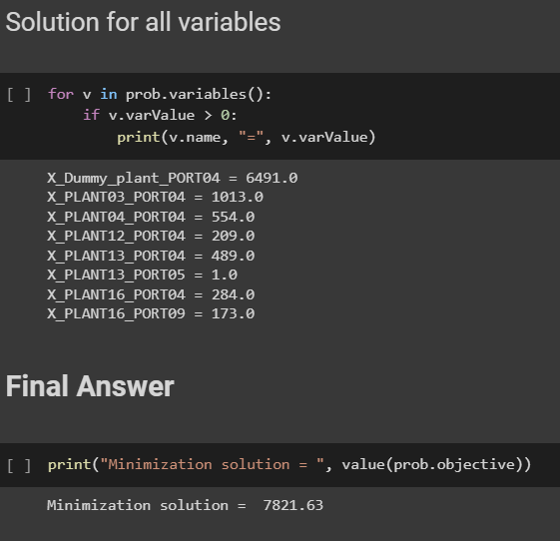
Implementation
Screenshots of python with output

Slide 25
Conclusion
The problem formulated was as follows:
Objective function:
MINIMIZE 0.5*X_PLANT03_PORT04 + 0.625*X_PLANT03_PORT05 + 0.32*X_PLANT03_PORT09 + 0.73*X_PLANT04_PORT04 + 0.87*X_PLANT04_PORT05 + 0.975*X_PLANT04_PORT09 + 0.84*X_PLANT12_PORT04 + 4.32*X_PLANT12_PORT05 + 2.21*X_PLANT12_PORT09 + 9.56*X_PLANT13_PORT04 + 3.22*X_PLANT13_PORT05 + 8.94*X_PLANT13_PORT09 + 6.36*X_PLANT16_PORT04 + 3.2*X_PLANT16_PORT05 + 1.45*X_PLANT16_PORT09 + 0.0

Slide 26
Conclusion
Subject to constraints:
SUBJECT TO
_C1: X_Dummy_plant_PORT04 + X_PLANT03_PORT04 + X_PLANT04_PORT04 + X_PLANT12_PORT04 + X_PLANT13_PORT04 + X_PLANT16_PORT04 >= 9040
_C2: X_Dummy_plant_PORT05 + X_PLANT03_PORT05 + X_PLANT04_PORT05 + X_PLANT12_PORT05 + X_PLANT13_PORT05 + X_PLANT16_PORT05 >= 1
_C3: X_Dummy_plant_PORT09 + X_PLANT03_PORT09 + X_PLANT04_PORT09 + X_PLANT12_PORT09 + X_PLANT13_PORT09 + X_PLANT16_PORT09 >= 173
_C4: X_PLANT03_PORT04 + X_PLANT03_PORT05 + X_PLANT03_PORT09 <= 1013
_C5: X_PLANT04_PORT04 + X_PLANT04_PORT05 + X_PLANT04_PORT09 <= 554
_C6: X_PLANT12_PORT04 + X_PLANT12_PORT05 + X_PLANT12_PORT09 <= 209
_C7: X_PLANT13_PORT04 + X_PLANT13_PORT05 + X_PLANT13_PORT09 <= 490 _C8: X_PLANT16_PORT04 + X_PLANT16_PORT05 + X_PLANT16_PORT09 <= 457 _C9: X_Dummy_plant_PORT04 + X_Dummy_plant_PORT05 + X_Dummy_plant_PORT09 <= 6491

Slide 27
Conclusion
Variables:
VARIABLES
X_Dummy_plant_PORT04 Continuous
X_Dummy_plant_PORT05 Continuous
X_Dummy_plant_PORT09 Continuous
X_PLANT03_PORT04 Continuous X_PLANT03_PORT05 Continuous X_PLANT03_PORT09 Continuous X_PLANT04_PORT04 Continuous X_PLANT04_PORT05 Continuous X_PLANT04_PORT09 Continuous X_PLANT12_PORT04 Continuous X_PLANT12_PORT05 Continuous X_PLANT12_PORT09 Continuous X_PLANT13_PORT04 Continuous X_PLANT13_PORT05 Continuous X_PLANT13_PORT09 Continuous X_PLANT16_PORT04 Continuous X_PLANT16_PORT05 Continuous X_PLANT16_PORT09 Continuous

Slide 28
Conclusion
The result we found was as follows:
Optimal minimization solution:
Minimization solution = 7821.63
Decision variable solutions:
X_Dummy_plant_PORT04 = 6491.0
X_PLANT03_PORT04 = 1013.0
X_PLANT04_PORT04 = 554.0
X_PLANT12_PORT04 = 209.0
X_PLANT13_PORT04 = 489.0
X_PLANT13_PORT05 = 1.0
X_PLANT16_PORT04 = 284.0
X_PLANT16_PORT09 = 173.0

Slide 29
THANK YOU

