Slide 1
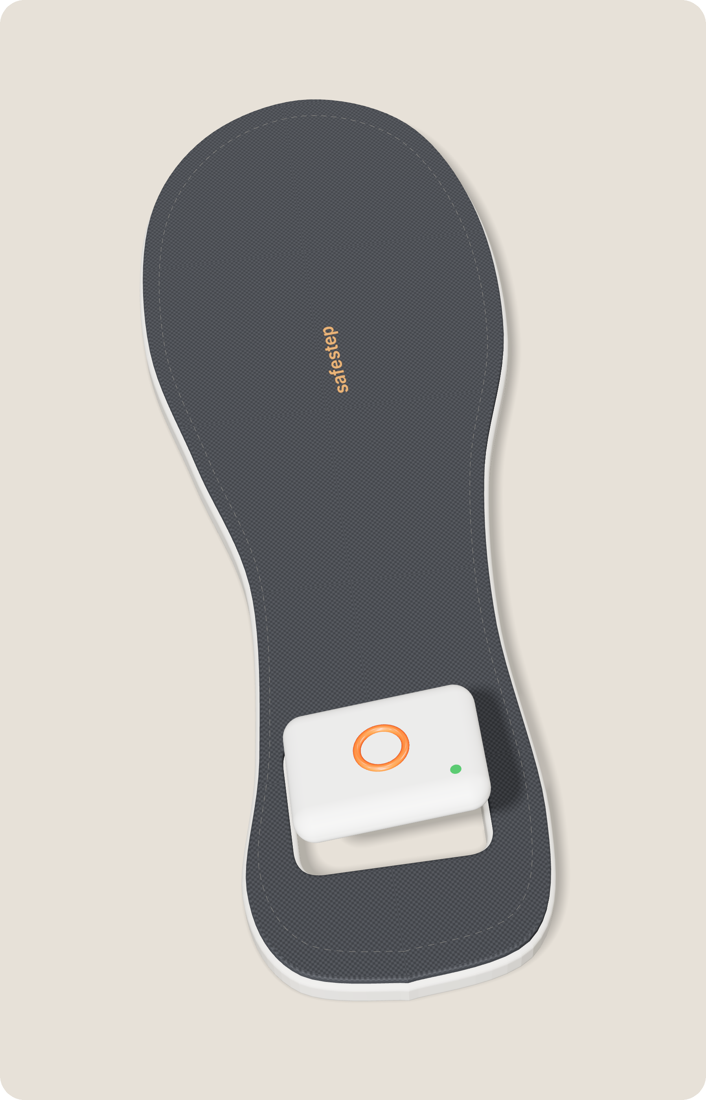

Presented by Yuvraj
SafeStep
An AI-enabled smart insole that calls for help when you can't
Double heel-tap sends a silent SOS with live location
On-device AI spots a fall or danger and alerts by itself
Own GPS + SIM so it works even when the phone is gone
By Team 12, BS-DSAI, IIM Sambalpur
Avidha Chandra · Agrima · Anirudh Kumar · Yuvraj Rao Padala · Divyansh Sinha · Pratyush Phadnaik · Shreyam Sai Vinayak · Aayush Agrawal
Notes:
YUVRAJ (0:00-0:35). [Walk to the centre, pause two seconds.] It's ten at night. You're in a shared auto, your phone is on 3%, and the driver has just taken a turn you don't recognise. What do you do? Every safety tool you own lives inside that phone. Good afternoon, we're Team 12, and this is SafeStep: an AI-enabled smart insole that calls for help even when you can't. A small pod sits in the heel of any shoe. Tap your heel twice, and a silent SOS goes out with your live location. And if something happens that you can't report, the pod notices on its own. Agrima will show you why we built it.

Slide 2
Presented by Agrima
The Problem
Safety tools fail exactly when the phone does
Crimes against women
Public transport
4,48,211
9%
cases registered in India in 2023
of women feel it is "very safe"
NCRB, Crime in India 2023
Ola Mobility Institute, 9,935 women, 11 cities
After dark
The gap we found
77%
Phone = failure point
of women feel unsafe on Delhi buses at night
Every safety app, ride SOS and pendant needs a working phone, the first thing snatched, switched off or dead
Greenpeace India, 2024
If unsolved: students skip evening classes, families restrict women's mobility, field workers can't call for help, and every lost minute delays rescue.
Notes:
AGRIMA (0:35-1:10). The numbers are hard to ignore. India registered 4,48,211 cases of crime against women in 2023, and those are only the ones reported. Only 9% of women feel public transport is very safe. In Delhi, 77% feel unsafe on buses after dark. But the gap we found is simpler. Every safety app, ride-app SOS button and safety pendant depends on a working phone. In an emergency, the phone is the first thing snatched, switched off or dead. Then help arrives late, or not at all. So who needs this most? Anirudh.

Slide 3

Presented by Anirudh
Who Needs SafeStep?
Persona: Priya, 20, takes a shared auto to her hostel after evening classes, often with her phone nearly dead
Who Uses It
Who Pays (B2B2C)
Why They Would Switch
College students (especially women) travelling alone at night, NGO and health field workers in remote areas, and women on late shifts using shared autos and cabs.
Colleges, NGOs and employers through safety or CSR budgets, plus parents. Model: about Rs 2,499 per pod + Rs 99 per seat per month (team estimate).
Safety apps, ride-app SOS buttons and pendants like Safer all need the phone and the user to act. SafeStep works without the phone, unseen, and alerts on its own.
Notes:
ANIRUDH (1:10-1:45). Meet Priya. She's 20, takes a shared auto back to her hostel after evening classes, and by then her phone is nearly dead. She's our user, along with NGO field workers in remote areas and women on late shifts. But Priya isn't the one who pays. Colleges, NGOs and employers buy SafeStep through their safety and CSR budgets, and parents buy it too. That's a B2B2C model. Why would they switch? Because every alternative needs the phone, and needs the user to act. Shreyam will show you what's actually new.

Slide 4
Presented by Shreyam
What Makes It Different
01
Value from the Product
A hidden heel-tap SOS with its own GPS and 4G SIM, so it works when the phone is gone. Alerts are stored and sent when signal returns; location is shared only during an SOS.
02
What the AI Adds
Unique value proposition
SafeStep calls for help even when you can't.
A tap classifier stops false alarms from walking or stairs. Fall and anomaly detection alerts when the user can't act. Route scoring flags a ride that goes wrong but ignores normal detours.
03
Better Than Today's Options
More reliable (no phone needed), more discreet (inside the shoe), more proactive (AI alerts on its own). An improvement on existing safety wearables.
Notes:
SHREYAM (1:45-2:20). There are two layers of value. The product gives you a hidden SOS trigger with its own GPS and 4G SIM, so it works when the phone is gone. The AI makes that trigger usable. One: a tap classifier tells a deliberate double-tap from walking or climbing stairs, so no false alarms. Two: fall detection raises an alert even when you can't act. Three: route scoring flags a ride that goes wrong but ignores normal detours. So our promise is simple: SafeStep calls for help even when you can't. Divyansh, how does it work?

Slide 5
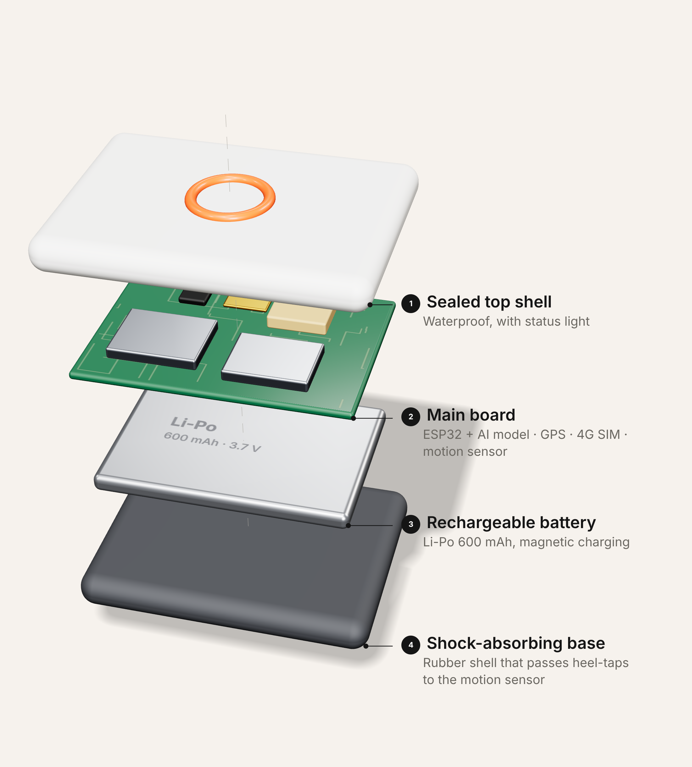
Presented by Divyansh
Product Design & How It Works
Sense: heel-tap, motion sensor and GPS inside the pod
Think: on-device AI classifies taps, falls and long stops
Decide: a tap sends an SOS instantly; auto-alerts get a 30-second cancel window
Alert: sent over the pod's own 4G SIM, stored if there is no signal
Respond: trusted contacts, campus security, then police (112)
Notes:
DIVYANSH (2:20-2:55). [Point to the steps as you say them.] Five steps. Sense: the pod's motion sensor and GPS are always listening. Think: the AI runs on the pod itself, so it works offline. Decide: a deliberate tap sends an SOS instantly. An automatic alert, like a fall, first gives you 30 seconds to cancel, so a stumble never scares anyone. Alert: the pod sends it over its own SIM, and with no signal it stores the alert and sends it when signal returns. Respond: your contacts, campus security, and if needed, police on 112.

Slide 6

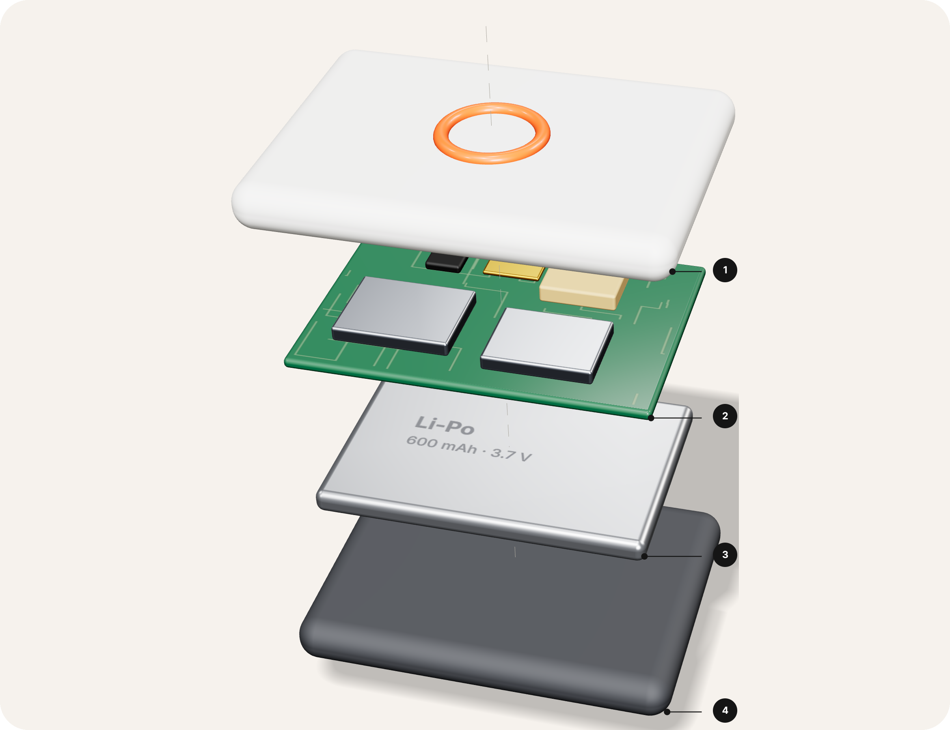
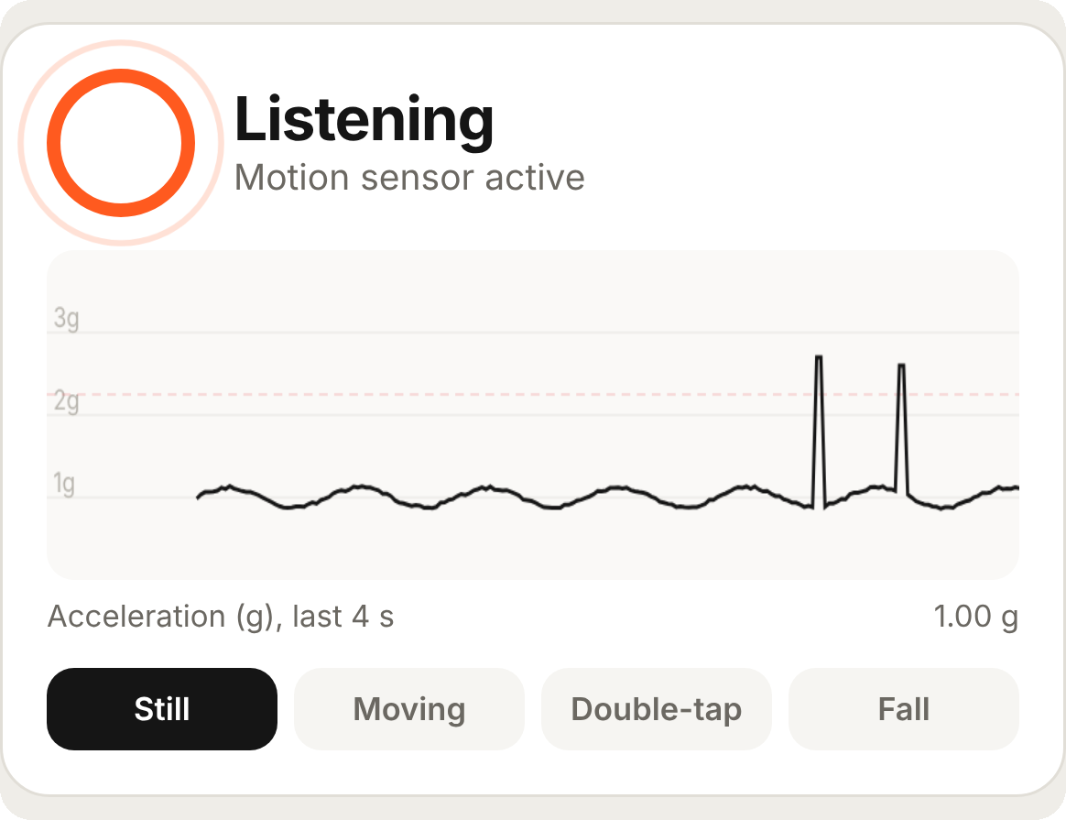
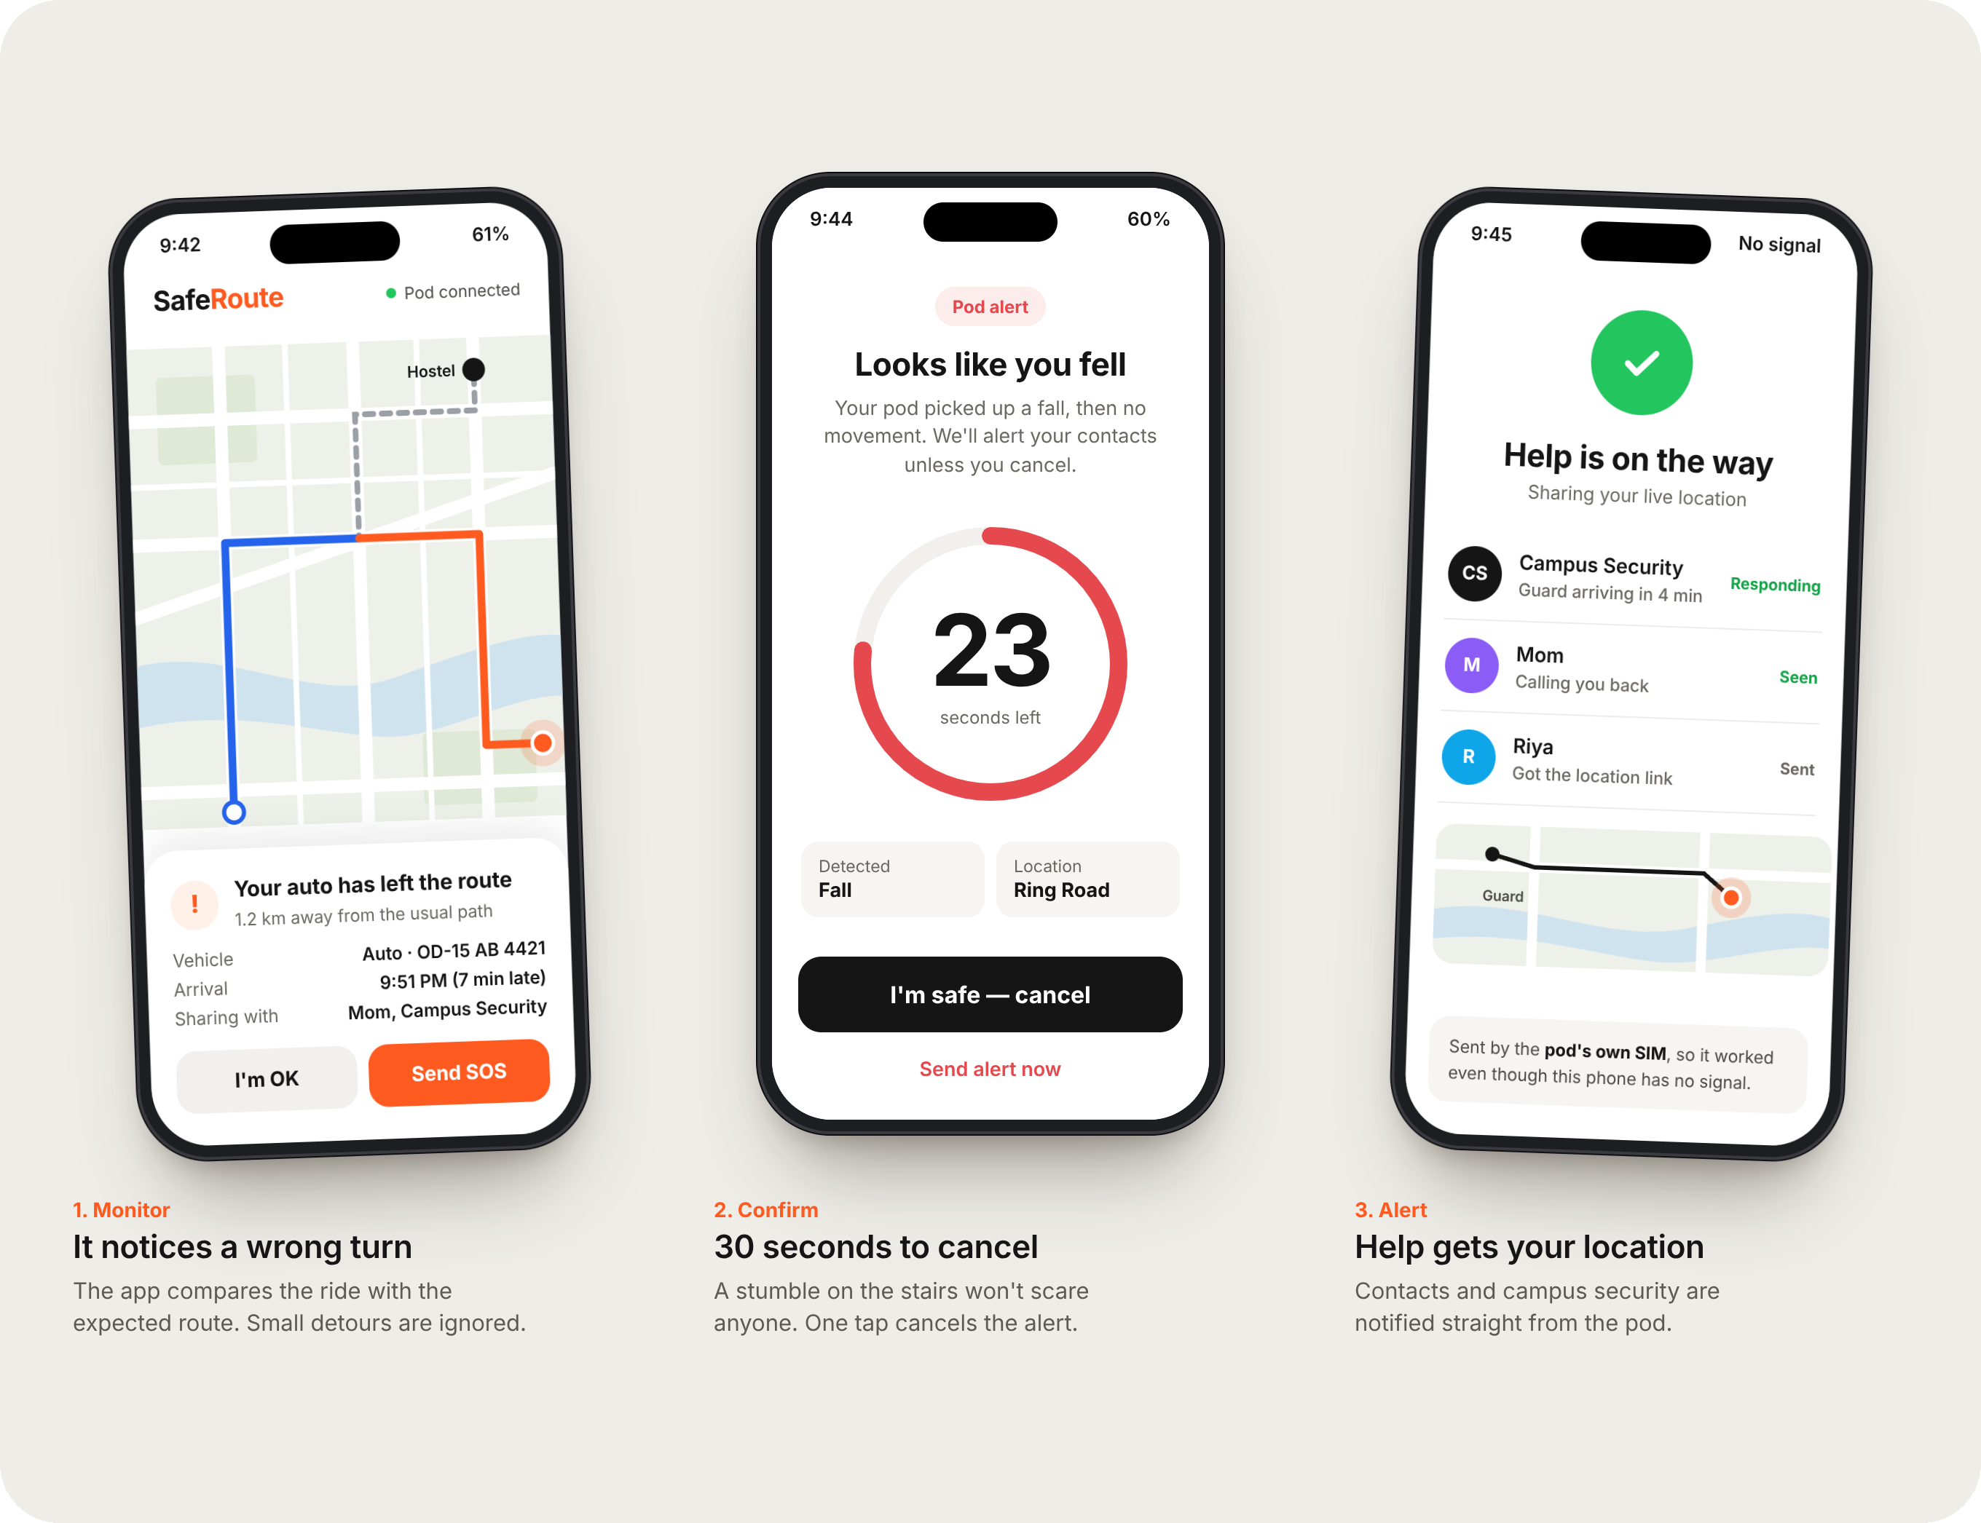
Presented by Pratyush
Prototype Development
Try it live
1 · Build the Pod
2 · Train the AI
3 · Live Prototype
ESP32, MPU6050 motion sensor, NEO-6M GPS, 4G LTE-M module, Li-Po battery, waterproof casing. Months 0–3.
TensorFlow Lite Micro and Edge Impulse, trained on our own walk, tap and fall data plus the SisFall dataset. Months 0–3.
Built and tested: a phone stands in for the pod, with real tap and fall detection, GPS SOS and a live campus dashboard. Pilot with 100 students in months 3–6.
Notes:
PRATYUSH (2:55-3:35). Building it is realistic because every part is off the shelf: an ESP32 chip, a motion sensor, GPS and a 4G module, about 1,500 rupees in parts. For the AI, we'd use TensorFlow Lite Micro and Edge Impulse, trained on our own walking, tapping and falling data, plus the public SisFall dataset. The plan: three months to build the pod, then a pilot with 100 students and one NGO team. Institutions pay about 2,499 rupees per pod plus 99 a seat each month. But we didn't want to just show you slides. So we built a working prototype, where a phone stands in for the pod. Let's show you. Avidha? [Move to the next slide. Pratyush picks up the demo phone; Avidha switches to the Command Center tab.]

Slide 7
Presented by Avidha
Try It Live
It calls for help, even when you can't.
Scan to try the working prototype
Your phone becomes the pod: double-tap it, or drop it on something soft, and watch the alert reach the Command Center.
superb-dodol-78b5ea.netlify.app
Building a safer way home, together
Notes:
AVIDHA (3:35-5:00). [Browser: Command Center open, sound on.] Thank you, Pratyush. Now let's stop talking about SafeStep and actually use it. One quick thing first. The real SafeStep is a small pod inside your shoe, with its own sensor, GPS and SIM card, so it works even without a phone. That's the physical product we'd build next. What you're about to see is our functional prototype. We've put the exact same logic on a phone, because every phone already has a motion sensor and GPS. So the phone stands in for the pod, but the detection, the alert and this dashboard are all real and running live. Can someone take out their phone? Just scan this QR code. [While they scan:] Type your name and tap Start pod. If it asks for Motion or Location, tap Allow. [Name appears.] There it is: their phone is now a SafeStep pod, connected to campus security. Now imagine you're in danger and can't take out your phone. Tap your phone firmly twice on your palm, like tapping your heel. [Siren, red alert.] And there's the SOS, with their location, on the security screen. No app opened, no call made. Just a double tap. [Click Dispatch guard.] Security sends a guard, and on their phone it now says Responding, ETA 4 minutes. So the person knows help is coming. [Volunteer taps I'm safe now. Drop your own paired phone on a bag.] And if you fall and can't tap at all, the pod notices: a sudden drop, an impact, then stillness. Because it's automatic, you get 30 seconds to cancel, so a simple stumble never scares anyone. [Cancel.] Everything you just saw was real code reading a real sensor. In the final product, this exact logic runs on a tiny chip inside the insole. [Back to this slide.] So, back to that shared auto at ten at night, with your phone on 3%. With SafeStep, you don't need your phone. You don't even need to ask. Just tap your heel, and help is on its way. Because your safety should never depend on your battery. [Pause.] SafeStep: it calls for help, even when you can't. Thank you! Scan the QR code to try it yourself.

