Slide 1
Assignment 02
Group Members for Group 20
Avishka De Silva (215326393)
Sameera Dinusha (215158268)
Dilina Perera (216260121)

Slide 2
PROJECT DESCRIPTION
For this project, our team will be making a weather application where a user can check weather according to given postcode.

Slide 3
PLATFORMS
We will be using visual studio and Xamarin to develop the project
This is a cross platform application which will support android and iOS devices.

Slide 4
FEATURES
Check weather
Use postcode to check weather
See detailed weather
See weather forecast for upcoming days

Slide 5
PROJECT TIMELINE
Week 7 – Forming group and discussing the idea.
Week 8 – Finalising User interface (UI) and start basic coding.
Week 9 –
Week 10 -

Slide 6
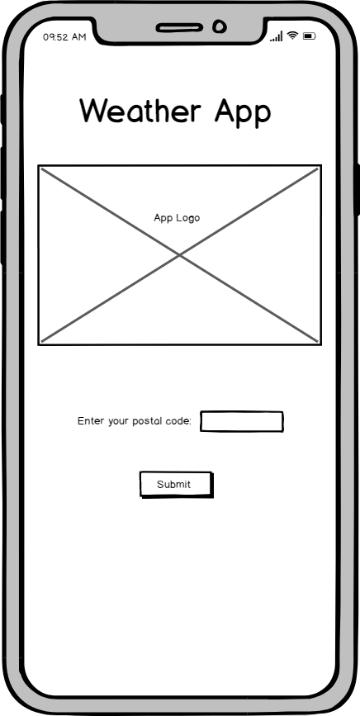
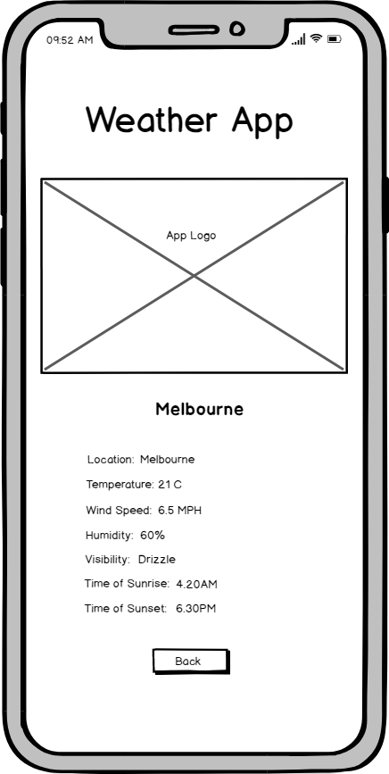
APP UX DEVELOPMENT

Slide 7
Trello Link
https://trello.com/b/jwXMI6n5/week-6

Slide 8
GROUP PARTICIPATION
Avishka De Silva – Project description and Timeline planning
Sameera Dinusha – Trello update and mockup creation
Dilina Perera – Demo video and presentation creation

