Slide 1
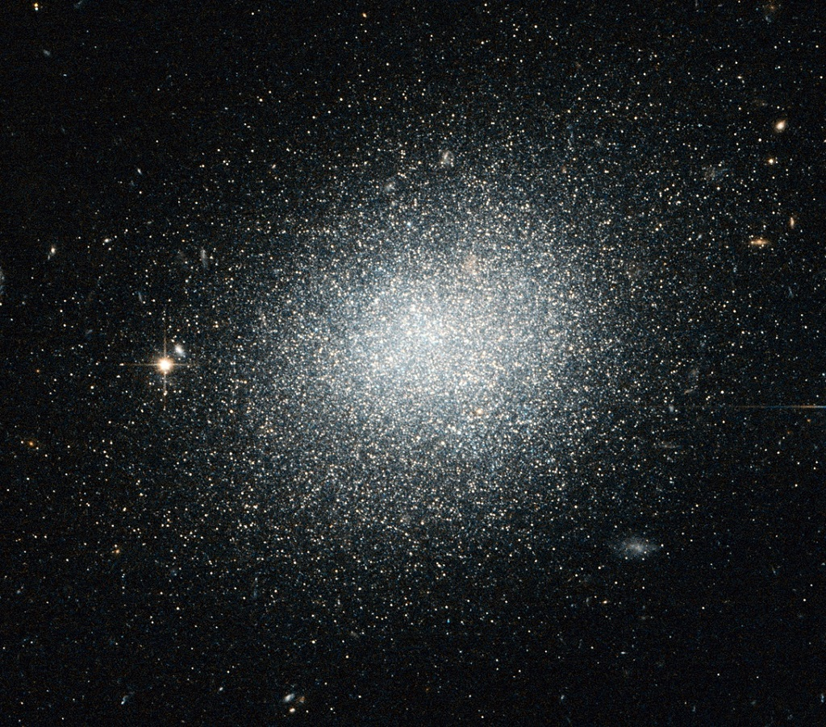
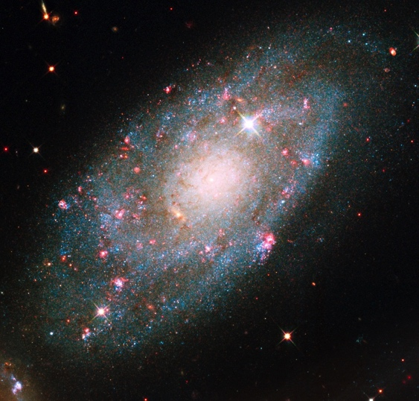
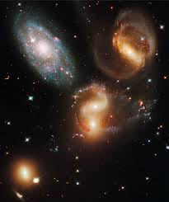
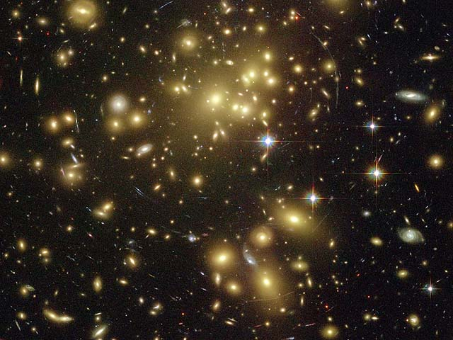
Dwarf Galaxy (10⁹ M)
Galaxy (10¹¹ M)
Galaxy Group (10¹³ M)
Time
Galaxy Cluster (>10¹⁴ M)

