Slide 1
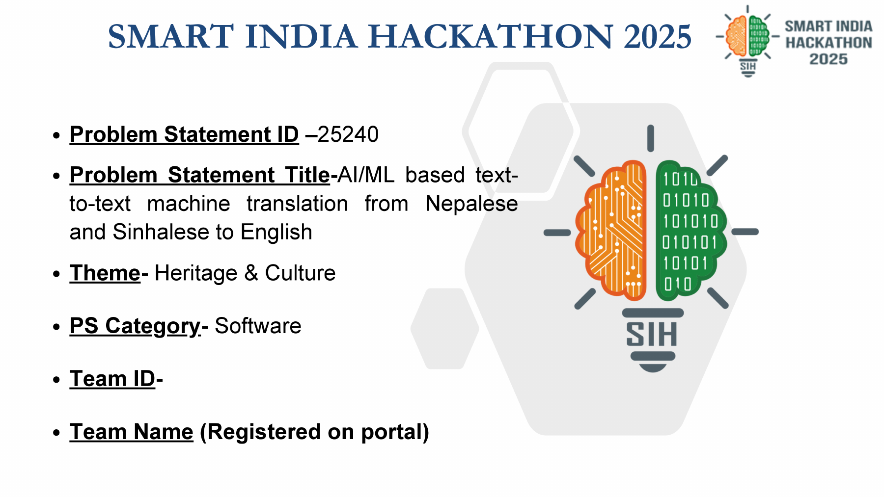
2026
Smart & Automatic Rural Land Mapping System
PROBLEM STATEMENT ID
26010
PROBLEM TITLE
Survey / Resurvey of Rural Agricultural Land in India
ORGANIZATION
Ministry of Rural Development (Dept. of Land Resources)
TEAM NAME
Hacksmits

Slide 2
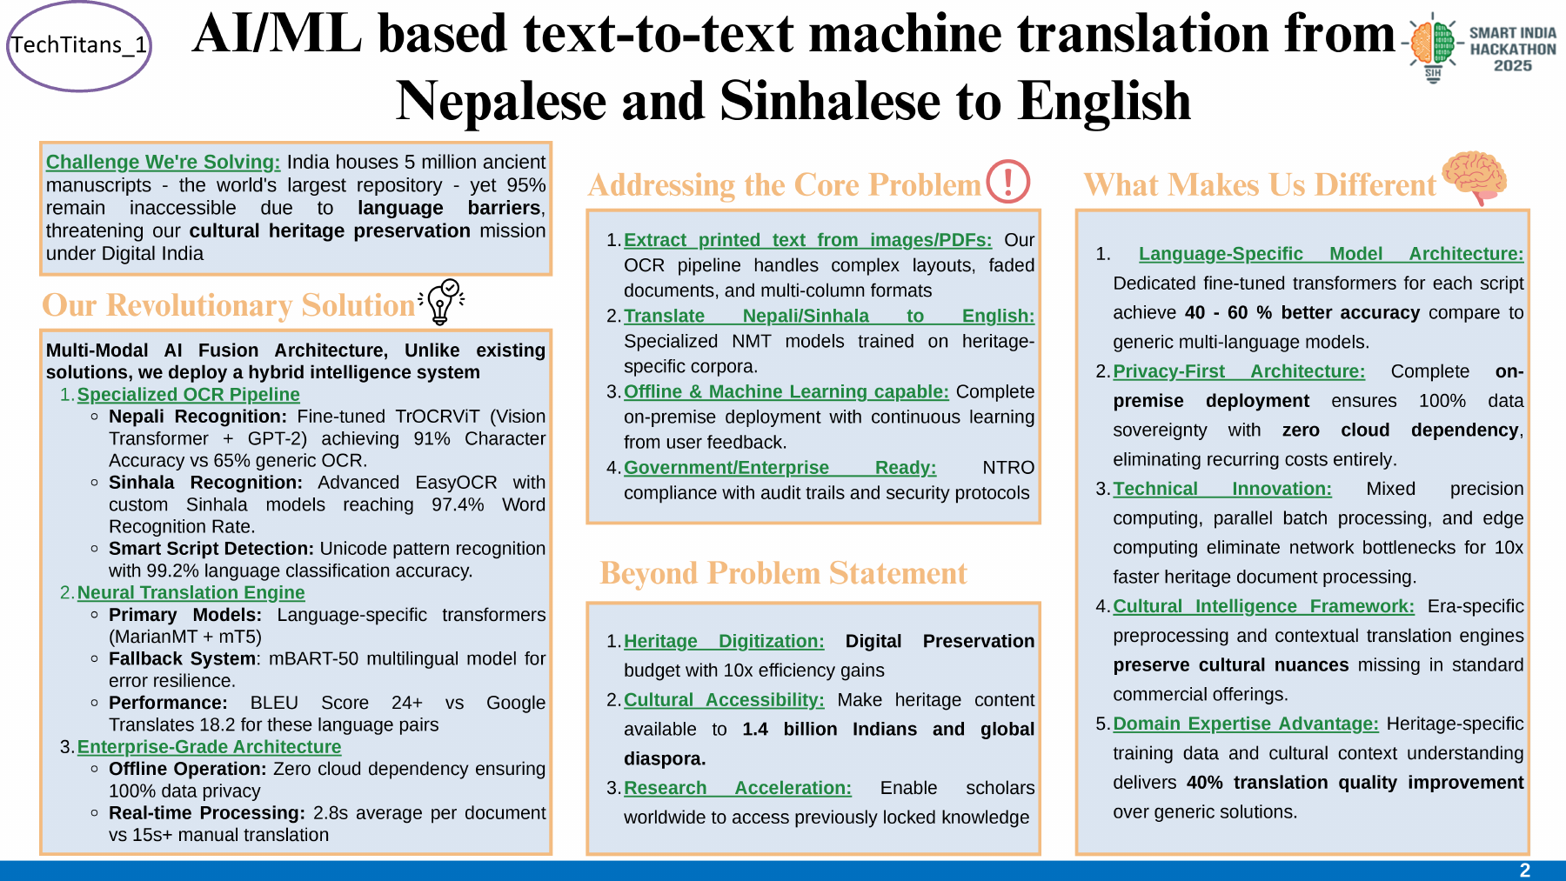
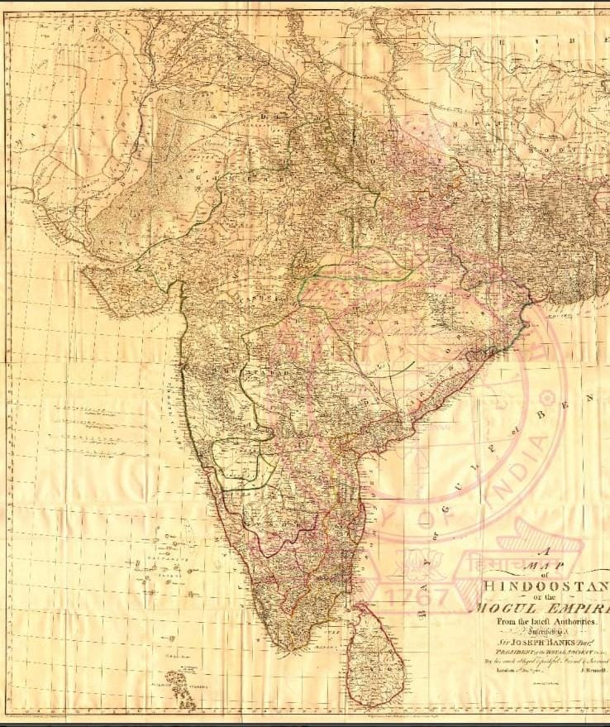
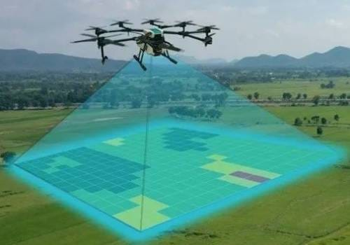
Problem & Solution
Problem & Solution
Problem & Solution
THE PROBLEM
OUR SOLUTION
Challenges We're Solving
Our Solution
• Inaccurate boundaries — Old maps made with measuring tapes cause errors and boundary fights between villagers. • Slow & costly surveys — Traditional physical land surveying takes months to finish and costs a lot of money. • Missing digital records — Small farmers lose land rights because digital records are missing or outdated.
• Smart drone & GPS mapping — Drone photos and satellite GPS measure farms accurately in minutes. • AI boundary detection — An intelligent system automatically traces farm borders on digital maps. • Easy mobile dashboard — A simple app lets farmers and officials view and verify land records instantly.
Key outcome: faster surveys, accurate digital boundaries, and accessible land records.

Slide 3
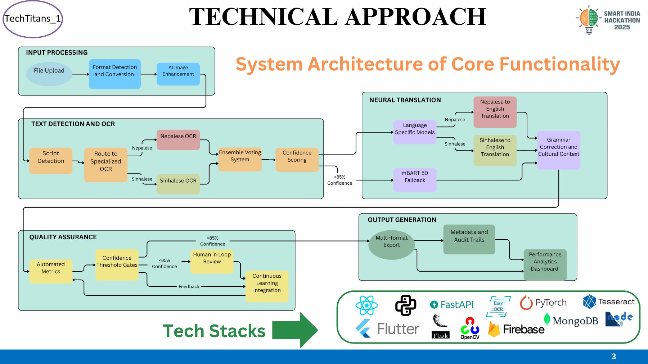
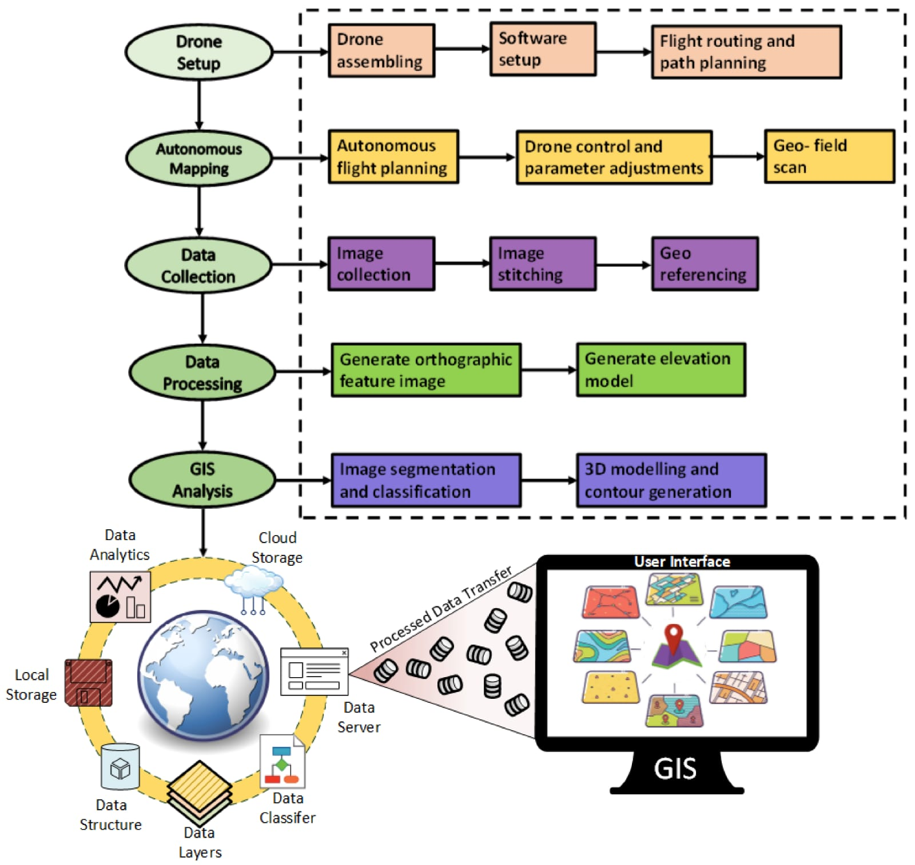
Technical Approach & Workflow
Technical Approach & Workflow
Technical Approach & Workflow
Step 1 — Data Collection
SYSTEM WORKFLOW / ARCHITECTURE
• Fly commercial camera drones over agricultural fields to capture high-definition photos. • Tag exact GPS coordinates (latitude & longitude) for every corner of the land.
Step 2 — Smart Image Processing
• Computer vision software automatically traces farm boundaries from drone photos. • Overlay the new digital drone map on old government paper maps to find errors.
Step 3 — Mobile App & Output
• Show the clean digital land map on a simple app for farmers and survey officers. • Generate an instant PDF survey report with exact plot size and digital boundaries.

Slide 4
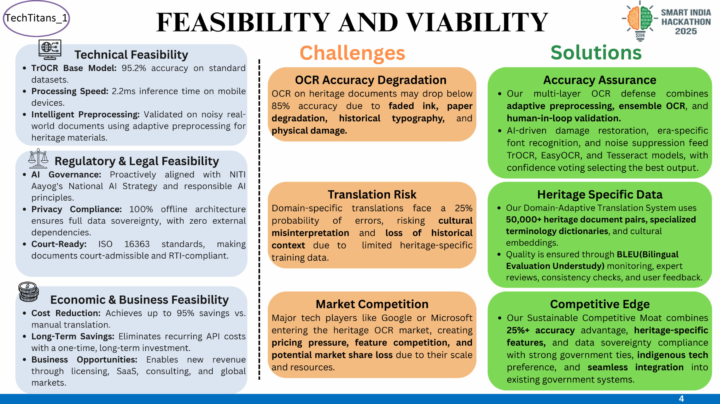
Project Feasibility & Mitigation
Project Feasibility & Mitigation
Project Feasibility & Mitigation
WHY THIS PROJECT IS FEASIBLE
RISKS & OUR SOLUTIONS
Low hardware cost
Bad weather / lighting
Uses existing commercial drones and smartphone GPS — no expensive specialized equipment.
Automatic contrast adjustment + flights scheduled during clear daylight hours.
Easy for farmers
Tree cover hides borders
Simple visual interface on mobile phones needs zero technical training.
Combine satellite GPS coordinates with drone photos to mark hidden corners.
Scalable
Poor rural connectivity
The software can process mapping data for an entire village in a few hours.
Offline mode saves map data locally and syncs automatically when back online.

Slide 5
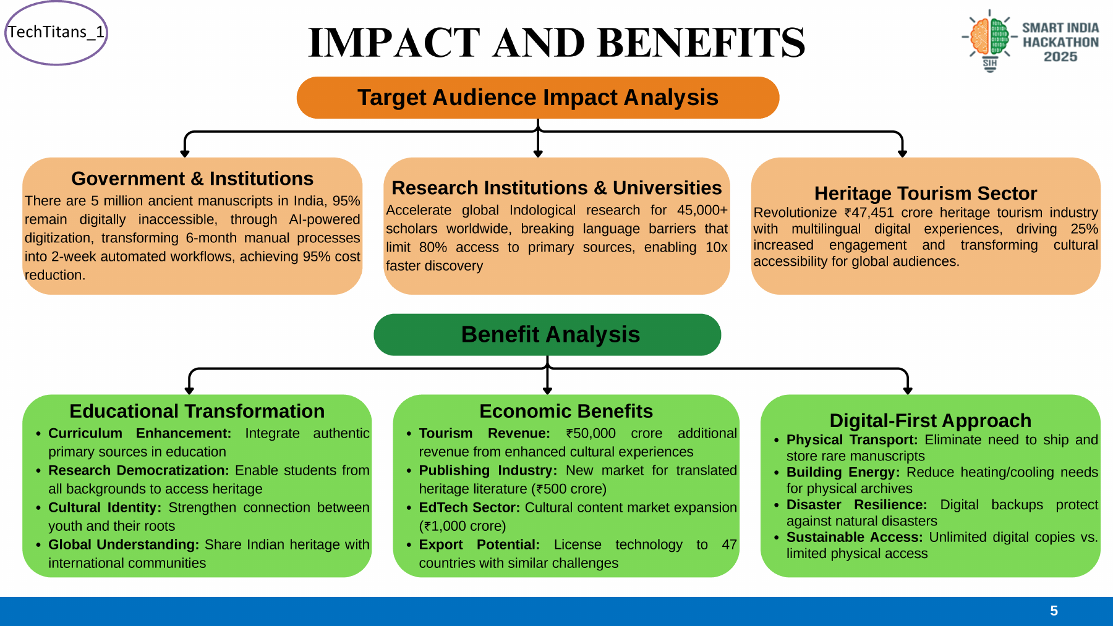
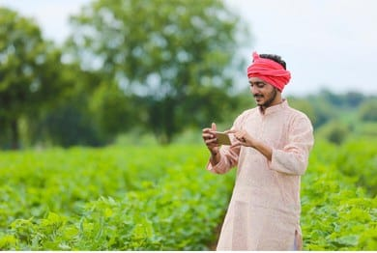
Impact, Benefits & Real-World Use Cases
Impact, Benefits & Real-World Use Cases
Impact, Benefits & Real-World Use Cases
REAL-WORLD BENEFITS
Saves time
Reduces land survey time from months to just a few hours per village.
100% transparency
Eliminates human errors, corruption, and manual land manipulation.
Fewer legal fights
Clear digital boundaries stop boundary disputes between neighboring farmers.
Government (DoLR)
WHO BENEFITS?
Maintains an updated, error-free central database of rural land records.
Farmers
Get official digital land certificates (Pattas) to apply for loans and crop insurance.
Village Panchayats can plan roads, water pipelines & public land projects with confidence.

Slide 6
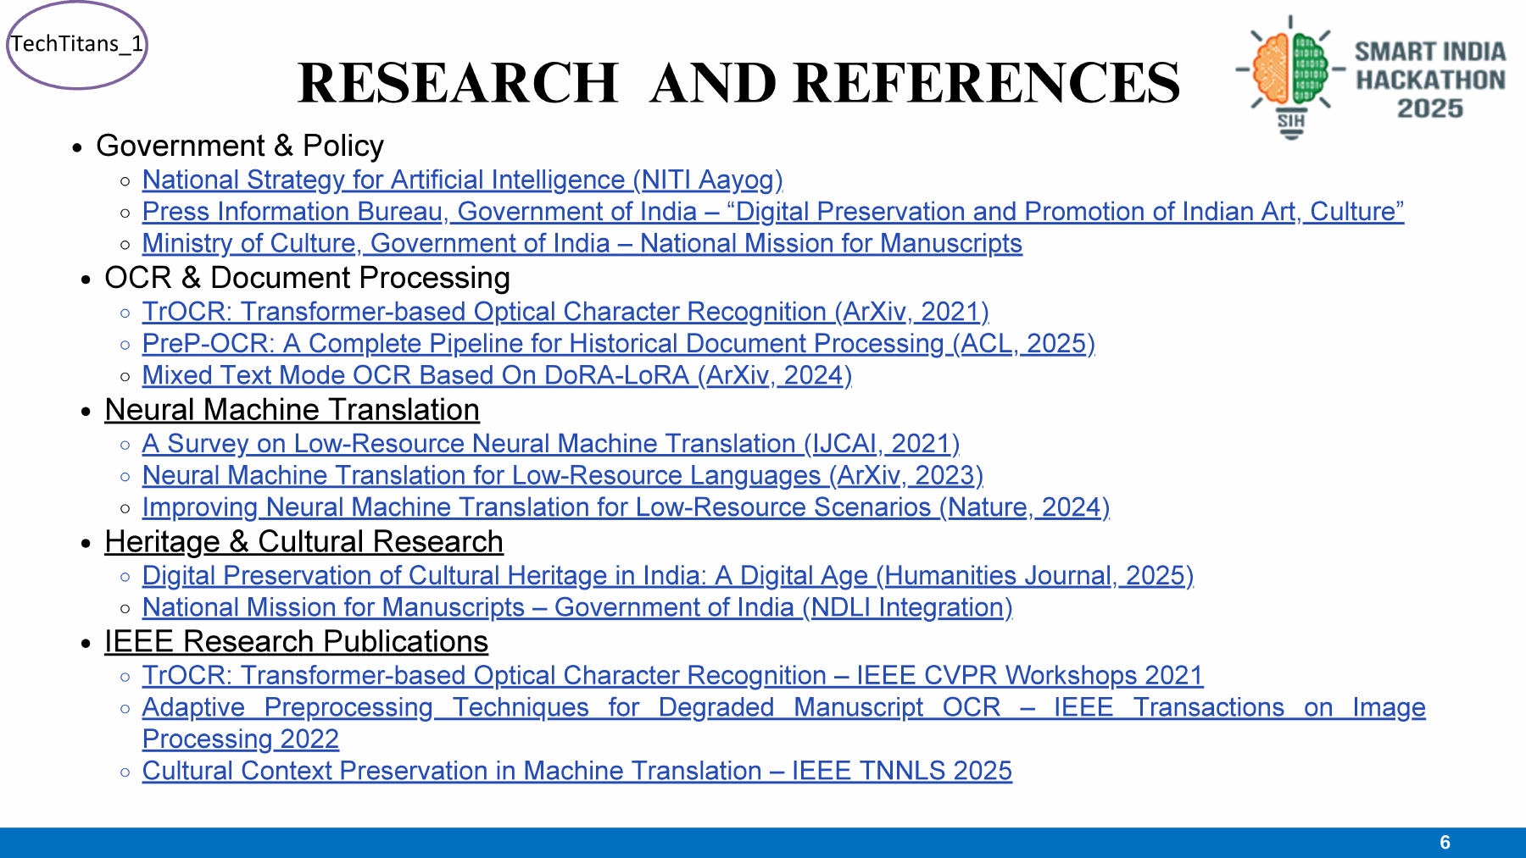
Future Scope & References
Future Scope & References
Future Scope & References
FUTURE SCOPE
REFERENCES & RESEARCH
Local languages
Research basis
Add Hindi, Tamil, and other regional languages so farmers can read maps in their own tongue.
• Studied the guidelines of the Ministry of Rural Development and the SVAMITVA scheme. • Researched open-source mapping tools like QGIS and the Google Maps API for accurate GPS plotting.
Crop health tracking
Use the same drone cameras to scan fields for plant diseases and soil quality.
Technology focus
Government portal integration
Drone imagery • GPS coordinates • Computer vision • Mobile dashboard • Digital PDF survey reports
Link directly with SVAMITVA / Bhunaksha portals for real-time official updates.
Thank You

