Slide 1
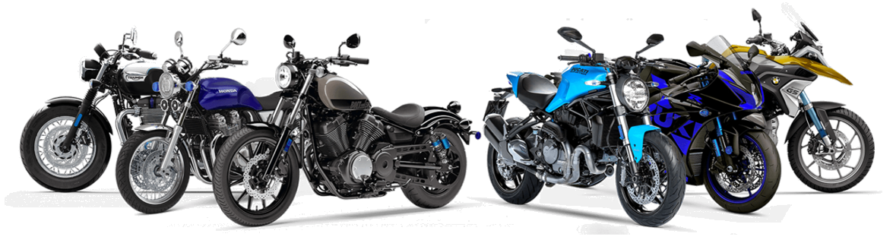
Bike Sharing Data Analysis

Slide 2
Dataset Overview
Dataset_1: Time and weather details (hourly)
Dataset_2: Temperature, humidity, usage (count, casual, registered)
Dataset_3: Combined dataset for analysis
Fields: Date, Hour, Temp, Humidity, Windspeed, Count, Season, etc.
Datasheet_1 and Datasheet_2 Merged on the common column that is on instant
After that the Merged Datasheet and the Datasheet_3 merged on Append.

Slide 3
Finalized Datasheet
instant | Date | Month | Hour | Holiday | Weekday | Weather | Temperature | Humidity | Windspeed | Casual | Registered | Count
1 | 1/1/2011 | January | 0 | FALSE | Saturday | Clear | 0.24 | 0.81 | 0.1949 | 3 | 13 | 16
2 | 1/1/2011 | January | 1 | FALSE | Saturday | Clear | 0.22 | 0.80 | 0.1949 | 8 | 32 | 40
3 | 1/1/2011 | January | 2 | FALSE | Saturday | Clear | 0.22 | 0.80 | 0.1949 | 5 | 27 | 32
4 | 1/1/2011 | January | 3 | FALSE | Saturday | Clear | 0.24 | 0.75 | 0.1949 | 3 | 10 | 13
5 | 1/1/2011 | January | 4 | FALSE | Saturday | Clear | 0.24 | 0.75 | 0.1949 | 0 | 1 | 1
6 | 1/1/2011 | January | 5 | FALSE | Saturday | Heavy Rain | 0.24 | 0.75 | 0.0896 | 0 | 1 | 1
7 | 1/1/2011 | January | 6 | FALSE | Saturday | Clear | 0.22 | 0.80 | 0.1949 | 2 | 0 | 2
8 | 1/1/2011 | January | 7 | FALSE | Saturday | Clear | 0.2 | 0.86 | 0.1949 | 1 | 2 | 3
9 | 1/1/2011 | January | 8 | FALSE | Saturday | Clear | 0.24 | 0.75 | 0.1949 | 1 | 7 | 8
10 | 1/1/2011 | January | 9 | FALSE | Saturday | Clear | 0.32 | 0.76 | 0.1949 | 8 | 6 | 14
11 | 1/1/2011 | January | 10 | FALSE | Saturday | Clear | 0.38 | 0.76 | 0.2537 | 12 | 24 | 36
12 | 1/1/2011 | January | 11 | FALSE | Saturday | Clear | 0.36 | 0.81 | 0.2836 | 26 | 30 | 56
13 | 1/1/2011 | January | 12 | FALSE | Saturday | Clear | 0.42 | 0.77 | 0.2836 | 29 | 55 | 84
14 | 1/1/2011 | January | 13 | FALSE | Saturday | Heavy Rain | 0.46 | 0.72 | 0.2985 | 47 | 47 | 94
15 | 1/1/2011 | January | 14 | FALSE | Saturday | Heavy Rain | 0.46 | 0.72 | 0.2836 | 35 | 71 | 106
16 | 1/1/2011 | January | 15 | FALSE | Saturday | Heavy Rain | 0.44 | 0.77 | 0.2985 | 40 | 70 | 110
17 | 1/1/2011 | January | 16 | FALSE | Saturday | Heavy Rain | 0.42 | 0.82 | 0.2985 | 41 | 52 | 93
18 | 1/1/2011 | January | 17 | FALSE | Saturday | Heavy Rain | 0.44 | 0.82 | 0.2836 | 15 | 52 | 67
19 | 1/1/2011 | January | 18 | FALSE | Saturday | Light Snow/Rain | 0.42 | 0.88 | 0.2537 | 9 | 26 | 35
20 | 1/1/2011 | January | 19 | FALSE | Saturday | Light Snow/Rain | 0.42 | 0.88 | 0.2537 | 6 | 31 | 37
21 | 1/1/2011 | January | 20 | FALSE | Saturday | Heavy Rain | 0.4 | 0.87 | 0.2537 | 11 | 25 | 36
22 | 1/1/2011 | January | 21 | FALSE | Saturday | Heavy Rain | 0.4 | 0.87 | 0.1949 | 3 | 31 | 34
23 | 1/1/2011 | January | 22 | FALSE | Saturday | Heavy Rain | 0.4 | 0.94 | 0.2239 | 11 | 17 | 28
24 | 1/1/2011 | January | 23 | FALSE | Saturday | Heavy Rain | 0.46 | 0.88 | 0.2985 | 15 | 24 | 39
25 | 1/2/2011 | January | 0 | FALSE | Sunday | Heavy Rain | 0.46 | 0.88 | 0.2985 | 4 | 13 | 17
26 | 1/2/2011 | January | 1 | FALSE | Sunday | Heavy Rain | 0.44 | 0.94 | 0.2537 | 1 | 16 | 17
27 | 1/2/2011 | January | 2 | FALSE | Sunday | Heavy Rain | 0.42 | 1.00 | 0.2836 | 1 | 8 | 9
28 | 1/2/2011 | January | 3 | FALSE | Sunday | Heavy Rain | 0.46 | 0.94 | 0.1949 | 2 | 4 | 6

Slide 4
Key Columns Explained
Temp / Atemp: Normalized temperatures
Hum: Humidity (0–1 scale)
Windspeed: Normalized wind speed
Casual, registered, cnt: Bike usage metrics
Hr, weekday, holiday: Time features

Slide 5
ANALYSIS
Total Count = 58304
Registered= 53383
Casual = 4921
Weather : 1 = CLEAR, 2 = HEAVY RAIN, 3 = LIGHT SNOW/RAIN, 4 = MIST.
Weekday : 0 = Sunday , 1 = Monday, 2 = Tuesday , 3 = Wednesday , 4 = Thusday , 5 = Friday , 6 = Saturday
MONTH : 1 = January, 2 = February.
Windspeed 0 Values replaced by Mean that is 0.1949
Atemp(Aparent Temperature) is slightly higher than Temperature in most cases, likely due to humidity or other comfort-affecting factors.(Atemp is removed)
Columns Removed: Season (As all the datasheets are of same season),Unamed(not necessary),Year(As all the Datasheet have the same Year 2011)

Slide 6
GRAPHS

Slide 8
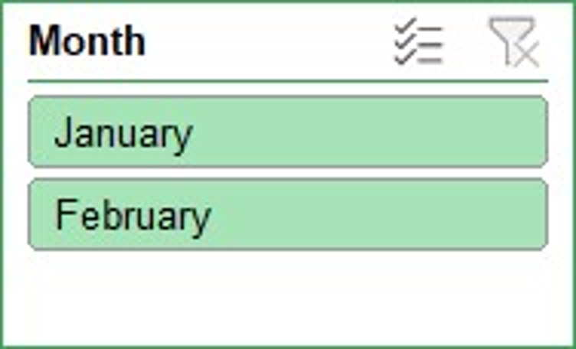
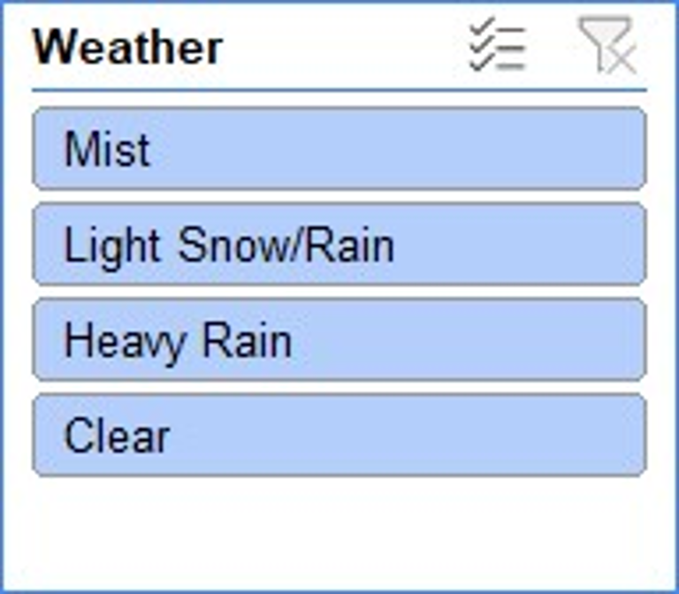
SLICERS

Slide 9
THANK YOU

