Slide 1
Scientific Calculator with Tkinter
Keyboard Input & GUI Enhancements

Slide 2
Overview
This project implements a scientific calculator using Python's Tkinter GUI library. It includes both button and keyboard input support with extensive scientific operations.

Slide 3
Key Features
- GUI interface using Tkinter
- Scientific operations: sin, cos, tan, log, ln, factorial, square root, etc.
- Keyboard input support: numbers, operators, Enter (=), Backspace (C)
- Error handling for invalid expressions
- Supports both mouse click and typed input

Slide 4
Code Structure
1. Import Libraries (tkinter, math)
2. Define click() to handle button events
3. Define key_event() to handle keyboard input
4. Set up Tkinter window, entry field, and button grid
5. Bind key events to window and entry field
6. Main event loop using root.mainloop()

Slide 5
Keyboard Input Support
- Digits (0-9), arithmetic operators (+, -, *, /, %, .)
- Enter key evaluates expression (=)
- Backspace deletes last character (C)
- Invalid expressions show 'Error' message
- Key events are bound to both root and entry widget

Slide 6
GUI Layout & Design
- Entry field for displaying expressions/results
- Grid layout with scientific and standard buttons
- Responsive to both button and keyboard inputs
- Black-themed styling using Grey background and Black text

Slide 7
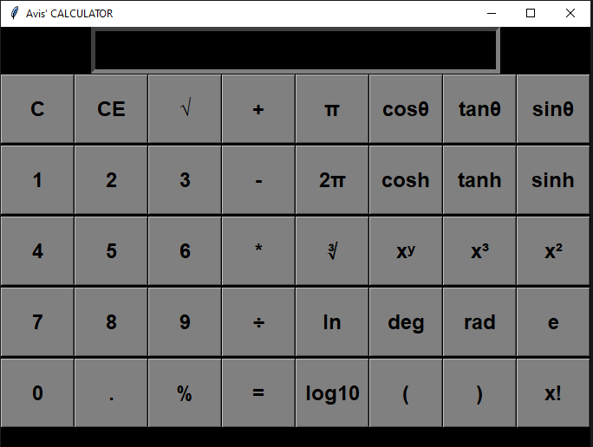
Interface

Slide 8
Final Thoughts
This scientific calculator demonstrates the flexibility of Tkinter in creating custom desktop GUI applications with real-time interaction and input handling. The project can be extended further with history tracking, memory features, and themes.

