Slide 1
Mobile Phone Price Prediction
Machine Learning-based analysis and model comparison

Slide 2
Objective
Predict mobile phone prices and identify key features influencing price.

Slide 3
Dataset Overview
File: Processed_Flipdata.xlsx
Rows: 541 Columns: 12
Target column: Prize
Numeric columns: 7
Categorical columns encoded: 5

Slide 4
Data Preprocessing
Missing values (numeric -> median, categorical -> mode),
One-hot encoding for categorical variables,
Rows with invalid target values dropped if any.

Slide 5
Feature Extraction (Top predictors)
Top features according to Gradient Bosting importance:
1. Memory
2. Battery_
3. RAM
4. Front Camera_12MP
5. Unnamed: 0
6. Mobile Height
7. Model_APPLE iPhone 14 Plus
8. Model_Google Pixel 7
9. Processor__Google Tensor G2
10. Rear Camera_12MP

Slide 6
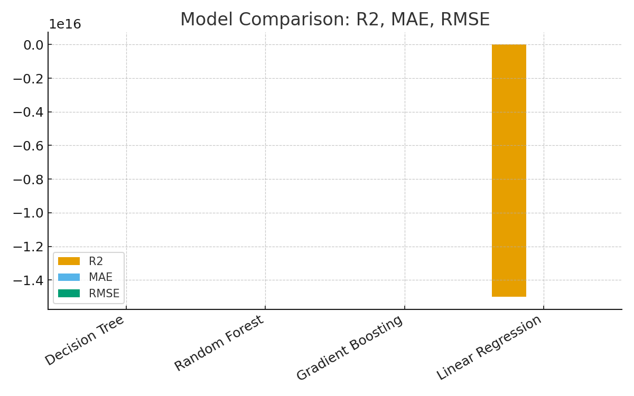
Model Comparison (Metrics)

Slide 7
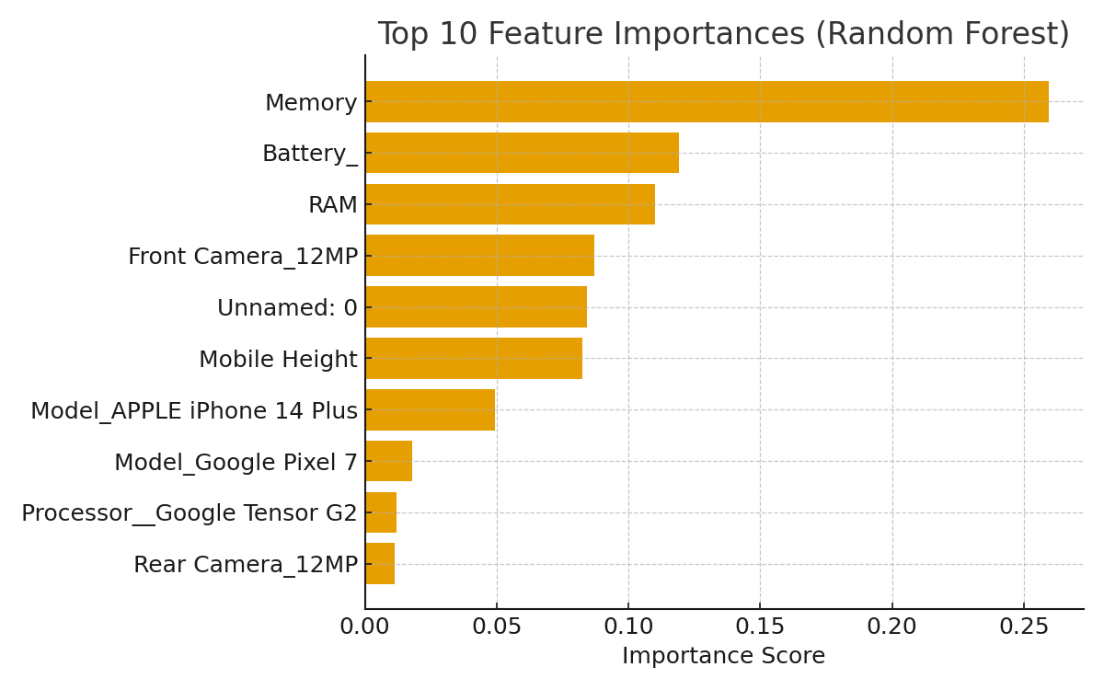
Feature Importance (Top 10)

Slide 8
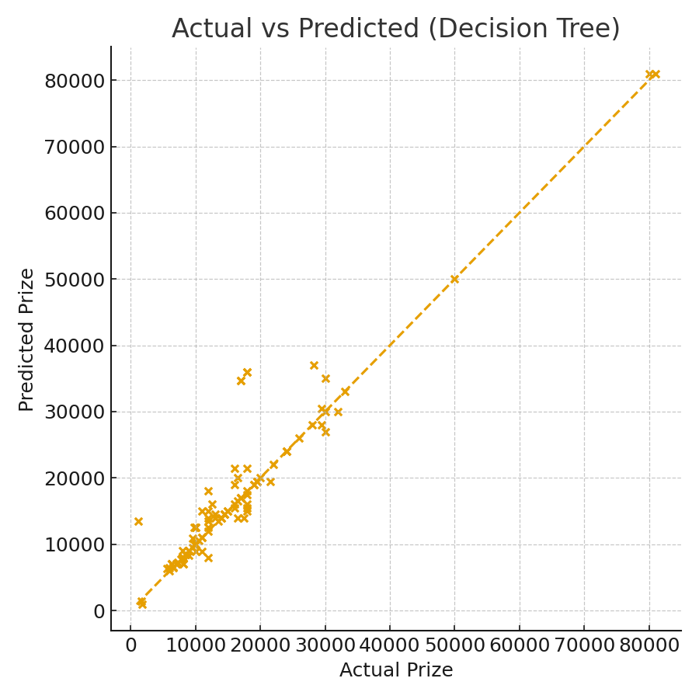
Actual vs Predicted Prices (Decision Tree)

Slide 9
Insights & Recommendations
Memory, RAM and Camera and specs are the strongest predictors of price.
Consider focusing on these product features when pricing or marketing.
Use Gradient Boosting for robust predictions; consider GBM with tuning for deployment.

Slide 10
Conclusion
A Gradient Boosting model provides strong predictive performance for mobile phone prices.
Presentation includes model metrics, feature importance, and visual diagnostics.

