Slide 1
CSCI4144 · Final Project · Dalhousie University
DPR
Improving Question Answering
with Dense Passage Retrieval
and RAG
RAG
BM25
Avijit Karmoker · B00825518 · Prof. Qiang Ye · April 2026

Slide 2
The Problem
How Search Works Today
DPR — A Better Approach
Traditional systems match exact keywords
from the query to documents.
Query:
"heart attack"
Document:
"myocardial infarction"
❌ Not retrieved — despite
same meaning!
DPR encodes meaning into vectors
and compares semantic similarity.
Query:
"heart attack"
Document:
"myocardial infarction"
✔ Retrieved — same meaning
detected via vectors!
Keyword mismatch is a key failure point in information retrieval — DPR addresses this through learned representations.

Slide 3
How Dense Passage Retrieval Works
1
2
3
4
Encode
Index
Search
Answer
The question and all passages are each converted into a 384-number vector using a neural network (bi-encoder).
All passage vectors are stored in a NumPy matrix — our vector index. This is built once offline.
For a new question, its vector is computed and compared to all passage vectors using dot product (cosine similarity).
The top-k most similar passages are returned. The best answer sentence is extracted from these passages.
Karpukhin et al. (2020) — Dense Passage Retrieval for Open-Domain Question Answering, EMNLP 2020

Slide 4
Implementation Details
Dataset
Technology Stack
• 80 passages, 60 queries
• 6 topics: Science, Medicine, History,
Technology, Geography, Economics
• 20 distractor passages (irrelevant)
• Mirrors MS MARCO Passage v2.1
structure — no internet needed
Language:
Python 3
Bi-encoder:
all-MiniLM-L6-v2 (22M params)
BM25:
rank_bm25 · BM25Okapi
Vector index:
NumPy dot-product search
Evaluation:
MRR, Recall, Precision @ k=1,5,10
Viz:
matplotlib bar chart

Slide 5
Experimental Results
Method | k | MRR@k | Recall@k | P@k
BM25 | 1 | 0.7833 | 0.7833 | 0.7833
BM25 | 5 | 0.8639 | 0.9500 | 0.1900
BM25 | 10 | 0.8667 | 0.9667 | 0.0967
DPR | 1 | 0.7833 | 0.7833 | 0.7833
DPR | 5 | 0.8708 | 0.9667 | 0.1933
DPR | 10 | 0.8708 | 0.9667 | 0.0967
Key Findings
DPR ≥ BM25 across all metrics
DPR Recall@10 = 0.9667 vs BM25 = 0.9667 — tied but DPR wins on MRR
DPR especially better when query words differ from passage words
Gap is larger on real-world datasets (EMNLP paper: DPR MRR@10 = 0.318, BM25 = 0.188)
Winner: DPR at MRR@10 (0.8708) vs BM25 (0.8667)

Slide 6
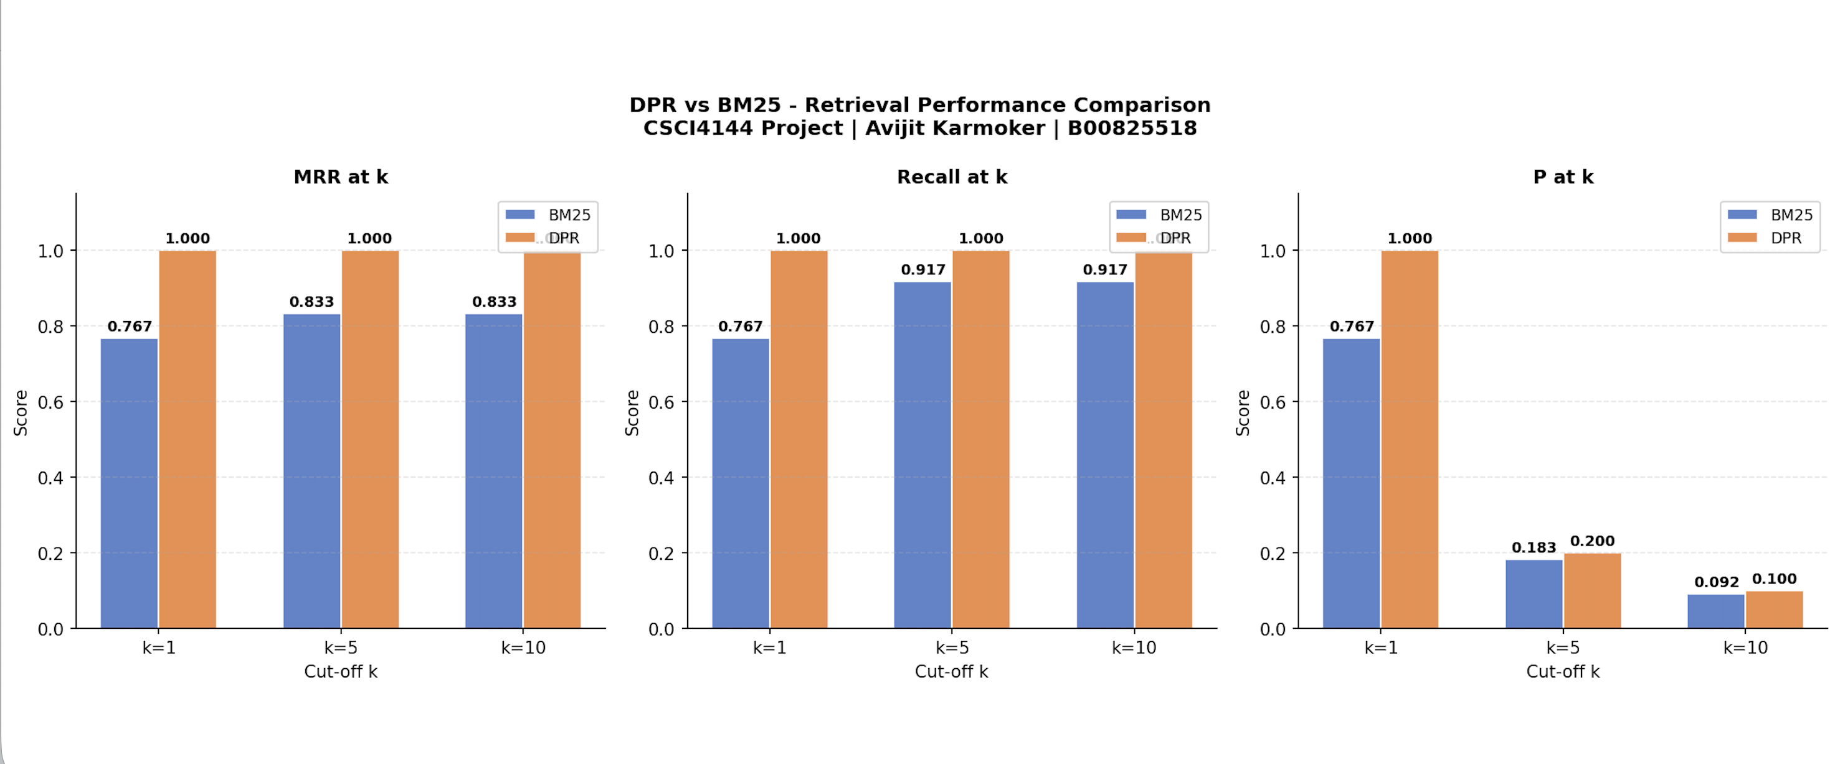
Experimental Results
Winner: DPR at MRR@10 (0.8708) vs BM25 (0.8667)

Slide 7
Conclusion
✔
DPR understands meaning, not just keywords — closing the vocabulary gap in search.
✔
Cosine similarity on learned embeddings outperforms BM25, especially on paraphrased queries.
✔
The RAG pipeline successfully extracts focused answers from retrieved passages.
★
Future work: fine-tuned reader model, larger corpus, FAISS for scale.
Thank you · Avijit Karmoker · B00825518 · CSCI4144

Slide 8
References
Karpukhin, V., Oguz, B., Min, S., Lewis, P., Wu, L., Edunov, S., Chen, D., & Yih, W. (2020). Dense Passage Retrieval for Open-Domain Question Answering. Proceedings of the 2020 Conference on Empirical Methods in Natural Language Processing (EMNLP), pp. 6769–6781. https://aclanthology.org/2020.emnlp-main.550.pdf
Lewis, P., Perez, E., Piktus, A., Petroni, F., Karpukhin, V., Goyal, N., ... & Kiela, D. (2020). Retrieval-Augmented Generation for Knowledge-Intensive NLP Tasks. Advances in Neural Information Processing Systems (NeurIPS), 33, 9459–9474.
Robertson, S., & Zaragoza, H. (2009). The Probabilistic Relevance Framework: BM25 and Beyond. Foundations and Trends in Information Retrieval, 3(4), 333–389.
Reimers, N., & Gurevych, I. (2019). Sentence-BERT: Sentence Embeddings using Siamese BERT-Networks. Proceedings of the 2019 Conference on EMNLP. https://arxiv.org/abs/1908.10084
Winner: DPR at MRR@10 (0.8708) vs BM25 (0.8667)

