Slide 1
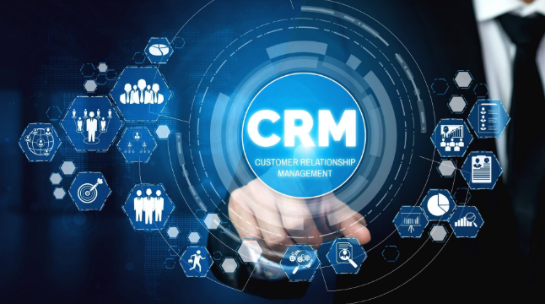

Euphoria Infotech

Slide 2
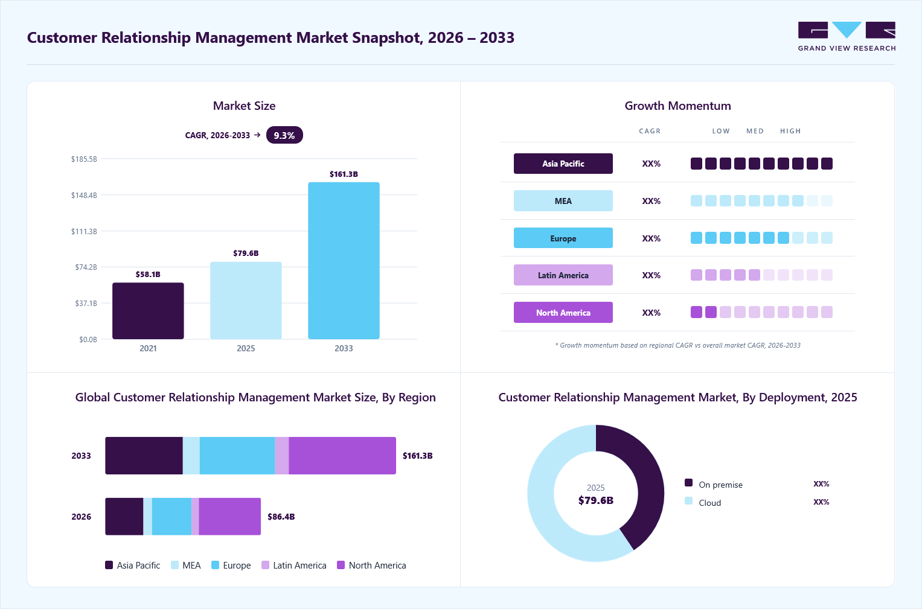

Slide 3
4.5%
9.0%
22.5%
(Banking, Financial Services & Insurance)
9.5%
13.0%
22.0%
19.5%

Slide 5
Key Customer Relationship Management Companies:
Adobe
ClickUp
Copper CRM, Inc.
Creatio
Freshworks Inc.
Insightly Inc.
Microsoft Corporation
monday.com
Nimble
Oracle Corporation
Salesforce.com, Inc.
SAP SE
SugarCRM Inc.
Zendesk
Zoho Corporation Pvt. Ltd.

Slide 6
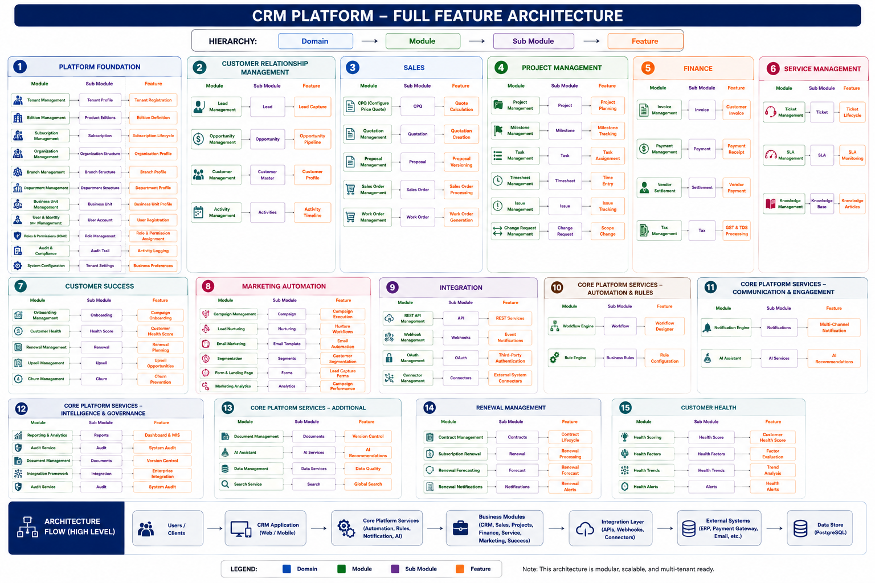

Slide 7
CRM Platform – Feature Architecture
Domain
→
Module
→
Sub Module
→
Feature
PLATFORM FOUNDATION
Tenant • Edition • Subscription • Organization • Users • RBAC • Audit • Settings
BUSINESS APPLICATIONS
CRM • Sales • Project Management • Finance • Service Management
CORE PLATFORM SERVICES
Workflow • Rules • Notifications • Reporting • Documents • AI • Audit
INTEGRATION
REST API • Webhooks • OAuth • Connectors • Enterprise Integration
DATA & INFRASTRUCTURE
PostgreSQL • API • Storage • Cache • Events • External Systems
Design principle: Foundation first → Business domains → Cross-cutting services → Integration → Data/Infrastructure

Slide 8
Platform Foundation
1. Platform Foundation
Module
Sub Module
Feature
Tenant Management
Tenant Profile
Tenant Registration
Edition Management
Product Editions
Edition Definition
Subscription Management
Subscription
Subscription Lifecycle
Organization Management
Organization Structure
Organization Profile
Branch Management
Branch Structure
Branch Profile
Department Management
Department Structure
Department Profile
Business Unit Management
Business Unit
Business Unit Profile
User & Identity Management
User Account
User Registration
Roles & Permissions (RBAC)
Role Management
Role & Permission Assignment
Audit & Compliance
Audit Trail
Activity Logging
System Configuration
Tenant Settings
Business Preferences

Slide 9
Business Domains
CRM, Sales, Project Management, Finance and Service Management.
2. Customer Relationship Management
3. Sales
4. Project Management
5. Finance
6. Service Management
Module
Sub Module
Feature
Module
Sub Module
Feature
Module
Sub Module
Feature
Module
Sub Module
Feature
Module
Sub Module
Feature
Lead Management
Lead
Lead Capture
CPQ
CPQ
Quote Calculation
Project Management
Project
Project Planning
Invoice Management
Invoice
Customer Invoice
Ticket Management
Ticket
Ticket Lifecycle
Opportunity Management
Opportunity
Opportunity Pipeline
Quotation Management
Quotation
Quotation Creation
Milestone Management
Milestone
Milestone Tracking
Payment Management
Payment
Payment Receipt
SLA Management
SLA
SLA Monitoring
Customer Management
Customer Master
Customer Profile
Proposal Management
Proposal
Proposal Versioning
Task Management
Task
Task Assignment
Vendor Settlement
Settlement
Vendor Payment
Knowledge Management
Knowledge Base
Knowledge Articles
Activity Management
Activities
Activity Timeline
Sales Order Management
Sales Order
Sales Order Processing
Timesheet Management
Timesheet
Time Entry
Tax Management
Tax
GST & TDS Processing
Work Order Management
Work Order
Work Order Generation
Issue Management
Issue
Issue Tracking
Change Request Management
Change Request
Scope Change

Slide 10
Core Platform Services & Integration
CRM, Sales, Project Management, Finance and Service Management.
7. Customer Success
8. Marketing Automation
9. Integration
10. Core Platform Services
Module
Sub Module
Feature
Module
Sub Module
Feature
Module
Sub Module
Feature
Module
Sub Module
Feature
On boarding Management
On boarding
Customer On boarding
Campaign Management
Campaign
Campaign Execution
REST API Management
API
REST Services
Workflow Engine
Workflow
Workflow Designer
Customer Health Management
Health Score
Customer Health Score
Lead Nurturing
Nurturing
Nurture Workflows
Webhook Management
Webhooks
Event Notifications
Rule Engine
Business Rules
Rule Configuration
Renewal Management
Renewal
Renewal Planning
Email Marketing
Email Templates
Email Automation
OAuth Management
OAuth
Third-Party Authentication
Notification Engine
Notifications
Multi-Channel Notification
Upsell Management
Upsell
Upsell Opportunities
Segmentation
Segments
Customer Segmentation
Connector Management
Connectors
External System Connectors
Reporting & Analytics
Reports
Dashboard & MIS
Churn Management
Churn
Churn Prevention
Form & Landing Page
Forms
Lead Capture Forms
Audit Service
Audit
System Audit
Marketing Analytics
Analytics
Campaign Performance
Document Management
Documents
Version Control
AI Assistant
AI Services
AI Recommendations
Integration Framework
Integration
Enterprise Integration

Slide 11
Core Platform Services & Integration
Cross-cutting capabilities that support all business domains.
11. Renewal Management
12. Customer Health
Module
Sub Module
Feature
Module
Sub Module
Feature
Contract Management
Contracts
Contract Lifecycle
Health Scoring
Health Score
Customer Health Score
Subscription Renewal
Renewal
Renewal Processing
Health Factors
Health Factors
Factor Evaluation
Renewal Forecasting
Forecast
Renewal Forecast
Health Trends
Health Trends
Trend Analysis
Renewal Notifications
Notifications
Renewal Alerts
Health Alerts
Alerts
Health Alerts

Slide 12
Why should a business buy this CRM?
Isn't “because it has many modules.”
NO! because it wants better control over customers, sales, activities, service, and business decisions.
WITHOUT CRM WITH CRM
────────────── ──────────────
Scattered customer data → Customer 360°
Excel / spreadsheets → Centralized information
Missed follow-ups → Activity & reminders
Leads get lost → Lead pipeline
Poor sales visibility → Opportunity pipeline
Individual knowledge → Shared organizational knowledge
Manual reporting → Management dashboards
Unclear ownership → User / role responsibility
Limited control → Permissions & audit
Reactive customer service → Structured service management
So why buy our CRM?
Our business story could be:
1. Acquire customers: Capture leads and turn prospects into opportunities.
2. Convert customers: Give sales teams visibility into every opportunity and follow-up.
3. Understand customers: Maintain a complete history of contacts, activities, transactions and interactions.
4. Retain customers: Ensure commitments, service requests and follow-ups don't disappear.
5. Grow revenue: Identify opportunities for repeat business, cross-selling and upselling.
6. Control the business: Management can see pipeline, sales performance, customer activity and business KPIs.
7. Protect business information: Roles, permissions, tenant isolation and audit controls prevent uncontrolled access.

Slide 13
CUSTOMER 360°
CUSTOMER 360°
│
┌─────────────────────┼─────────────────────┐
│ │ │
CRM SALES CUSTOMER SUCCESS
│ │ │
Customer Profile Opportunities Onboarding
Contacts CPQ / Quotes Health Score
Activities Proposals Renewals
Leads Orders Upsell
│ │ │
└─────────────────────┼─────────────────────┘
│
┌─────────────────────┼─────────────────────┐
│ │ │
PROJECTS SERVICE FINANCE
│ │ │
Projects Tickets Invoices
Tasks SLA Payments
Milestones Knowledge Outstanding
Timesheets
│ │ │
└─────────────────────┼─────────────────────┘
↓
CUSTOMER 360
│
┌────────────────┼────────────────┐
↓ ↓ ↓
CRM SALES CUSTOMER SUCCESS
↓ ↓ ↓
Leads CPQ/Quote Health
Customer Orders Renewal
Activities Revenue Upsell
│ │ │
└────────────────┼────────────────┘
↓
PROJECTS
↓
SERVICE
↓
FINANCE
↓
Unified Customer Data
CUSTOMER 360
Customer Profile
Revenue
Engagement
Health
Service
Projects
Financials
Contracts
Renewals
Opportunities
└───────────────────┘
│
↓
AI / Analytics
│
┌─────────────┴─────────────┐
↓ ↓
Next Best Action Risk / Churn
Recommendations Prediction

Slide 14
CRM ARCHITECTURE
CRM PLATFORM
┌───────────────────────┼────────────────────────┐
│ │ │
▼ ▼ ▼
FOUNDATION BUSINESS CORE INTELLIGENCE
│ │ │
Tenant CRM AI
Edition Sales AI Agents
Subscription Projects Prediction
Organization Finance Recommendations
RBAC Service Forecasting
│ │ │
└───────────────────────┼────────────────────────┘
    │
    PLATFORM SERVICES
    │
    Workflow • Rules • Notifications
    Documents • Reporting • Audit
    │
    ▼
    ENGAGEMENT
    │
    Email • WhatsApp • SMS • Chat
    │
    ▼
    CUSTOMER 360
    │
    ▼
    CUSTOMER PORTAL
    │
    ▼
    CPQ (Configure, Price, Quote)
    │
    ▼
    REVOPS / GROWTH (Revenue Operations)

Slide 15
CRM Business Foundation
BUSINESS
│
▼
TENANT > ORGANIZATION
┌───────────────────────────┐
▼ ▼ ▼
Customers Employees Partners
│
▼
Contacts
│
▼
Leads
│
▼
Opportunities
Quotation
│
▼
Sales
│
▼
Customer
Relationship
│
┌───────-──-───────┐
▼ ▼ ▼
Service Tasks Communication
│
▼
Retention
│
▼
Growth
Legal / Business Organization
│
▼
Tenant
│
┌────┼────┐
▼ ▼ ▼
Users Teams Business Data
Important point: There is also a possible Organization vs Tenant distinction. Depending on your CRM's intended architecture, Organization and Tenant may be the same conceptual entity, or Organization may be the business/legal entity while Tenant represents its technical SaaS boundary.

Slide 16
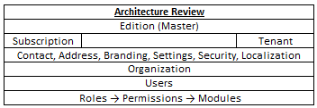
And this brings us back to your three levels
This is where Edition → Subscription → Tenant becomes a very strong business story:
"WHAT DO I NEED?"
│
▼
EDITION
│
▼
"WHAT DO I BUY?"
│
▼
SUBSCRIPTION
│
▼
"WHO WILL USE IT?"
│
▼
TENANT > ORGANIZATION > USERS
│
▼
"WHAT WILL I ACHIEVE?"
│
┌───────────────┼───────────────┐
▼ ▼ ▼
MORE SALES BETTER CONTROL HAPPY CUSTOMERS
Edition → What capability do I need?
Subscription → What commercial entitlement do I purchase?
Tenant → Which organization gets that capability?

Slide 17
CRM Business Foundation
Layer | Community | Professional | Enterprise
Authentication | ✓ | ✓ | ✓ + SSO/MFA
CRM | ✓ | ✓ | ✓
Sales | Basic | ✓ | ✓
Projects | - | ✓ | ✓
Finance | - | ✓ | ✓
Help Desk | - | ✓ | ✓
Workflow Engine | - | Limited | ✓
Rule Engine | - | Basic | ✓
Document Engine | Basic | ✓ | ✓
Reports | Basic | Advanced | Enterprise BI
Audit | Basic | Standard | Advanced
AI Services | - | Optional | ✓
API Gateway | - | - | ✓
Third-party Integrations | - | Basic | Enterprise
Multi-tenancy | Single Tenant | Optional | Full SaaS
The important relationship:
PRODUCT: CRM
│
▼
EDITION
"What can I use?"
│
▼
SUBSCRIPTION
"What did I buy?"
│
▼
TENANT > ORGANIZATION
"Who is using it?"
┌──────────────────────┐
▼ ▼ ▼
Users Roles Business Data
│
┌──────────────────────┐
▼ ▼ ▼
Customers Contacts Sales
ABC Technologies Pvt Ltd
│
└── Tenant Or Organization
│
├── Users
├── Roles
├── Customers
├── Contacts
├── Leads
├── Opportunities
└── Activities
Edition
Enterprise
│
Subscription
Annual / 100 Users / Active
Subscription = What has the customer purchased, for how long, and under what terms?

Slide 18
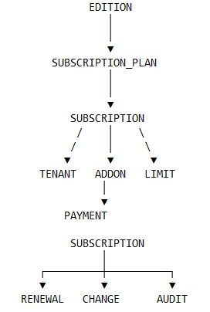
Subscription
Relationship with Edition and Tenant
Example Suppose:
ABC Ltd chooses: Professional Edition → Professional Annual
The data becomes:
EDITION
Professional Edition
│
▼
SUBSCRIPTION PLAN
Professional Annual
│
▼
SUBSCRIPTION
SUB-2026-000001
│
├── Tenant = ABC Ltd
├── Start = 01-Apr-2026
├── End = 31-Mar-2027
├── Amount = ₹XXX
├── Payment = PAID
└── Status = ACTIVE
Then the subscription can have:
Subscription Limits
├── Users = 100
├── Storage = 100 GB
└── API Calls = 0
Subscription Add-ons
└── AI Services = Enabled
The Tenant therefore receives:
Tenant
↓
Active Subscription
↓
Professional Edition
↓
Edition Feature Matrix
↓
Actual Subscription Limits / Add-ons
↓
Available CRM functionality
And the customer-facing relationship remains:
Edition
↓
Subscription Plan
↓
Subscription
↓
Tenant

Slide 19
TENANT > ORGANIZATION
PF — PLATFORM FOUNDATION
│
├── PF-001 EDITION MANAGEMENT
│ │
│ ├── Edition
│ ├── Edition Feature
│ ├── Edition Module
│ ├── Edition Security
│ └── Edition Integration
│
├── PF-002 TENANT MANAGEMENT
│ │
│ ├── Tenant
│ ├── Tenant Contact
│ ├── Tenant Address
│ ├── Tenant Branding
│ ├── Tenant Settings
│ ├── Tenant Security
│ ├── Tenant Localization
│ └── Users
│
├── PF-003 SUBSCRIPTION MANAGEMENT
│ │
│ ├── Subscription Plan
│ ├── Subscription Plan Price
│ ├── Subscription
│ ├── Subscription Add-on
│ ├── Subscription Limit
│ ├── Subscription Renewal
│ ├── Subscription Change
│ ├── Subscription Payment
│ └── Subscription Audit
│ EDITION
│ Community
│ Professional
│ Enterprise │
└────────┬────────┘
│
▼
┌─────────────────┐
│ SUBSCRIPTION │
│ Plan + Billing │
│ + Entitlement │
└────────┬────────┘
│
▼
┌─────────────────┐
│ TENANT │
│ Customer / SaaS │
│ Boundary │
└────────┬────────┘
│
▼
┌─────────────────┐
│ ORGANIZATION │
│ Legal / Branch │
│ Dept / Team │
└────────┬────────┘
│
▼
┌─────────────────┐
│ USER │
│ Employee / User │
└─────────────────┘
└── PF-004 ORGANIZATION MANAGEMENT
│
├── Organization
├── Organization Type
├── Organization Address
├── Organization Contact
├── Organization User*
├── Organization Settings
└── Organization Audit

Slide 20
Demonstration Roadmap
A practical sequence for developing the CRM
Phase 1
Platform Foundation
Phase 2
Identity & Access
Phase 3
Customer & Contact
Phase 4
Lead & Opportunity
Phase 5
Activities & Sales
Phase 6
Reports & Enterprise

Slide 21
Technology Stack
Frontend
Flutter
Backend
Python + FastAPI
ORM / Migration
SQLAlchemy + Alembic
Database
PostgreSQL
Development
VS Code / Cursor / Git
Mobile Toolchain
Android Studio + Flutter SDK

