Slide 1

PREDICTING ZETA POTENTIAL OF NANOPARTICLES WITH VARIOUS MACHINE LEARNING METHODS
CLL729
ABHIJEET GAUTAM (2020CH10069)
AMAN RAJORIA (2020CH70153)
AVIK GHOSH (2020CH10081)
SUPERVISOR: PROF. VIKRAM SINGH

Slide 2
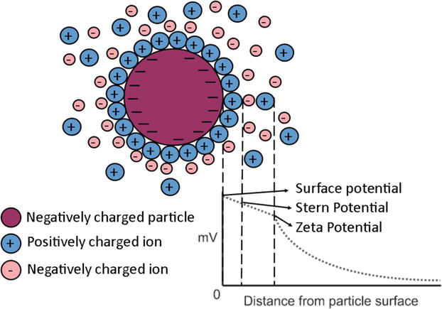
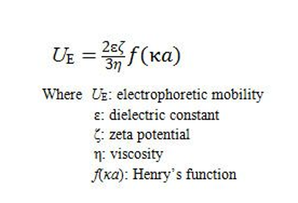
INTRODUCTION TO ZETA POTENTIAL
Zeta potential is a measure of the effective electric charge on the surface of a nanoparticle, which helps to quantify the charges on the surface of the particle
The zeta potential measurement is based on the electrophoretic mobility of the particles in a liquid medium, which is then converted into a zeta potential value using the Henry equation
INDIAN INSTITUTE OF
TECHNOLOGY DELHI
Vinogradov, J., Jackson, M.D., & Chamerois, M. (2018). Zeta Potential in Sandpacks: Effect of Temperature, Electrolyte pH, Ionic Strength and Divalent Cations. Colloids Surfaces A Physicochem. Eng. Asp., 553, 259–271.
Page : 1
Koopal, L. K., & van der Wal, J. (2005). Zeta Potential. In Encyclopedia of Analytical Chemistry (pp. 1–16). John Wiley & Sons, Ltd.

Slide 3
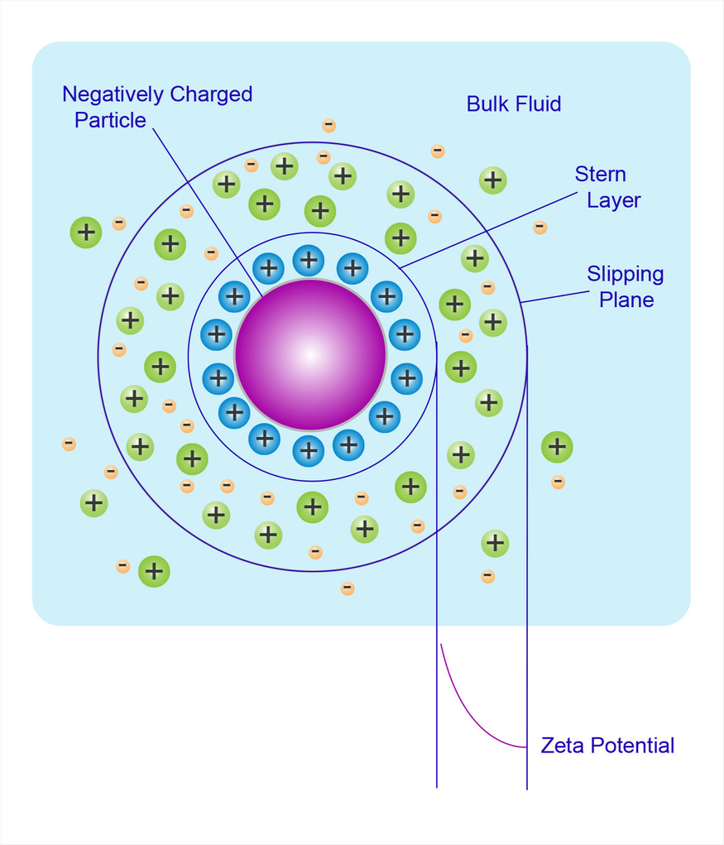
WHY IS ZETA POTENTIAL IMPORTANT?
Zeta potential is a key parameter in determining the colloidal stability of a system, as it provides information about the electrostatic interactions between particles in a dispersion
higher zeta potential values generally indicate greater stability, as they result in stronger repulsive forces between particles, preventing aggregation and sedimentation
lower zeta potential values indicate weaker repulsive forces and a greater likelihood of particle aggregation and sedimentation, leading to decreased stability
INDIAN INSTITUTE OF
TECHNOLOGY DELHI
Vinogradov, J., Jackson, M.D., & Chamerois, M. (2018). Zeta Potential in Sandpacks: Effect of Temperature, Electrolyte pH, Ionic Strength and Divalent Cations. Colloids Surfaces A Physicochem. Eng. Asp., 553, 259–271.
Page : 2
Koopal, L. K., & van der Wal, J. (2005). Zeta Potential. In Encyclopedia of Analytical Chemistry (pp. 1–16). John Wiley & Sons, Ltd.

Slide 4
WHAT FACTORS DOES THE ZETA POTENTIAL DEPEND UPON?
Various factors can influence the surface charge of the colloidal system
The concentration of ions in the solution
The pH of the solution
The medium on which the colloidal particle isplaced
The temperature of the system
The type and concentration of nanoparticles in the colloidal system
INDIAN INSTITUTE OF
TECHNOLOGY DELHI
Vinogradov, J., Jackson, M.D., & Chamerois, M. (2018). Zeta Potential in Sandpacks: Effect of Temperature, Electrolyte pH, Ionic Strength and Divalent Cations. Colloids Surfaces A Physicochem. Eng. Asp., 553, 259–271.
Page : 3

Slide 5
OBJECTIVE OF THE PROJECT
Measurement of zeta potential can be time-consuming and resource-intensive, and various factors can influence the surface charge of the colloidal system
We aim to implement machine-learning models to predict the zeta potential of dispersions while considering influencing factors without the need for extensive laboratory experiments.
INDIAN INSTITUTE OF
TECHNOLOGY DELHI
Page : 4

Slide 6
DATA ANALYSIS TECHNIQUES
Linear Regression:
Framework:
Dataset: {y_{i}, x_{i}, …., x_{ip}}^{n}_{i=1} of n statistical units
Linear equation: y_{i} = b₀ + b₁x_{i1} + …. + b_{p}x_{ip} + e = x­_{i}^{T}.b + e
Least square estimation:
Assuming the independent variable is x­­_{i} = [1, x_{i1}, x_{i2}, …., x_{ip}] and the model parameters are b = [b₀, b₁, …., b_{p}], then the model prediction would be:
y_{i} = x­_{i}^{T}. b
In the least square setting, the optimum parameter can be calculated as follows:
b = argmin ∑ (y_{i} - x­_{i}^{T}. b)²
Breiman, L. (2001). Random Forests. Machine Learning, 45(1), 5-32.
Chen, T., & Guestrin, C. (2016). XGBoost: A Scalable Tree Boosting System. Proceedings of the 22nd ACM SIGKDD International Conference on Knowledge Discovery and Data Mining, 785-794.
INDIAN INSTITUTE OF
TECHNOLOGY DELHI
Page : 5

Slide 7
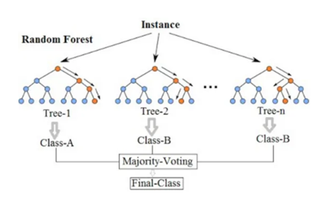
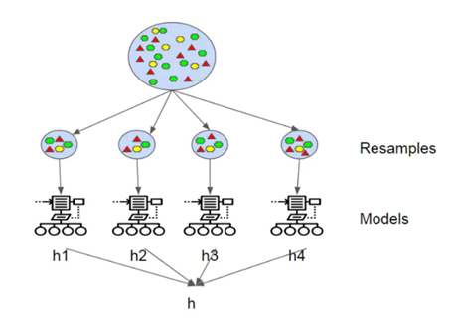
DATA ANALYSIS TECHNIQUES
Ensemble method:
Random Forest model:
a. Bagging:
Taking sample with replacement
Lowering variance without changing bias
Random-forest does both row sampling and column sampling with Decision tree as a base.
Random Forest = DT(base learner)+ bagging(Row sampling with replacement)+ feature bagging(column sampling) + aggregation(mean/median, majority vote)
Breiman, L. (2001). Random Forests. Machine Learning, 45(1), 5-32.
Chen, T., & Guestrin, C. (2016). XGBoost: A Scalable Tree Boosting System. Proceedings of the 22nd ACM SIGKDD International Conference on Knowledge Discovery and Data Mining, 785-794.
INDIAN INSTITUTE OF
TECHNOLOGY DELHI
Page : 6

Slide 8
DATA ANALYSIS TECHNIQUES
Boosting(XGBoost):
-Boosting is another ensemble technique to create a collection of predictors.
-In this technique, learners are learned sequentially with early learners fitting simple models to the data and then analyzing data for errors.
-we fit consecutive trees (random sample) and at every step, the goal is to solve for net error from the prior tree.
F_{m+1} (x_{i}) = F_{m}(x_{i}) + h_{m}(x_{i}) = y_{i}
Or, h_{m}(x_{i}) = y_{i} – F_{m}(x_{i})
Therefore, gradient boosting will fit h_{m} to the residual. As in other boosting variants, each F_{m+1} attempts to correct the errors of its predecessor F_{m}.
Breiman, L. (2001). Random Forests. Machine Learning, 45(1), 5-32.
Chen, T., & Guestrin, C. (2016). XGBoost: A Scalable Tree Boosting System. Proceedings of the 22nd ACM SIGKDD International Conference on Knowledge Discovery and Data Mining, 785-794.
INDIAN INSTITUTE OF
TECHNOLOGY DELHI
Page : 7

Slide 9
PARAMETERS FOR MODEL GENERATION
Medium: Water, Sand & Glass beads
Temperature: ranging from as low as 5 degrees in case of water to 118 degrees in case of sand
Ionic Concentrations: NaCl and KCl
The pH of the solution
The size and concentration of the nanoparticle
INDIAN INSTITUTE OF
TECHNOLOGY DELHI
Vinogradov, J., Jackson, M.D., & Chamerois, M. (2018). Zeta Potential in Sandpacks: Effect of Temperature, Electrolyte pH, Ionic Strength and Divalent Cations. Colloids Surfaces A Physicochem. Eng. Asp., 553, 259–271.
Page : 8

Slide 10
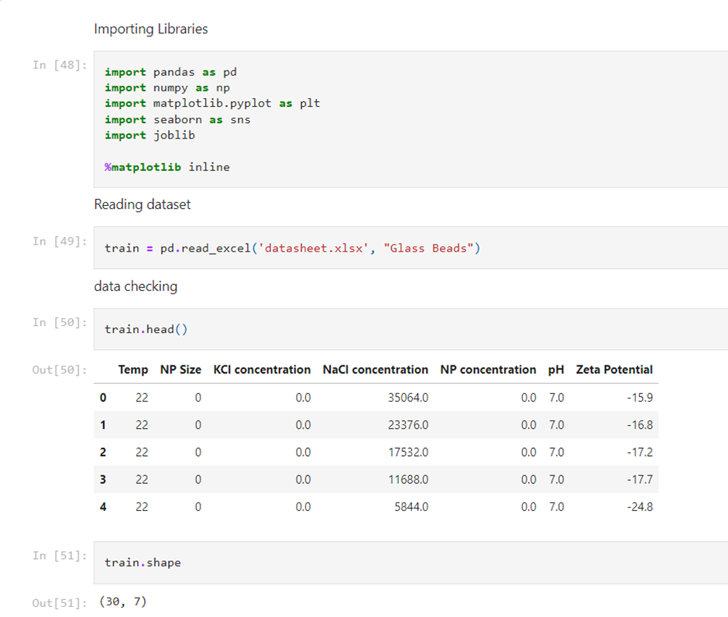
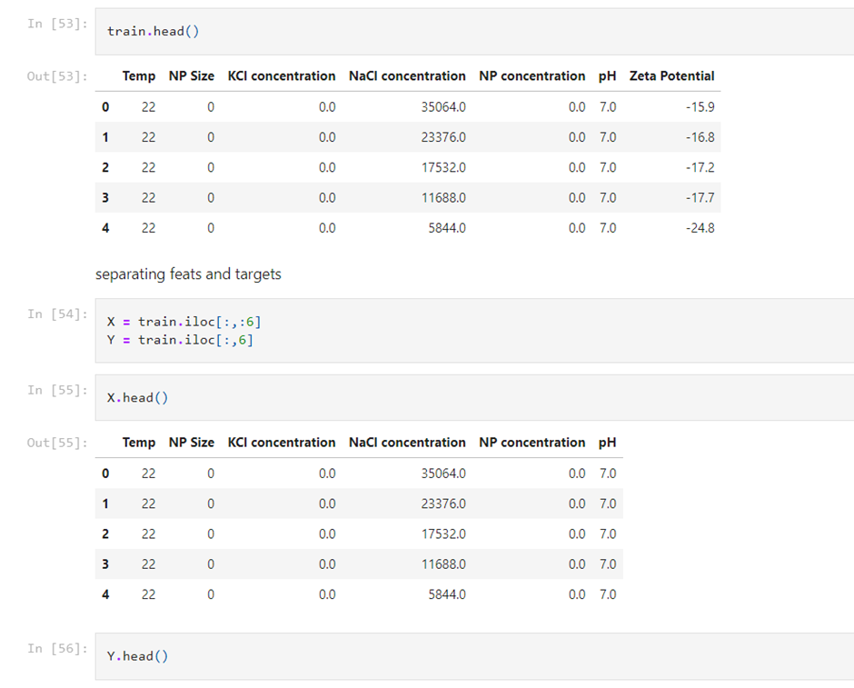
CODE SNIPPETS OF THE MODELS
INDIAN INSTITUTE OF
TECHNOLOGY DELHI
Page : 9

Slide 11
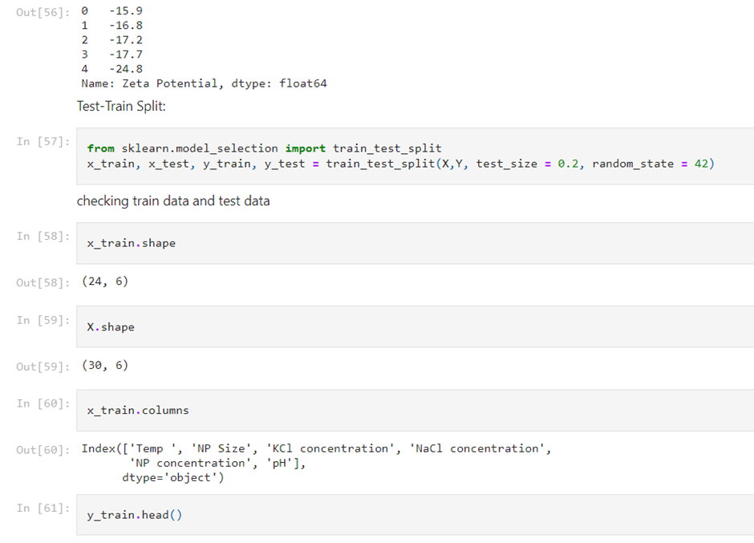
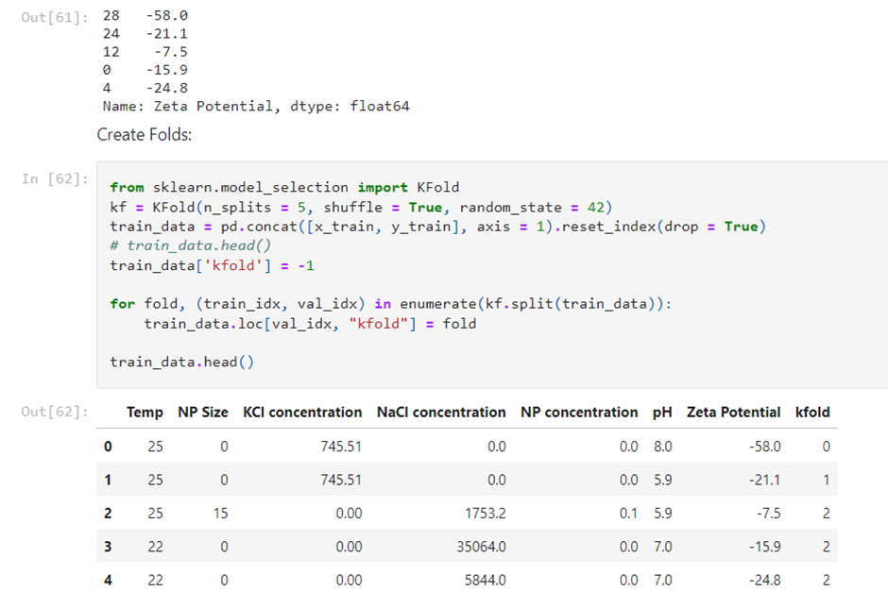
CODE SNIPPETS OF THE MODELS
INDIAN INSTITUTE OF
TECHNOLOGY DELHI
Page : 10

Slide 12
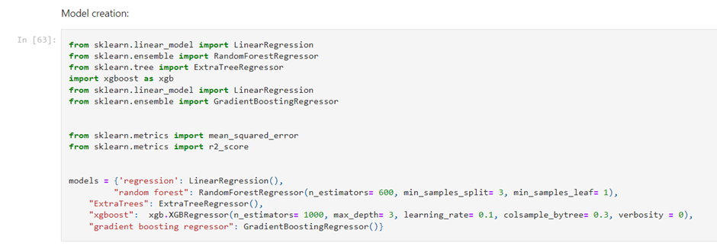
CODE SNIPPETS OF THE MODELS
INDIAN INSTITUTE OF
TECHNOLOGY DELHI
Page : 11

Slide 13
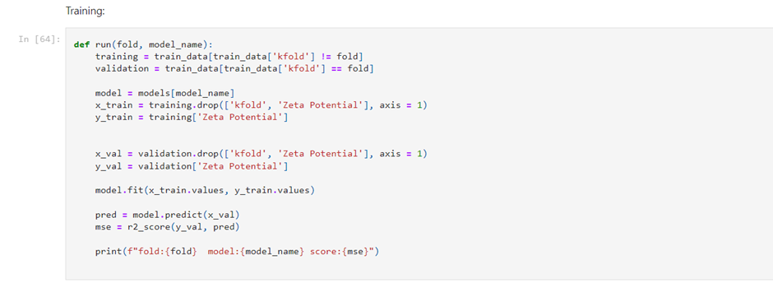
CODE SNIPPETS OF THE MODELS
INDIAN INSTITUTE OF
TECHNOLOGY DELHI
Page : 12

Slide 14
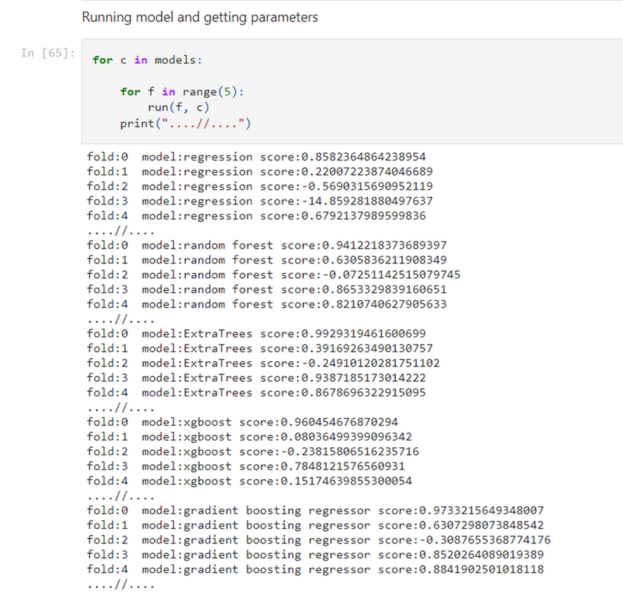
CODE SNIPPETS OF THE MODELS
INDIAN INSTITUTE OF
TECHNOLOGY DELHI
Page : 13

Slide 15
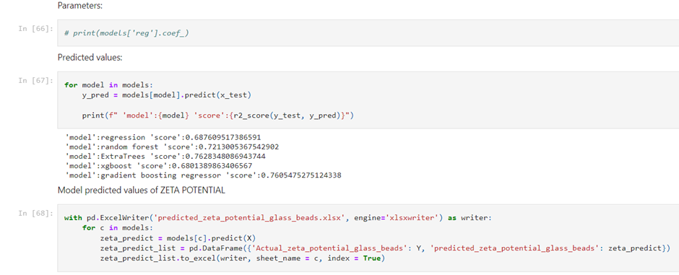
CODE SNIPPETS OF THE MODELS
INDIAN INSTITUTE OF
TECHNOLOGY DELHI
Page : 14

Slide 16
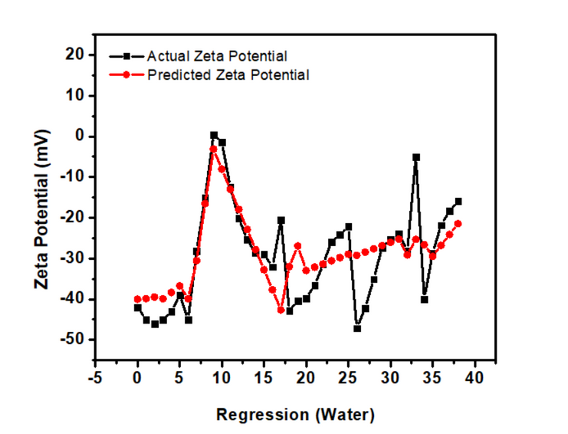
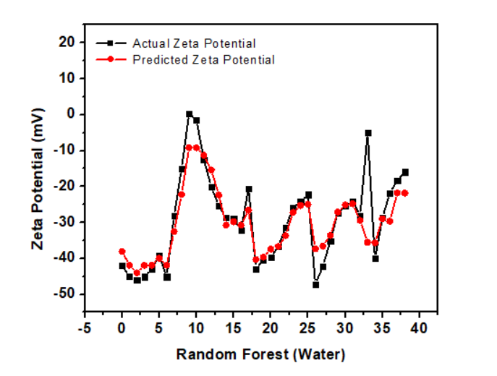
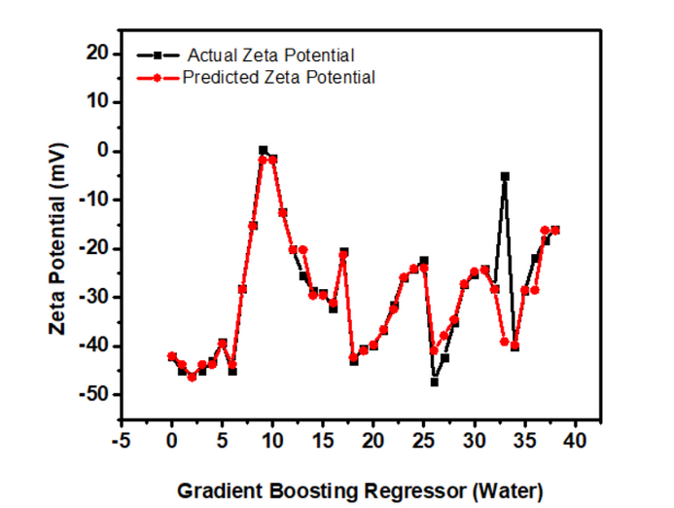
RESULTS AND DISCUSSIONS
WATER
INDIAN INSTITUTE OF
TECHNOLOGY DELHI
Page : 15

Slide 17
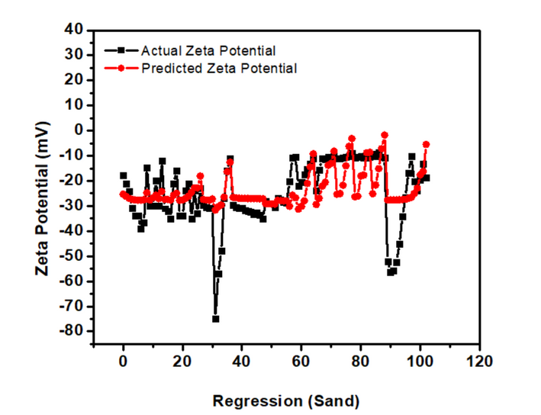
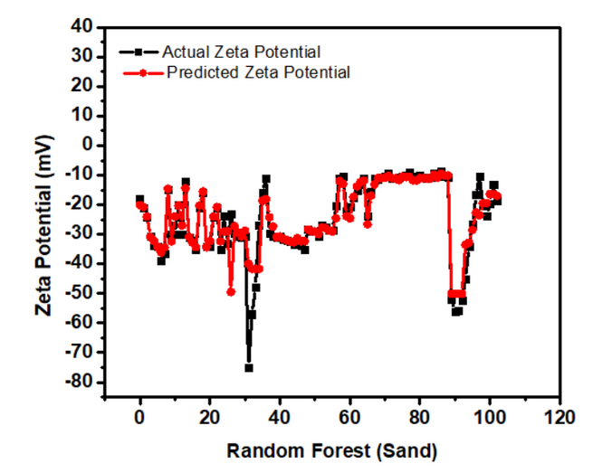
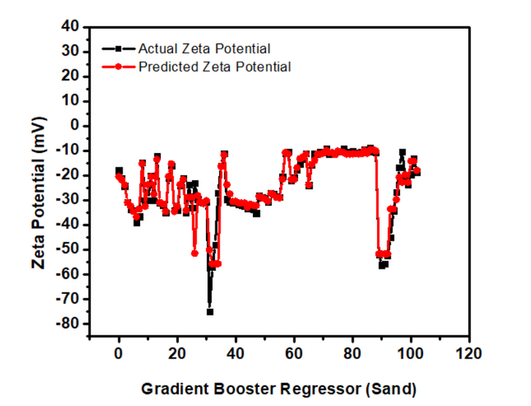
RESULTS AND DISCUSSIONS
SAND
INDIAN INSTITUTE OF
TECHNOLOGY DELHI
Page : 16

Slide 18
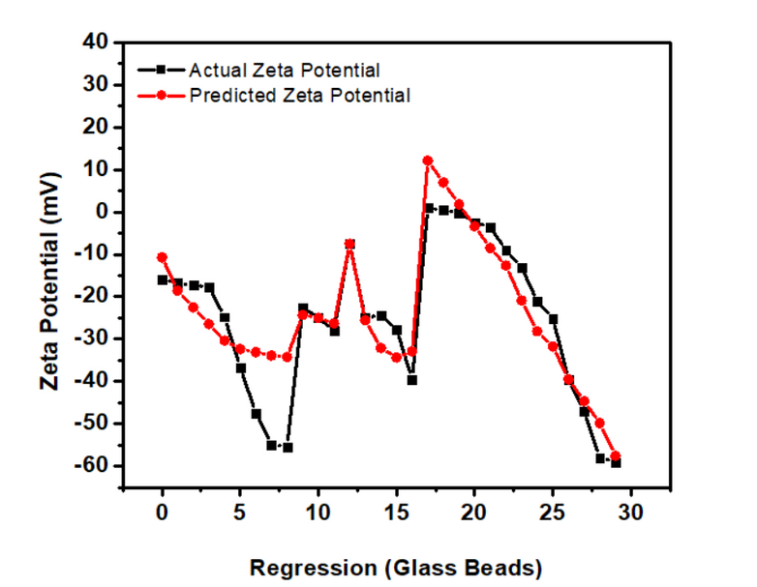
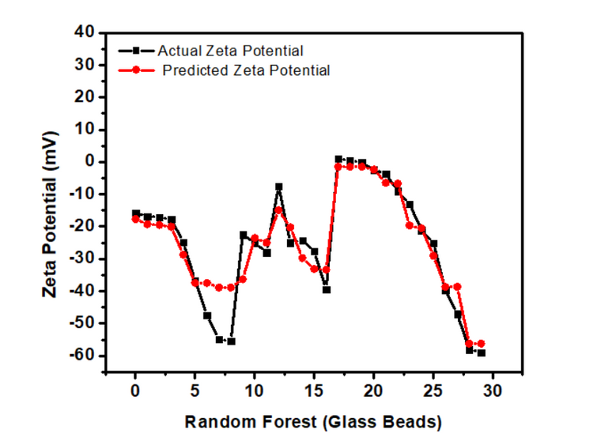
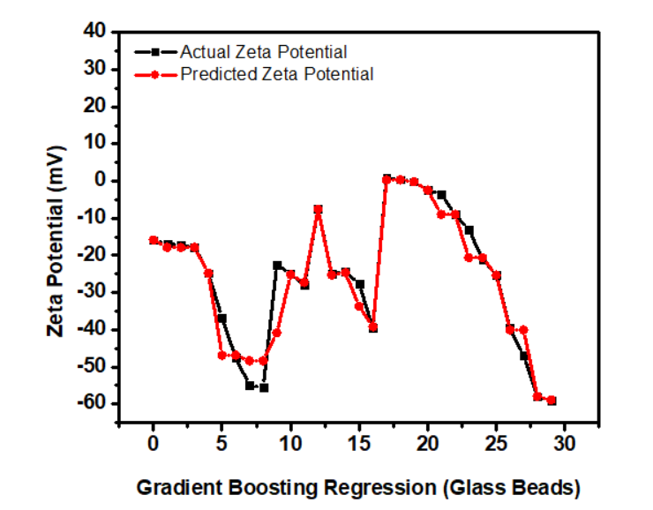
RESULTS AND DISCUSSIONS
GLASS BEADS
INDIAN INSTITUTE OF
TECHNOLOGY DELHI
Page : 17

Slide 19
RESULTS AND DISCUSSIONS
CORRELATION COEFFICIENTS
 | Temp | NP Size | KCl concentration | NaCl concentration | NP concentration | pH
Water | -0.145007983 | -0.116093485 | -0.023893249 | 0.287937777 | 0.003170245 | -0.654895785
Sand | 0.469253165 | -0.09068997 | 0.088252552 | 0.235088031 | -0.081121134 | 0.016651044
Glass Beads | 0.237072708 | 0.032561764 | 0.194388035 | 0.146916554 | 0.132780214 | -0.789405506
INDIAN INSTITUTE OF
TECHNOLOGY DELHI
Page : 18

Slide 20
RESULTS AND DISCUSSIONS
ERROR ANALYSIS
 | Score
Method | Water | Sand | Glass Beads
Regression | 0.593508993 | 0.340015069 | 0.687609517
Random Forest | 0.765268895 | 0.813708237 | 0.721300537
Gradient Boosting Regression | 0.836395739 | 0.774515718 | 0.760547528
INDIAN INSTITUTE OF
TECHNOLOGY DELHI
Page : 19

Slide 21
CONCLUSION
In this project, we realized that measuring Zeta potential is a very time-consuming and resource-intensive process.
So, we aimed to develop appropriate ML models to accurately predict Zeta potential values while considering a broad range of critical parameters that could impact the zeta potential of a colloidal particle.
The proposed methods eliminate the need for lengthy experimentation and provide a rapid and accurate prediction.
We observed that the results from [Model Name] were the closest to the actual experimentally measured values of Zeta Potential.
INDIAN INSTITUTE OF
TECHNOLOGY DELHI
Page : 20

Slide 22
REFERENCES
Datasets: Muneer, R., Hashmet, M. R., Pourafshary, P., & Shakeel, M. (2023). Unlocking the Power of Artificial Intelligence: Accurate Zeta Potential Prediction Using Machine Learning. Nanomaterials, 13(7), 1209.
Liu, Q., Chen, Z., & Yang, Y. (2021). Neural Network Modelling for Prediction of Zeta Potential. Mathematics, 9(23), 3089.
Breiman, L. (2001). Random Forests. Machine Learning, 45(1), 5-32.
Chen, T., & Guestrin, C. (2016). XGBoost: A Scalable Tree Boosting System. Proceedings of the 22nd ACM SIGKDD International Conference on Knowledge Discovery and Data Mining, 785-794.
Vinogradov, J., Jackson, M.D., & Chamerois, M. (2018). Zeta Potential in Sandpacks: Effect of Temperature, Electrolyte pH, Ionic Strength and Divalent Cations. Colloids Surfaces A Physicochem. Eng. Asp., 553, 259–271.
Koopal, L. K., & van der Wal, J. (2005). Zeta Potential. In Encyclopedia of Analytical Chemistry (pp. 1–16). John Wiley & Sons, Ltd.
INDIAN INSTITUTE OF
TECHNOLOGY DELHI
Page : 21

