Slide 1
Presto
A website that predicts the restaurant ratings using selective parameters
Notes:
© Copyright Showeet.com – Creative & Free PowerPoint Templates

Slide 2
Here we will predict the quality of restaurants on the basis of given features. We use the Zomato dataset available on Internet specific to the location- “Bangalore”. This dataset has the fundamental features which are responsible for determining the restaurant ratings. By the use of best Machine learning models, we will predict the quality of the wine.
Notes:
© Copyright Showeet.com – Creative & Free PowerPoint Templates

Slide 3
Main Objective:
Perform extensive Exploratory Data Analysis(EDA) on the Zomato Dataset.
Build an appropriate Machine Learning Model that will help various Zomato Restaurants to predict their respective Ratings based on certain features
DEPLOY the Machine learning model via Flask that can be used to make live predictions of restaurants ratings

Slide 4

Food Industry Data collected
This dataset is taken from 2019 dataset of Zomato
Bengaluru
Notes:
© Copyright Showeet.com – Creative & Free PowerPoint Templates

Slide 5
Outline of the project…
01
Data Cleaning
04
Random Forest Classifier
Data cleaning is the process of fixing or removing incorrect, corrupted, incorrectly formatted, duplicate, or incomplete data within a dataset
A random forest is a meta estimator that fits a number of classifying decision trees on various sub-samples of the dataset and uses averaging to improve the predictive accuracy and control over-fitting
Extra Tree Classifier ★★★★★
02
05
HTML and CSS File
An extra-trees regressor. This class implements a meta estimator that fits a number of randomized decision trees (a.k.a. extra-trees) on various sub-samples of the dataset and uses averaging to improve the predictive accuracy and control over-fitting.
HTML (HyperText Markup Language) is the code that is used to structure a web page and its content.
03
Linear Regression
06
Flask Implementation
Linear Regression is a machine learning algorithm based on supervised learning. It performs a regression task
Flask is a web application framework written in Python
Notes:
© Copyright Inzamam-ul-Haq

Slide 6
Parameters in the Data Set
Heatmaps are used to determine the location of most orders
Name of Restaurants
Rating collected from the users according to their satisfaction will play major role
Some dishes make the specific restaurant famous. Hence we take that parameter prioritized
Cost is a huge factor that affects all the remaining parameters
Address
Name
Rating
Dish
Cost
Notes:
© Copyright Showeet.com – Creative & Free PowerPoint Templates

Slide 7
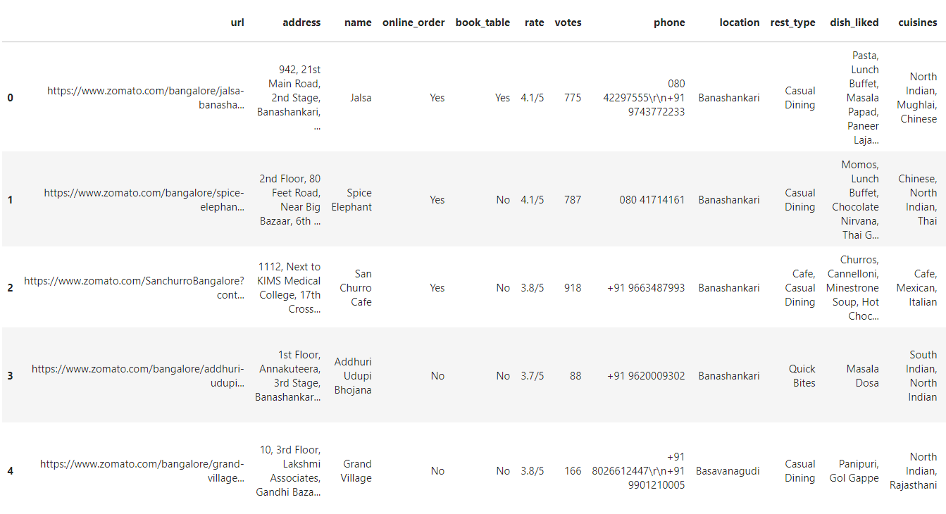
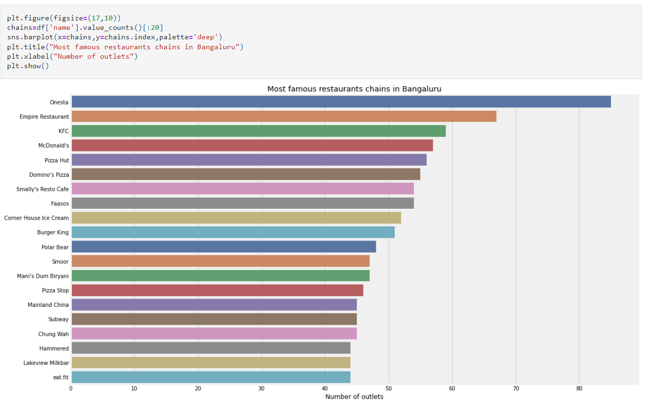
Columns description:
url </B> contains the url of the restaurant in the zomato website
address contains the address of the restaurant in Bengaluru
name contains the name of the restaurant
online_order whether online ordering is available in the restaurant or not
book_table table book option available or not
rate contains the overall rating of the restaurant out of 5
votes contains total number of rating for the restaurant as of the above mentioned date
phone contains the phone number of the restaurant
location contains the neighborhood in which the restaurant is located
rest_type restaurant type
dish_liked dishes people liked in the restaurant
cuisines food styles, separated by comma
approx_cost(for two people) contains the approximate cost of meal for two people
reviews_list list of tuples containing reviews for the restaurant, each tuple
menu_item contains list of menus available in the restaurant
listed_in(type) type of meal
listed_in(city) contains the neighborhood in which the restaurant is listed

Slide 8
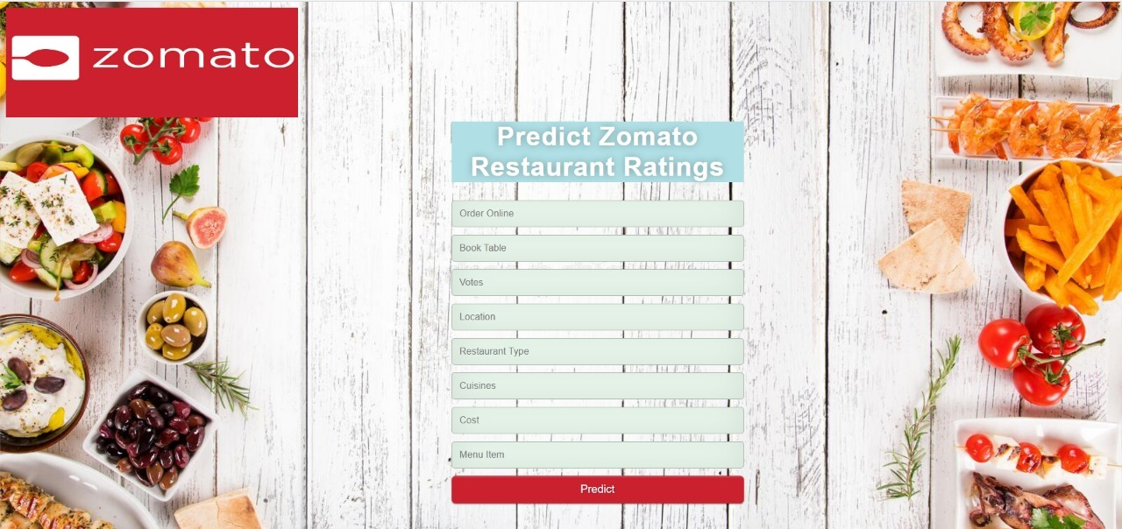
Implementation
Notes:
© Copyright Showeet.com – Creative & Free PowerPoint Templates

Slide 9
Thank You
Hope you enjoyed it.
Notes:
© Copyright Showeet.com – Creative & Free PowerPoint Templates

