Slide 1

Time Series Analysis on Daily exchange rate of Rupees per Euro
Avik Das (MDS202112)
Meghna Mondal (MDS202123)
Under the guidance of Prof. Srinivasan Mamandur
Notes:
Good morning professor and everyone!
Myself, Dharmendra Hingu and she is Harnisha Gevaria, he is Kushal Gevaria.
Today we will demonstrate our project on Foreign currency prediction.

Slide 2
Index
Introduction
Objective
About Data
Model based on ARIMA
Model based on Recurrent neural network
Comparison of proposed models
Future scope
References
Notes:
This is the agenda for today. We will cover, what is Foreign exchange?
Our motivation behind doing this project, the models we build and how it can be enhanced in future.

Slide 3
Introduction
Foreign exchange is the conversion of one currency to another, analyzing currency exchange rates is important for various reason:
International Trade
affect the cost of goods and services traded between countries
Investment Decisions
help investors make informed investment decisions and mitigate risks
Economic Indicators
leading indicator of economic conditions
strengthening currency signal a stable economy
Notes:
Now, What is forex? It is market for trading currencies. This includes all aspects of buying, selling and exchanging currencies at determined prices.
The main participants in this market are the large international banks and the transactions are huge in volume.
Consider business deal finalized between two parties amounting to one billion dollars buyer residing in USA and seller residing in Europe. A slight variation in the exchange rate can have significant impact and seller may have to pay more that the settled amount.
Question is what can we do about it? Can we know such change in currency beforehand? Yes, not the exact value but we can make prediction about it.
There are 4 ways to make predictions about the currency exchange as described by Investopedia purchasing power parity, relative economic strength. Econometric models, and time series analysis. We would be focusing on time series analysis.

Slide 4
Objective
To analyze historical daily exchange rate data to identify patterns, trends, and seasonality in the data.
To develop reliable and accurate forecast models for predicting future exchange rate movements.
Implementing ARIMA
Implementing Recurrent Neural Network
To compare between the results of the fitted models
Notes:
How does this help us? We can pay less tuition fees in terms of our home currency. Plus this would definitely help people doing overseas business. That’s our main motivation.

Slide 5
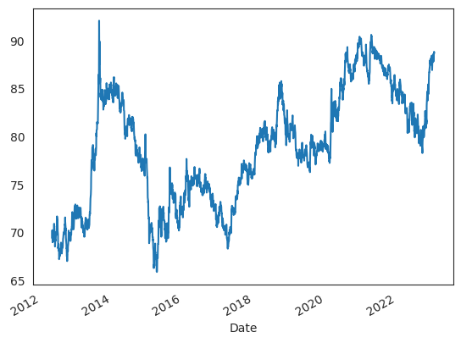
About Data
Our data is from 2012-05-01 to 2023-01-27
Notes:
Now, lets spend little bit time on how we can achieve this?
Our main objective here is to build a system can predict the exchange rate for the next day or any number of future days between the two currencies.
We propose two models,
First using Neural Network and second using a statistical method model namely ARIMA.

Slide 6
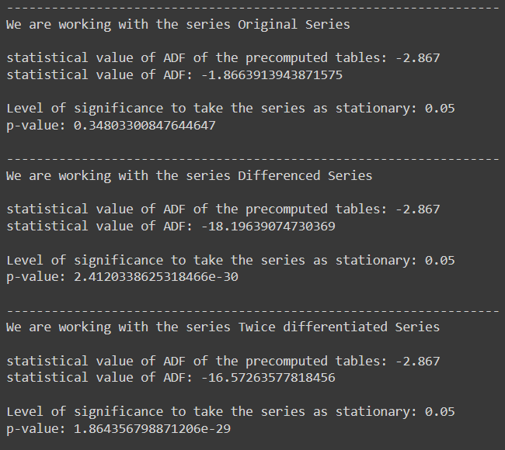
ADF test Result

Slide 7
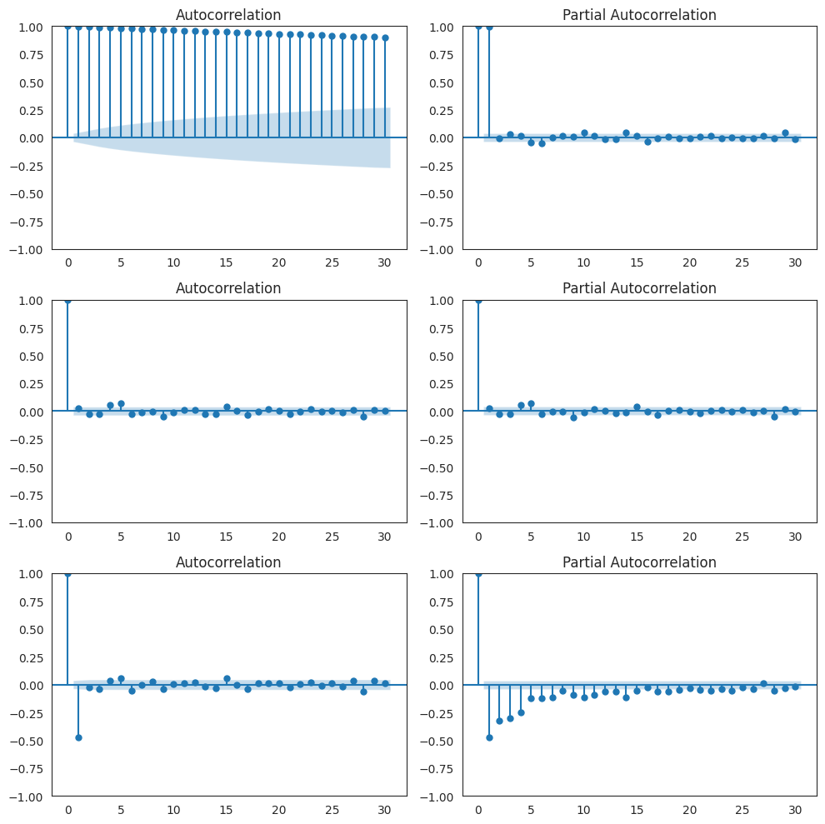
Observation from the plots:
Slight upward Trend
Presence of Cyclicity
No Seasonal Component
Non-Stationary
Good to fit an ARIMA model
with an AR and Integration
component

Slide 8
Model based on ARIMA
ARIMA – Autoregressive integrated moving average
Statistical model used to forecast time series data
Combination of AR (autoregression) I (Integration) and MA (moving average)
The values p, d and q are called the parameters of the ARIMA model.
Used auto_arima function to determine the parameter values p, d and q
Notes:
Good Morning professor and my fellow classmates,I will be explaining you about the next model called ARIMA model.It is a statistical model which is used to forecast on time series based dataset.
So, ARIMA stands for an Auto-regressive integrated moving average model.
This model is itself subdivided into three smaller models namely Auto-regression(AR), Integration(I) and Moving Average(MA). Each of these three models can be used separately or can be combined together to create a model of our own. These three models are supported by three parameter p, q, and r.
Auto-regression part of the ARIMA model is used to do the regression for current data point based on the previous number of lag points that we consider. These number of lag points are specified by the parameter p of the ARIMA model. In our case, these lag points are the exchange rate values for previous three days.
Integration part of the Arima model is used to carry out the difference between the current data point with the selected lag observations. This term is also called as the degree of differencing. The differencing is needed to make the given data look stationary. This is handled by the parameter q of the ARIMA model. For this project, the value of the parameter q is one which means that we are doing the differencing just once.
The third part of the model is the Moving Average which is used to calculate the regression error caused by averaging the lagged observations and comparing it with the regression value which we obtained earlier. This comprises of the last parameter r of the ARIMA model. For our project we are eliminating this third part by using value of parameter r as zero.

Slide 9
Model based on ARIMA
Divide the time-series data into two sets training (70%) and testing (30%)
Taking into account past values to make prediction for the next 5,10,15 & 20 days
Repeat the above procedure until getting the fitted values against the test set
Training Set
Next 10 days
Prediction
Training Set
extended with next 10 actual observations
ARIMA
Notes:
Now, as you can see, we used 70% of the data as training set and remaining 30% of the data as a testing set. We trained the above model on the given training set using python statsmodels package. After training the model, we used our testing data set to find out how accurate the model is and calculated the MSE value which came out to be as low as approximately 0.02. Now my teammate will move forward the presentation explaining about the comparisons between the two models and the future scope for this project. Thank you

Slide 10
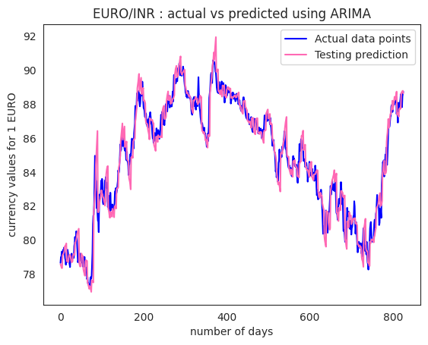
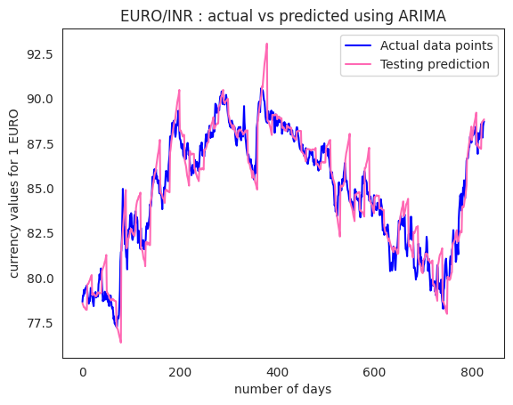
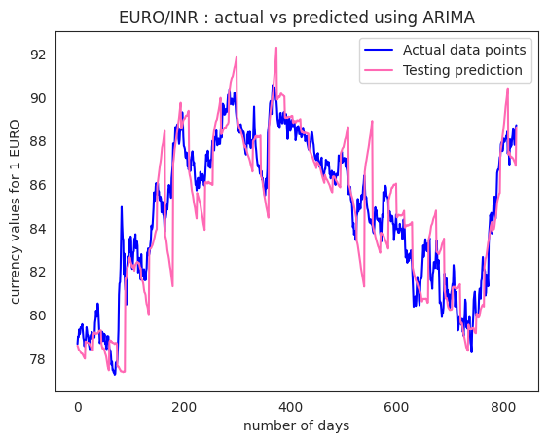
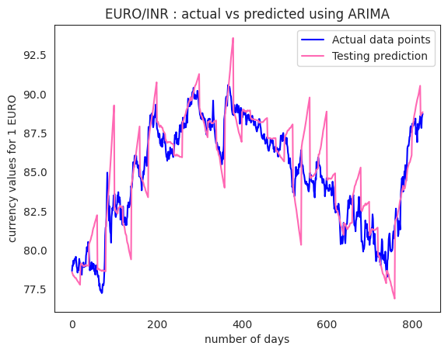

Slide 11
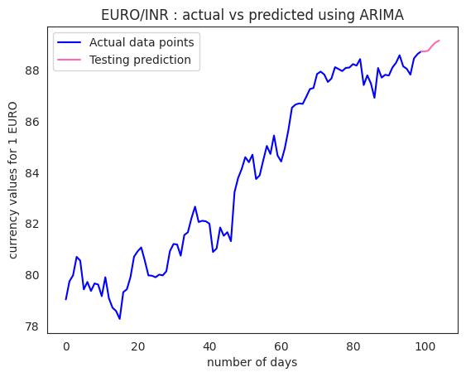
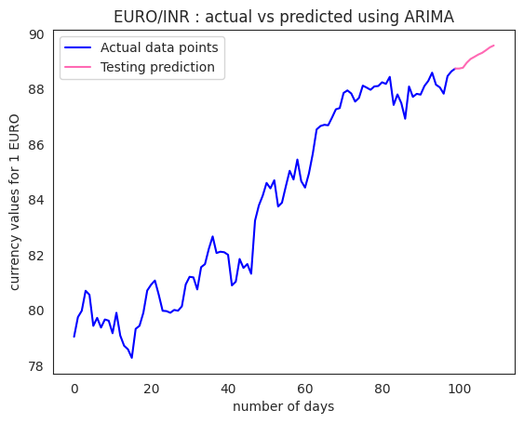
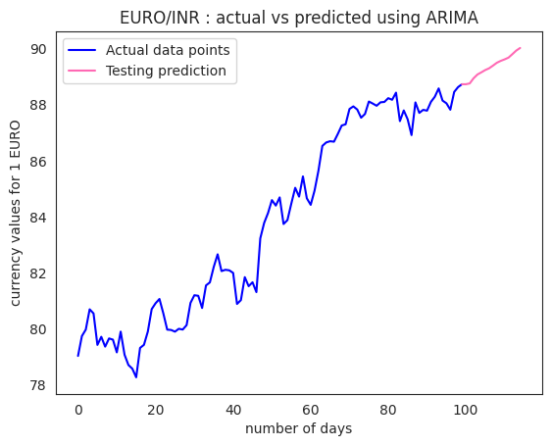
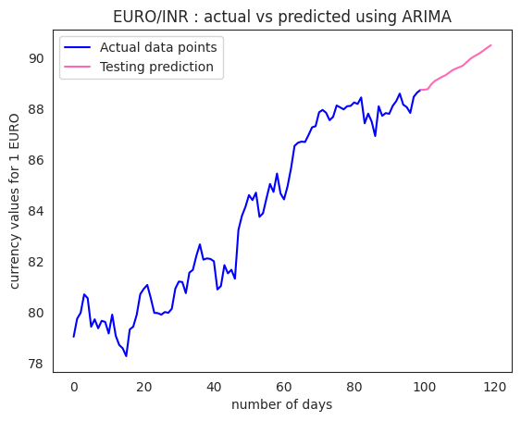

Slide 12
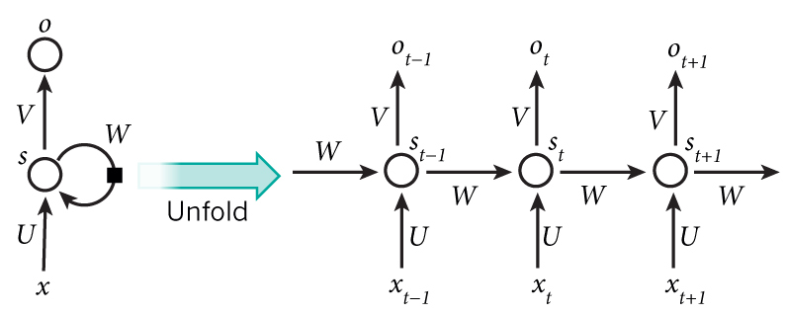
Model based on neural network
Multi-layer perceptron with back-propagation
A special type of NN, recurrent neural network that takes past sequential values as input instead of features
Notes:
Our first model is based on Neural Network. As we all know NN is nothing but a combination of Neurons. One of the property of time series data that data is captured at regular interval of time and here we consider daily data.
So essentially speaking there is no feature to extract from the data. But we need to somehow give input to NN. So we give the time lag values as feature to our NN. This type of NN are called Recurrent Neural Network. And the output is a prediction for next day. We use backpropagation algorithm to update the weights.
We use Kera’s deep neural network library to build RNN.

Slide 13
Model based on neural network
Why Using RNN
Ability to capture non-linear patterns
Flexibility in input and output
Divide the time-series data into two sets training (70%) and testing (30%)
Taking into account past 30 values to make prediction for the next 5,10,15 & 20 days
Notes:
We follow the standard procedure load the dataset, divide it into training and testing set. We build and train the RNN with training set and evaluate the model using testing set. We use mean square error to measure the performance of the model. The graph shows actual dataset vs testing prediction. And you can see the MSE is very low.
Now Kushal will talk about the next model.

Slide 14
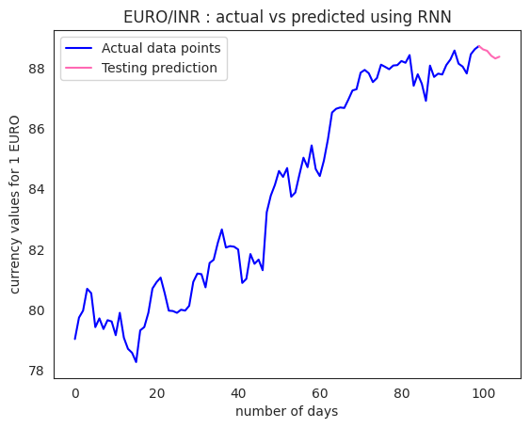
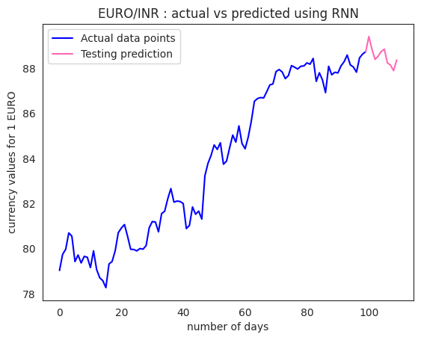
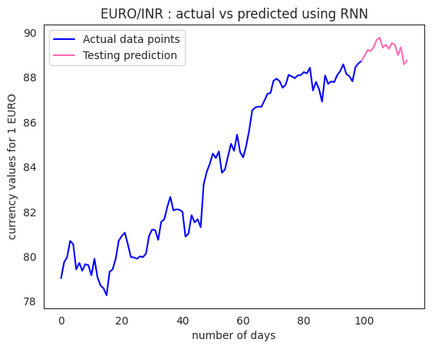
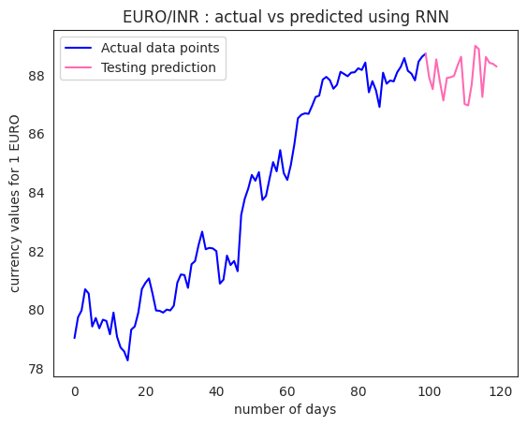

Slide 15
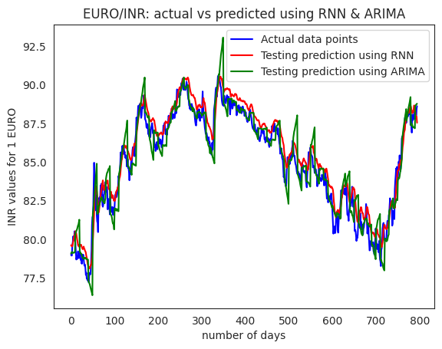

Comparison of proposed models
Notes:
Now lets compare the two models that we created and analyze the performance.
We have considered the 4 currencies against USD. INR – India, CNY – China, EUR – Europe , and AUD – Australia.
In the graphs green line - ARIMA model, Red line - NN model and blue line is the actual data points.

Slide 16
Comparison of proposed models
The mean square error as low as,
The R-square value for ARIMA models:
Prediction for- | 5 days | 10 days | 15 days | 20 days
ARIMA | 0.5719 | 1.1205 | 2.3099 | 2.8723
RNN | 0.7019 | 1.3348 | 2.1261 | 2.3959
Prediction for- | 5 days | 10 days | 15 days | 20 days
ARIMA | 0.9499 | 0.9018 | 0.7977 | 0.7485
Notes:
We get these mean square errors, looking at these we see that they are very very low. We get this high accuracy of 98% because of the reasons, in the real world the exchange rate fluctuations are very small. It can’t happen that the rate of USD to INR today is 64 and tomorrow it’s 90.
after analyzing these two models we conclude that ARIMA model is performing better than the neural network model.

Slide 17
Future scope
Neural network can be used in a slightly different way, where we can introduce a feature, that represents e.g. GDP of a country, for improving the performance
Developing real-time forecasting tools:
uses a combination of historical data, current market data, and economic indicators.
update on a regular basis, depending on the frequency of data updates and the level of volatility in the market.
Developing hybrid models
Notes:
Now what can we do to improve it furthur?
Using ARIMA model we tried to predict the values of next 7 days and we observed that the MSE was high giving accuracy of 95%during the period when market fluctuations were high, as it was taking into account the predicted values which were faulty.
Now to improve this, we can take into consideration factors like, GDP of a country, and income growth rate which also have huge impact on the forex market. This can be done by augmenting the current NN in a slightly different way where we can feed these features and then analyzing the trend to predict the values for any number of future days accurately.
With this we end our presentation and now are open to any questions you may have for us!

Slide 18
References
https://alkaline-ml.com/pmdarima/modules/generated/pmdarima.arima.auto_arima.html
https://towardsdatascience.com/temporal-loops-intro-to-recurrent-neural-networks-for-time-series-forecasting-in-python-b0398963dc1f
Images source:
http://2.bp.blogspot.com/-o4WiHObJ5RY/UD7XvgE_PjI/AAAAAAAAAA8/z6vB3yix9Fg/s1600/currency.png
Data source:
https://drive.google.com/file/d/1AXxzPdQO5VQjpe0DWikDXPvFit2_Qb56/view?usp=share_link

