Slide 1

MUTUAL FUND ANALYTICS PLATFORM
A full-stack fund analytics pipeline — from raw AMFI data to an interactive dashboard
Bluestock Fintech Internship — Capstone Project I Avika Aswal | Project Manager: Yash Kale August 2026

Slide 2

Mutual fund investors and analysts need a way to see fund performance, risk, and investor behavior in one place — not scattered across raw NAV files and static fact sheets.
Problem &
Objective
1
Build an ETL pipeline that ingests AMFI + mfapi.in data into a clean, queryable database
2
Compute industry-standard performance metrics (CAGR, Sharpe, Sortino, Alpha/Beta) correctly and verifiably
3
Layer in risk and investor-behavior analytics: VaR, cohorts, SIP continuity, a fund recommender
4
Present it all through an interactive, four-page Power BI dashboard

Slide 3




Data Sources
40
~1.6M
32,778
10
Fund schemes tracked
Daily NAV rows (Jan 2022 – May 2026)
Investor transactions (Jan 2024 – May 2025)
Raw source CSVs + live mfapi.in feed
Key tables
01_fund_master.csv Fund attributes — category, expense ratio, risk grade
nav_history_clean.csv Daily NAV history for all 40 schemes
scheme_performance_clean.csv Precomputed Sharpe, Sortino, Alpha, Beta
10_benchmark_indices.csv Nifty 50 / Nifty 100 and 5 other indices
Notable scope gap: investor transaction data (2024–2025) is narrower than NAV/benchmark data (2022–2026)

Slide 4




System Architecture
Raw Data
Cleaning
SQLite DB
Notebooks
Dashboard
AMFI CSVs +
mfapi.in live feed
Python / pandas
scripts
Star schema,
6 tables
EDA, performance,
advanced analytics
Power BI,
4 pages + drill-through
Each stage writes its output to disk before the next stage reads it — so any stage can be re-run and verified on its own.
Tech stack
Python · pandas · SQLite · SQLAlchemy · Jupyter · scipy.stats · Plotly · Power BI · DAX · Git

Slide 5

EDA Highlights
Day 3 — Exploratory Data Analysis
19
16
10
Charts built
Chart PNGs exported
Findings documented
Coverage
NAV trends · AUM · SIP inflows · sector allocation · investor demographics · geography · folio growth · correlation · risk-return
Environment fixes along the way: Kaleido downgraded 1.3.0 → 0.2.1 for PNG export on Windows; Timestamp serialization fixed with .strftime() before JSON export.

Slide 6

EDA Highlights
The finding that shaped everything after it
Near-zero correlation between funds — even funds tracking the same index
First signal that the NAV data was generated independently rather than from shared market movement — confirmed later with Beta, R², and tracking error.
Other notable patterns
Debt & liquid funds show unusually low volatility — later found to mathematically inflate Sharpe Ratio under a near-zero risk-free assumption
Sector allocation across 34 equity funds shows plausible diversification, later quantified with HHI (0.108–0.206)

Slide 7
Performance Metrics
Day 4 — Sharpe, Sortino, Alpha & Beta
Sharpe & Sortino
Alpha & Beta vs. Nifty 100
Rf = 6.5% (RBI repo rate proxy, per spec) Found a discrepancy vs. the database’s precomputed Sharpe — traced to a near-zero Rf assumption there, not an error in either calculation.
Mean β = −0.002 R² = 0.0006 None of the 40 slopes significant at p < 0.05. Strong evidence fund returns move independently of the benchmark.
Also computed
CAGR: 1yr / 3yr / since-inception — true 5yr not computable (dataset spans ~4.4 years)
Maximum Drawdown: Range: −21.8% to −52.6%, with peak-to-trough windows of 169–1,015 days

Slide 8
Performance Metrics
Fund Scorecard & Benchmark Comparison
Top 5 funds — composite score (0–100)
AMFI Code | Score | 3Yr Return | Sharpe | Alpha
148567 | 86.25 | 34.0% | 1.45 | 0.27
120505 | 82.25 | 31.8% | 1.18 | 0.29
120843 | 82.00 | 29.6% | 1.31 | 0.27
100033 | 80.75 | 32.4% | 1.09 | 0.27
120504 | 80.00 | 32.5% | 1.03 | 0.21
Tracking Error
18.7%–23.3%
annualized, top 5 funds vs. Nifty 100 — vs. a typical 2–8% for active funds
30% 3yr return + 25% Sharpe + 20% Alpha + 15% expense ratio (inv) + 10% max drawdown (inv), all percentile-ranked.
All five top funds trended upward (100 → 220–260) while Nifty 50 trended downward (100 → ~75) over the same 3-year window — visually reinforcing the near-zero Beta finding.

Slide 9
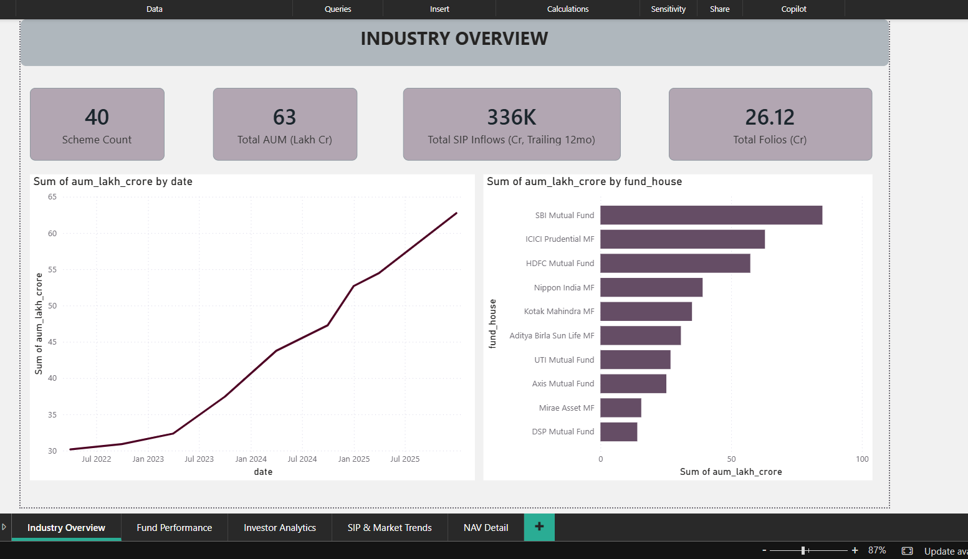
The Dashboard
Page 1 — Industry Overview

Slide 10
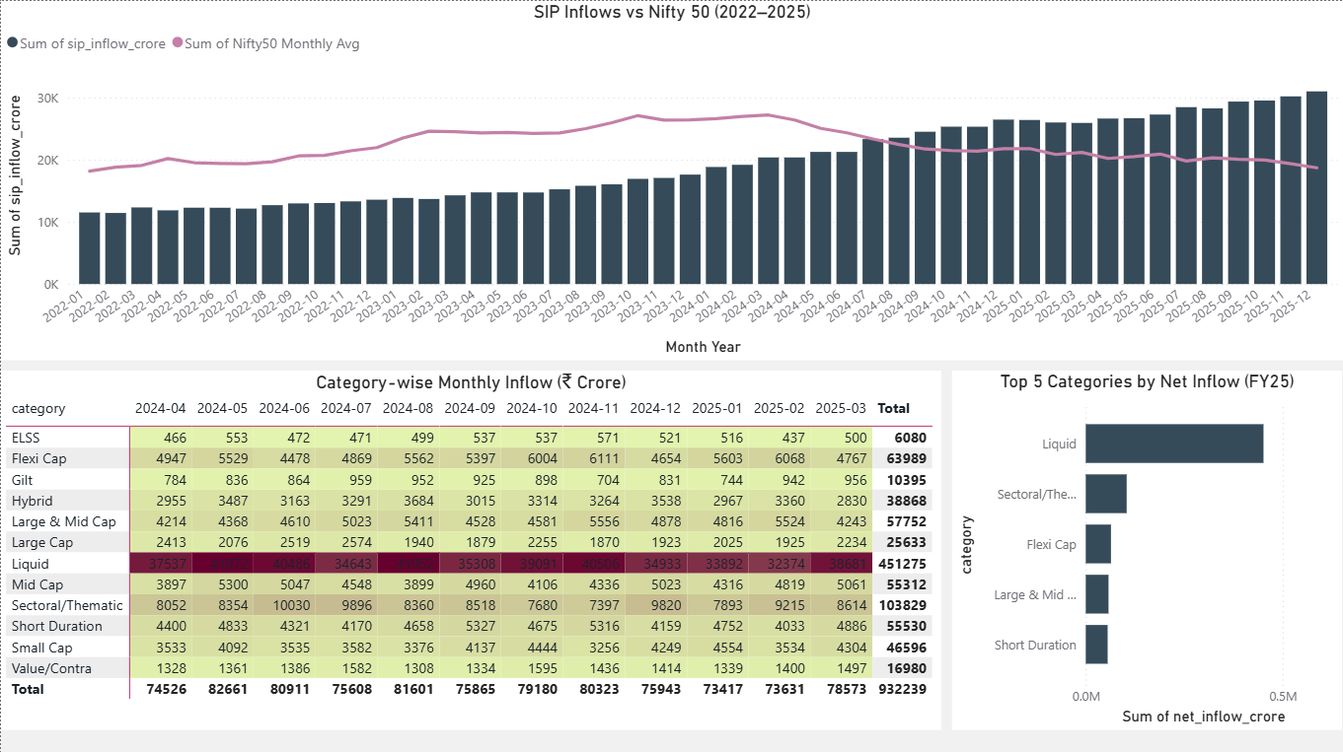
The Dashboard
Page 4 — SIP & Market Trends

Slide 11


Key Findings
Complete, verified pipeline
ETL, database, EDA, performance analytics, advanced risk metrics, and a 4-page dashboard — all built and cross-checked
Evidence of synthetic NAV data
Near-zero correlation, near-zero Beta/R², and abnormal tracking error all point the same direction — flagged as a limitation, not hidden
Three real bugs caught and fixed
AUM units mislabeling, a many-to-many fan-out in Power BI, and a Sharpe Ratio discrepancy traced to its root cause
Verification-first approach
Every precomputed value was cross-checked against an independent calculation before being trusted

Slide 12
Thank You
Questions welcome
Avika Aswal
github.com/Avika26/mutual-fund-capstone

