Slide 1
Advanced Programming 2 Recitation 13 – Android Part II
Roi Yehoshua 2017

Slide 2
Activities and Intents
2

Slide 3
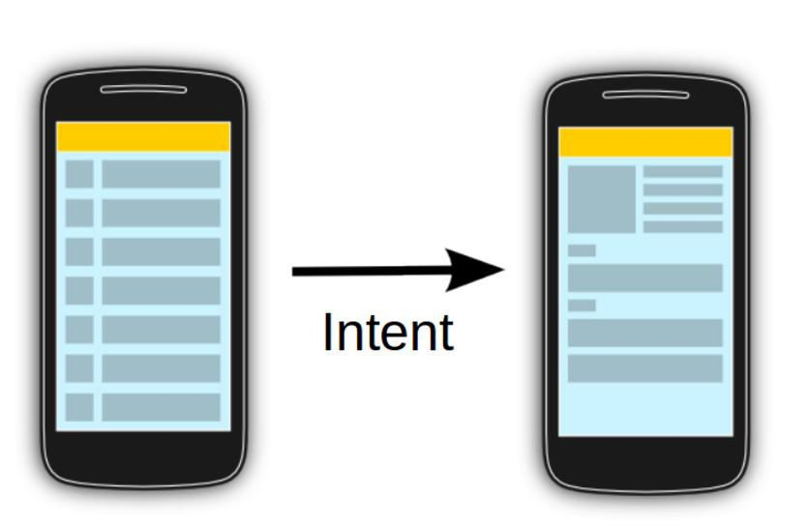
Intent
 An intent is an abstract description of an operation to be performed
 It allows application components to request functionality from other apps
 For example, to start an activity you can use the method startActivity(intent)
3

Slide 4
Starting Another Activity
 Example for starting a second activity when clicking a button:
public class MainActivity extends AppCompatActivity {
@Override
protected void onCreate(Bundle savedInstanceState) { super.onCreate(savedInstanceState); setContentView(R.layout.activity_main);
}
The Intent c’tor takes two parameters: a Context (an Activity is a subclass of Context) and the class of the app component the system should deliver the intent to
// Called when user taps the Send button
public void sendMessage(View view) {
EditText editText = (EditText)findViewById(R.id.editText);
The putExtra() method can add data to the intent as key-value pairs
Intent intent = new Intent(this, DisplayMessageActivity.class); String msg = editText.getText().toString(); intent.putExtra("message", msg);
startActivity(intent);
The startActivity() method starts an instance of the activity specified by the Intent
}
}
4

Slide 5
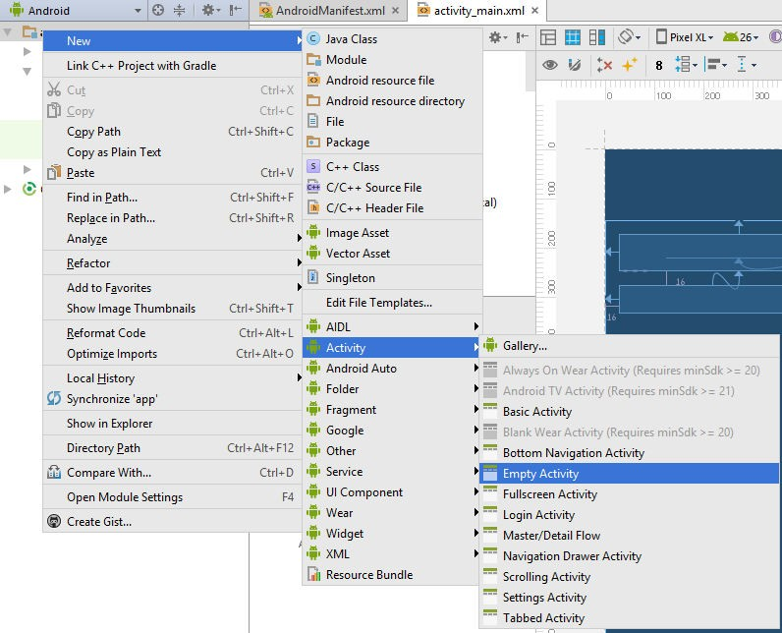
Create the Second Activity
 In the Project window, right-click the app folder and select New > Activity > Empty
Activity
5

Slide 6
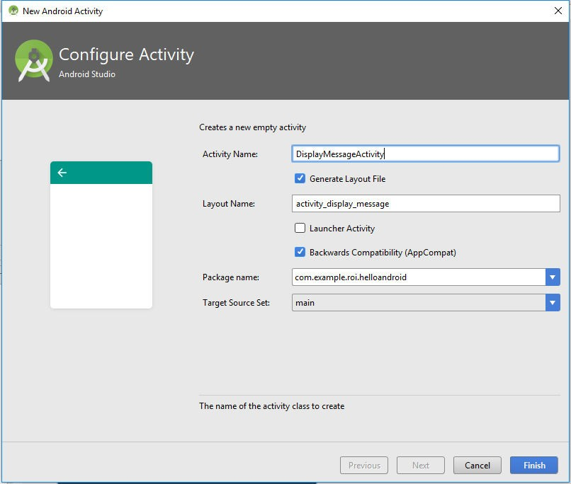
Create the Second Activity
 In the Configure Activity window, enter "DisplayMessageActivity" for Activity Name and click Finish
 Android Studio automatically does three things:
 Creates the DisplayMessageActivity.java file
 Creates the activity_display_message.xml layout file
 Adds the required <activity> element in AndroidManifest
6

Slide 7
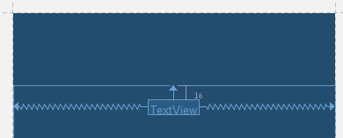
Add a TextView
 The new activity includes a blank layout file
 Add a text view where the message will appear
 Open the file app > res > layout > activity_display_message.xml.
 Click Turn On Autoconnect in the toolbar
 From the Pallete window, drag a TextView into the layout and place it near the top of the
layout, near the center so it snaps to the vertical line that appear, and then drop it
 Autoconnect adds constraints to place the view in the horizontal center
7

Slide 8
Display the Message
 In DisplayMessageActivity.java, add the following code to the onCreate() method:
public class DisplayMessageActivity extends AppCompatActivity {
@Override
protected void onCreate(Bundle savedInstanceState) { super.onCreate(savedInstanceState); setContentView(R.layout.activity_display_message);
getIntent() returns the intent that started this activity
// Get Intent String
the Intent that started this activity and extract
intent = getIntent();
msg = intent.getStringExtra("message");
the message
// Display the message on the textview
TextView textView = (TextView) findViewById(R.id.textViewMsg); textView.setText(msg);
}
}
8

Slide 9
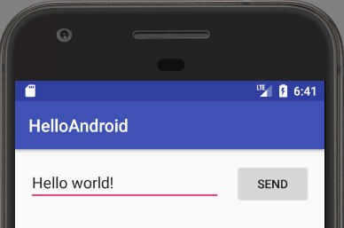
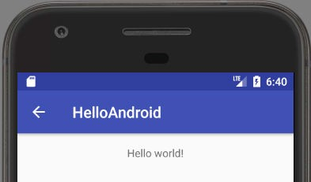
Add Up Navigation
 Each screen that is not the main entrance to your app should provide navigation so
the user can return to its logical parent screen in the app hierarchy
 You declare which activity is the logical parent in the AndroidManifest.xml file:
<activity android:name=".DisplayMessageActivity" android:parentActivityName=".MainActivity"></activity>
9

Slide 10
Passing Objects To Another Activity
 In order to pass an object to another activity, your custom class should implement
the Serializable interface
 Then you can pass object instances in the intent extra using the putExtra(Serializable..) method
 To retrieve the object in the second activity call getIntent().getSerializableExtra()
// To pass an object
intent.putExtra("MyClass", obj);
// To retrieve object in second Activity
getIntent().getSerializableExtra("MyClass");
10

Slide 11
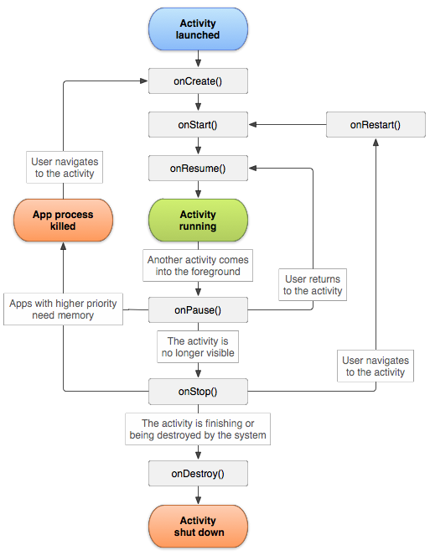
Activity Life Cycle
11

Slide 12
Images
12

Slide 13
Reading all the Images
First, we need to include the permission to read from the file system
<uses-permission android:name="android.permission.READ_EXTERNAL_STORAGE" />
// Getting the Camera Folder
File dcim = Environment.getExternalStoragePublicDirectory(Environment.DIRECTORY_DCIM); if (dcim == null) { return; }
File[] pics = dcim.listFiles(); int count =0; if (pics != null) { for (File pic : pics) {
…
}
}

Slide 14
Progress Bar Notification
NotificationManagerCompat notificationManager = NotificationManagerCompat.from(this); NotificationCompat.Builder builder = new NotificationCompat.Builder(this, "default"); builder.setContentTitle("Picture Transfer") .setContentText("Transfer in progress") .setPriority(NotificationCompat.PRIORITY_LOW); builder.setContentText(“Half way through") .setProgress(100, 50, false); notificationManager.notify(1, builder.build()); // At the End builder.setContentText("Download complete") .setProgress(0, 0, false); notificationManager.notify(1, builder.build());
https://www.youtube.com/watch?v=5ioczmk95AU

Slide 15
Connecting to the Network
12

Slide 16

Network Communication
 In order to perform network operations in your application, your manifest must
include the INTERNET permission:
<?xml version="1.0" encoding="utf-8"?>
<manifest xmlns:android="http://schemas.android.com/apk/res/android" package="com.example.roi.httpconnection">
<application
android:allowBackup="true" android:icon="@mipmap/ic_launcher" android:label="@string/app_name" android:roundIcon="@mipmap/ic_launcher_round" android:supportsRtl="true" android:theme="@style/AppTheme">
<activity android:name=".MainActivity">
<intent-filter>
<action android:name="android.intent.action.MAIN" />
<category android:name="android.intent.category.LAUNCHER" />
</intent-filter>
</activity>
</application>
<uses-permission android:name="android.permission.INTERNET" />
</manifest>

Slide 17
Tcp Connection
In order to create a TCP connection with a remote Server, a Tcp Socket needs to be constructed
try { //here you must put your computer's IP address. InetAddress serverAddr = InetAddress.getByName(“10.0.0.2"); //create a socket to make the connection with the server Socket socket = new Socket(serverAddr, 1234); try { //sends the message to the server OutputStream output = socket.getOutputStream(); FileInputStream fis = new FileInputStream(pic); .. output.write(imgbyte); output.flush(); } } } catch (Exception e) { Log.e("TCP", "S: Error", e); } finally { socket.close(); }
} catch (Exception e) { Log.e("TCP", "C: Error", e); }
The emulator runs behind a virtual router/firewall service that isolates it from your development machine network interfaces
10.0.2.2 is a special alias to your host loopback interface (i.e., 127.0.0.1 on your development machine)

Slide 18
Convert Picture To Array Byte
FileInputStream fis = new FileInputStream(pic); Bitmap bm = BitmapFactory.decodeStream(fis); byte[] imgbyte = getBytesFromBitmap(bm);
public byte[] getBytesFromBitmap(Bitmap bitmap) { ByteArrayOutputStream stream = new ByteArrayOutputStream(); bitmap.compress(Bitmap.CompressFormat.PNG, 70, stream); return stream.toByteArray(); }

Slide 19
Services
34

Slide 20
Service
A Service is an application component that can perform long-running operations in the background, and it doesn't provide a user interface.
We must include the Service in the Manifest
Contains the following events:
onStartCommand()
onBind()
onCreate()
onDestroy()
<service android:name =".ImageServiceService" android:exported="false"></service>

Slide 21
onStartCommand
onStartCommand()
The system invokes this method by calling startService() when another component (such as an activity) requests that the service be started. When this method executes, the service is started and can run in the background indefinitely. If you implement this, it is your responsibility to stop the service when its work is complete by calling stopSelf() or stopService(). If you only want to provide binding, you don't need to implement this method.

Slide 22
onBind()
You must always implement this method; however, if you don't want to allow binding, you should return null.

Slide 23
onCreate()
The system invokes this method to perform one-time setup procedures when the service is initially created (before it calls either onStartCommand() or onBind()). If the service is already running, this method is not called.

Slide 24
onDestroy()
The system invokes this method when the service is no longer used and is being destroyed. Your service should implement this to clean up any resources such as threads, registered listeners, or receivers. This is the last call that the service receives.

Slide 25
The Main Activity
Main Activity
public void startService(View view) { Intent intent = new Intent(this, ImageServiceService.class); startService(intent); } public void stopService(View view) { Intent intent = new Intent(this, ImageServiceService.class); stopService(intent); }

Slide 26
The Service
public class ImageServiceService extends Service { public ImageServiceService(){} @Nullable @Override public IBinder onBind(Intent intent) { return null; } @Override public void onCreate() { super.onCreate();
// Here put the Code of Service
}
public int onStartCommand(Intent intent, int flag, int startId) { Toast.makeText(this,"Service starting...", Toast.LENGTH_SHORT).show(); return START_STICKY; }
public void onDestroy() { Toast.makeText(this,"Service ending...", Toast.LENGTH_SHORT).show(); }
https://www.youtube.com/watch?v=HYctmRwYHOg

Slide 27
Broadcast Receiver
34

Slide 28
Broadcast Receiver
The system automatically sends broadcasts when various system events occur
The broadcast message itself is wrapped in an Intent object whose action string identifies the event that occurred
We must include intent filters in order to specify the broadcast actions your receiver subscribes to.

Slide 29
Wifi Broadcaster
final IntentFilter theFilter = new IntentFilter(); theFilter.addAction("android.net.wifi.supplicant.CONNECTION_CHANGE"); theFilter.addAction("android.net.wifi.STATE_CHANGE"); this.yourReceiver = new BroadcastReceiver() { @Override public void onReceive(Context context, Intent intent) { WifiManager wifiManager = (WifiManager) context .getSystemService(Context.WIFI_SERVICE); NetworkInfo networkInfo = intent.getParcelableExtra(WifiManager.EXTRA_NETWORK_INFO); if (networkInfo != null) { if (networkInfo.getType() == ConnectivityManager.TYPE_WIFI) { //get the different network states if (networkInfo.getState() == NetworkInfo.State.CONNECTED) { startTransfer(); // Starting the Transfer } } } } }; // Registers the receiver so that your service will listen for // broadcasts this.registerReceiver(this.yourReceiver, theFilter); }

Slide 30
Gestures Detection
34

Slide 31
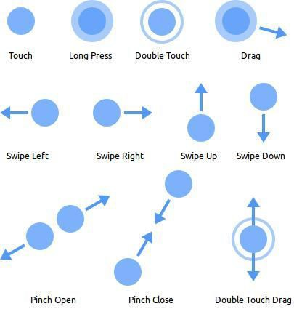
Detecting Common Gestures
 Gestures are motions that trigger interactions
between the touch screen and the user
 They last from the first touch on the screen to the point when the last finger leaves the surface

Slide 32
Responding to Touch Events
 In order to make your view respond to touch events, you must implement the
onTouchEvent() method
 This method receives a MotionEvent object
 Motion events describe movements in terms of an action code and a set of axis values
 For example, when the user first touches the screen, the system delivers a touch event with the action code ACTION_DOWN, the X and Y coordinates of the touch and information about the pressure, size and orientation of the contact area
 The method MotionEvent.getActionMasked() returns the current action being performed (e.g., ACTION_DOWN, ACTION_UP, etc.)

Slide 33
Dragging an Object
 A common operation for a touch gesture is to use it to drag an object across the screen
 To implement a drag operation you need to track the following motion events:
 ACTION_DOWN - A pressed gesture has started, the motion contains the initial starting location
 ACTION_MOVE - A change has happened during a press gesture (between ACTION_DOWN and ACTION_UP). The motion contains the most recent point, as well as any intermediate points since the last down or move event.
 ACTION_UP - A pressed gesture has finished, the motion contains the final release location as well as any intermediate points since the last down or move event.
 ACTION_CANCEL - The current gesture has been aborted. You will not receive any more points in it.
You should treat this as an up event, but not perform any action that you normally would.

Slide 34
Dragging an Object Example
@Override
public boolean onTouchEvent(MotionEvent event) {
int action = MotionEventCompat.getActionMasked(event);
switch (action) {
case MotionEvent.ACTION_DOWN: {
int pointerIndex = MotionEventCompat.getActionIndex(event);
float x = event.getX();
float y = event.getY();
Point pos = convertTouchPosToMazeCell(x, y);
if (pos.equals(playerPos))
isPlayerMoving = true; break;
}
case MotionEvent.ACTION_MOVE: {
if (!isPlayerMoving)
return true;
float x = event.getX();
float y = event.getY();
Point pos = convertTouchPosToMazeCell(x, y);
if (pos.x >= maze[0].length || pos.y >= maze.length) {
isPlayerMoving = false;
}
// Check if this is a free cell
else if (maze[pos.y][pos.x] == 0) {
playerPos = pos; invalidate();
} else {
isPlayerMoving = false;
}
break;
}
case MotionEvent.ACTION_UP:
case MotionEvent.ACTION_CANCEL:
isPlayerMoving = false; break;
}
return true;
}

