Slide 1
Advanced Programming 2
Recitation 10 – Web Applications Server Side Part I
Dor Nisim
2018

Slide 2
ASP.NET
2
Roi Yehoshua, Bar Ilan University

Slide 3

ASP.NET
 ASP.NET is an open-source server-side web application framework developed
by Microsoft
 ASP.NET Core was released in 2016 and merges into one application:
 ASP.NET Web Pages
 ASP.NET MVC
 ASP.NET Web API – API application model

Slide 4
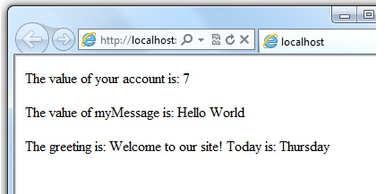
ASP.NET Web Forms
<!-- Single statement blocks -->
@{ var total = 7; }
@{ var myMessage = "Hello World"; }
<!-- Inline expressions -->
<p>The value of your account is: @total </p>
<p>The value of myMessage is: @myMessage</p>
<!-- Multi-statement block -->
@{
var greeting = "Welcome to our site!";
var weekDay = DateTime.Now.DayOfWeek;
var greetingMessage = greeting + " Today is: " + weekDay;
}
<p>The greeting is: @greetingMessage</p>

Slide 5
Web API
5
Roi Yehoshua, Bar Ilan University

Slide 6
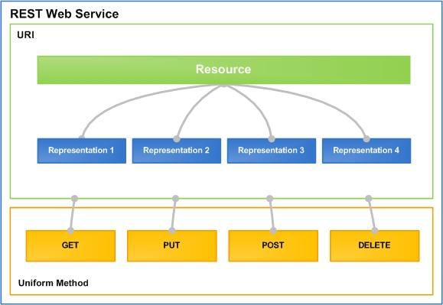
RESTful Services – Why ?
 Loose Coupling
 Resources are represented as disconnected state
 Scalability
 State is cacheable and moveable
 Interoperability
 HTTP-based
 JSON, XML
 Intuitive and flexible uniform URL syntax
 Proven to work – World Wide Web
 Trade-off – No WS-* Support

Slide 7
ASP.NET Web API
 A platform for building RESTful services using the .NET framework
 Reaches broad range of clients, including browsers and mobile devices
 Is based on the foundation of ASP.NET MVC
 A service is implemented as a Controller
 Allows for tight control over HTTP details
 Such as security, caching, etc.
 Documentation available at https://www.asp.net/web-api

Slide 8
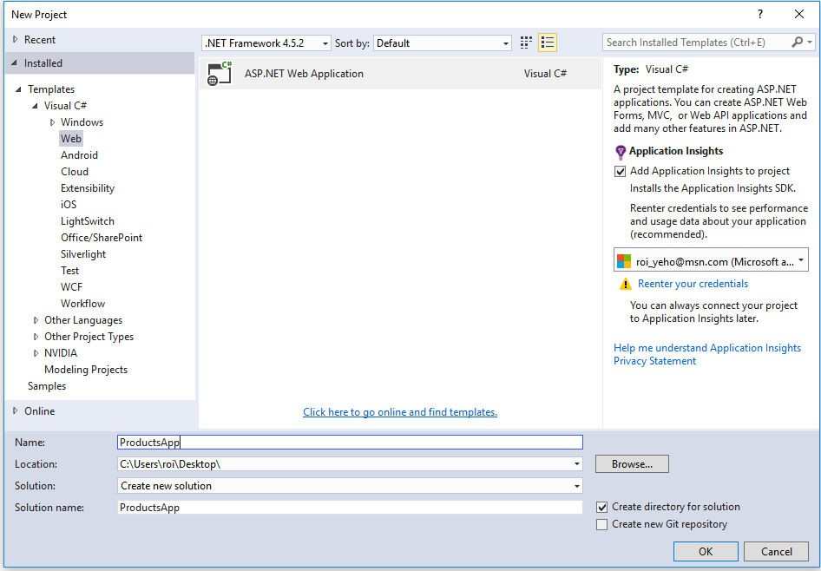
Create a Web API Project

Slide 9
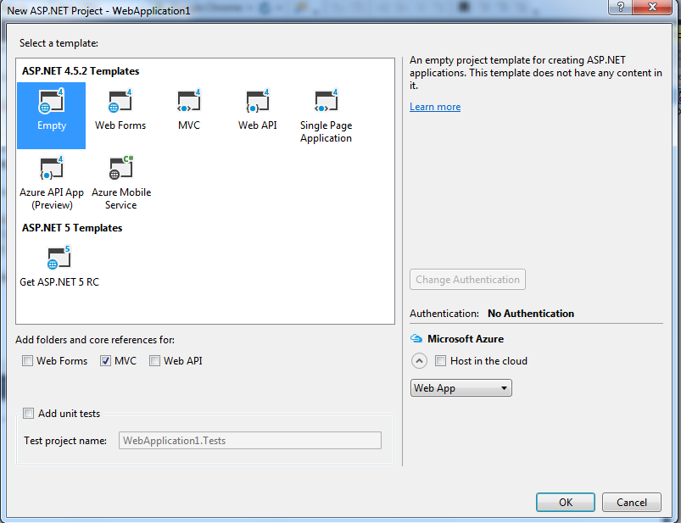
Create a Web API Project

Slide 10
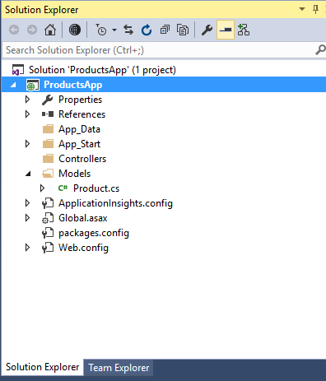
Web API Project Structure
 App_Data – contains the data files (e.g., .mdf files)
 App_Start – contains startup tasks (e.g., defining the
routing table)
 Controllers – the Controller layer
 Models – the Models layer
 Global.asax - an optional file that contains code for responding to application-level events raised by ASP.NET, e.g., Application_Start
 Web.config – the main settings and configuration file for an ASP.NET web application

Slide 11
Adding a Model
 A model is an object that represents the data in your application
 ASP.NET Web API can automatically serialize your model to JSON, XML, or some
other format, and write the serialized data into the HTTP response message.
  Let's create a simple model that represents a product
 In Solution Explorer, right-click the Models folder
 From the context menu, select Add then select Class
public class Employee
{
public int ID { get; set; }
public string FirstName { get; set; }
public string LastName { get; set; }
public int Salary { get; set; }
public string Phone { get; set; }
public string Email { get; set; }
}

Slide 12
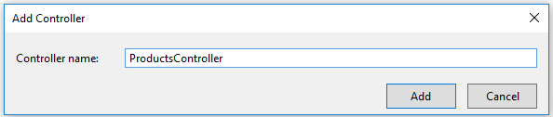
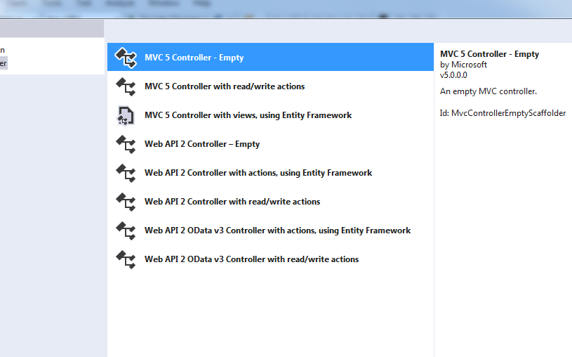
Adding a Controller
 In Web API, a controller is an object that handles HTTP requests
 The public methods of the controller are called actions
 When the Web API framework receives a request, it routes the request to an action
 We'll add a products controller that will enable
the user to get the list of products or add a new product
 In Solution Explorer, right-click the Controllers folder
 Select Add and then select Controller
 In the Add Scaffold dialog, select MVC 5 Controller - Empty.
Click Add.
 In the Add Controller dialog, name the controller "ProductsController". Click Add.
 The scaffolding creates a file named ProductsController.cs in the
Controllers folder.

Slide 13
Adding a Controller
public class FirstController : Controller
}
static List<Employee> employees = new List<Employee>();
// GET: First
public ActionResult Index()
}
return View();
{
[HttpPost]
public ActionResult Create(Employee emp)
{
employees.Add(emp);
return RedirectToAction("Details");
}
}
If there is an attribute applied via [HttpGet], [HttpPost], [HttpPut], etc, the action will accept the specified HTTP method

Slide 14
Routing and Action Selection
 To determine which action to invoke, the framework uses a routing table
 The Visual Studio project template for MVC 5 creates a default route:
routes.MapRoute(
name: "Default",
url: "{controller}/{action}/{id}",
defaults: new { controller = "First", action = "Index", id = UrlParameter.Optional }
);
 Each entry in the routing table contains a route template
 For example, the following URIs match the default route:
 /First/Index
 To find the controller, MVC 5 adds "Controller" to the value of the {controller} variable.
 To find the action, MVC 5 looks at the HTTP method, and then looks for an action whose name begins with that HTTP method name
 Placeholder variables such as {id} are mapped to action parameters

Slide 15
RAZOR
16
Roi Yehoshua, Bar Ilan University

Slide 16
Razor
Markup syntax that lets you embed server-based code (Visual Basic and C#) into web pages.
Razor uses a syntax very similar to PHP and Classic ASP.
<ul>
@for (int i = 0; i < 10; i++) { <li>@i</li> }
</ul>

Slide 17
Razor
Razor code blocks are enclosed in @{ ... }
Inline expressions (variables and functions) start with @
Code statements end with semicolon
Variables are declared with the var keyword
Strings are enclosed with quotation marks
C# code is case sensitive
C# files have the extension .cshtml

Slide 18

Razor
<!-- Single statement block --> @{ var myMessage = "Hello World"; } <!-- Inline expression or variable --> <p>The value of myMessage is: @myMessage</p> <!-- Multi-statement block --> @{ var greeting = "Welcome to our site!"; var weekDay = DateTime.Now.DayOfWeek; var greetingMessage = greeting + " Here in Huston it is: " + weekDay; } <p>The greeting is: @greetingMessage</p>

Slide 19
If and Else Conditions
An important feature of dynamic web pages is that you can determine what to do based on conditions.
@{ var txt = ""; if(DateTime.Now.Hour > 12) {txt = "Good Evening";} else {txt = "Good Morning";} } <html> <body> <p>The message is @txt</p> </body> </html>

Slide 20
Reading User Input
@{ var totalMessage = ""; if(IsPost) { var num1 = Request["text1"]; var num2 = Request["text2"]; var total = num1.AsInt() + num2.AsInt(); totalMessage = "Total = " + total; } } <html> <body style="background-color: beige; font-family: Verdana, Arial;"> <form action="" method="post"> <p><label for="text1">First Number:</label><br> <input type="text" name="text1" /></p> <p><label for="text2">Second Number:</label><br> <input type="text" name="text2" /></p> <p><input type="submit" value=" Add " /></p> </form> <p>@totalMessage</p> </body> </html>
Another important feature of dynamic web pages is that you can read user input.
Input is read by the Request[] function

Slide 21
Redirecting To pages
public virtual string Action(string actionName, string controllerName )
Generates a fully qualified URL to an action method by using the specified action name and controller name.
Can be used for redirection:
Response.Redirect(Url.Action("Details", new { id = Model.ID }));
@Url.Action("someaction", "somecontroller", new { id = "123" })
/somecontroller/someaction/123

Slide 22
ViewBag
Enables you to dynamically share values from the controller to the view.
public ActionResult Index() {
ViewBag.MyMessageToUsers = "Hello from me.";
ViewBag.AnswerText = "Your answer goes here.";
return View();
}
@ViewBag.MyMessageToUsers @Html.TextBox("AnswerText")
Enables you to dynamically share values within a session (Multiple Pages)
@{
Session["a"] = "foo";
}
<h1>@Session["a"].ToString()</h1>

Slide 23
Local File Path
In order to read a file within a web server, we need to specify an absolute path.
The following code maps a given local path of a file in the solution to an absolute path:
public class SampleClass
{
public string GetFilePath()
{
return HttpContext.Current.Server.MapPath("/UploadedFiles");
}
}

Slide 24
Displaying an Image Album
https://getbootstrap.com/docs/3.3/components/#thumbnails
https://www.w3schools.com/bootstrap/bootstrap_images.asp

Slide 25
AJAX
16
Roi Yehoshua, Bar Ilan University

Slide 26
AJAX
 Asynchronous Javascript And XML
 A combination of technologies
 XML – data exchange (+ JSON, HTML & plain text)
 JavaScript –XMLHTTPREQUEST object (XHR)
 Send & receive data on the background
 Parts of the page are "refreshed͞
 Smoother – no need to wait for a new page to load
 Requires neither XML nor async requests

Slide 27
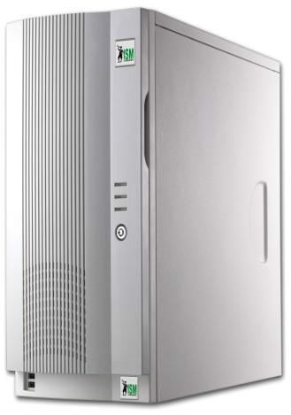




Classic vs. AJAX Web Architectures
Classic Web Architecture
Web Server
Browser
HTML 1
HTTP Request
HTML 2
HTTP Response
AJAX Web Architecture
Web Server
Browser
HTML
HTTP Request
HTTP Response
18

Slide 28
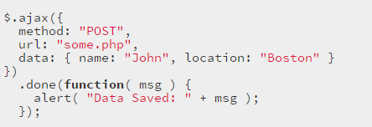
AJAX & jQuery
 .ajax()
 The main AJAX method
 Provides precise control over your Ajax call
 GET or POST method
 Error callback
 Different formats of data
 AJAX Shortcuts
 .get() – Load data from the server using a HTTP GET request
 $.getJSON() – Gets a JSON object from the server using a HTTP GET request
 .post() - Load data from the server using a HTTP POST request
 .load() - Load data from the server and place the returned HTML into the matched
element

Slide 29
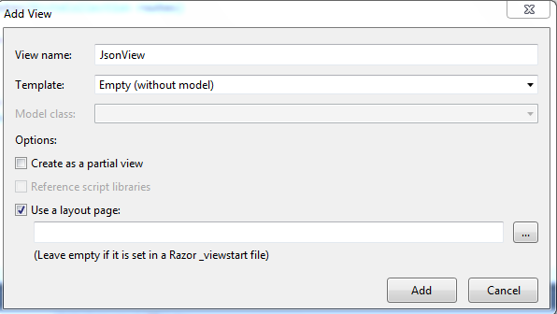
Calling the Web API with Javascript and jQuery
 In this section, we'll add an HTML page that uses AJAX to call the web API
 In Solution Explorer, right-click the Controllers Directory and select Add, then select View
 Then write the view name , choose the Empty option, and click Add

