Slide 1

Project I.P.G
Intelligent Program Generator

Slide 2
IllegalSkillsException
A little about our self:
We are students of the Math department.
Work distribution:
Our work was divided to three parts: theory,algorithmic,datasets.
Members: Efraim Vagner, Yoav Ben Azar, Or Vardi, Sean Zaretzky, Avi Kadria

Slide 3
Research Question
Is it possible to create a new virus program using DL and a family of known viruses?

Slide 4
Work process
We decided to take an easier problem
The new problem was to generate code using a large dataset of code files

Slide 5
Results
Legitimate assembly codes.
C++,python and C code.
The ChessApple.

Slide 6
Computing results
After entering many files in C to our neural networks
main() {
int a=0;
a = 92 + 88 / 29 * 17 * 35 + 5;
printf(" a = %d",a);}

Slide 7
Computing problems along the way
We had many problems among the way:
It took us a lot of time to find the DL algorithm we needed.
We didn’t found a compatible datasets.
We had problem that the runtime was enormous

Slide 8
Insights
we can infer that it is indeed possible to let the computer build us a program, in specific it could be used to get a new virus from existing ones.
The idea is to send our DL code a lot of permutations of a viruses and he will be able to create a new better one,

Slide 9
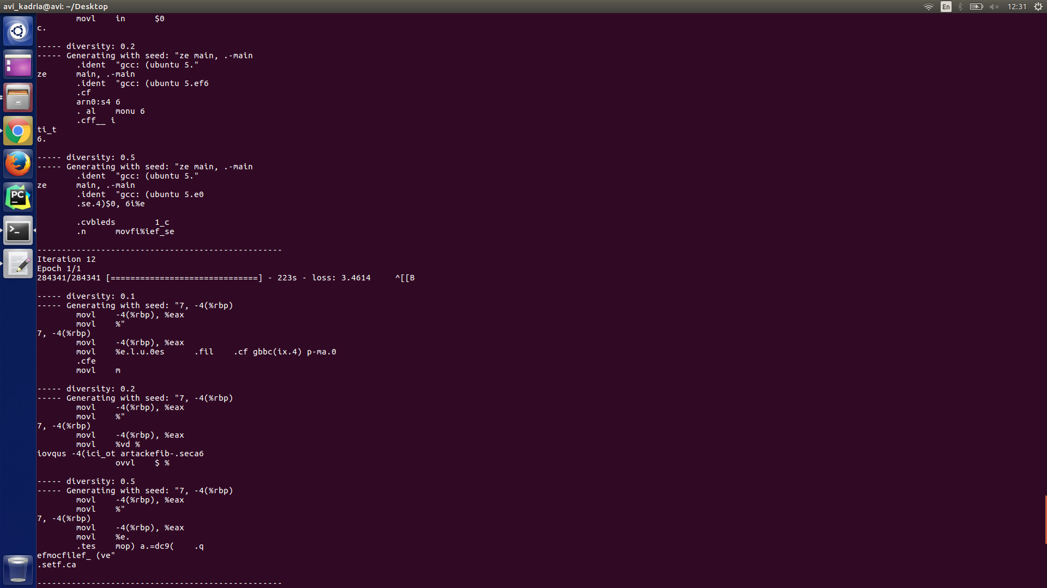
More computing results
Runtime example:

Slide 10
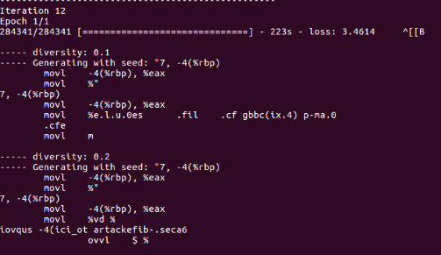
More computing results
More Assembly Runtime example:

Slide 11
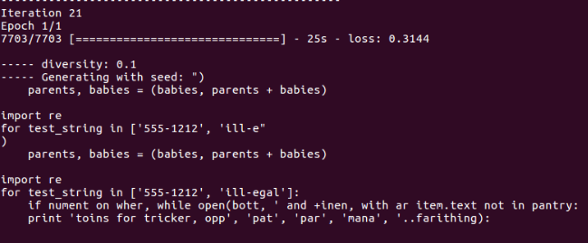
More computing results
More python Runtime example:

