Slide 1
Language Learning Quiz Application
Name- Avikam Bir
Roll No. - 2210990198

Slide 2
Introduction
Brief overview of the Language Learning Quiz Application.
Importance of learning vocabulary in a new language.
Introduction to the quiz format.
The Language Learning Quiz Application is designed to make learning vocabulary in a new language both accessible and enjoyable.
Learning a new language can be challenging, but with the right tools and approach, it becomes an exciting journey of exploration and discovery.
Our application aims to provide users with an interactive and dynamic platform to practice vocabulary, focusing on Spanish-English translations.
Through consistent practice and exposure to vocabulary in context, users can build a solid foundation for language proficiency.

Slide 3
Objective
To help users learn Spanish-English vocabulary effectively.
To provide an interactive and engaging learning experience.
To track user progress and enhance retention through repetition.
Foster a fun and engaging learning environment that motivates users to actively participate in vocabulary practice.
Offer a convenient way for users to reinforce their understanding of Spanish-English translations through a quiz format.
Facilitate active recall and repetition, two essential components of effective vocabulary acquisition.
Enable users to track their progress over time, providing them with a sense of accomplishment and motivation to continue learning.
Ultimately, our goal is to empower users to develop confidence and fluency in Spanish-English vocabulary, laying the groundwork for broader language and communication skill.

Slide 4
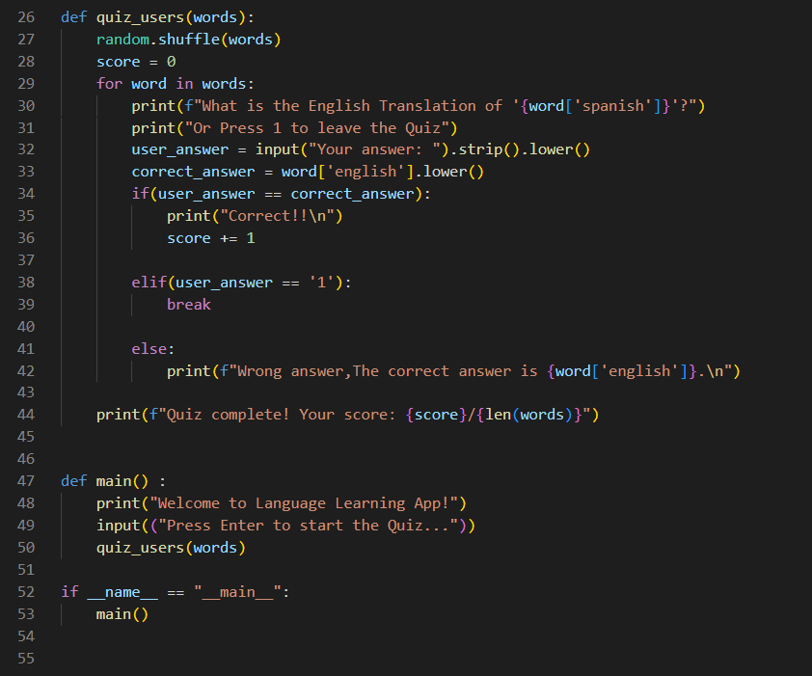
Code Snippet

Slide 5
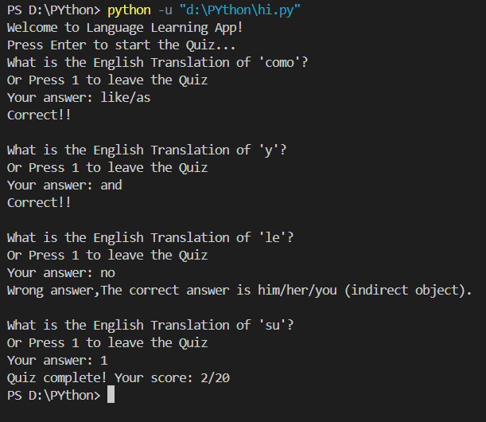
Output

Slide 6
Conclusion
Recap of the Language Learning Quiz Application's key features.
Encouragement for regular usage for effective learning.
Future enhancements and potential features (e.g., additional languages, difficulty levels).
Invitation for feedback and suggestions.

