Slide 1



Alpha Code Analyzer: TCS Al Hackathon
TATA CONSULTANCY 6ERVICES
Automated, multi-source code review and optimization.
Avikanshit Dogra
Team Alpha (TCS Al Hackathon) - 30/04/2026
Members: Soham Surya Ankit Vishal Gavin

Slide 2


Alpha Code Analyzer - Architecture
RAG-Powered Al Code Review & Analysis Assistant
II
�
1. INPUT SOURCES
2. INGESTION & PREPROCESSING
3. ROUTING DECISION
4. RAG PIPELINE (For Large Code)
Paste Code Manual input
D
File Discovery
Walk directory/ parse repo
collect files
4.1 Code Splitting 4.2 Embeddings ^{4.3 Vector Store} :k * @ CodeAwareTextSplitte, _{OpenAI Embeddings} FAISS f,n-memory) chun.k.s:i.2e := 1500 _{(te,xt ..emoodding-ada-002} Store vector chun"-overfap = 200 representations
 | 4.4 Retrieval � Similarity Search Top-K relevant chunks (k = 8)
Upload File Single code file
♦
Total Characters
<= MA)(_TOTAL_CHARS (800,000)?
T
File Filtering
Keep only supported
Upload Folder (ZIP) Extract & read files
•
�
code extensions
YES
(Small Code)
NO
(Large Code)
0
GitHub Link
Repo/ path/ branch
(i)
Size Check
Skip files> MAX_FII.E_SIZE_K8
•
a"₀
(5,000 KB)
DIRECT PIPELINE
Use entire code as conteX't
RAG PIPELINE
Retrieve only
relevant chunks
Custom GitHub Link
+ Requirements
Safe Read Read withutf-8,
m
�
•
Explain GitHub Link
ignore errors
.
Aggregation Combine all files with
FILE: <path>" header
5. PROMPT BUILDER (Task-Specific)
'..- -----------------------..
�
'Q. '.,
Suggestions
ln•de:l'M .ction� ifflfll'OYtmitnt su�stions
@- ]
Full Review fk,gs,.;,tC!,lrily,pe,1�. ptOjoc:tstwKlatd\,gran'lfflM,
ethks..6'dli1ecture,
qua,1ity & suucture
w
i, �� Context Assembler i,
·o
.
fl
Enhance Code
l�re�. perlonn.anco•nd bHt prac:t�·
�
Custom
-1
Combine retrieved chunks into context for the prompt
!,
... ------••-•---L•••••••-•-•-••--• \
I �n�Tens
Gtntr•t��nSNt
tfft eases with edge
<:aS-e$•
-·-
!
!
I
; GitHub API
:
Fi�
�IXal� .ind rowm ONLy the conected cod•
Expl.ain
l
l,. ,.
i
.......
Resolve default branch
j
Anw,erC\1$1om
E)(J',blnan:hitoctur�.
- ---••••--••••••-'
,
Get repository ttee (recursive) ,
requirem,eM$ Jribout
�&:men
l
l. - -
Fetch filecontents (blobs} :
)
KEY FEATURES
6L.LM LAYER
7. SUPPORTING SERVICES
Configuration
API keys, base URLs. model settings
Error Handling
Graceful failures & user feedback
Caching (Future)
Cache embeddings/ FAISS index per repo hash
Rate Limit Handling GitHub API limits & retries
O Multiple Input Options (Paste. File, ZIP. GitHub. Custom, Explain)
0 Smart File Filtering & Size Limits
O Automatic Routing (Direct/ RAG)
0 Code-Aware Chunking
0 Semantic Search with FAISS
0 Task-Specific Prompts for Different Actions
0 Powered by GPT-4o via Custom Endpoint
0 Streamlit Based Modern UI
ChatOpenAI (GPT-4o) Base URL: https:J/genailab.tc•.in
Model : azure/genailab•maas--gpt-.4o
Temperature: 0.2
Stateless API Invocation
i-·-----►
-----------:
i
r------•
i
8. OUTPUT LAYER
Response formatter � Format LLM output (Matkdown / Code) |  | _{y} Streamlit UI _{l} Display results in beautiful UI | User Download/ Copy � Copy code/ Download results
r-'-----►
'
◄----L------►
+
•••
.
• • End User
..
-� ����-�-:-=-
��:�o:I�:_���::' . ._':�:�
'
-��t:�_ :�- :: :---�- _
�����t��- -�r=:�s��� . ����_ :����:�� .. :_��:_��r�- �_ ��� .._��:�:. ,;

Slide 3







USE CASES - Real Impact Across TCS Domains
TATA CONSULTANCY SERVICES
Al Code Assistant delivering tangible value in real-world TCS projects
D Banking & Financial Services (BFSI) El IT Services/ Large Codebase Maintenance
El
Manufacturing &
Automation Systems
0 Problem 0
Legacy Java/Python codebases Manual code reviews take weeks
High risk of bugs in transaction systems
Problem
Multiple teams working on same repository Inconsistent code quality Code review bottlenecks
0 Problem
Embedded & control system code Bugscan cause real-world failures
0
Our Solution
Auto-analyze legacy code Suggest improvements
Generate test cases for critical flows
0 Our Solution
Al-powered pre-review assistant Standardized suggestions
Auto-enhancement of code quality
0 Our Solution
Static analysis + bug detection Edge-case test generation
Clients:
OSBI
0 Impact
Faster release cycles Reduced production bugs Cost savings in QA
0 Impact
Uniform coding standards Reduced review load
Better developer onboarding
Clients:
0 Impact
Reduced system failures Better reliability
Safer deployments
TATA MOTORS
a Cloud Migration Projects
EJ
Developer Productivity Tool (Internal TCS)
Secure Code Review (Cybersecurity)
0 Problem
Old monolithic code ➔ cloud-native Poor documentation &
outdated patterns
0 Problem
New hires struggle with largecodebases
Time wasted understanding code
m
0 Problem
Security vulnerabilities missed in manual reviews
�
0 Our Solution
Code enhancement suggestions Refactor recommendations Identify outdated patterns
0
Our Solution
Al explains code
Suggests improvements instantly
Generates testsautomatically
0 Our Solution
Detect risky patterns Suggest secure alternatives
0 Impact
Faster migration
Better cloud-ready code Reduced rework
0 Impact
Faster onboarding Better understanding
Reduced dependency on seniors
0 Impact
Improved security posture
Fewer vulnerabilities Compliance-ready code

Slide 4
Bottlenecks in Manual Code Reviews
Missed Logic Errors
Human reviewers frequently fail to catch subtle logic errors or complex edge cases, particularly when operating under high-pressure, tight release
cycle deadlines.
Complexity Limits
Teams struggle to maintain high standards of code review quality as the size of the repository
grows and the underlying system architecture becomes more complex.
Technical Debt
Legacy codebases remain unoptimized because the manual effort required to refactor or rewrite problematic segments is prohibitively high for current engineering teams.
Context Switching
Developers lose their flow state while waiting hours or even days for feedback on simple syntax or logic improvements, drastically reducing overall output velocity.
Engineering teams currently face a significant review tax, where manual code analysis consumes 30% of total development time, stalling productivity and preventing consistent quality acrosscomplex,growing codebases.

Slide 5
Introducing the Alpha Code Analyzer Solution Overview
Direct LLM Logic
Utilizing advanced LLM capabilities to provide sophisticated reasoning on complex logic directly within the development environment.
Universal Inputs
The system features flexible ingestion capabilities, seamlessly handling inputs ranging from single pasted functions to full GitHub repositories.
Specialized Flow
Access dedicated workflows for fixing, testing, and optimizing code, streamlining development tasks with efficient single-click actions.
Fast Feedback
Accelerating the development process significantly by reducing the time-to-insight for code analysis from hours down to mere seconds.

Slide 6

Core Modules
The application is structured around five core actions, each utilizing specialized prompts to extract the best possible results from the LLM.
e
Q
e
G)
e
Detects syntax errors and logical bugs, returning
corrected code.
Produces test cases focusing on boundary and edge conditions.
Analyzes bottlenecks and suggests optimizations for efficiency.
Provides improvementsregarding readability and best practices.
Deep-dive analysis combining bugs, strategies, and
quality scores.

Slide 7
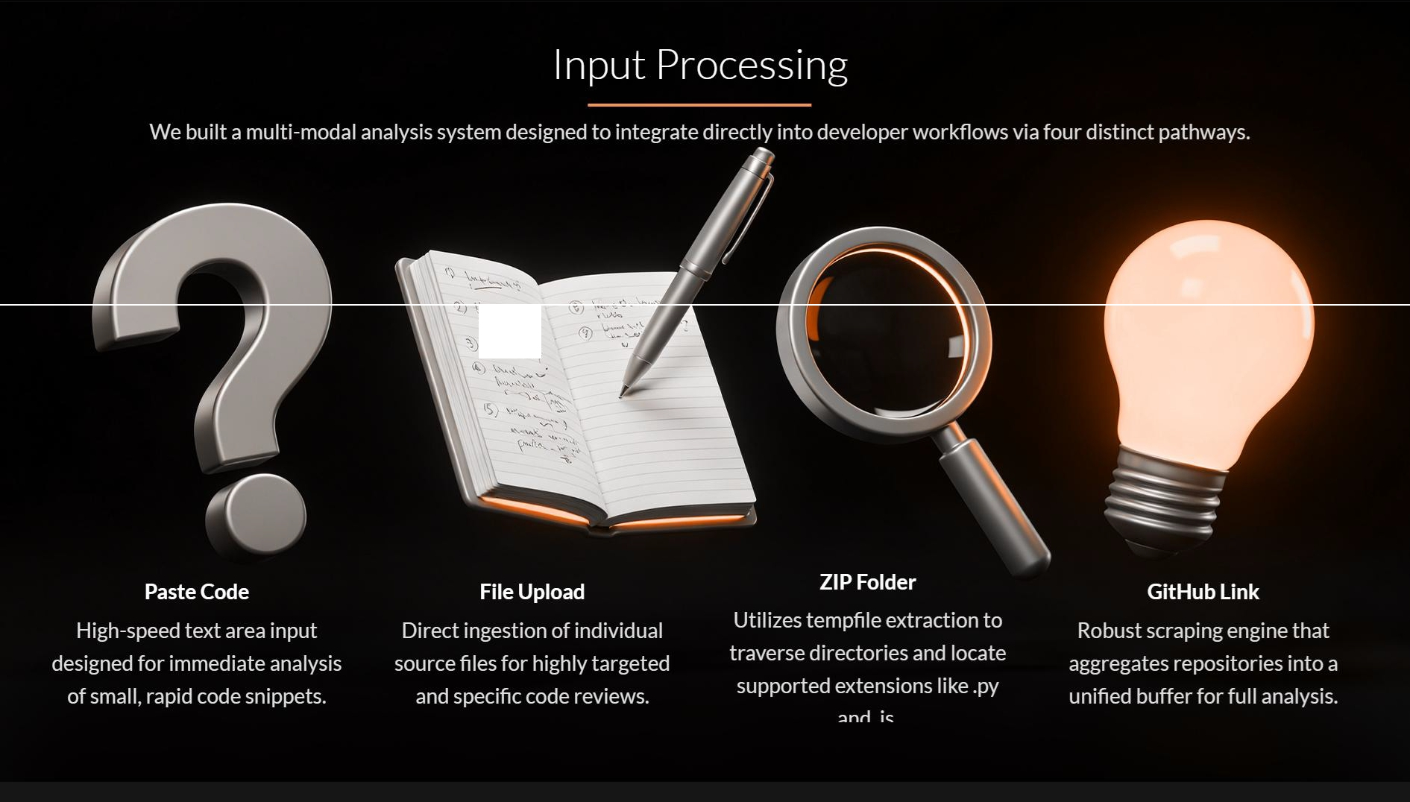
,....�..�>,,<...._{s}.,. ,
\'-.-- """<>

Slide 8

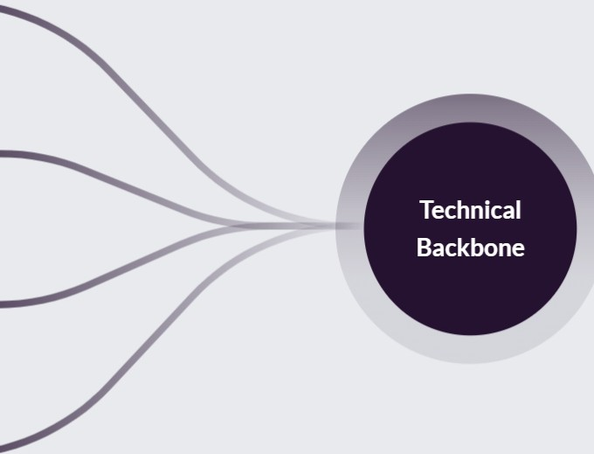

Alpha Code Analyzer: Technical Stack and Core Infrastructure
UI Layer
Streamlit provides responsive dashboards
Orchestration
LangChain manages prompts and LLM communication
Intelligence
Azure GPT-4o ensures deterministic output
Connectivity
Custom httpx ensures secure enterprise calls

Slide 9
GitHub Fetcher
Technical overview of automated repository ingestion and processing without requiring local clones.
•URL Normalization
•Branch Detection
•Resource Optimization
•Data Aggregation
System automatically cleans | The fetcher intelIigently | Using TemporaryDirectory | Thousands of lines of code
user inputs, correctly | resolves the primary branch | and ZipFile minimizes local | across nested directories
handling .git suffixes and | by sequentially checking | disk usage by processing | are flattened into a single,
specific branch or blob flle | standard defaults, | only relevant source flies | LLM-readable context
paths to ensure accurate | specifically prioritizing main | like .java,.cpp, and .ts | window to enable
repository targeting. | or master branch | formats efficiently. | comprehensive cross-
 | references. |  | file analysis.

Slide 10
Dev Experience Shift
Alpha Code Analyzer improves speed, consistency, and coverage while reducing senior developer hours spent on manual reviews, elevating oversight capabilities.
Feature
Manual Review
Alpha Code Analyzer
Speed
30+ Minutes
~15 Seconds
Consistency
Subjective/Human Error
High/Deterministic
Scope
Limited focus
Full Repository
Unit Tests
Often skipped
Instant Generation
Cost
High Dev Hours
Low API Tokens

Slide 11
Future Engineering Excellence
By combining Streamlit UI with GPT-4o reasoning, the Alpha Code Analyzer reduces maintenance overhead, ensures high code quality, and accelerates development timelines to ship better code faster.

Slide 12
Open to questions!
Thank You

