Slide 1
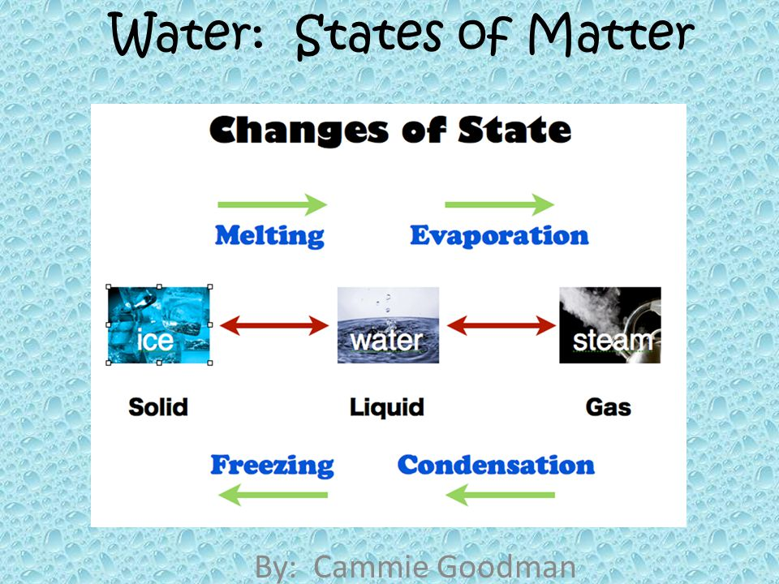
WATER
W.Ostwald stated that almost all the chemical processes which occur in nature, takes place among solutions in water’ thus water is elixir of life.
Water is found as natural water and treated water.
In the free state it occurs as solid(ice, snow, frost),liquid state(water)and Gaseous state(water vapour, clouds, mist and fog)
Water occurs in the combined form in all living matter i.e plants and animals.
Water is present in hydrated salts eg MgCl₂ .6H₂O and certain minerals.

Slide 2
Water cycle
Water evaporates from the surface of the Earth and falls back to the surface in the form of rain water.
Water is a compound and not an element as properties of water are different from its individual elements.

Slide 3
WATER IS A UNIVERSAL SOLVENT
Water has the ability to dissolve a large number of substances e.g. salts, sugar etc. It also dissolves a large number of gases e.g. Hydrogen chloride, ammonia etc. Hence water dissolves almost every common substance and is therefore called a UNIVERSAL SOLVENT.
Solvent: Liquid [generally water] or medium of dissolution which allows the solute to dissolve in it as to form a solution is called a solvent.
Solute: Substance which dissolves or disappears in the solvent to form a solution.
Solution: a homogenous mixture of a solute in a solvent.[i.e. a uniform mixture of two or more substances] whose composition maybe gradually changed by changing the relative amount of the components.

Slide 4
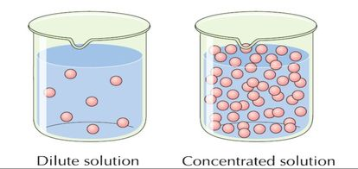
TYPES OF SOLUTIONS
Dilute solutions | Concentrated solutions
A solution in which the amount of solute is relatively small | A solution in which the amount of solute is relatively large
Compared to the amount of solvent in a given mass of it. | Compared to the amount of solvent in a given mass of it.
Less solute
More solute

Slide 5
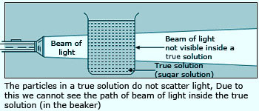
TRUE SOLUTIONS
It is clear and transparent and homogenous in nature.
The particles can pass through filter paper but cannot be seen under a microscope and do not settle down.
Solute can be separated from the solvent by physical means (evaporation) and not by chemical means.
So we can say that a true solution is therefore a mixture and not a compound.

Slide 6
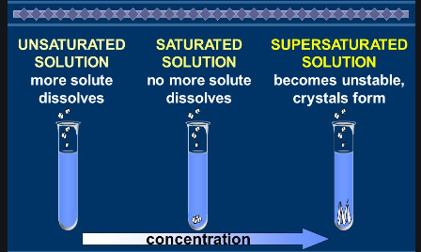
Solutions
Unsaturated solution | Saturated solution | Super saturated solution
it can dissolve more of the solute at a given temperature. | it cannot dissolve more of the solute at a given temperature | it contains more of the solute at a given temperature than that present in a saturated solution
A saturated solution can be converted to unsaturated solution
by heating the saturated solution slowly.
by adding more of the solvent at that temperature.

Slide 7
Solubility
The solubility is the ability of a solute to dissolve in a particular solvent.
The solubility of a solute in a solvent at a particular temperature is the maximum amount of the solute in grams that will saturate 100 g of the solvent at that temperature.
Solubility of solids changes with temperature.
The solubility of some salts increases with temperature.eg.KNO₃,KClO₃
The solubility of some salts increases slightly with rise in temperature. eg. NaCl, KCl
The solubility of some salts decreases with temperature.eg. CaSO₄
Solubility of solids is independent of change in pressure.

Slide 8
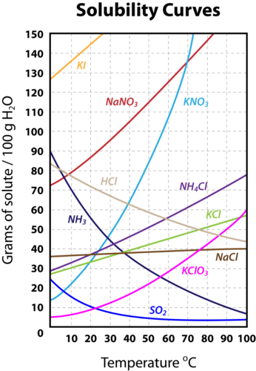

Slide 9
Applications for uses of Solubility Curves
Medical: Enables a pharmacist to determine the amount of drugs that must be dissolved together in a given quantity of solvent at different temperatures.
Chemists and Research workers: Enables them to determine the most suitable solvents to be used at various temperature for extraction of essential chemicals
from their natural sources.
Separation and purification of solvents: When a saturated solution of a given mixture of solutes is cooled, those fractions with very low solubilities will be first to crystallize out from the solution.
So, Solubility curves can be used :
To determine Solubility of a given solute at a particular temperature.
To compare solubilities of different solutes in a solvent at a given temperature.
To calculate the amount of substance which will crystallize out when a hot saturated solution is cooled at a lower temperature.

Slide 10
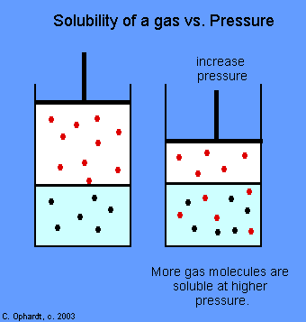
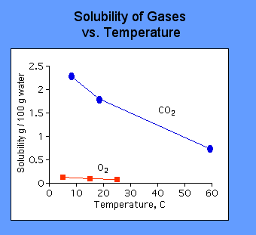
Factors affecting solubility of gases
Increase in pressure on surface of water causes increase in solubility of gas in water.
2. Increase of temperature of water causes decrease in solubility of gas in water.
If the pressure is increased, the gas molecules are "forced" into the solution since this will best relieve the pressure that has been applied. All carbonated beverages are bottled under pressure to increase the carbon dioxide dissolved in solution. When the bottle is opened, the pressure above the solution decreases. As a result, the solution effervesces and some of the carbon dioxide bubbles off.
Increased temperature causes an increase in kinetic energy. The higher kinetic energy causes more motion in molecules which break intermolecular bonds and escape from solution. Boiled water also tastes "flat" because all of the oxygen gas has been removed by heating.

Slide 11






CRYSTALLISATION
When a hot saturated solution is cooled the excess solid is thrown out in the form of particles having definite shape called crystals and the process is called crystallisation.
Crystals are homogenous solids, arranged symmetrically.
Crystals are bounded by plane surfaces, meeting at sharp edges at definite angles to one another.
Conditions for crystallisation
1)the hot saturated solution should be cooled slowly followed by slow evaporation.
2)Rapid cooling of a hot saturated solution results in formation of amorphous solids instead of well defined crystals

Slide 12
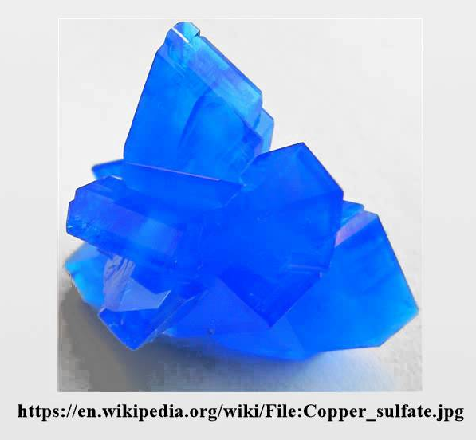
WATER OF CRYSTALLISATION
The fixed number of water molecules which enters into loose chemical combination with the substance when the substance is crystallised from its hot saturated solution is called water of crystallisation.
It is responsible for geometric shape and colour of crystals.

Slide 13
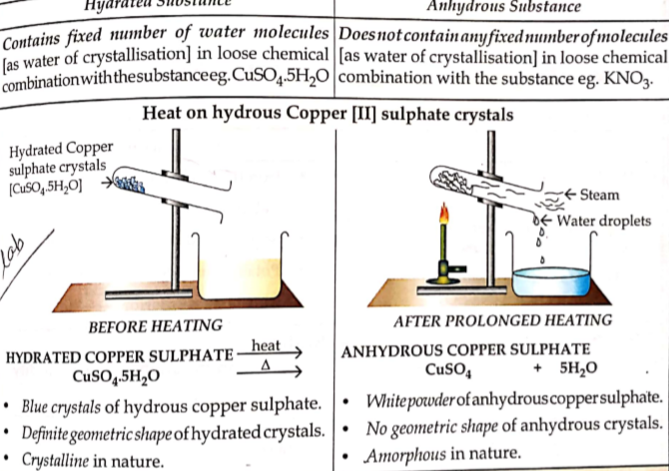

Hydrated substances | Anhydrous Substances
contain fixed number of water molecules in loose chemical combination. | do not contain any fixed number of molecules in loosecombination.eg.KNO3
Can release water vapour upon heating. | Do not release water vapour upon heating.

Slide 14
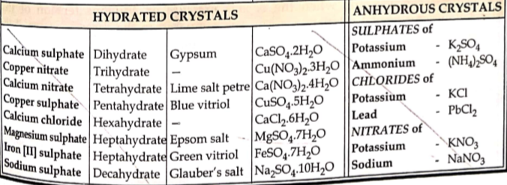

Slide 15
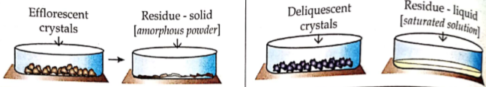
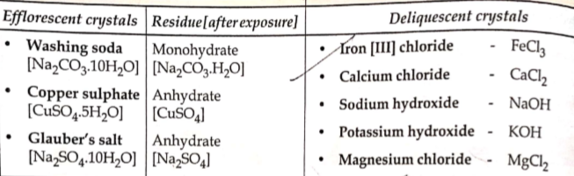
Efflorescent and Deliquescent Substances
Efflorescent Substances | Deliquescent Substances
Crystalline hydrated salts which on exposure to air lose their moisture partly or completely to the atmosphere and change into amorphous state | Water soluble salts which on exposure to atmosphere absorb moisture and dissolve in the absorbed moisture and change into liquid state
The process is efflorescence. | The phenomenon is called deliquescence.

Slide 16
Vapour pressure: Whenever the liquid evaporates, the gaseous molecules formed will escape in the air. But, if the liquid is kept in a closed container, the gaseous molecules will not escape in the air but will remain above the liquid. Those evaporated particles will create a pressure above the liquid, which is then known as the vapour pressure.
Vapour pressure of hydrated salt
Vapour pressure of atmospheric humidity
Efflorescence occurs
Efflorescence is minimum during humid conditions.
Vapour pressure of deliquescent salt
Vapour pressure of atmospheric humidity
Deliquescence occurs
Deliquescence is minimum during dry conditions.
NOTE: Common salt turns moist on exposure to air
Common salt is not deliquescent but contains small amounts of calcium and magnesium chloride impurities which are deliquescent.
hence the impurities absorb moisture from air, thereby turning common salt sticky and wet.

Slide 17
HYGROSCOPIC SUBSTANCES
When materials are said to be hygroscopic, they tend to have the ability of absorbing moisture or more precisely water vapour from the environment and retaining that water vapour within them. It can be via a mechanism of ‘adsorption’ or ‘absorption.’ When it is ‘adsorbed’, the water molecules remain on the surface of the substance whereas, when it is ‘absorbed’, the water molecules are taken up through the molecules of the substance. This absorption of water vapour can give rise to various physical differences within the substance.
Deliquescence: This is an extreme case of the hygroscopic activity where the materials absorb water vapour (moisture) from the air until the point that they dissolve in the absorbed water turning into a solution.
Hygroscopic substances absorb moisture from the atmosphere when exposed to it but unlike deliquescent substances do not change their state
Deliquescent have a higher affinity to water than hygroscopic substances.
Hygroscopic substances may be amorphous solids or liquids.
Examples-Quicklime, anhydrous CaCl₂,P₂O₅,silica gel are solids.
Conc. H₂SO₄ is a liquid

Slide 18
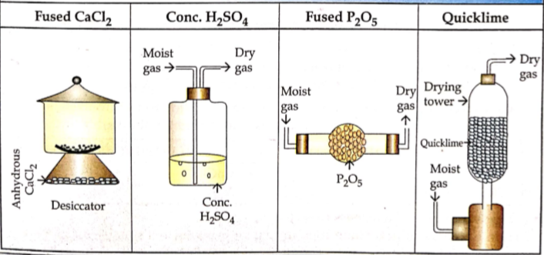
DRYING AND DEHYDRATING AGENTS
Drying agents readily absorb or remove moisture from other substances.
Eg-Fused/Anhydrous CaCl₂ is used in a dessicator.
Dehydrating agents-remove chemically combined water or elements of water from compounds due to their strong affinity for water.
Eg-Conc H₂SO₄ being hygroscopic in nature acts both as a dehydrating agent and also as a drying agent.
Examples of Drying agents

Slide 19
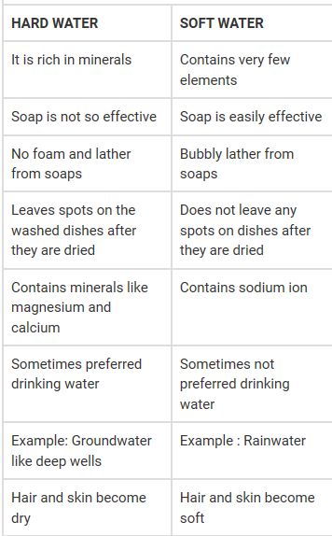

Slide 20
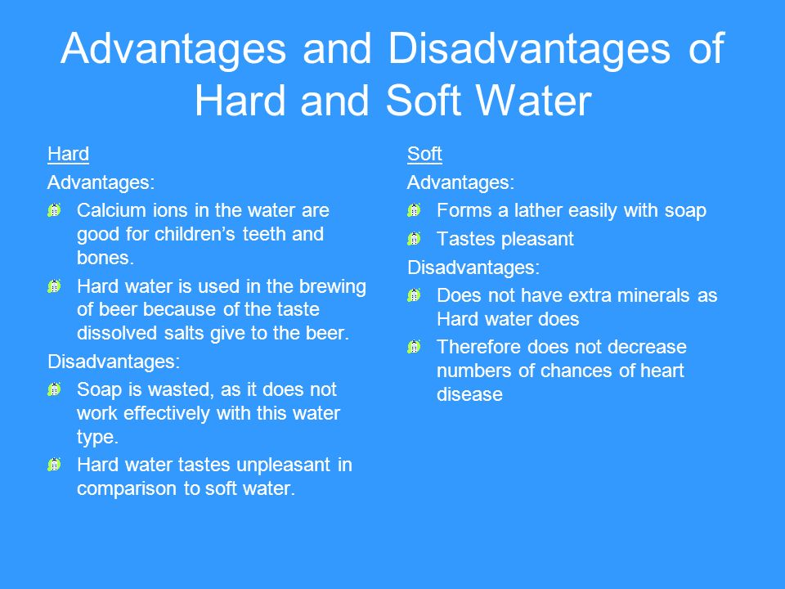
Disadvantages of hardness in water:
Unfit for laundries
Not suitable for preparing solutions
For industrial uses since it forms a crusty boiler scale or fur in boilers.

Slide 21
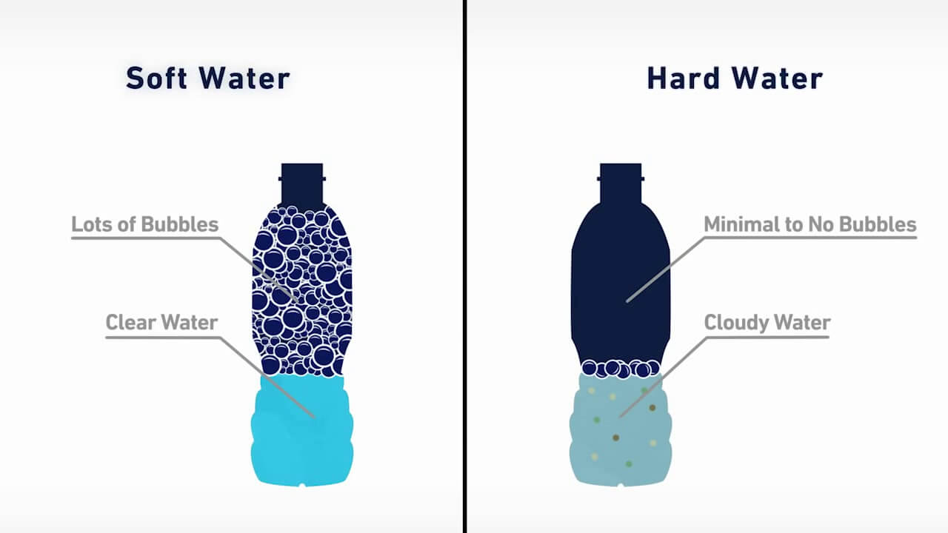

Slide 22
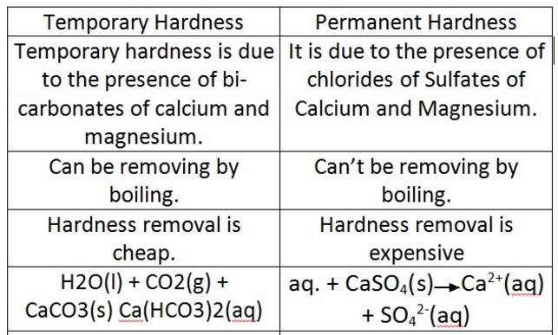
Water is said to be hard when it doesn’t lather readily with ordinary soap and hence wastes soap. Eg-Springs and river water
Water is said to be soft when it lathers readily with ordinary soap and hence does not waste soap. Eg-rain water and distilled water

Slide 23
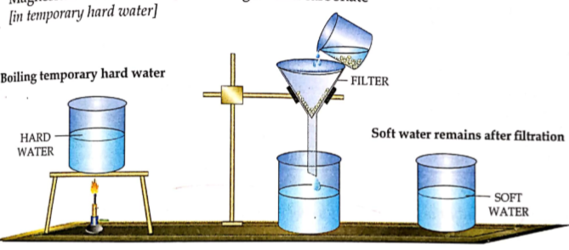
REMOVAL OF HARDNESS
Temporary hardness can be removed by boiling.
Ca(HCO₃)₂→CaCO₃ +H₂O +CO₂
Mg(HCO₃)₂→MgCO₃ +H₂O +CO₂
The insoluble carbonates are filtered out,CO₂ gas escapes out .

Slide 24
Permanent and temporary hardness both can be removed by adding washing soda(Na₂CO₃).
CaSO₄ + Na₂CO₃-→CaCO₃ + Na₂SO₄
MgSO₄ + Na₂CO₃-→MgCO₃ + Na₂SO₄
CaCl₂ + Na₂CO₃ ₋₋₋ CaCO₃ +2NaCl
MgCl₂ + Na₂CO₃ ₋₋₋ MgCO₃ +2NaCl
Ca(HCO₃)₂ + Na₂CO₃→CaCO₃ +2NaHCO₃
Mg(HCO₃)₂ + Na₂CO₃→MgCO₃ +2NaHCO₃
The insoluble carbonates are filtered out
The filtrate contains soluble sodium salts which do not cause hardness.

Slide 25
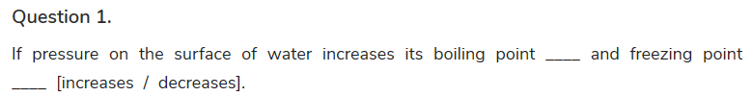



Page No 49 Unit Test Paper

Slide 26



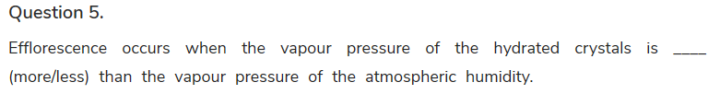


Slide 27
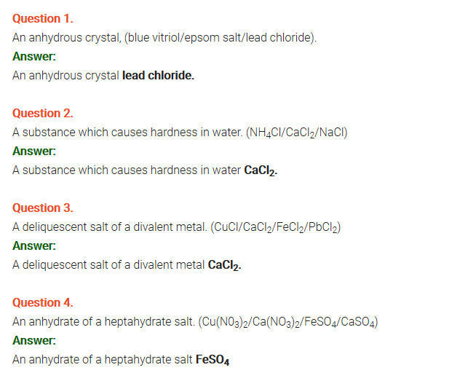
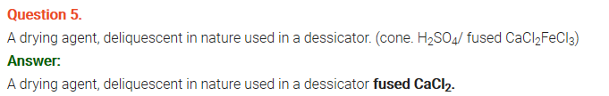


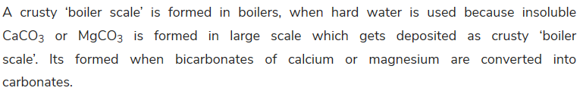
1.
2.
3.
4.
5.
3.
4.
5.

Slide 28
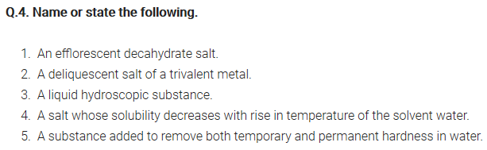
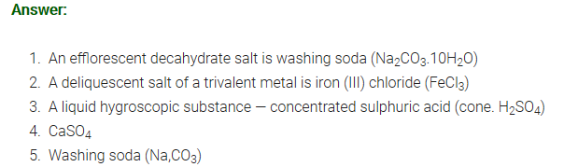
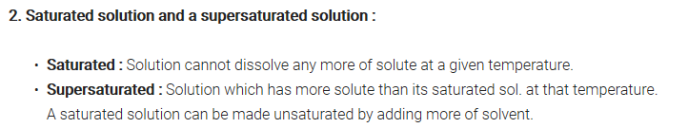
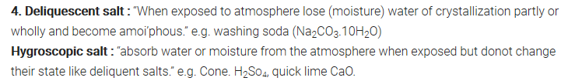

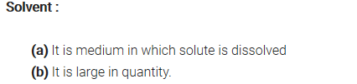

Slide 29
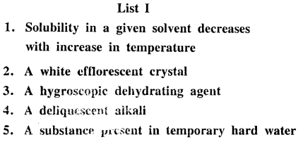
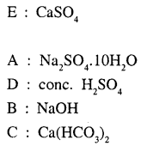

Slide 30
THANK YOU

