Slide 1

Predicting Lead Conversion: Data-Driven Scoring to Prioritize High-Value Customers
- Case Study

Slide 2
Objective
Business Objective
Build a predictive model that estimates the probability of a lead converting into a paying customer.
Identify paying Customers. Shift from treating all leads equally → to prioritizing high-value leads, help Strategy boosting for business.
Identify key factors driving customer conversions for actionable insights.
Focus resources on the top 10–20% of leads most likely to convert, maximizing return on sales efforts.
Problem (Low conversion rate, many leads, limited sales bandwidth)
Approach (Data cleaning, feature engineering, ML models)
Output (Lead scores)
Action

Slide 3
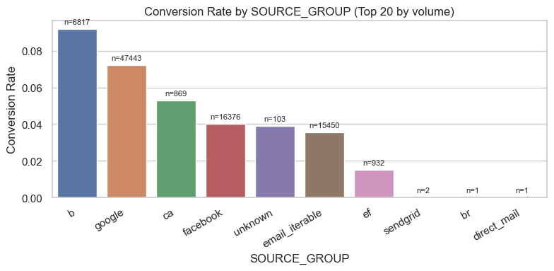
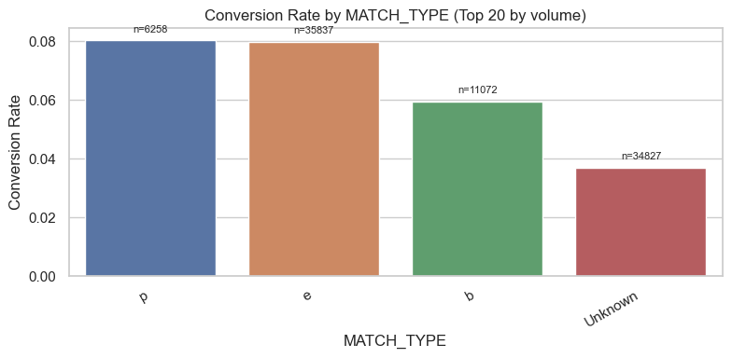
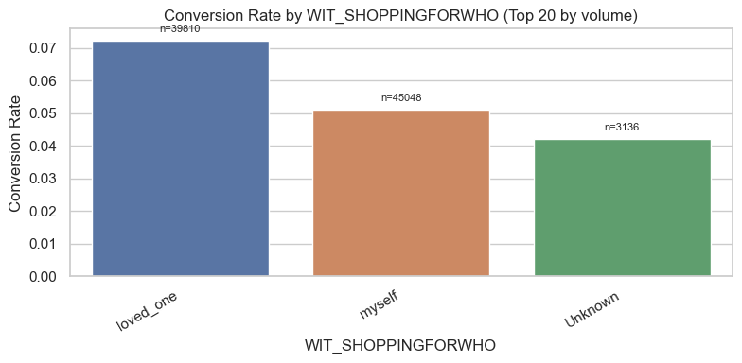
Key Insights from Data
Conversion rate across the dataset is ~6%, meaning only a small portion of leads become buying customers.
Urgency is the strongest signal: Leads marked “As soon as possible” converted at 8–9%, nearly 2× higher than hesitant customers (“I’m not sure” ~3%).
Source & Network matter: Google and “b” channels performed better (7–9% conversion) compared to Facebook/email (3–4%).
Device type influences outcomes: Desktop leads converted at ~8%, outperforming mobile/tablet (~7%).
Customer profile signals: Higher Buying Power Score and Net Asset Value were associated with higher conversion.
Geography matters: Certain states (e.g., AK, NM, SD) showed conversion rates >8%, above the ~6% average.
Data quality matters: “Unknown” or missing categories (e.g., MATCH_TYPE_Unknown) still carry signal — they should be tracked as predictive features, not ignored as noise.
Not all leads are equal — urgency, source, and customer profile are key levers to prioritize high-value opportunities.

Slide 4
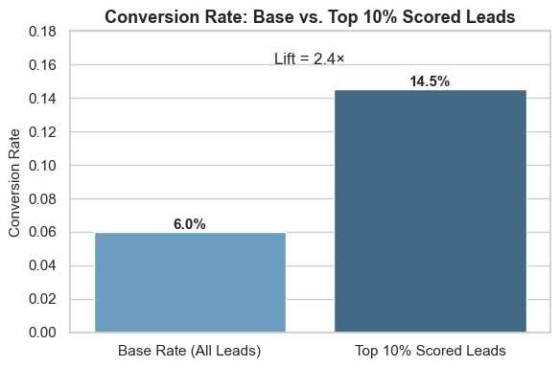
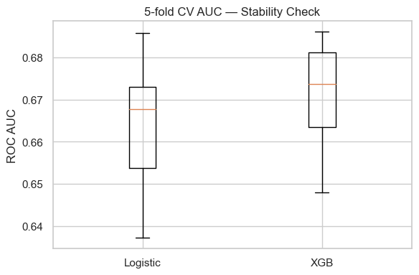
Model Results
Logistic Regression (Tuned)
ROC AUC: 0.6816 (vs. random 0.5 → solid separation of good vs. weak leads).
Recall for converters: ~65% → captures nearly 2 out of 3 buyers.
Precision for converters: ~9–10% → many false positives, but expected in a 6% base conversion rate setting.
Lift: Top 10% of leads convert at ~2.4× the base rate (≈14–15% vs. 6%).
XGBoost (Tuned)
ROC AUC: 0.6834 (slightly stronger than logistic).
Similar recall/precision tradeoff, with better handling of feature interactions.
Lift: Top 10% of leads convert at ~2.36× the base rate.
Key Takeaway for the Business
Both models are consistent and stable, with 5-fold CV AUC ≈ 0.66–0.67 across folds.
While not perfect, models reliably rank leads by quality.
Example: Prioritizing the top 10% of leads could more than double conversion efficiency for sales teams.

Slide 5
Most Important Features Driving Predictions
Urgency: Strongest positive driver — customers saying “as soon as possible” are much more likely to buy.
Network & Source: Not all channels are equal — Bing and Google consistently outperform social/email sources.
Age & Financial Indicators: Middle-aged to older customers with higher income/buying power are more likely to convert.
Phone Activity & Match Quality: Verified/active phone signals (e.g., INPUT_PHONE_MATCHES, phone usage) boost trust and conversion odds.
Time of Submission: Afternoon and evening submissions show higher conversion likelihood compared to morning.
Unknown / Missing Values: “Unknown” or missing categories (e.g., MATCH_TYPE_Unknown) also carry signal — absence itself predicts behavior

Slide 6
Business Application & Next Steps
Lead Prioritization: Models can reliably separate higher- vs. lower-quality leads → focus sales on the top 10–20% most likely to convert.
Campaign Optimization: Insights on source, network, and urgency help allocate marketing spend to high-performing channels.
Sales Efficiency: By reducing time wasted on low-probability leads, sales teams can increase ROI and close rates.
Customer Insights: Feature importance (urgency, phone activity, demographics) gives actionable signals to improve targeting and messaging.
Scalable Process: The reproducible pipeline allows for continuous updates as new data arrives, keeping predictions relevant.
simple production pipeline:
New Lead → Preprocessing (cleaning, feature engineering, encoding) → Model (Logistic/XGB) → Score
(probability of conversion) → Dashboard/CRM (Snowflake, Salesforce, Power BI/Tableau) → Sales Prioritization (focus on top leads)

