Slide 1
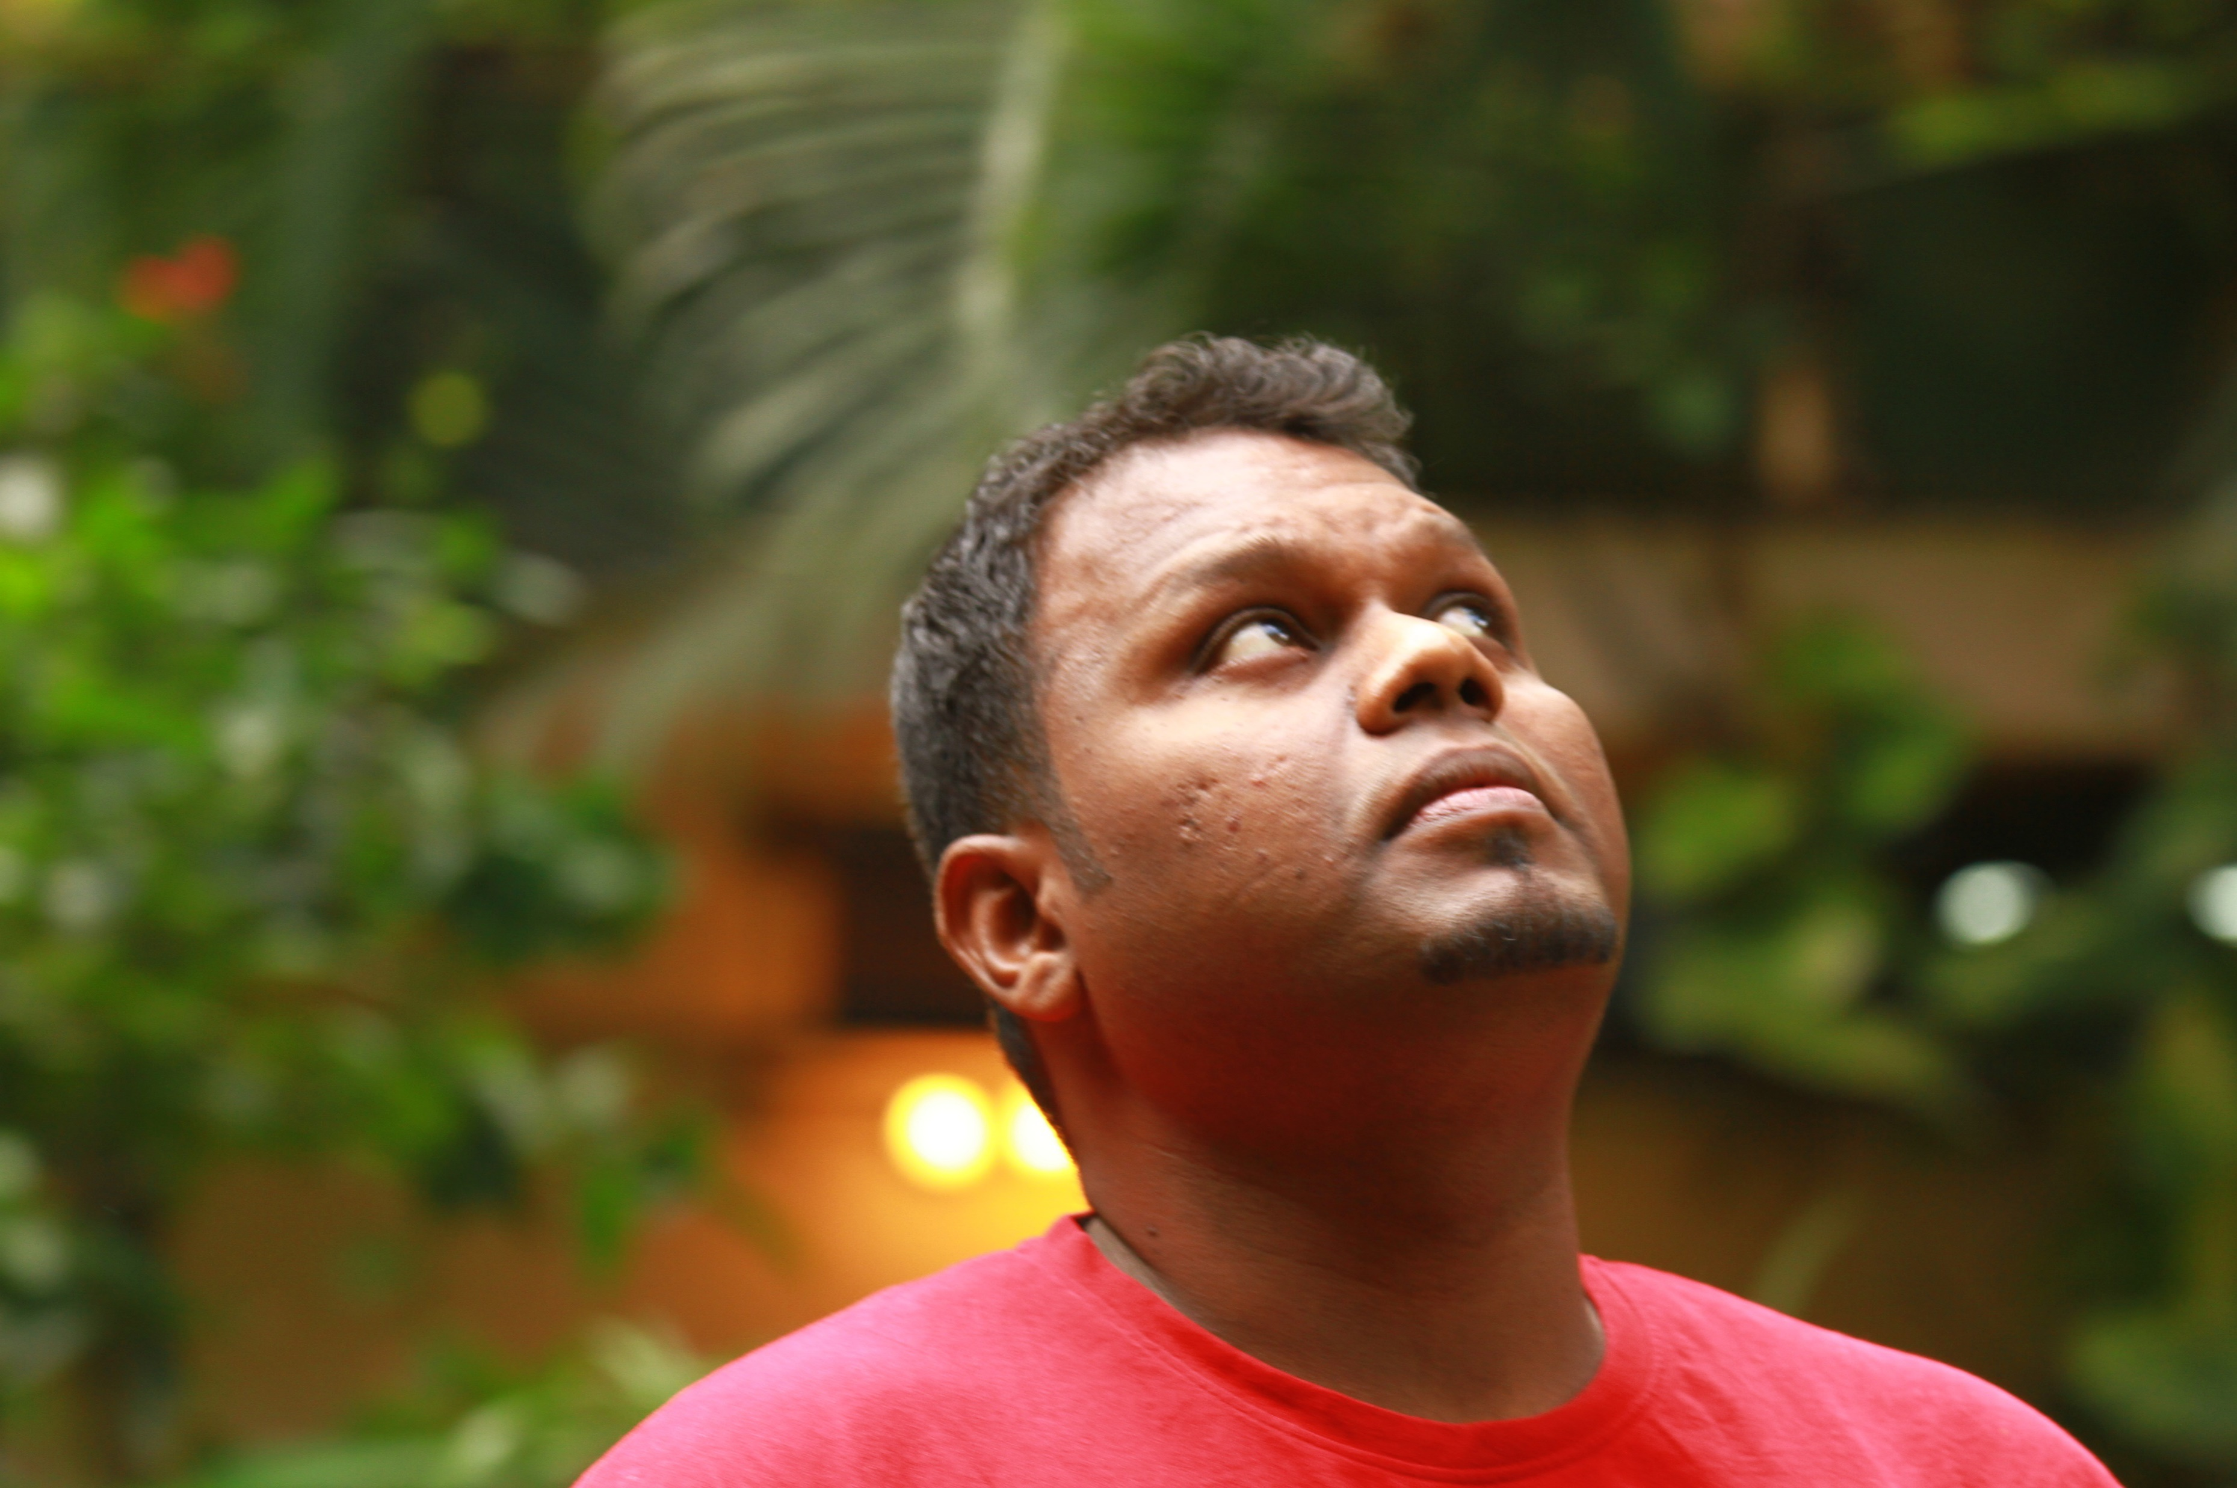
Welcome to the journey
Down the memory lane

Slide 2
