Slide 1
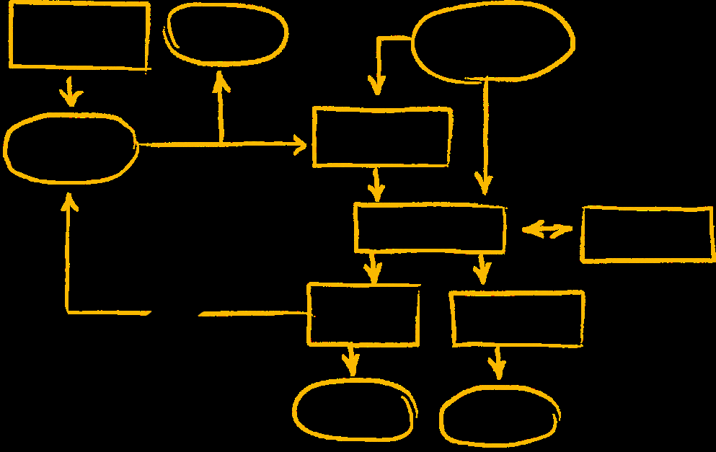
Analytics Strategy Assessment Findings & Recommendations
Customer Logo
[Report Date]

Slide 2
Agenda
Executive Summary
Key Observations & Maturity
Key Findings, Recommendations & Improvement Areas
Key Opportunities
Solution Recommendations
Next Steps
Appendices:
Agenda & Participants
Strategy & Execution Baseline, Business Discovery Opportunity Summary
Strategy Assessment Approach, Maturity Model, Additional Resources

Slide 3
Executive Summary
Overview
Assessment sponsor name and title
Customer objective for strategy assessment
Interviews
Date interviews conducted and Lines of Business included
Recap of interview findings
What SAP heard at [customer name]
Sound Bite 1
Sound bite 2
Sound bite 3
Notes:
A “Sound Bite” is a key comment made during the Strategy Assessment Interviews. Limit to top 3.

Slide 4
Key Observations
Amend with actual customer observations
<Insufficient IT BI team resources>
<Lack of a data warehouse, data warehouse strategy and semantic layer inhibiting user data access>
<Lack of understanding and use of SAP Analytics products licensed>

Slide 5
BI & Analytics Maturity Model Levels of performance along the best practice framework
Annotate with stars to indicate maturity
Notes:
Participant Profile
BACC - Business Analytics Competency Center / Center of Excellence

Slide 6
BI/Analytics Maturity Model: Detail
BI Performance Stages
Level 4
Level 3
KPIs and Analytics are used to manage the full Value Chain
Level 2
KPIs and Analytics are identified and effectively used
Level 1
KPIs and Analytics are identified, but not well used
Strong business ownership of requirements
Increased use leading indicators for KPIs and analytics
Collaborative development of requirements across the value chain
Robust ad-hoc analytics and information availability (structured and unstructured)
Requirements are driven from a limited Executive group
Strong business ownership of requirements
Common set of rationalized KPIs and information requirements
Business relevance of every metric validated
Value is tracked and reported
Ad-hoc report development in place
Information and Analytics
Weak to moderate business ownership of requirements
Multiple sets of KPIs and information requirements often conflict
Generic KPIs are not business optimized
Value measurement is coincidental
Not standardized or linked to business needs
Few Operational reports with little business benefit
Historical reporting. Information reliant on lagging indicators
No Value KPIs
Enterprise-wide Governance with Business Leadership
Business Governance with Competency Center Developing
Business Driven Governance Evolving
Enterprise participation on all developments
Governance includes feedback mechanisms from the full value chain
ESS and MSS fully adopted
Competency center is mature
Standard support across the enterprise
High security and authorization
IT Driven Governance
Low to moderate participation of Business in analytics governance
Considering a competency center
Weak to moderate end-user skills. Some core group of super-users
Employee Self Service (ESS) partially used
Manager Self Service (MSS) not in place
Proliferation of data access through Excel
High Business Ownership to all BI Activities
All analytics activities guided by business goals
Business case and ROI for projects
Moderate end-user skills with “pockets” of strong users. No lack of super-users
ESS fully adopted; MSS partly adopted
Competency center is new or developing
Security and Authorizations becoming uniform
Analytics Governance
Technology-centric organization and implementations
No/little business participation in projects
Weak end-user skills. No employee or manager self service
No competency center
Data access limited to few key individuals
Uniform, followed and audited
Exist and are not uniform
Processes and standards are documented, consistently followed and audited
Formal governance board in place for strategy and direction
Written SLA's in place with formal and regular update/negotiation process
Heavy reuse of information
Master data is fully standardized
Ownership and responsibility is established for all data elements used by the business
Evolving effort to formalize
Processes and standards are documented but not always followed
Informal governance group which is mainly responsible for issue resolution
Written SLA's in place, but no formal and regular update process
Moderate to heavy reuse of information.
Master data standardized to large extent
Each major data area has a senior champion who drives data standardization and quality
Do not exist or are not uniform
Processes and standards may be documented
Verbal SLA's in place; no formal and regular update/negotiation process
Little to moderate reuse of information
Initial efforts to standardize master data
Occasional executive interest in data when considering major initiatives
Standards and Processes
No service level agreements (SLA’s)
Design, development and management processes are informal
High use of generic objects or heavily customized development
No reuse of data or information
Non-standardized master data
Data ownership is undefined or conflicting
Robust and flexible BI architecture
Some Shared BI Applications
Consolidating and Upgrading
Global Enterprise Data Warehouse implemented
Analytics platform viewed as a strategic enabler for Business
Ability for high-speed analytics
Robust and user-friendly presentation layer
High reliability of delivery to local, regional and global business needs
Application Architecture
Analytics “Silos” for each BU
Variances between BU’s with multiple analytics systems
Heavy reliance on spreadsheets and data manipulation
Planned migration to better landscapes
Documented plans for patches and upgrades
Shared documentation
Initial attempts at implementing a Global Enterprise Data Warehouse (either logical or physical)
Spreadsheets are used selectively
Central tech support
Patches up-to-date
System consolidation planned and / or implemented
Significant variances between BU’s
Limited access to information
Users get what IT gives
Ad-hoc patches & upgrades
No enterprise standardization
Minimal documentation
Source: ASUG BI Benchmark Report, April 2007

Slide 7





Analytics Strategy Framework Key Baseline Assessment Areas & Components
Objectives
Background & Purpose
Current State & History
Objectives & Scope
Business Needs
Summary of Needs
Envisioned To-Be State
Priorities & Alignment
Business Benefits
Value Proposition
Expected Benefits
Business Case
Tools & Technology
Information Categories
Architecture & Standards
Tools & Applications
Organization
Governance Structure
Program Management
Roadmap & Milestones
Measurement
Education & Training
Support

Slide 8
Key Findings
Amend with actual customer observations
Objectives
Business
Needs
Business Value
Tools & Technology
Organization
No Executive Business Sponsor for Analytics
No Business Analytics Competency Center
No Enterprise Analytic Strategy; non SAP Analytic Strategy is in process
Strategic business alignment is partial
Business Needs only partially defined and aligned
User Adoption is low; maturity is low, focused on reporting
No formal Value Methodology in place
Simple cost benefit analysis approach being used to justify project requests instead of using a formal value methodology
No post implementation business value validation
No Enterprise Data Warehouse; BW houses SAP data only
An architecture review is recommended
No Agile Development Environment/Innovation Lab
No advanced analytic tools (e.g., predictive); limited data management tools
Business Objects Package has been licensed but not fully deployed
No Executive Analytics Committee. No Working Analytic or Data Governance Committee
No published Analytics Scorecard/Dashboard
Gap in User Training and IT/User Communication

Slide 9
Key Recommendations
Amend with actual customer recommendations
Area | Recommendations
Strategy | Name executive business sponsor Define an overall analytics strategy, for both SAP and non-SAP data Create a Business Analytic Competency Center
Business Needs | Document, align and prioritize business needs with all LOBs Align the analytics strategy with the transformation strategy
Business Value | Adopt a formal value methodology Use value methodology with business cases for cost justification Document and communicate business impact from significant projects post implementation
Tools & Technology | Define data strategy and build semantic models Create a more agile development environment including an advanced analytics lab Define, implement and enforce analytic and data management tool standards Develop, communicate and ensure adherence to development standards
Organization | Expand working analytics governance committee Create a Data Governance Council and appoint data stewards from business areas Formalize an analytics training program, communities of interest and ongoing communication Create and publish an analytics scorecard

Slide 10
Key Improvement Areas & Identified Projects
Amend with actual customer improvement areas & projects
Improvement Areas
Identified Projects
Build a business case for significant initiatives
Prioritize Initiatives based on business value
Document and communicate value post implementation
Business Benefit
Participate in SAP Value Academy
Adopt value methodology
Apply methodology in business cases justification and post implement value review
Review any current performance issues
Define a data strategy
Define agile architecture & innovation lab
Define and communicate agile development standards
Define standard tools
Conduct tech performance & architecture review
Improve organization & access to existing metadata and reports
Implement enterprise data model; develop semantic views
Adopt and enforce standard tools
Technology
Define Executive & Working Analytics & Data Governance structure
Define Analytics Roadmap with Milestones
Develop an analytic scorecard
Develop training and communities of interest
Develop executive analytics and data governance committees; develop working committees
Publish analytics roadmap
Define and publish analytics scorecard
Formalize training/develop communities of interest
Organization

Slide 11
Key Use Cases/Opportunities Customer Action: Review & Rank
Amend with actual customer opportunities
Initiative | Value Rank | Effort | Quick Win Candidate?

Slide 12
Key Use Case/Opportunity Matrix
Amend with actual customer key use cases/opportunities
Master Transformation Project Use Cases
Develop Semantic Layer
Implement SAPBO BPC
SAPBO Training
Define EDW & Data Model
Review / replace current Excel reports

Slide 13
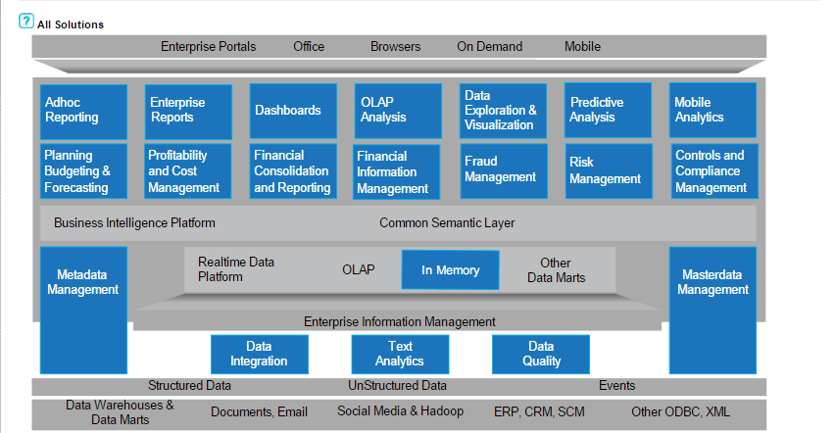
Solution Recommendations
Annotate solutions substantially, partially, and not in place
Green outline reflects solutions largely in place
Yellow outline reflects solutions partially in place
Red outline reflects solution gaps.
Notes:
Optional: Use green outline to reflect solutions currently largely in place.

Slide 14
Placeholder for Value Dashboard

Slide 15

Next Steps
Amend with actual customer recommended next steps
[Executive Business Sponsor for Analytics]
[Business Analytics Competency Center formation/enhancements]
[Develop/review and socialize Analytics Strategy and Roadmap]
[Review business opportunities; validate & prioritize Quick Wins]
[Prioritize longer term projects and find business sponsorship and funding]

Slide 16
Data & Analytics Roadmap Example Action: Review and annotate current status
Complete
In
Process
Phase 1
Phase 2
Phase 3
Levels 1-2
Level 3
Maturity Level
Level 4
Level 5
Not
Begun
Create & Publish BI Program Scorecard & Dashboard
Fully communicated and aligned strategy
+3yrs.
Document Strategy Objectives & Scope
Business Aligned & Value Driven Strategy
Objectives
Document Strategy Current State & history
Sustainable Funding Model in place
Data Driven Analytics Architecture
Analytics Driven Culture
Document Strategy Background & Purpose
Define, Align & Prioritize Additional Use Cases
Integrated Information Architecture
BICC is fully operational
Define To Be State
Select Right BI Tools for Users
Incorporate key existing use cases into
Document post implementation value
Deploy Architecture
Standardize Security & Authorization
Define, Align & Prioritize Initial Use Cases
On-going training & documentation
Apply Value Methodology in Business Cases
Measure BI User Adoption
Business Needs
Conduct Business Discovery
ID Value Analysts
Establish BI Master Data & Analytics Tools Standards
Define/Review Training
Run Projects through BICC
Engage & Train Data Stewards
Adopt/Refine Business Value Methodology
Review existing database platform
Finalize Technical, Data Architecture & BI Tools
Name Leader & Create BICC
Start
Data & Analytics Roadmap defined
Define Governance Structure
Review BI & Data Architecture including
Health Check
Name Exec. Business Sponsor
Business Benefits
Tools &
Technology
Organization
Each phase is
6-12 months

Slide 17
Parking Lot/ Follow Up Items:
Amend with actual customer items
SAP to provide copies of presentations from workshop.
SAP to provide best practices training recommendations.
SAP to provide best practices on Information Governance.
SAP to provide info on SAP Consulting Services/Partner Services.
SAP to provide BACC best practices presentation.
SAP to provide SAP Business Objects analytics products overview.

Slide 18
Appendix A: Agenda & Participants

Slide 19

Analytics Strategy Workshop Agenda
Amend with custom agenda for customer
Time | Title | Length | Topics Covered | Participants
8:30 – 9:00 am | Welcome & Intro | 15 min. | Introductions, Objectives | All
9:00 - 9:30 am | Art of the Possible | 30 min. | SAP Analytics Vision | All
9:30 – 10:30 am | Business Interview (LOB 1) | 60 min | Current Pains Key Analytic Related Initiatives | Business
 |  | 15 min | Break
10:45 - 11:45 am | Business Interview (LOB 2) | 60 min. | Current Pains Key Analytic Related Initiatives | Business
11:45 – 12:30 pm |  | 45 min. | Lunch
12:30 – 1:00 pm | Strategy, IT/Analytic Org Structure, Initiatives, Gap | 30 min. | Current Analytics Strategy Existing BI/BACC initiatives & Org Gaps/Issues | IT/Analytics Team
1:00 – 1:45 pm | Analytics Strategy & BACC Role/Best Practices | 45 min. | BI/Analytics Maturity Model BACC Capabilities/Org Structures, Roles, Skills, Governance, Metrics | IT/Analytics Team
1:45 – 2:00 pm |  | 15 min | Break
2:00 – 3:30 pm | IT Interview | 90 min | Current Pains, Strategy Execution Current BACC Capabilities | IT/Analytics Team
3:30 – 4:30 pm | Preliminary Findings Discussion/Next Steps | 45 min | Review and discuss initial findings/recommendations; next steps | Workshop Sponsor
Note: Additional 30 minute executive business interviews (by LOB) can be included
Notes:
BACC = Business Analytics Competency Center (sometimes also called BICC – Business Intelligence Competency Center)

Slide 20
Workshop Participants
Participants
Amend with workshop participants
Sponsor
[name, title}
Pat Saporito, Global BI COE
[workshop facilitator name, title\
* Remote participants
Business Area
Name | Title
IT
Name | Title
SAP Team

Slide 21
Appendix B: Execution Baseline and Business Pains Summary
View detail in online version of the assessment at:
https://sap-bi-strategy-assessment.com/dashboards/ email: [customer sponsor email address]
passcode: [assigned passcode]
Paste in email address and passcode
Note: Use Chrome or Mozilla as browser to view; do not use Internet Explorer.

Slide 22
Opportunities: [LOB Name] Rankings
OP1 - Lack of responsiveness to market shifts
OP2 – Budget & Reporting Not Automated
OP3 – Systems Not Integrated
OP4 - Profitability is difficult to track
OP5 - Only ad hoc reporting
OP6 –Can’t Benchmark Against External Sources
OP7 – Lack of An Enterprise Analytics Strategy
OP8 - Limited Supply Management (People)
OP9 – Operations Inefficiency
Insert Screen Shot from On Line Assessment Dashboard
Opportunities in bold were all ranked with both pain and impact GT 5
Notes:
Use Add-Ins from Workshop Deliverables file in Workshop Facilitator file resources to annotate Pain and Value rankings and descriptions

Slide 23
Business Opportunities: IT
IT1 – Manual Report Generation
IT2 – Data Management
IT3 – Shadow IT
IT4 – Only Ad Hoc Reporting (no standard reports)
IT5 – Lack of Enterprise BI/Analytics Strategy
IT6 – IT Costs Too High
Insert Screen Shot from On Line Assessment Dashboard

Slide 24
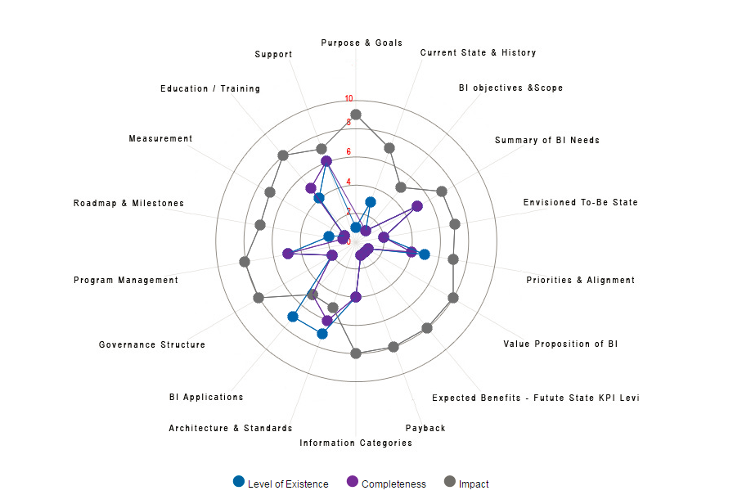
Business Strategy Execution Summary [Option 1: Radar Graph]
Insert revised screen shot with analytics wording
Insert Screen Shot from On Line Assessment Dashboard

Slide 25
Analytics Strategy Components Definitions
Component | Recommendation
1.1 Purpose and Goals | Document original drivers, mission statement, reasons, goals for building this Analytics strategy.
1.2 Current State and History | Document (and collect) current state of Analytics for each business unit (Line of Business, or LOB) in the following categories- users, technologies, architectures, data sources. Consider a BI/Analytics Benchmarking survey, which would help to compare against other companies in your industry and establish a baseline for ongoing progress and trend analysis.
1.3 Objectives and Scope | Define Analytics and what is in/out of scope (i.e. Performance Mgmt, Profitability, Budgeting/Planning, Data Management, etc.) Define Analytics Strategy Mission, Vision and Objectives. Leverage insights from business executives to develop a plan for Business. Develop an Analytics Strategy framework to use across the organization.
2.1 Summary of Needs | Identify information needs across the organization by stakeholder groups and by role. Map business unit (LOB) needs and future plans by business process area (Supply Chain, Sales, Marketing, etc) and by Line of Business.
2.2 Envisioned To-Be State | Define future state or vision for BI/Analytics - the desired reality of information availability, usage and other BI/Analytics capabilities once the initiative is implemented.
2.3 Priorities and Alignment | Align BI/Analytics approach with corporate and business unit objectives and KPIs. Select and group priorities agreed on by business stakeholder and Analytics leaders.
3.1 Value Proposition of Analytics | Adopt a value assessment methodology to quantify effectiveness and efficiency value of BI/Analytics. Provide formal value methodology training to Analytics leaders.
3.2 Expected Benefits- Future State KPI Levels | Identify key performance drivers affecting current operations and initiatives. If KPIs were not well defined, start with solid definition of KPIs before proceeding. Describe expected benefits of future state BI/Analytics. Define future state KPI levels in conjunction with business case development.
3.3 Payback | Develop qualitative and quantitative description of the costs and benefits of executing the Analytics Strategy, resulting in expected ROI, NPV, IRR, payback period, or similar financial return information. Define and document expected business value by business process and by LOB.

Slide 26
Analytics Strategy Components Definitions
Component | Recommendation
4.1 Information Categories | Develop taxonomy broad enough to include the majority of business questions to be addressed by this initiative. Prioritize Information Categories for addition and/or expansion based on prioritized Analytics needs.
4.2 Architecture and Standards | Develop and Expand system architecture and components for the Analytics infrastructure, including information and fact table standards, ETL component and database naming standards, key sources, the structure of the data warehouse, and applications.
4.3 BI Applications | Align current and planned technology solutions with BI/Analytics Strategy, architecture and standards.
5.1 Governance Structure | Establish BI/Analytics Executive Steering Committee (IT and business) to align corporate and LOB objectives with investments. Establish Data Management Governance structure, expectations and responsibilities.
5.2 Program Management | Establish BI/Analytics Working Committee - include corporate team and LOB BI/Analytics teams.
5.3 Roadmap and Milestones | Develop roadmap for implementation of BI/Analytics strategy based on prioritization of needs. (Steps include- manage timeline for execution, measure progress towards completion, and manage key decision points within the project timeline.) Develop a detailed, multi-year plan for expanding use of BI/Analytics, driven by business priorities.
5.4 Measurement | Begin measuring and reporting against defined KPIs and monitor expected benefits identified in the business case, and publish progress.
5.5 Education / Training | Determine education and training needs; develop learning plans for end users of the application.
5.6 Support | Establish support structure, including centralized and power user support expectations and roles.

Slide 27
Appendix C: BI Strategy Approach Strategy to Execution BI/Analytic Maturity Model – Detail Additional Resources

Slide 28
Approach Used SAP’s Analytics Strategy Assessment
Interactive discovery, prioritization, and recommendations for addressing
business pains and a successful enterprise analytics strategy in 4 steps:
Step 1
Step 2
Step 3
Step 4
Notes:
Developed in conjunction with Gartner, SAP Value Engineering and SAP analytics experts; it includes:
Most common analytics pains/issues by line of business
Key capabilities needed for an effective analytics program

Slide 29


Enterprise Analytics: Strategy to Execution
Business Driven
Link & Align
Strategy to Execution
User Access & Usability
Strategy
Execution
Strategically Aligned
Feedback to
Strategy
Improved Decisioning

Slide 30
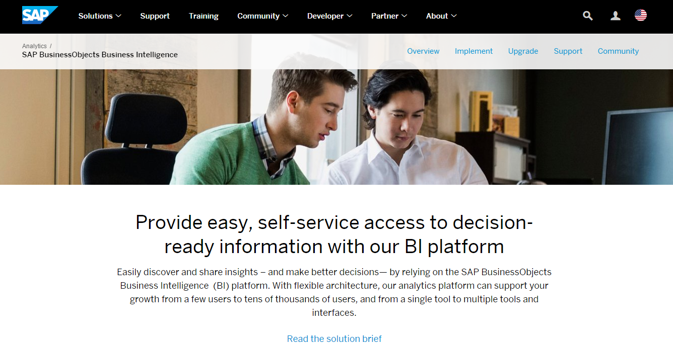
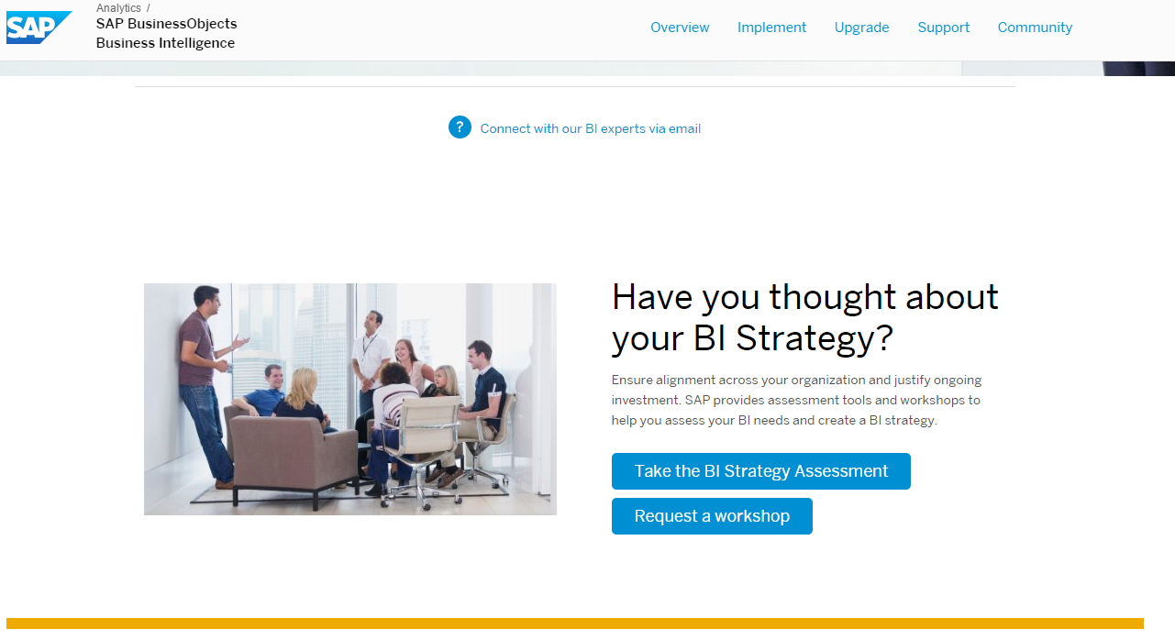

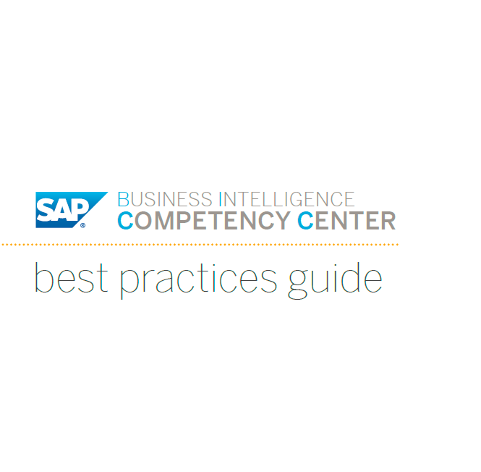
Additional Analytics Strategy Resources
SAPBO Business Intelligence Web Page
BI/Analytics Strategy Web Page
Ebooks:
BI/Analytic Strategy eBook
BICC eGuide

Slide 32
Facilitator Name
Title
Phone
Email

