Slide 1
Analyzing the performance of different TCP Variants in Wireless Ad-hoc Networks using different Routing Protocols
Kodavalla Durga Avinash, 123003114
Guided by
Dr. Sasikala Devi. N

Slide 2
Agenda
Problem statement
Implementation design
Tools used
Basic Concepts
Parameters for analysis
Output screenshots
Results & Analysis
Conclusion

Slide 3
Problem Statement
TCP [Transmission Control Protocol] is a connection-oriented protocol with its diverse congestion management mechanisms that manipulate TCP sending rate and makes TCP react to congestion alerts.
In this project, performing a comparative analysis of TCP variants like TCP Tahoe, TCP Reno, TCP New Reno, TCP Vegas, TCP Sack, and TCP Linux in Wireless Ad-hoc Networks over different routing protocols like AODV, DSDV, and DSR.
Packet Delivery Ratio [in %], Delay [in ms], and Throughput [in Mbps] are the factors considered while mobile nodes in motion [under different speeds] using NS-2 Network Simulator.

Slide 4
Implementation Design
Implementation of Wireless Ad-hoc Network:
Considering MAC protocol be IEEE 802.11, channel set to Wireless channel with Two Ray Ground propagation model and Omni Antenna.
Ten mobile nodes are considered to simulate network environment under 450 x 450 meter topology. Different routing protocols are set like AODV, DSDV, and DSR. The speed of mobile nodes are changed between 5 m/s to 30 m/s with 5 m/s difference for each case.
FTP application with different TCP variants like Tahoe, Reno, New Reno, Vegas, Sack, and Linux and used to analyze their performance.

Slide 5
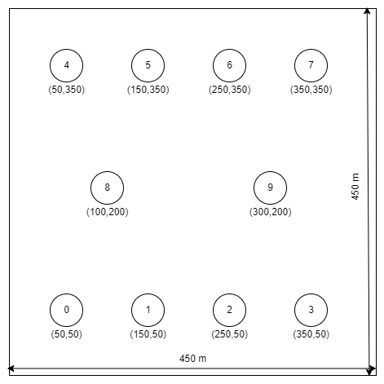
Implementation Design
Mobile nodes location just before TCP connection is started in network topology. They travel to their exact opposites with user set speeds.

Slide 6
Implementation Design
TCL script must be modified with different TCP variants, Routing Protocols, and different mobile nodes speeds.
Factors for comparison : PDR, Throughput, and ETE Delay
TCP Variants : Tahoe, Reno, New Reno, Vegas, Sack,
and Linux
Wireless routing protocols : AODV, DSDV, and DSR
Mobility Speeds [in m/s] : 5, 10, 15, 20, 25, and 30
Total data points collected : 324 [3 x 6 x 3 x 6]
All these 324 data points are used for deeper analysis to determine which TCP variants perform the best/worst in a particular network situation.

Slide 7
Tools Used
NS-2 Network Simulator:
Software to simulate the network environment using TCL scripts written with all the properties and functionality of the network.
NAM Network Animator:
This is used to show how network is performing like nodes & it’s movements, traffic, packet drops etc, in a graphical user interface.
Ubuntu 20.04 LTS:
This is a free, customizable, coherent Linux-based OS in which we run this NS-2 and NAM applications required for our network. This is the latest long term supported version of this OS.

Slide 8
Tools Used
VMware Workstation 16 Pro:
This is a Hypervisor application with advanced features where we can create Virtual Machines, Virtual Networks, and connecting to Remote Server. We run Ubuntu 20.04 LTS in this application in Windows 11.
Microsoft Office – Excel:
This is used to record all the data points like PDR, Throughput, and ETE Delay from all network situations and make tables & graphs which are helpful for analytical purposes.
Xgraph:
This is a plotting program used to create graphic representations of simulation results.

Slide 9
Basic Concepts
TCP & It’s Variants:
It’s a connection-oriented protocol, establishing the connection before the communication is started between devices in a network. The connection will be active until data is transmitted. This protocol has many congestion avoidance algorithms which improve PDR, and Throughput and decrease End-to-End [ETE] Delay.
TCP Tahoe:
Works on principle of ‘conversion of packets’ if connection is active at available bandwidth capacity. Tahoe uses ‘Additive Increase Multiplicative Decrease’. A packet loss is considered as congestion and halves the current window to 1 and a slow start until reaches threshold value.

Slide 10
Basic Concepts
TCP Reno:
Similar principle as Tahoe like slow start and adding intelligence so that lost packets are detected earlier and pipeline not emptied. Uses an algorithm called ‘Fast Re-Transmit’.
TCP New Reno:
Slightly modified version of Reno, as it can detect multiple packet losses.
TCP Vegas:
Extends on Re-Transmission of Reno, Vegas is different as congestion is detected if sending rate is reduced. Doesn’t waste bandwidth and not creating congestion in the first place. This is also called as ‘Modified Slow-Start’ technique.

Slide 11
Basic Concepts
TCP Sack:
TCP with ‘Selective Acknowledgements’, segments not be acknowledged cumulatively but it should be done selectively.
TCP Linux:
This congestion control algorithm modules are imported from Linux kernel. Behavior is analyzed by consistency of Linux hosts.

Slide 12
Parameters for Analysis
Packet Delivery Ratio [PDR]:
Ratio of number of packets received correctly at destination node to the number of packets dispatched by means of source node. This value metric is shown in percentage in this project paper. Higher the value of PDR, better the performance of the network, and less packet loss.
Throughput:
Calculated by division of the size of total packets received at destination nodes in a network by total time taken for transmission of those packets. Higher throughput means better in transmission speed, that is better in performance This value metric is expressed in Mbps.

Slide 13
Parameters for Analysis
End-to-End [ETE] Delay:
Total time taken for a packet to be transmitted in a network from source node to destination node. The faster a packet reaches the destination, the better the network, and delay will be less. Less ETE Delay leads to better network. This value metric expressed in ms [milliseconds].

Slide 14
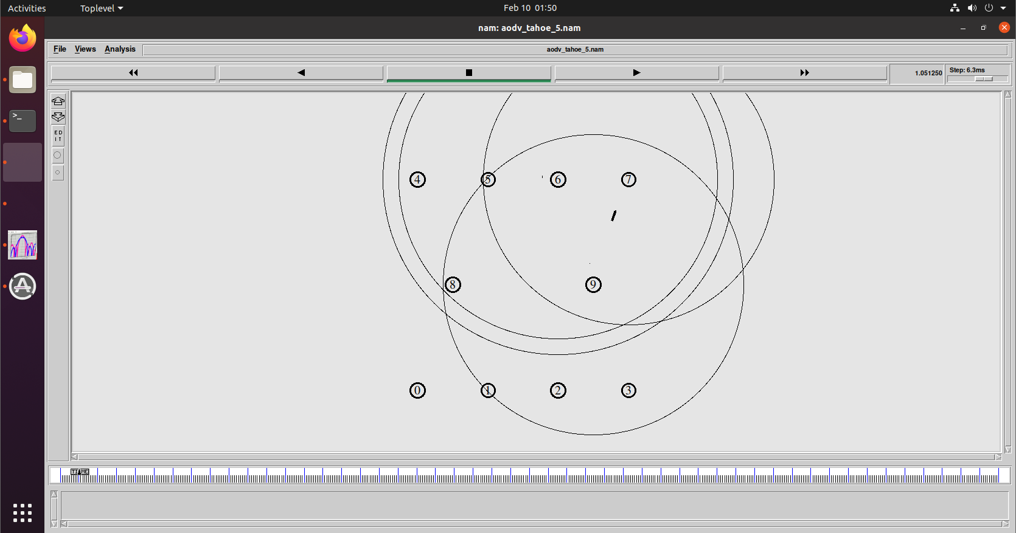
Output Screenshots
Initial nodes position in network topology

Slide 15
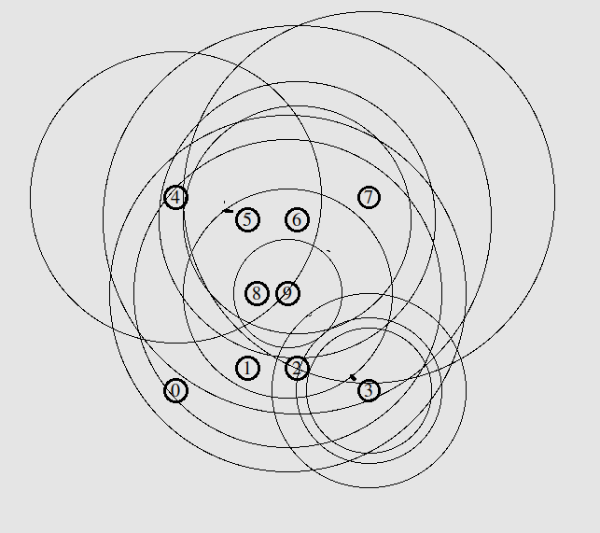
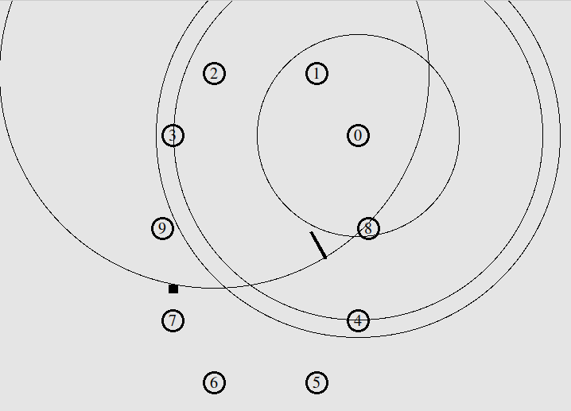
Output Screenshots
Nodes while reaching nearer to each other in network
Nodes while moving far away and packet loss

Slide 16
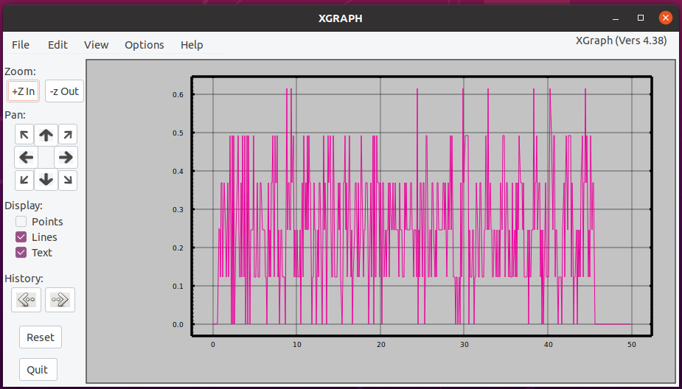
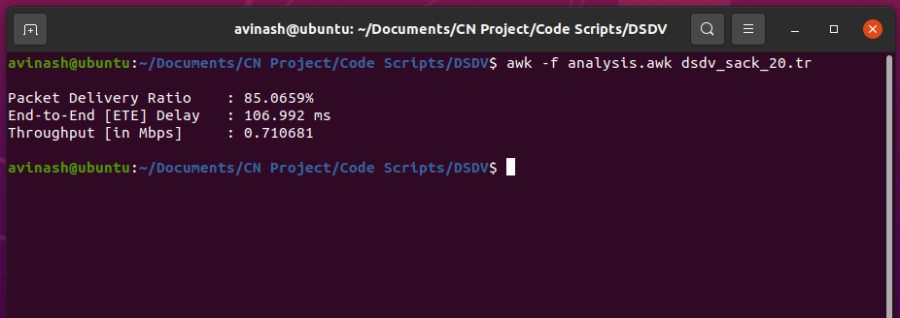
Output Screenshots
Xgraph plotting representation of bandwidth of TCP Tahoe in AODV routing protocol where nodes are in 5 m/s speed.
Trace file processing of TCP Sack in DSDV routing protocol where nodes are in 20 m/s speed using AWK script file

Slide 17
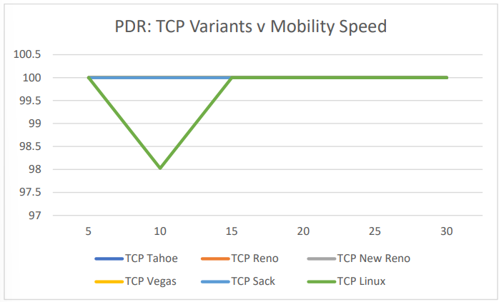
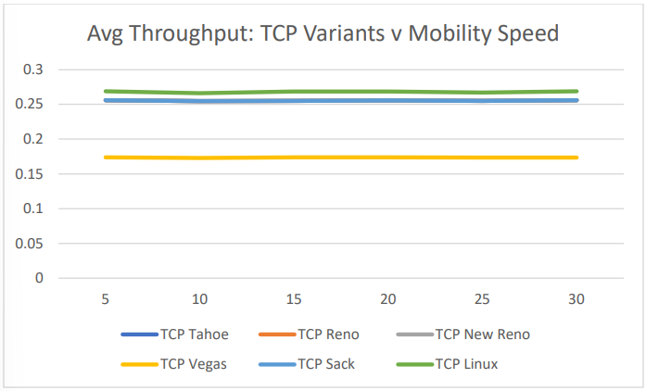
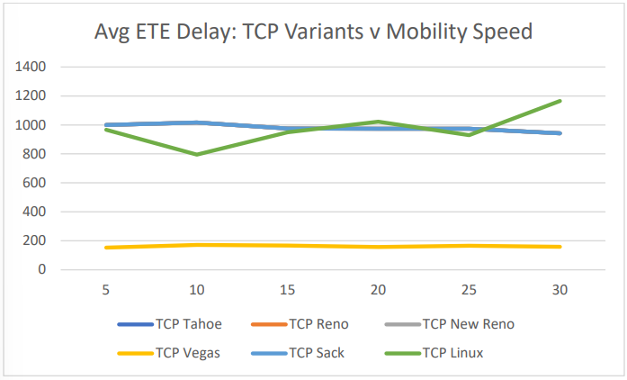
Results & Analysis
TCP Variants performance in AODV routing protocol.

Slide 18
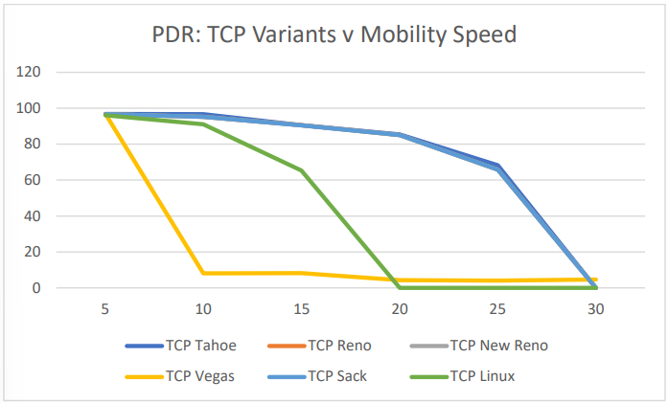
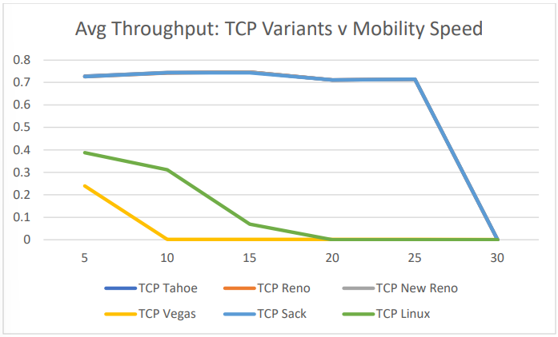
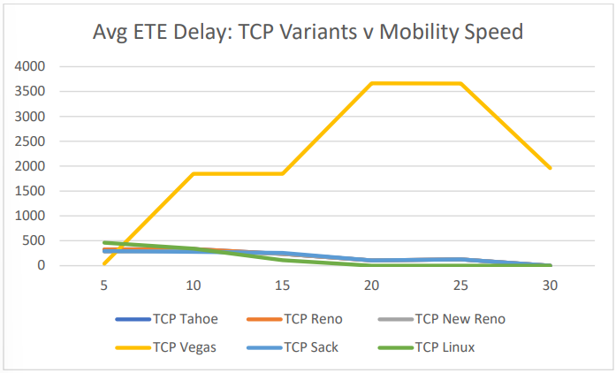
Results & Analysis
TCP Variants performance in DSDV routing protocol.

Slide 19
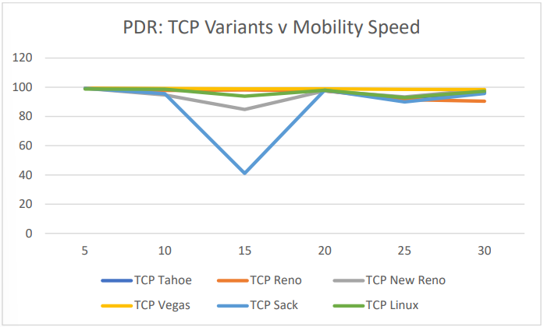
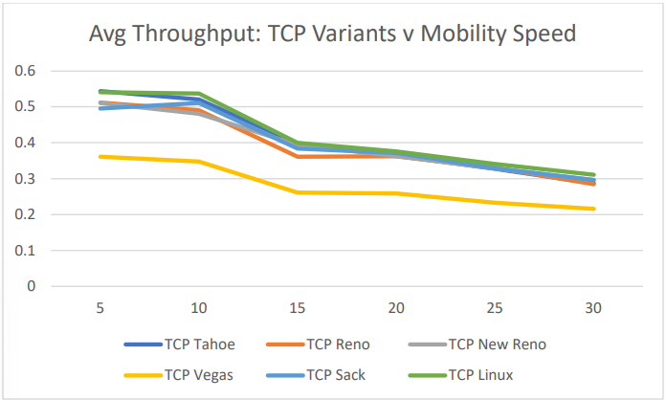
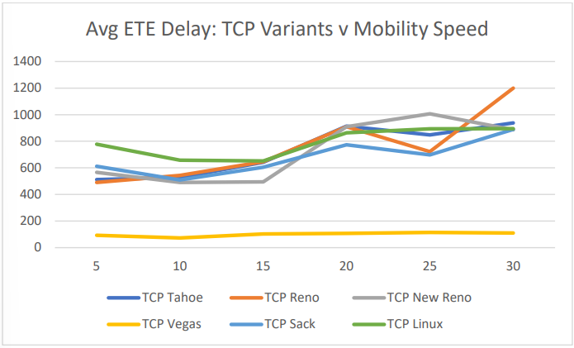
Results & Analysis
TCP Variants performance in DSR routing protocol.

Slide 20
Conclusion
By evaluation of analytical values, it is clearly observed that TCP Vegas is best in AODV routing protocol with no packet loss and very low average ETE delay but slightly lower average throughput than other TCP variants.
TCP Tahoe, Reno, New Reno, and Sack are top performers in DSDV routing protocol but all protocols tend to fail rapidly with increase in speed of mobile nodes.
TCP Tahoe is best performer in DSR routing protocol with consistent PDR, and very low average ETE delay with slightly lower average throughput. By this we can understand how TCP variants perform with change in routing protocols and varying speed of mobile nodes.

Slide 21
THANK YOU

