Slide 1
Team & Solution Overview
• Team name: Infinity
• Members: Avinandan Patel, Aman Rajput, Me Me Khaing
• Challenge area: To predict the districts in which students of grade 4 to 6 may fall in future
• One-line solution : Create a prediction model
• Contact: avinandan.patel@iiitb.ac.in
Evaluation: Depth of analysis | Policy relevance | Cross-dataset analysis | Innovation | Clarity of insights | Visualisation & presentation

Slide 2
Problem Statement
• Educational challenge: To find out which districts need educational reforms in the future.
• Objectives: To generate predictive model for early intervention.
• Key questions: Do students in a particular district needs help with education.
• Why it matters: For proper planning of distribution of resources, allocation of teachers and evaluation of
students’ performance.
Evaluation: Depth of analysis | Policy relevance | Cross-dataset analysis | Innovation | Clarity of insights | Visualisation & presentation

Slide 3
Dataset Understanding
• Dataset summary
1. Secondary dataset: master_features.csv
• Variables
1. Demographics(Census 2011): population, %SC/%ST, sex ratio, literacy rate (total/male/female),%rural population, work participation rate, occupation shares (cultivator/agri labourer/household industry/other)
2. Women's health & education (NFHS-5): women's literacy, schooling years, sanitation/clean cooking fuel/drinking water/electricity access, child anemia/wasting/underweight rates, health insurance coverage.
3. School infrastructure (UDISE-style): management type shares (state govt/aided/private/central govt/other), road access, anganwadi linkage, pre-primary section, CCE adoption, minority/CWSN schools, avg instructional days, grade 4-6 coverage.
4. Exam outcomes (SSLC): total appeared/pass, pass % (total/boys/girls), district rank
Evaluation: Depth of analysis | Policy relevance | Cross-dataset analysis | Innovation | Clarity of insights | Visualisation & presentation

Slide 4
Dataset Understanding
Cleaning
Median-imputed 4 occupation-share columns for 3 districts with no 2011 Census row (Belagavi, Belagavi Chikkodi, Kalaburgi), renormalized to sum to 100%, flagged via census_occupation_imputed boolean — no other Census columns imputed
Verified UDISE+ school management codes against official DCF documents; corrected to the official 5-group split (state govt/aided/private/central govt/other)
Assumptions
Imputed columns (3 districts only: Belagavi, Belagavi Chikkodi, Kalaburgi — no 2011 Census row existed for these):
census_pct_cultivator_worker
scensus_pct_agri_labourer_workers
census_pct_household_industry_workers
census_pct_other_workers
Method: cross-district median (from the other 28 districts), then proportionally renormalized so the 4 shares sum to exactly 100% per row.

Slide 5
Analytical Approach
• Workflow: Collection of data from the relevant government sites, Cleaning of the data, merging the data in to a single master csv,
Joining the secondary master dataset with the primary dataset, training the prediction model, testing the model and evaluation
• Methods: Feature Selection using Anova and chi square. Anova for numerical Feature and chi square for categorical feature.
• Models: Logistic Regression, Decision Tree, Random Forest, Hyperparameter Tuning for Random Forest.
• Validation: We have used 2025 data as unseen data, used the Cross Validation technique
Evaluation: Depth of analysis | Policy relevance | Cross-dataset analysis | Innovation | Clarity of insights | Visualisation & presentation

Slide 6
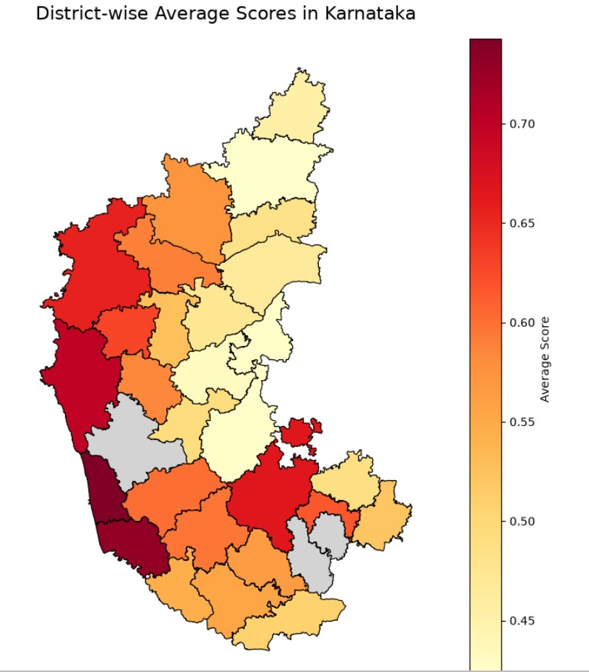
Key Insight 1
By analyzing the data in depth, we see distinctive geographic trends depending on the location. Western and southern regions of countries (the 'left' side of the map) show higher quality levels compared to the southern, eastern, and northern regions (the 'right' side of the map). Using ANOVA to examine this pattern confirms that key quality indicators like girls' practical reading skills, sanitation, and school building quality are really important. Historically, western countries have done better in specific economic and profit-related categories, which aligns with the model’s original 'Score' being higher. So, according to the data, regional development differences matter, and countries on the 'left' side can be placed at higher quality levels within the current framework.

Slide 7
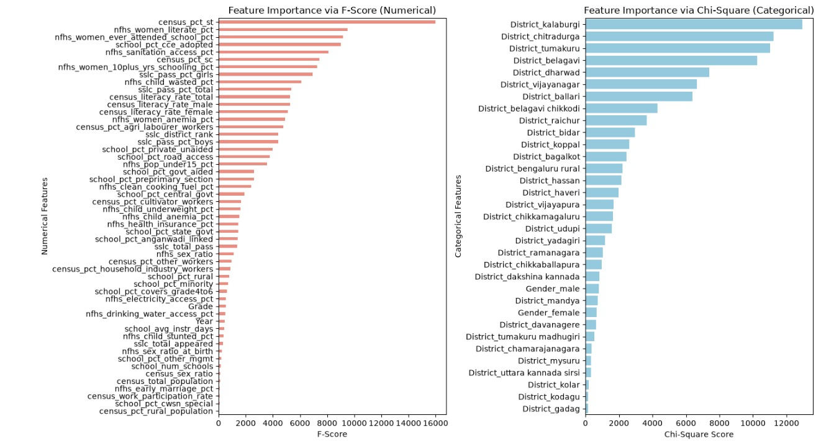
Key Insight 2
The feature selection process for this model utilized two distinct statistical methodologies to evaluate the importance of variables based on their data type. For numerical features, represented on the left side in red, an ANOVA (Analysis of Variance) F-score was applied to determine how strongly each continuous variable correlates with the target labels. Meanwhile, for the categorical features on the right side (typically represented in blue), a Chi-Square test was employed to measure the dependency between discrete categories and the output. By applying these tailored statistical tests, the analysis ensures that both types of data are accurately ranked, providing a comprehensive view of which factors—whether they are measurements like literacy rates or categories like school management types—have the most significant impact on the final results.
Response: At risk flag

Slide 8
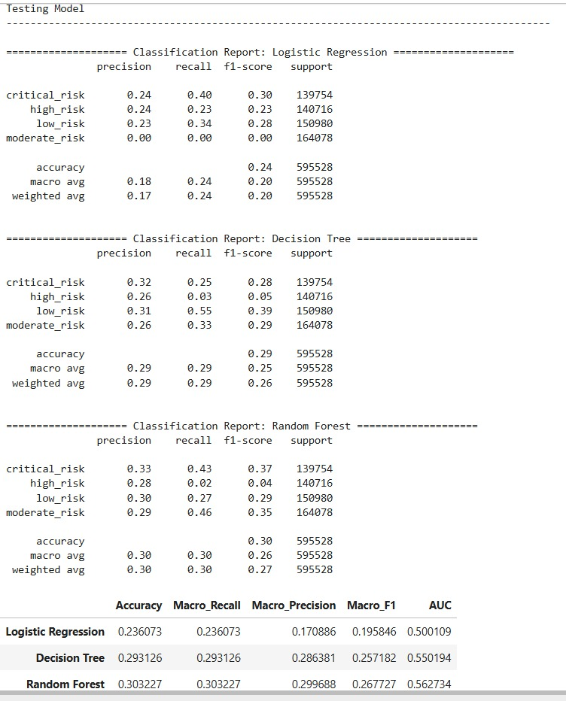
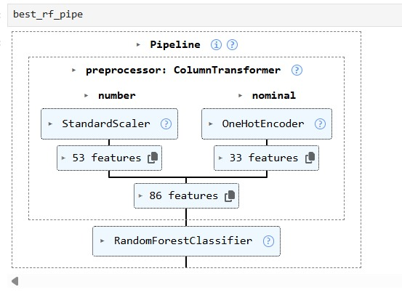
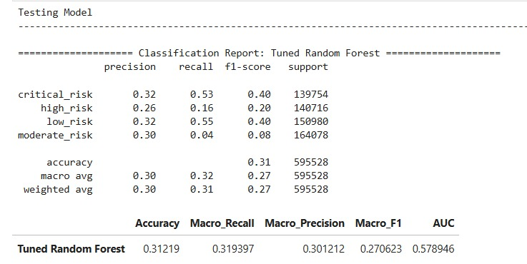
Predictive model
The project utilized a multi-class classification approach to analyze the data.
Three primary machine learning models were tested: Logistic Regression, Random Forest, and Decision Tree. To optimize the results, hyperparameter tuning was conducted using RandomizedCV Search on Random Forest model. Among the models tested, the Random Forest algorithm yielded the highest performance, achieving an accuracy of 31%.

Slide 9
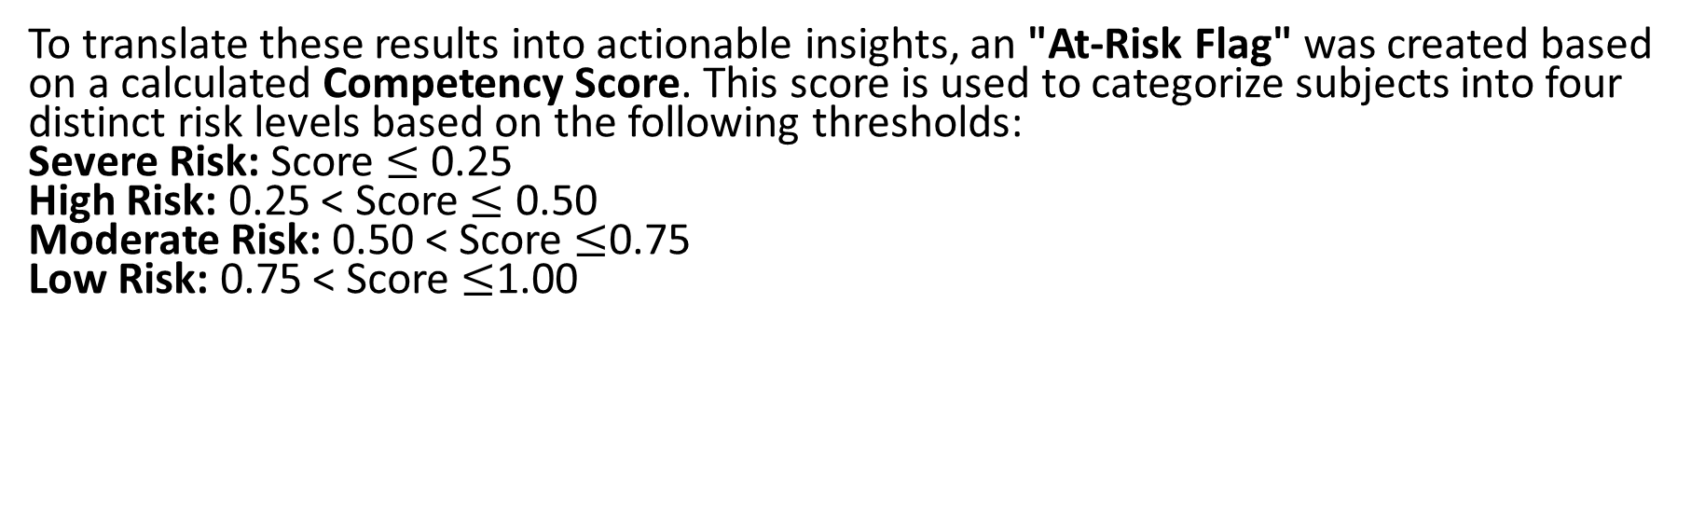
Predictive model cont’d Details of response features
To translate these results into actionable insights, an "At-Risk Flag" was created based on a calculated Competency Score. This score is used to categorize subjects into four distinct risk levels based on the following thresholds:
Severe Risk: Score $≤$ 0.25
High Risk: 0.25 < Score $≤$ 0.50
Moderate Risk: 0.50 < Score $≤$0.75
Low Risk: 0.75 < Score $≤$1.00

Slide 10
Innovation & Impact
• Novelty: Using Machine Learning model to predict the future grades of the students depending on changes in the data
• Scalability: Can be scaled to other states as well if the data is available.
• Limitations: For better predictions the data fed into the model has to be updated at regular intervals
• Expected impact: Better planning and efficient use of resources.
Evaluation: Depth of analysis | Policy relevance | Cross-dataset analysis | Innovation | Clarity of insights | Visualisation & presentation

Slide 11
Conclusion & Key Takeaways
This project successfully tackled the major challenge of identifying educational disparities across different regions. First, we created a flexible strategy that could be adjusted early on as needed. Using multi-class classification and feature selection validation (ANOVA and Chi-Square), this model turned complex socio-economic and infrastructure data into defined “At-Risk” levels. These risk levels range from Low to Severe, clearly showing where students need special attention. Finally, this predictive model can serve as an essential tool for data-driven management, helping to properly allocate resources, retain the best teachers, and improve student performance fairly across schools with different circumstances, all based on international standards.
Evaluation: Depth of analysis | Policy relevance | Cross-dataset analysis | Innovation | Clarity of insights | Visualisation & presentation

