Slide 1


Semaphores
----A Key Tool for Managing Concurrency in Operating Systems

Slide 2
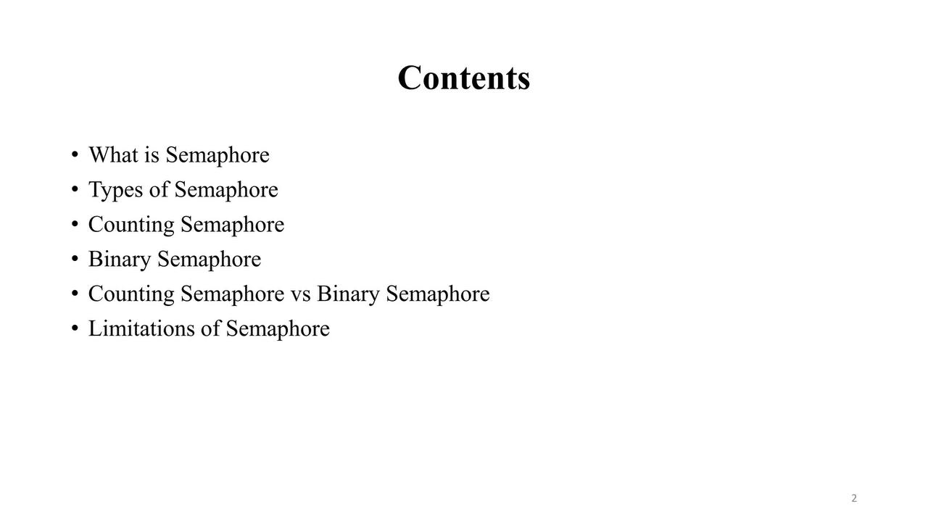
TABLE OF CONTENT

Slide 3
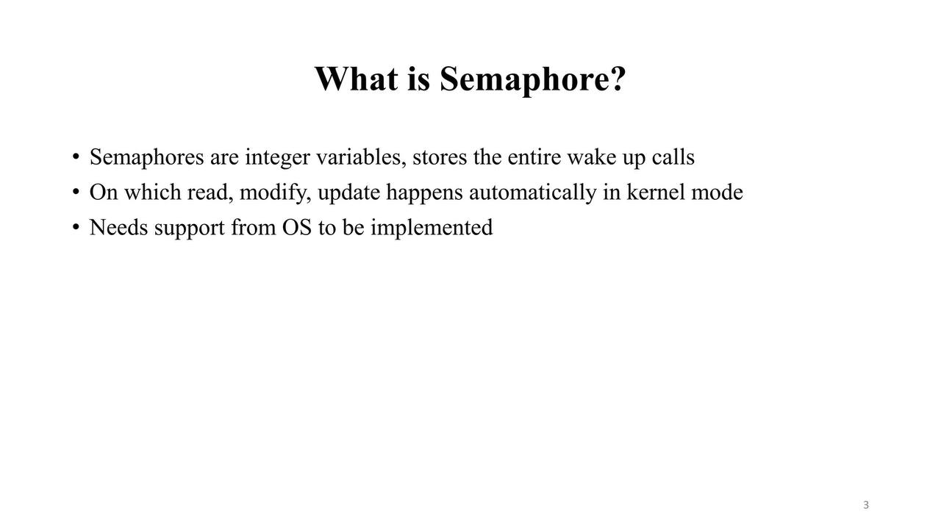

What is semaphore

Slide 4


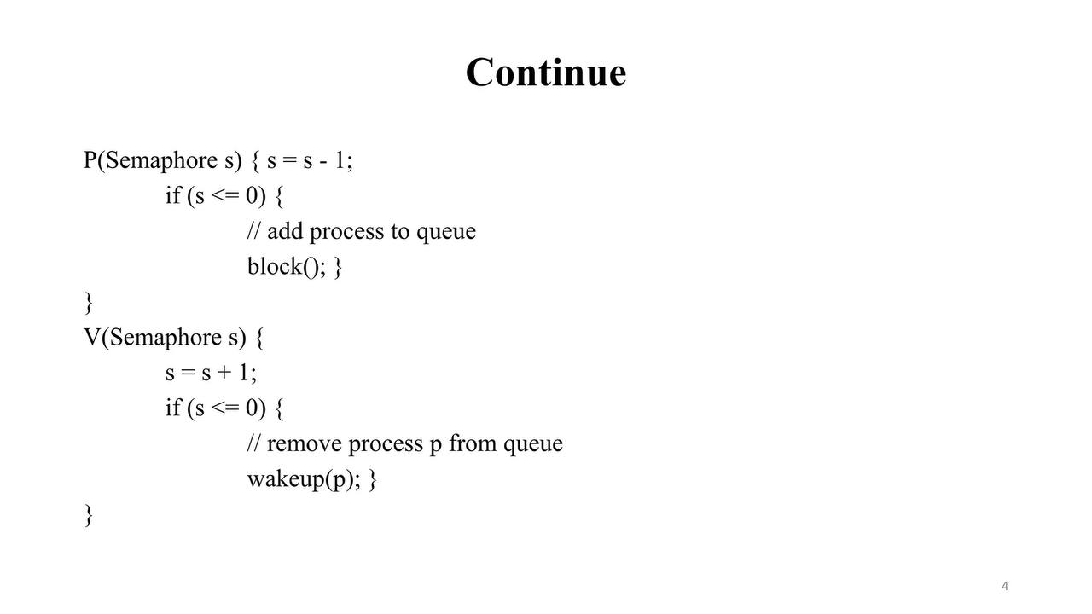


Slide 5
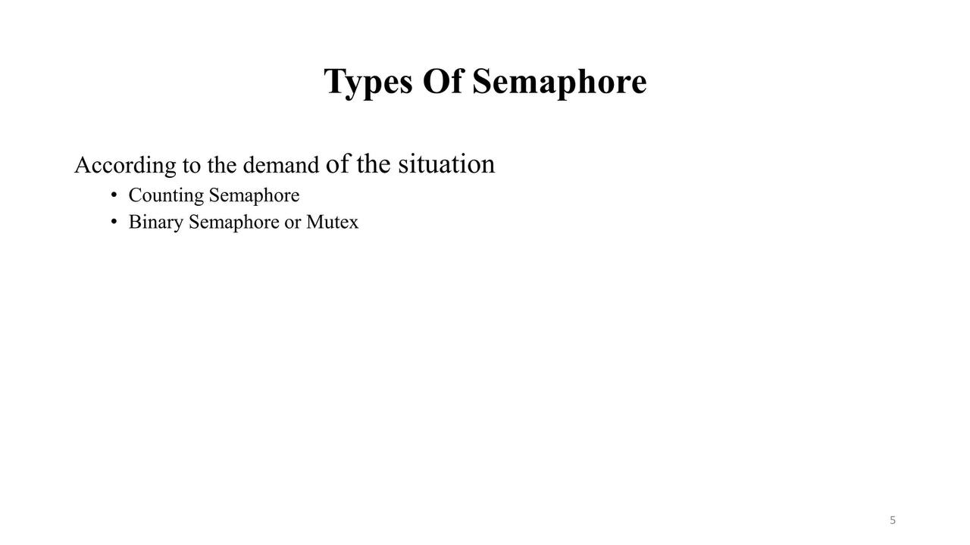
Types of semaphore

Slide 6
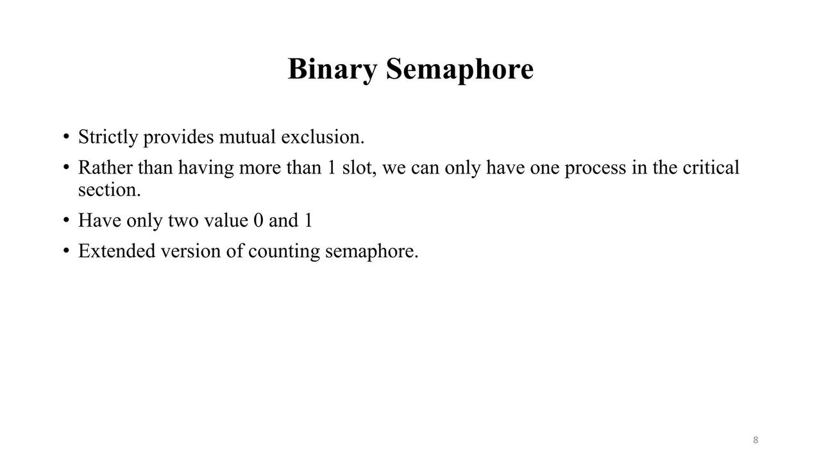
Binary semaphores

Slide 7
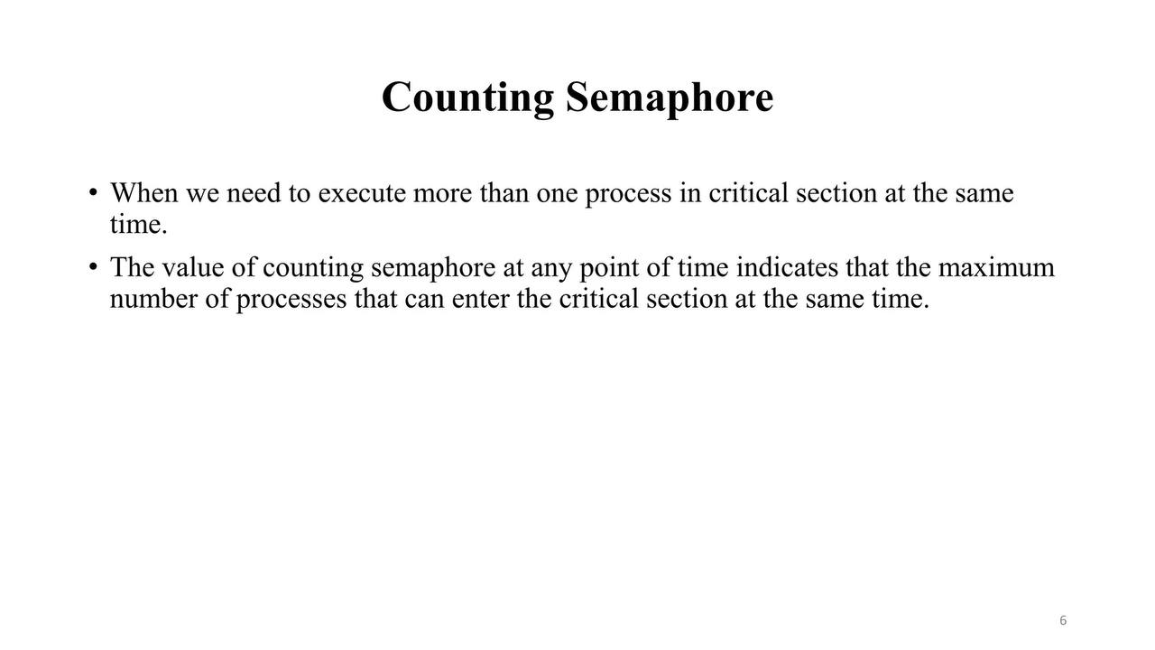
Counting Semaphore

Slide 8
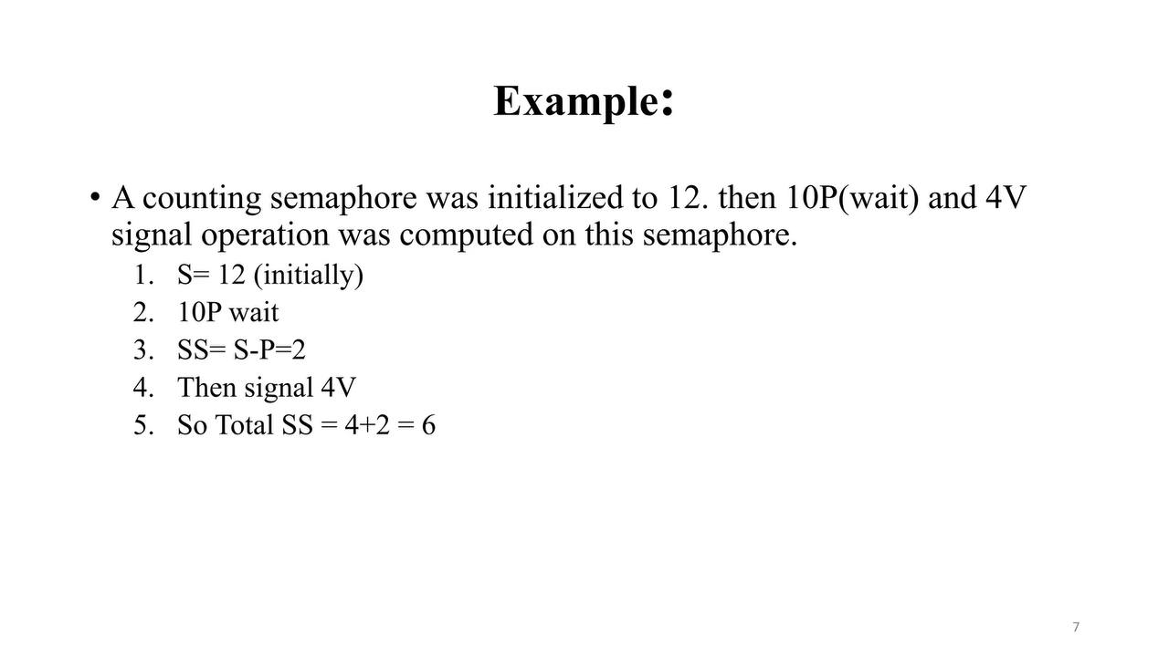
Example

Slide 9
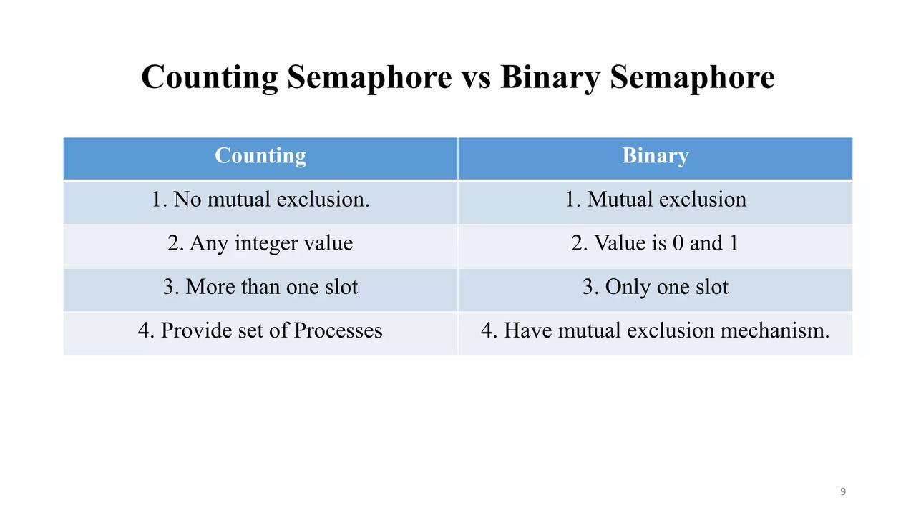
Counting vs Binary Semaphore

Slide 10
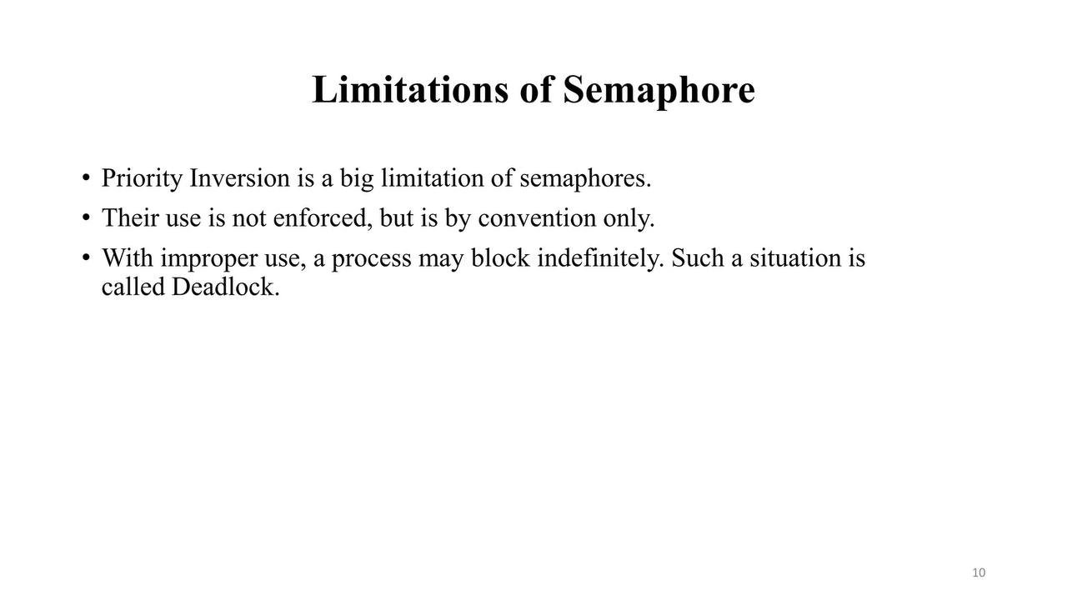
Limitation of Semaphore

Slide 11



OUR TEAM
Avinandan Roy
Nime ullah
221-15-4899
221-15-5515

