Slide 1
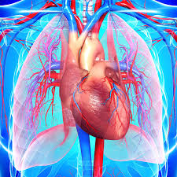

Topic: Machine Learning Models for Cardiovascular Disease Events Prediction
Team Members
1.Arafat Rahman (221-15-5422)
2.Jannati Nahid Akter (221-15-5523)
3.Avinandan Roy (221-15-4899)
4.Mst. Habiba sultana (221-15-5528)

Slide 2
Introduction
Cardiovascular diseases (CVDs) are a major cause of illness and death worldwide. Detecting them early is crucial for better outcomes. Machine learning (ML) offers a promising approach to spot CVD risks before symptoms appear.
Global death counts due to CVD increased from 12.4 million in 1990 to 19.8 million in 2022 reflecting global population growth and aging and the contributions from preventable metabolic, environmental, and behavioral risks.Eastern Europe had the highest age-standardized total CVD mortality at 553 deaths per 100,000.

Slide 3
Motivation
Machine learning models for predicting cardiovascular disease events make it easier to accurately assess individual risks by analyzing various health data. This helps doctors tailor prevention strategies and interventions for better patient outcomes.

Slide 4
Objective
Predict who is at risk of cardiovascular events like heart attacks or strokes.Data Used: Patient info like age, medical history, habits, and test results.Goal: Help doctors identify high-risk patients for preventive action.Benefit: Early intervention can save lives and improve health outcomes.

Slide 5
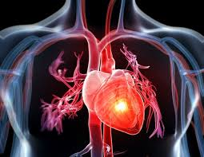
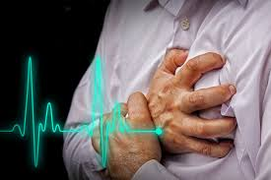
Problem Statement And Identification
Problem Statement:
The primary cause of death in the United States and around the world is cardiovascular disease. In the United States, about half of adult individuals suffer from cardiovascular disease.
Problem Identification:
High Risks: Cardiovascular diseases are among the top causes of death worldwide. Identifying individuals at risk early can save lives and reduce healthcare costs.
Multiple Factors: Many factors, like age, gender, hypertension, diabetes, and lifestyle choices, affect CVD risk. Integrating these diverse data points into predictive models is challenging.
Data Collection: Patient data needed for prediction comes from different sources, like electronic health records and genetic information. Bringing this data together and preparing it for analysis is crucial.
Rare Events: CVD events are relatively rare compared to non-events in medical datasets. Handling this imbalance ensures models accurately identify high-risk individuals.
Understanding Models: Healthcare providers need to understand why a model predicts a certain risk. Models should be interpretable and transparent to gain trust and acceptance.
Ethical Considerations: Models must comply with ethical guidelines and protect patient privacy. They should also be fair and unbiased, without discriminating based on factors like race or gender.

Slide 6

Symptoms of Heart Issues
Symptoms of heart issues[5]:Chest pain (angina)Chest pressure, heaviness or discomfort, sometimes described as a “belt around the chest” or a “weight on the chest”Shortness of breath (dyspnea)Dizziness or faintingYou may be more likely to develop cardiovascular disease if you have risk factors such as[7]:High blood pressure (hypertension).High cholesterol (hyperlipidemia).Tobacco use (including vaping).Type 2 diabetes.Family history of heart disease.Lack of physical activity.

Slide 7
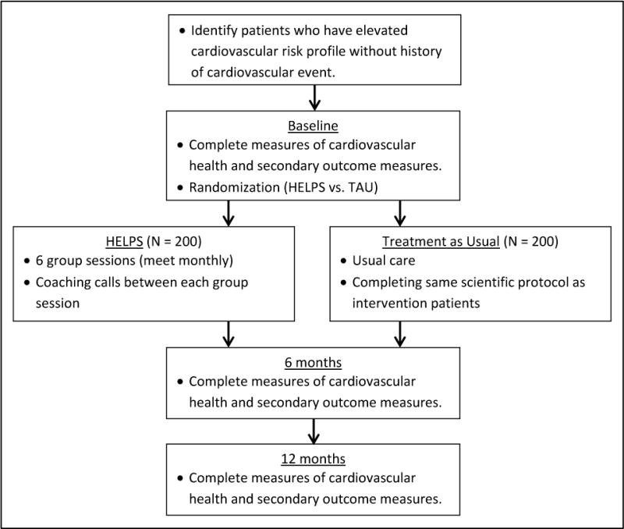
ProBLEM STATEMENT FLOWCHART

Slide 8
METHODOLOGY
In this paper we would be applying statistical tests to analyze the percentages and the growth rate of colon cancer and also suggest ML and DL approaches based on the previous research .
Data Collection: Gather patient information such as medical history and test results.
Data Preprocessing: Clean and prepare the data, handling missing values and normalizing features.
Feature Selection: Identify the most important features for prediction.
Model Selection: Choose suitable algorithms like logistic regression or decision trees.
Model Training: Train the models using the prepared data, adjusting parameters as needed.
Model Evaluation: Assess how well the models perform using metrics like accuracy or AUC-ROC.
Model Interpretation: Understand the factors influencing the predictions made by the models.
Continuous Improvement: Regularly update and refine the model based on new data and feedback.

Slide 9
Limitations
Data Quality: Limited and inaccurate data can affect predictions.Feature Selection: Choosing the right features is crucial.Model Overfitting: Models can memorize data instead of learning patterns.Imbalanced Data: Not enough positive cases can bias

Slide 10

Conclusion
machine learning models for predicting cardiovascular disease events offer a promising way to identify individuals at risk of heart attacks or strokes. However, challenges like combining different types of patient data, dealing with unbalanced data, and making sure the models are easy to understand need to be addressed. By working together, researchers, doctors, and policymakers can overcome these challenges and create reliable models for personalized risk prediction and prevention.

Slide 11
Reference
Alalawi, H.H. and Alsuwat, M.S., 2021. Detection of cardiovascular disease using machine learning classification models. International Journal of Engineering Research & Technology, 10(7), pp.151-7.
Dritsas, E. and Trigka, M., 2023. Efficient data-driven machine learning models for cardiovascular diseases risk prediction. Sensors, 23(3), p.1161.
Nieuwsma JA, Wray LO, Voils CI, Gierisch JM, Dundon M, Coffman CJ, Jackson GL, Merwin R, Vair C, Juntilla K, White-Clark C, Jeffreys AS, Harris A, Owings M, Marr J, Edelman D. A problem-solving intervention for cardiovascular disease risk reduction in veterans: Protocol for a randomized controlled trial. Contemp Clin Trials. 2017 Sep;60:42-50. doi: 10.1016/j.cct.2017.06.001. Epub 2017 Jun 23. PMID: 28600161; PMCID: PMC5579718.

Slide 12


