Slide 1
LEGAL DOCUMENT ANALYSIS AND AUTOMATED CONTRACT GENERATION USING AI
Submitted in the partial fulfillment for the award of the degree of
BACHELOR OF ENGINEERING
IN
CCOMPUTER SCIENCE WITH SPECIALIZATION IN
ARTIFICIAL INTELLIGENCE AND MACHINE LEARNING
NAME | UID
Avinash Singh Haobijam | 21BCS11467
Debasish Hazarika | 21BCS11696
Under the Supervision of:
Ms Kiran Preet Bedi
Department of AIT-CSE
DISCOVER . LEARN . EMPOWER

Slide 2
Outline
Introduction to Project
Problem Formulation
Objectives of the work
Literature Review
Methodology
Result
Prototype
Conclusion
References

Slide 3
Introduction to Project
The legal industry stands at the point for a significant transformation, driven by rapid advancements in Artificial Intelligence. Among impactful application of AI in law are legal document analysis and automated contract generation. The increase volume and complexity of legal information necessitates adoption of more efficient and accurate tools to manage and drive insights from this vast data. Several core AI methodologies underpin those advancements, each contributing unique capabilities to the process.

Slide 4
Problem Formulation
Traditional approaches to legal document analysis and generation have largely relied on static templates, rule-based automation, and conventional NLP models. While these methods can support basic document formatting or clause identification, they struggle to interpret language structural complexity, and contextual dependencies inherent in legal texts. As a result, they often produce rigid or incomplete outputs, failing to adapt to the specific requirements of different legal scenarios. These systems lack the ability to engage in dynamic interactions that can capture user intent, clarify ambiguities, or iteratively refine legal content.

Slide 5
Objectives of the Work
1
Simplify the process of legal document analysis by providing users with clear and structured outputs that highlight key information and relevant clauses.
2
Develop an intelligent legal assistant capable of interpreting, analyzing, and generating contracts autonomously.

Slide 6
Literature Review
The application of NLP and ML to automate analysis of legal contracts, tackling inefficiencies of manual processes. NLP techniques such as Bag of Words vectorization and ML algorithms such as text classification and ensemble methods to analyze construction contracts [1]. Utilizing Python libraries including spaCy, PDFMiner, and scikit-learn, they focused on the FIDIC standard contracts to identify risks, responsibilities, and rights. Achieving 89% accuracy in sentence type identification and 83% in classifying related parties, this work demonstrated the potential of automation to accelerate risk management, laying a critical foundation for subsequent legal tech innovations.

Slide 7
Literature Review cont…
Building on this groundwork, [2] explored NLP’s broader utility in legal tasks beyond contracts. Using foundational models like Bag of Words alongside advanced distributional semantics, researchers automated document review, legal brief analysis, and case outcome predictions. While effective in repetitive tasks, the study revealed NLP’s limitations in complex legal reasoning, signaling a need for more advanced tools and setting the stage for the field’s expansion.

Slide 8
Literature Review cont…
The scalability of NLP was tested in a subsequent effort [3] that tackled large-scale legal texts. Employing tools like CLAUDETTE and Deep Learning models with Word2Vec embeddings, researchers automated the detection of unfair clauses in terms of service agreements and extracted arguments from multilingual documents. This work highlighted NLP’s ability to handle vast datasets, a critical step toward broader legal applications

Slide 9
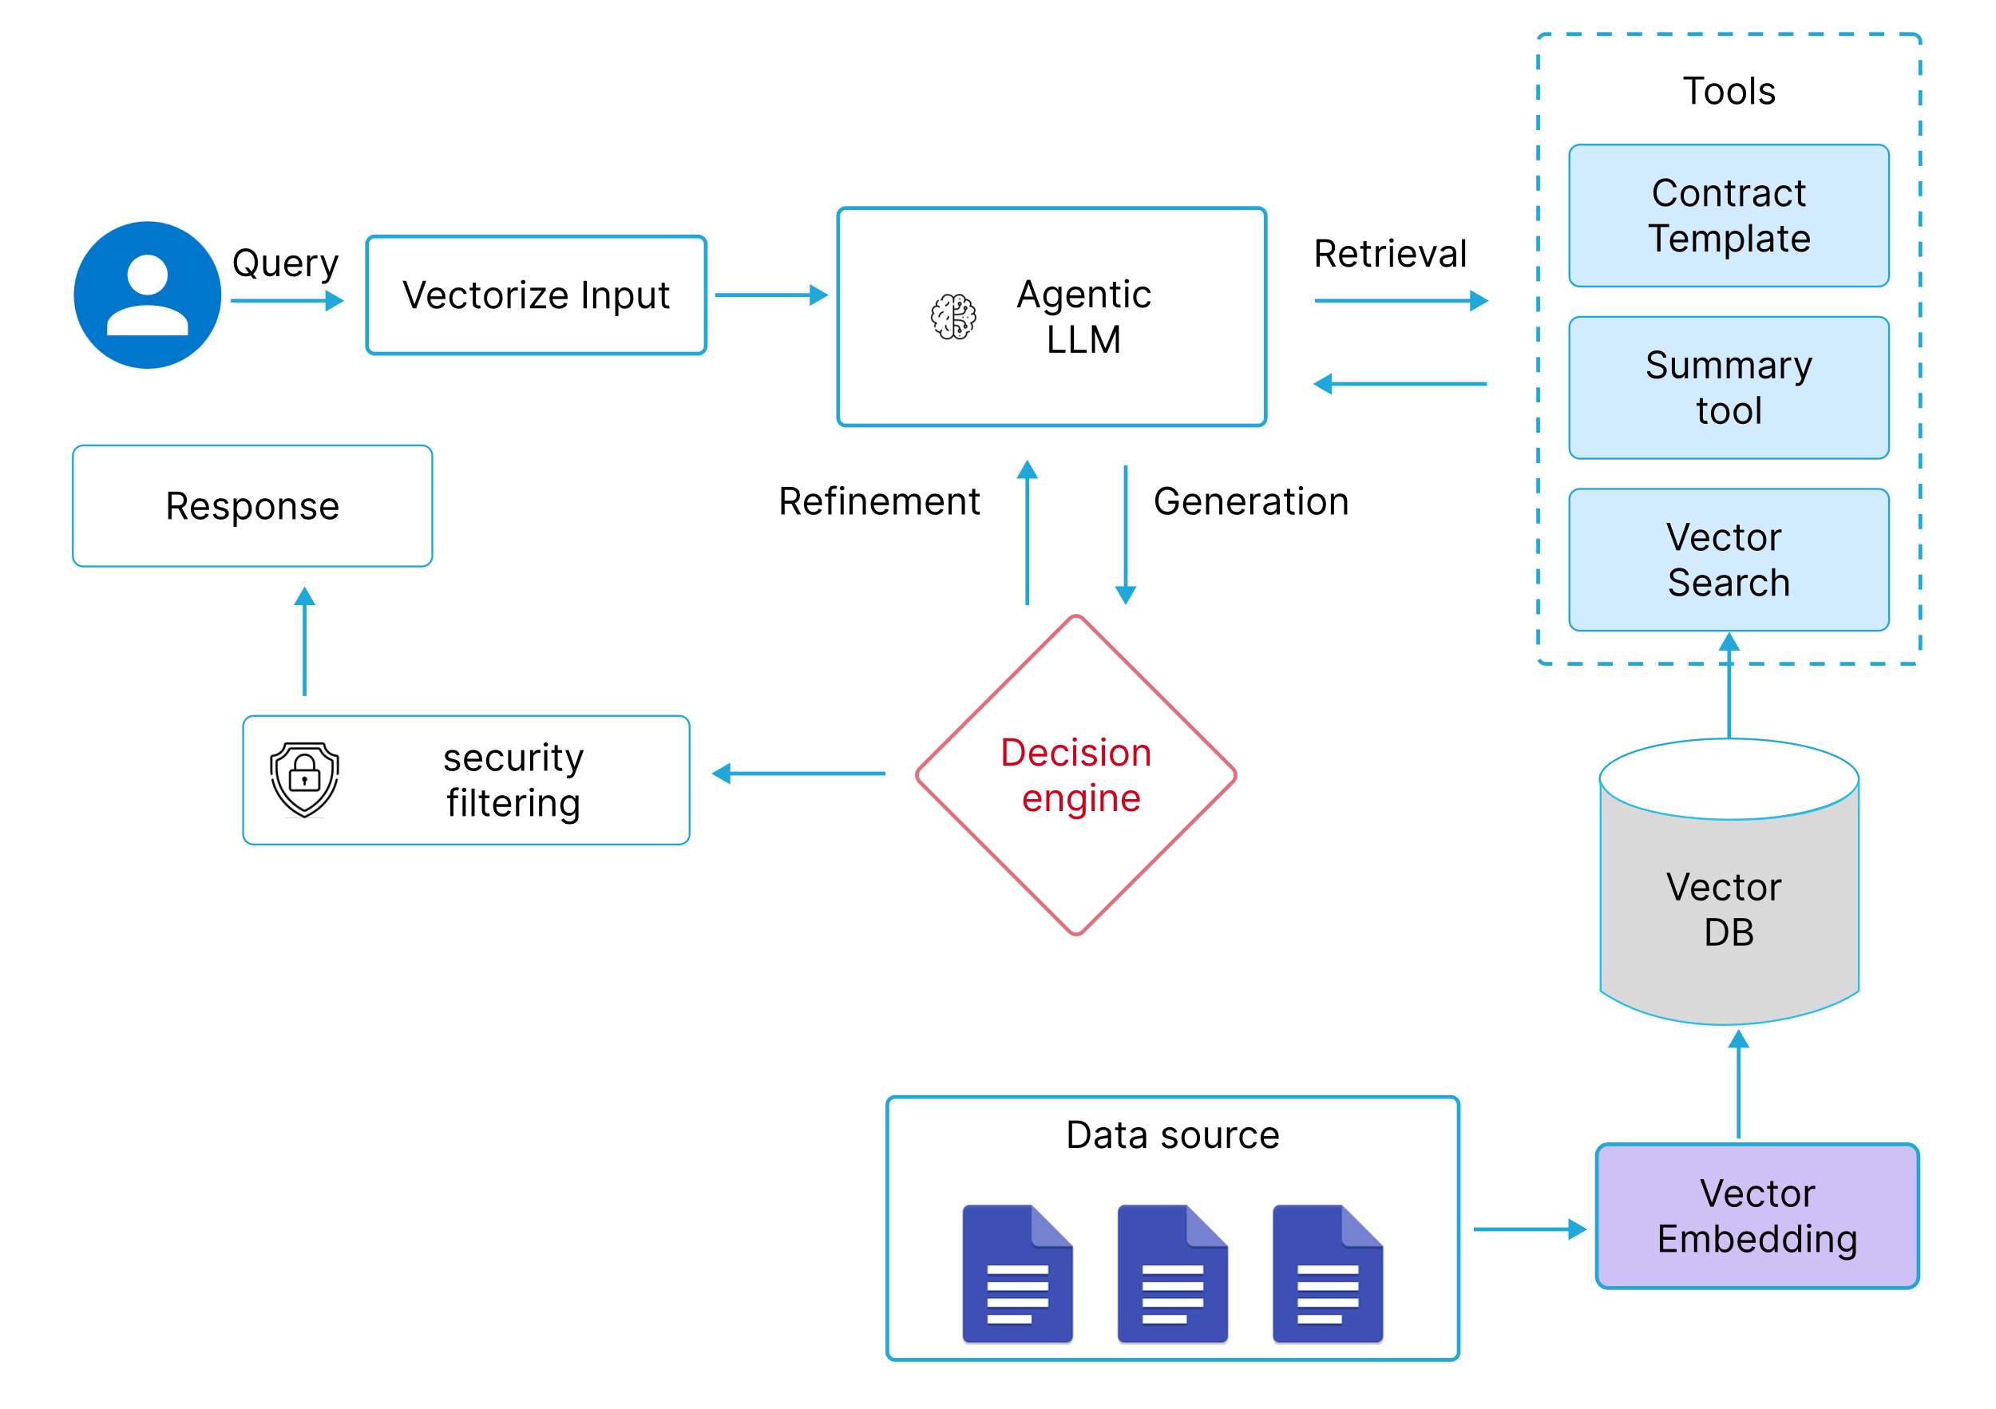
Methodology
Fig. 1 System architecture

Slide 10
Methodology
This study leverages an agentic-based large language model (LLM) for both legal document analysis and contract generation. The system architecture is built around three primary components
Natural Language Understanding (NLU): Uses Cohere LLM to process and comprehend legal texts.
Agents: Developed with the LangGraph framework to autonomously manage tool selection and workflow.
Decision Engine: A rule-based module that evaluates outputs for legal compliance and contextual relevance.

Slide 11
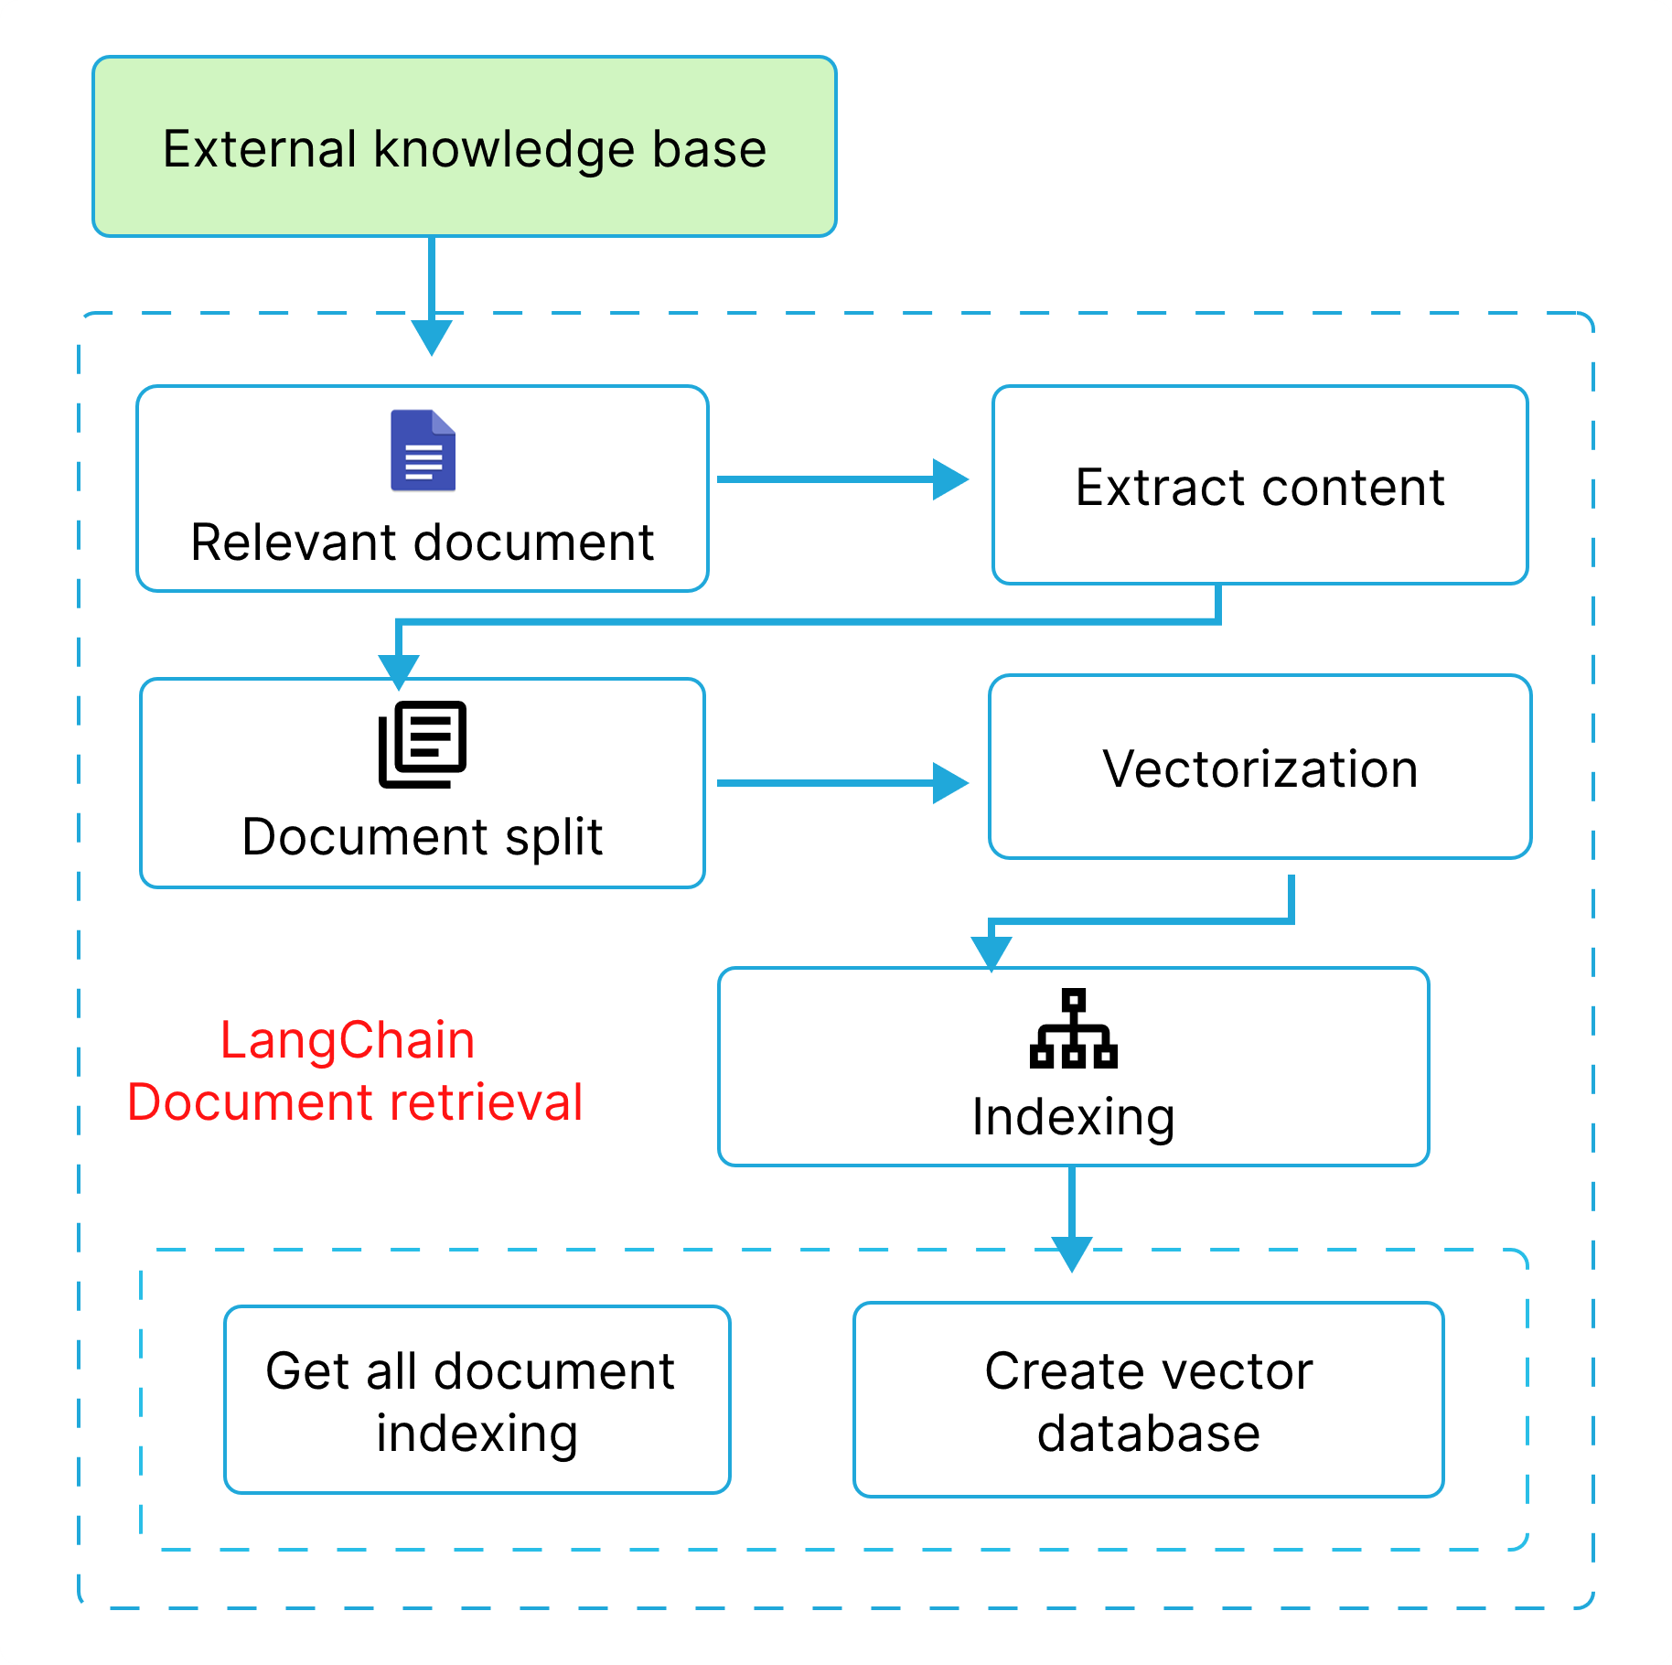
Information Retriever
The Information Retriever is responsible for interpreting customer queries and extracting relevant contextual details to provide accurate responses.
Query Understanding: Uses NLP techniques to analyze customer input, identifying intent and key entities (e.g., account details, issue type).
Contextual Retrieval: Retrieves relevant documents or structured data from internal databases, knowledge bases, or external APIs.

Slide 12
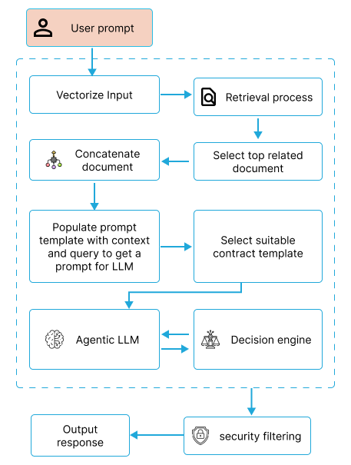
Agent
The Agent acts as the system’s memory and logic engine, ensuring seamless interactions by maintaining conversation history and making dynamic decisions.
Context Tracking: Maintains multi-turn dialogue history and keeps track of customer-specific details across sessions.
Action Execution: Generator methods, retrieves or updates document.
Decision Making: Determines when to escalate an issue to a human agent or request additional information from the user.

Slide 13

Generators
The Generator formulates responses by combining retrieved information, structured templates, and real-time data to produce natural and relevant replies.
Response Generation: Uses LLMs to create human-like responses tailored to customer queries.
Multi-Turn Response Handling: Ensures responses remain coherent across multiple interactions within the same session.
LLMs

Slide 14
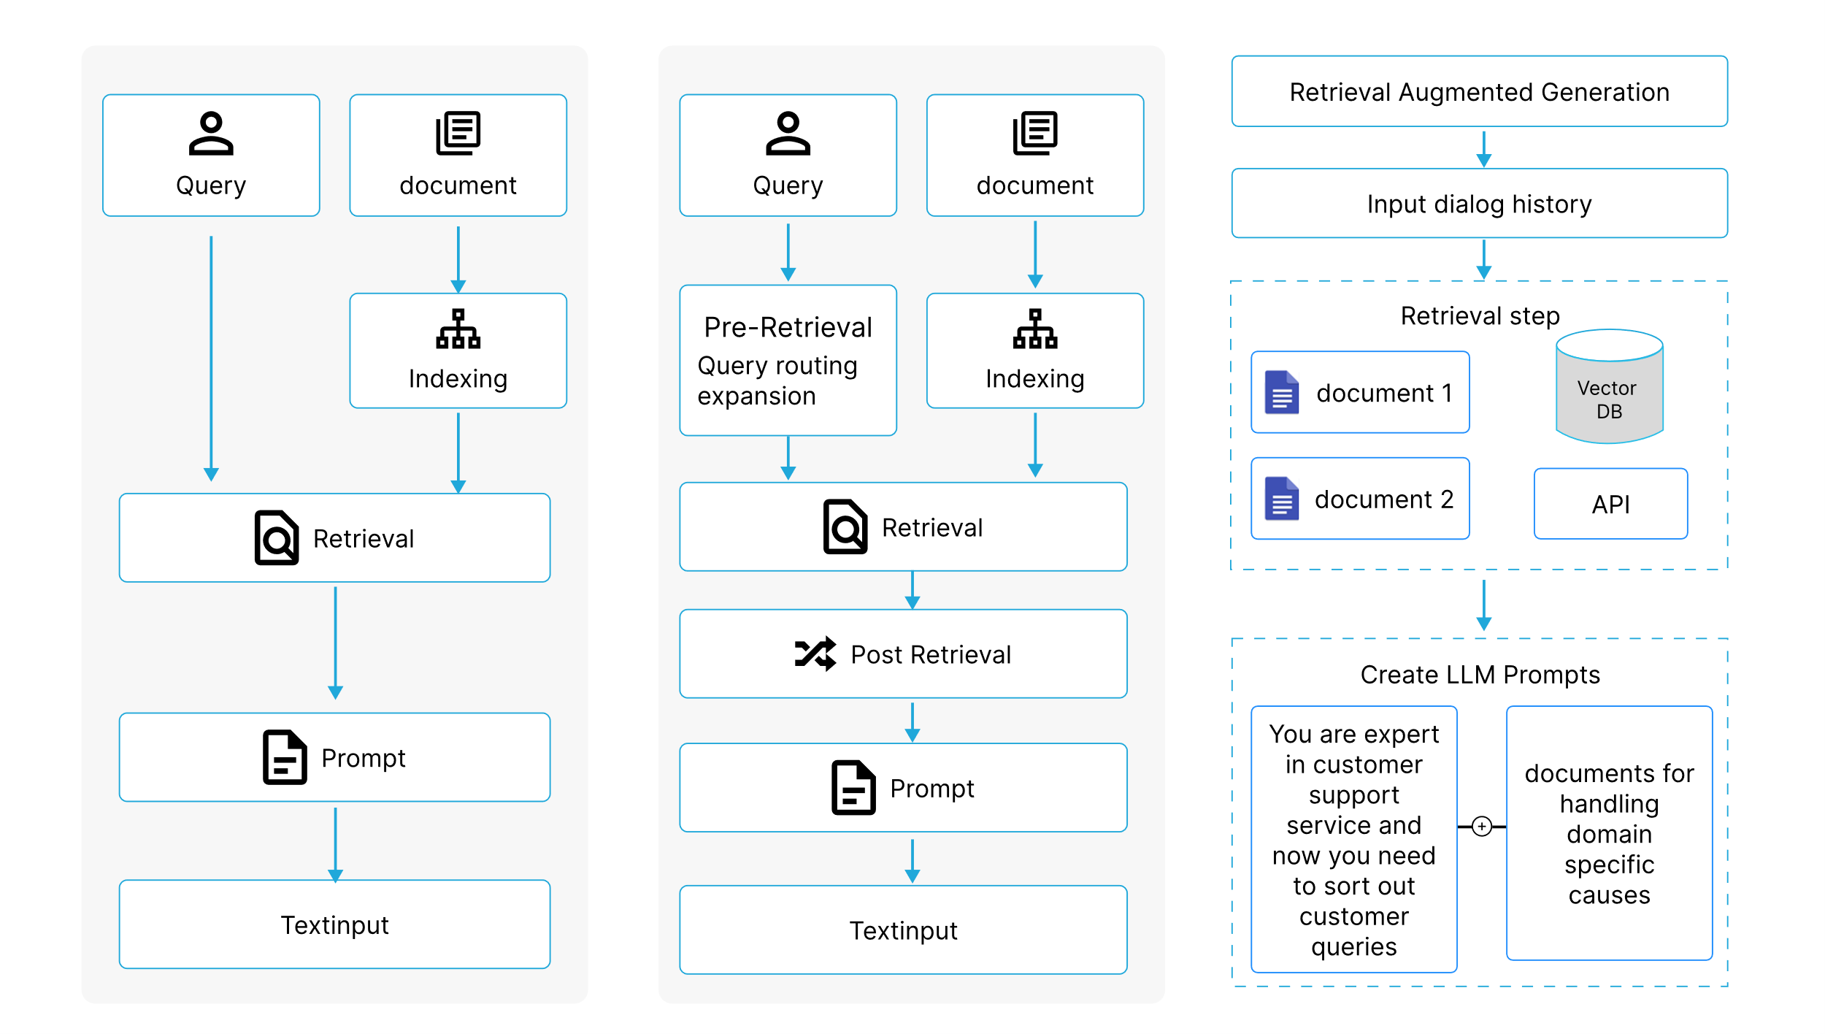
RAG-Types
Naïve RAG
Advanced RAG
Agentic RAG

Slide 15
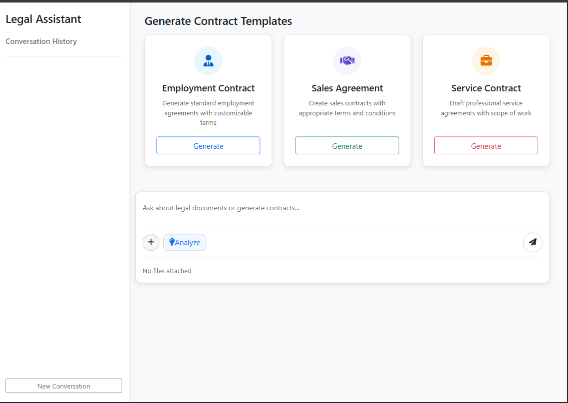
Proto-type
Legal chatbot Prototype

Slide 16
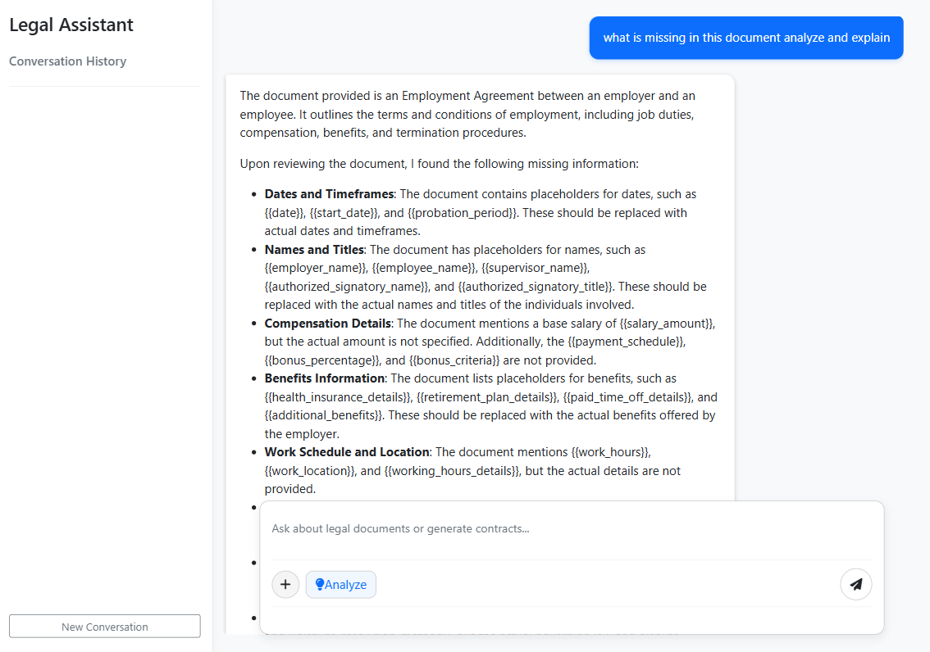
Proto-type
Legal chatbot analyzing doc type file

Slide 17
Proto-type
Legal chatbot analyzing doc type file

Slide 18
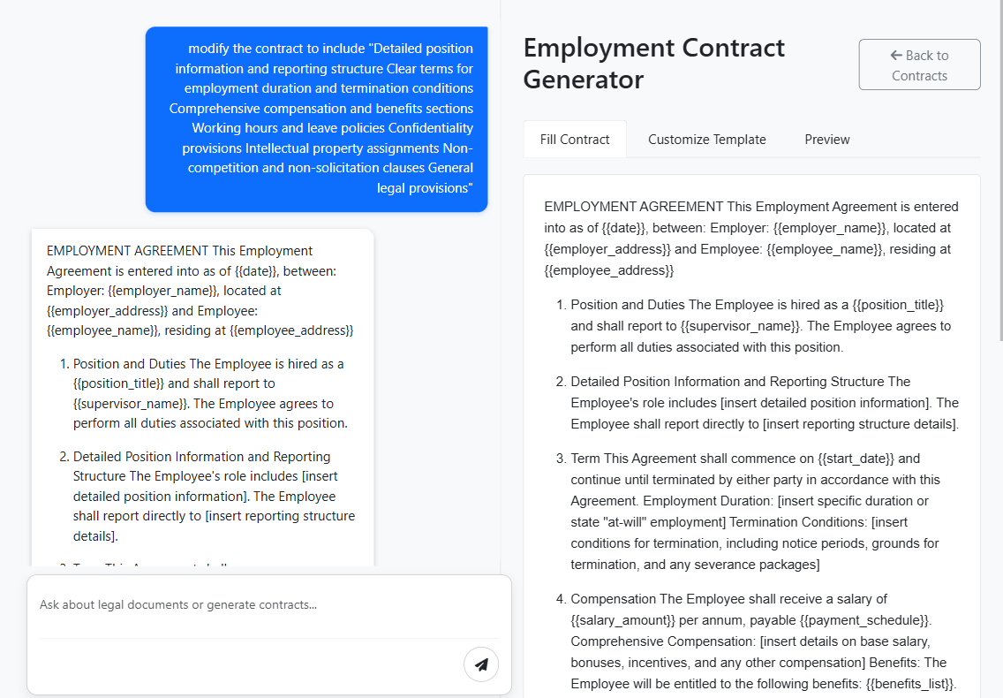
Proto-type
Legal chatbot generating contract

Slide 19
Result
Metrics | Legal Document Analysis (%) | Contract Generation (%)
Precision | 82 | 84
Recall | 78 | 81

Slide 20
Conclusion
The findings demonstrate that integrating an agentic-based LLM with an iterative refinement process substantially improves the accuracy and reliability of legal document analysis and contract generation. This approach not only enhances the precision of legal information extraction but also ensures that generated contracts are legally compliant and contextually appropriate. Consequently, the proposed method presents a promising avenue for automating complex legal tasks while reducing the potential for human error.

Slide 21
References
[1] I. Dikmen, G. Eken, H. Erol, and M. T. Birgonul, “Automated construction contract analysis for risk and responsibility assessment using natural language processing and machine learning,” Computers in Industry, vol. 166, p. 104251, Jan. 2025, doi: 10.1016/j.compind.2025.104251.
[2] J. Frankenreiter and J. Nyarko, “Natural language processing in legal tech,” SSRN Electronic Journal, Jan. 2022, doi: 10.2139/ssrn.4027030
[3] L. Robaldo, S. Villata, A. Wyner, and M. Grabmair, “Introduction for artificial intelligence and law: special issue ‘natural language processing for legal texts,’” Artificial Intelligence and Law, vol. 27, no. 2, pp. 113–115, Apr. 2019, doi: 10.1007/s10506-019-09251-2.
[4] Vinay, S. B. "Natural Language Processing for Legal Documentation in Indian Languages." International Journal of Natural Language Processing (IJNLP) 2, no. 1 (2024): 1-11.
[5] Agarwal, R., Sharma, A.. “The Future of Legal Practice: The Impact of Technology,” International Journal of Research Publication and Reviews (IJRPR), Vol 5(11), 2024, 6292–6300. https://ijrpr.com/uploads/V5ISSUE11/IJRPR35521.pdf.
[6] C. Kerdvibulvech, “Big data and AI-driven evidence analysis: a global perspective on citation trends, accessibility, and future research in legal applications,” Journal of Big Data, vol. 11, no. 1, Dec. 2024, doi: 10.1186/s40537-024-01046-w.

Slide 22
References
[7] J. H. Choi and D. Schwarcz, “AI assistance in Legal Analysis: an Empirical study,” SSRN Electronic Journal, Jan. 2023, doi: 10.2139/ssrn.4539836.
[8] M. H. Zakir, S. Bashir, R. N. Ali, and S. H. Khan, “Artificial Intelligence and Machine Learning in Legal Research: A Comprehensive Analysis,” QJSS, vol. 5, no. 1, pp. 307–317, Mar. 2024, doi: 10.55737/qjss.203679344.
[9] R. Bhambhoria, S. Dahan, J. Li, and X. Zhu, “Evaluating AI for Law: Bridging the Gap with Open-Source Solutions,” arXiv (Cornell University), Apr. 2024, doi: 10.48550/arxiv.2404.12349.
[10] P. N. Devaraj, P. V. R. Teja, A. Gangrade, and M. K. R, “Development of a legal document AI-Chatbot,” arXiv (Cornell University), Jan. 2023, doi: 10.48550/arxiv.2311.12719.
[11] S. Nasir, Q. Abbas, S. Bai, and R. A. Khan, “A comprehensive framework for reliable legal AI: combining specialized expert systems and adaptive refinement,” arXiv (Cornell University), Dec. 2024, doi: 10.48550/arxiv.2412.20468.
[12] C. J. Mahoney, J. Zhang, N. Huber-Fliflet, P. Gronvall, and H. Zhao, “A framework for Explainable text Classification in Legal Document review,” arXiv (Cornell University), Jan. 2019, doi: 10.48550/arxiv.1912.09501.

