Slide 1

OPTIMIZING TRANSPORTATION SOLUTIONS: ANALYZING THE NW METHOD AND INTRODUCING SIMULATED ANNEALING

Slide 2


are crucial for optimizing logistics and reducing costs.
This presentation will explore the
INTRODUCTION TO TRANSPORTATION SOLUTIONS
for transportation optimization and
introduce as a
powerful alternative. Understanding these methods will enhance decision- making in transportation management.

Slide 3
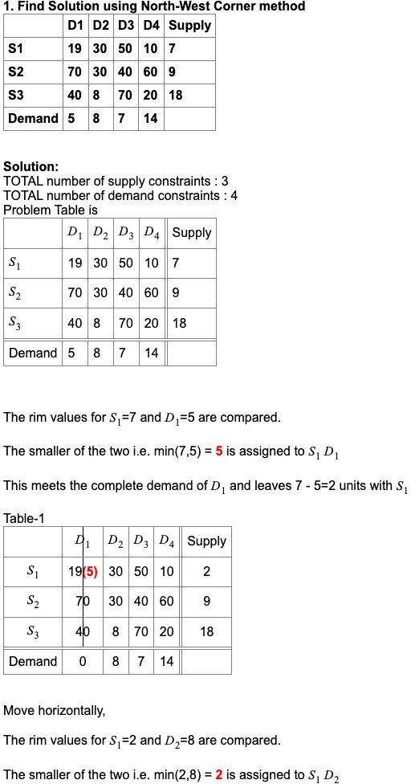
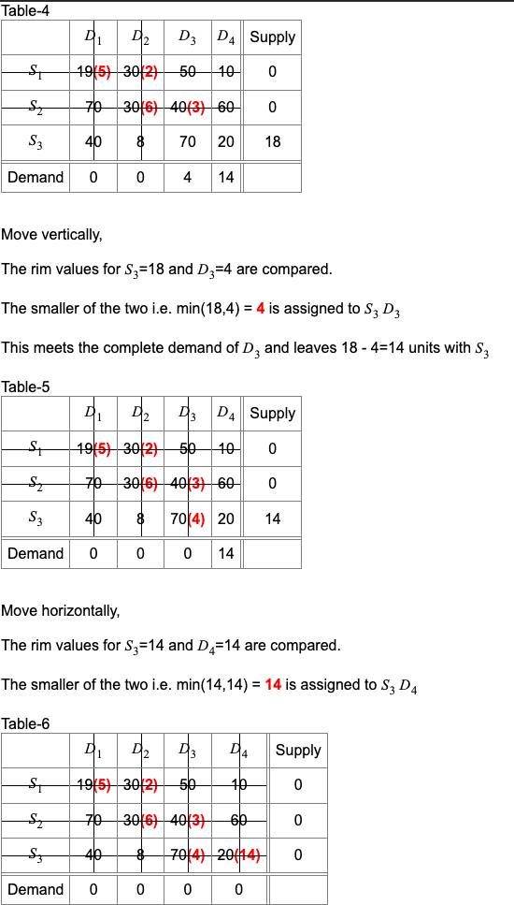
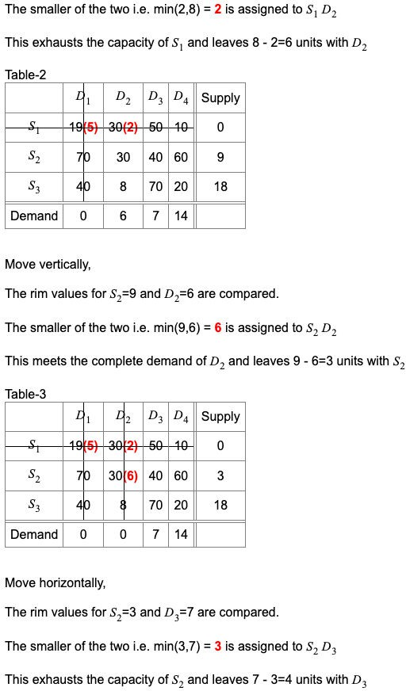


Slide 4






ADVANTAGES OF THE NW METHOD
The ofers several advantages, including , ,
and the ability to provide an
quickly. This method is particularly beneﬁcial for small to medium-sized
transportation problems, allowing for rapid decision-making in logistics.

Slide 5

INTRODUCTION TO SIMULATED ANNEALING
is a probabilistic technique for approximating the global optimum of a given function. Inspired by the annealing process in metallurgy,
this method is efective for large and complex transportation problems,
allowing for exploration of the solution space beyond local optima.

Slide 6



COMPARING THE TWO METHODS
While the provides a quick feasible solution,
excels in ﬁnding optimal solutions for larger problems. Each method has its own strengths and weaknesses, making it essential to choose the right approach
based on the speciﬁc transportation challenge faced.

Slide 7


CONCLUSION AND FUTURE DIRECTIONS
In conclusion, optimizing transportation solutions requires understanding both the and . By leveraging these methods, organizations can enhance their logistics eficiency. Future research should focus on hybrid approaches that combine the strengths of both techniques for superior results.

Slide 8

Thanks!
Do you have any questions? youremail@email.com
+91 620 421 838
www.yourwebsite.com @yourusername

