Slide 1
Flight Ticket Price Prediction
Avinash Nalawade

Slide 2
AGENDA
Introduction
Domain Overview
Dataset Structure
Problem Statement
Data Preprocessing
Model Selection
Model Evaluation
Insights
Conclusion

Slide 3
Introduction
INTRODUCTION
The objective of this project is to predict flight ticket prices based on various features using machine learning models.
Predicting accurate ticket prices is crucial for both airlines and consumers.

Slide 4
Domain Overview
DOMAIN OVERVIEW
The airline industry is highly competitive and prices fluctuate frequently.
Factors influencing prices include demand, route, seasonality, and competition.
Accurate price prediction can help in revenue management and customer satisfaction.

Slide 5
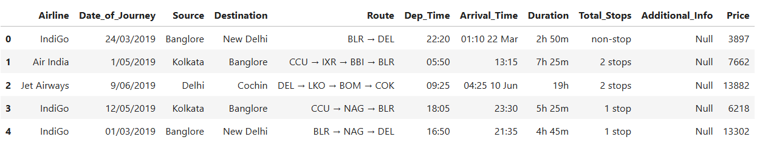
Dataset Structure
DATASET STRUCTURE
DATASET STRUCTURE
The dataset contains 10,683 records with 11 features.
Key features include Airline, Source, Destination, Route, and Price.
The target variable is the flight ticket price.

Slide 6
Problem Statement
PROBLEM STATEMENT
The aviation industry in India is witnessing rapid growth, with multiple airlines operating flights across various cities. However, the prices of air tickets are highly dynamic, influenced by a multitude of factors such as demand, timing, airline reputation, and more. For both airlines and passengers, predicting these prices with accuracy is crucial for maximizing revenue and ensuring affordability.
This project aims to develop a robust machine learning model that accurately predicts the air ticket prices for flights within India. By analyzing data from different airlines and flights between various cities, the model will identify key factors affecting ticket pricing and provide insights to enhance decision-making processes for stakeholders.

Slide 7
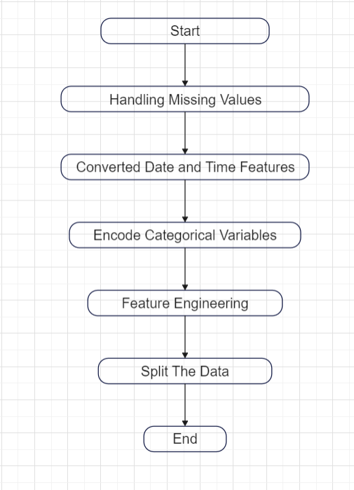
DATA PREPROCESSING
Flowchart of Data Preprocessing

Slide 8

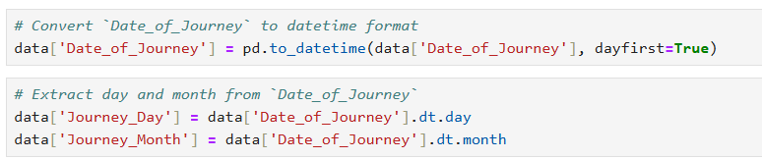
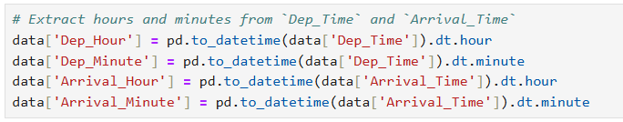
DATA PREPROCESSING
Handling Missing Values
Converted date and time features to extract useful information.

Slide 9
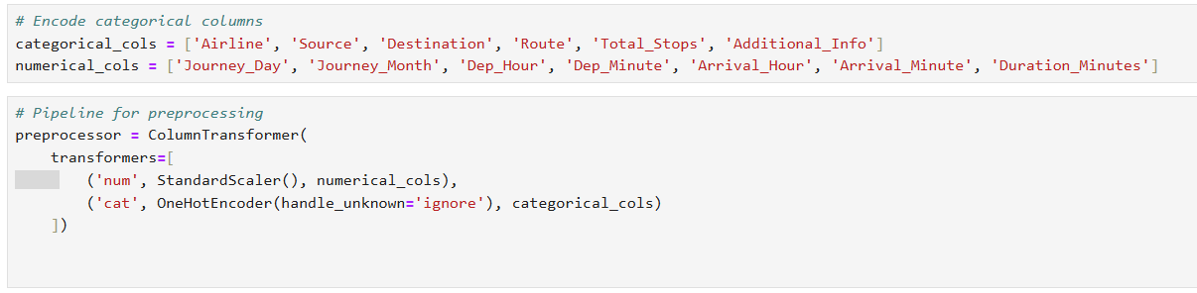
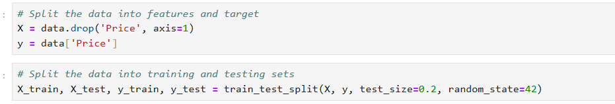
DATA PREPROCESSING
Encoded categorical variables such as Airline, Source, and Destination.
Split the Data

Slide 10
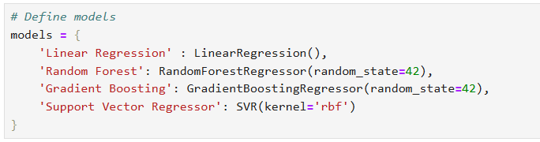
Model Selection
MODEL SELECTION
Tried different machine learning models:
1. Linear Regression
2. Random Forest Regressor
3. Gradient Boosting Regressor
4. Support Vector Regressor (SVR)

Slide 11
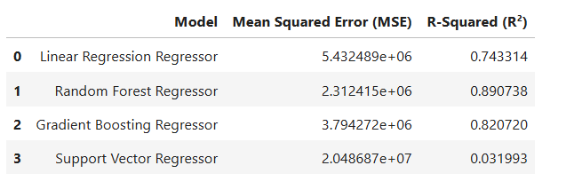
Model Evaluation
MODEL EVOLUTION
Performance of different models:
- Random Forest Regressor: MSE = 2,312,415, R² = 0.891
- Gradient Boosting Regressor: MSE = 3,794,272, R² = 0.821
- Support Vector Regressor: MSE = 20,486,871, R² = 0.032
Best Model: Random Forest Regressor

Slide 12
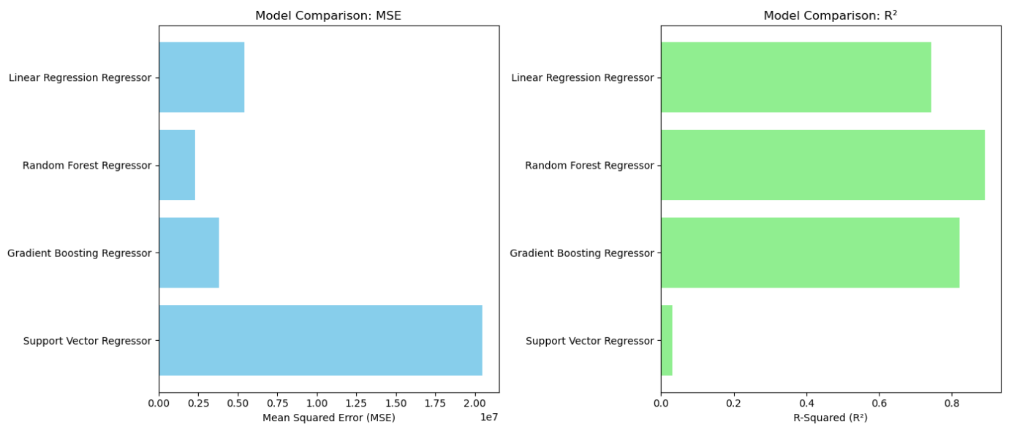
MODEL EVOLUTION

Slide 13
Insights
INSIGHTS
Random Forest Regressor performed the best, capturing most of the variance in ticket prices.
Support Vector Regressor did not perform well, indicating it may not be suitable for this type of data.

Slide 14
Conclusion
CONCLUSION
The Random Forest Regressor is the best model for predicting flight ticket prices with an R² of 0.891.
Accurate predictions can help airlines optimize pricing strategies and improve customer satisfaction.

Slide 15
THANK YOU !!

