Slide 1
Assessment -1

Slide 2

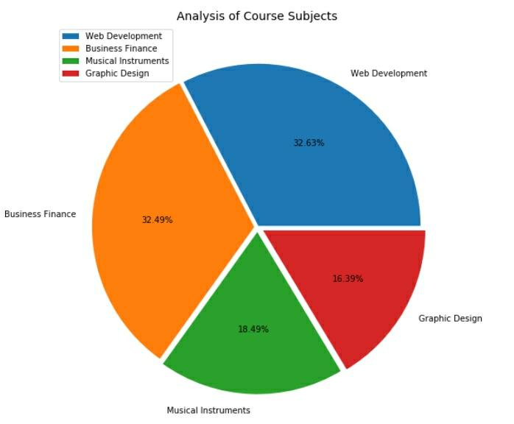

Figure: 1 This picture represents the distribution of courses by subjects

Slide 3

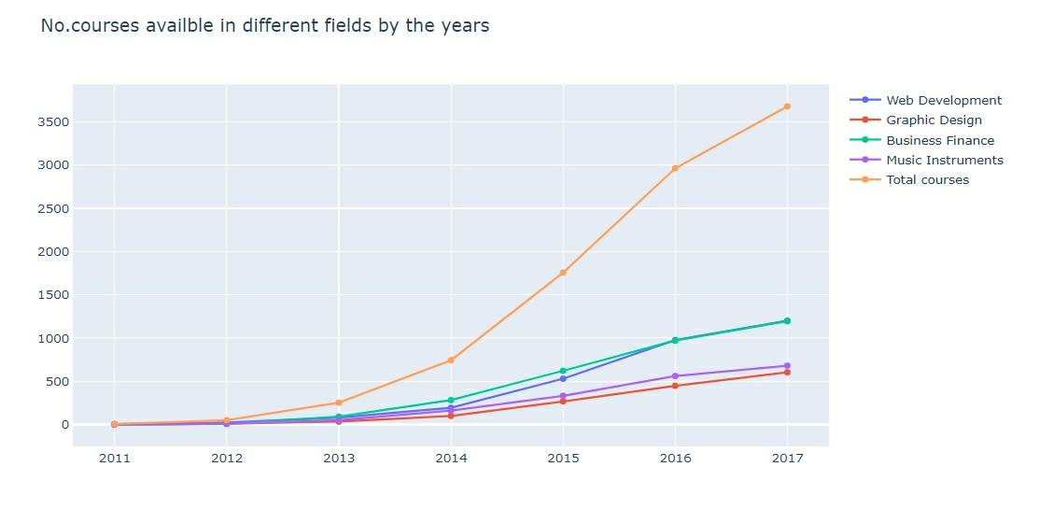
Figure: 2 Among all the subjects, most of the courses available in Web development over the years

Slide 4
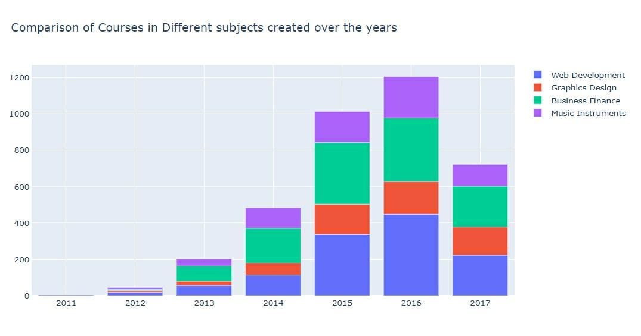
Figure: 3 Comparison of courses in different subjects created over the years

Slide 5
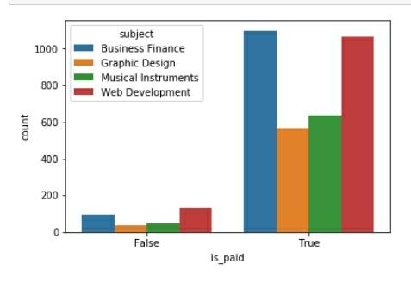
Figure: 4 1. Paid vs unpaid courses 2. Most of them preferred paid courses in all subjects

Slide 6
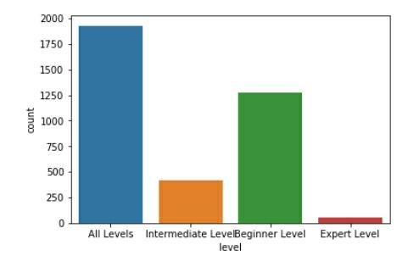
Figure: 5 Students mostly subscribed “All levels” courses

Slide 7
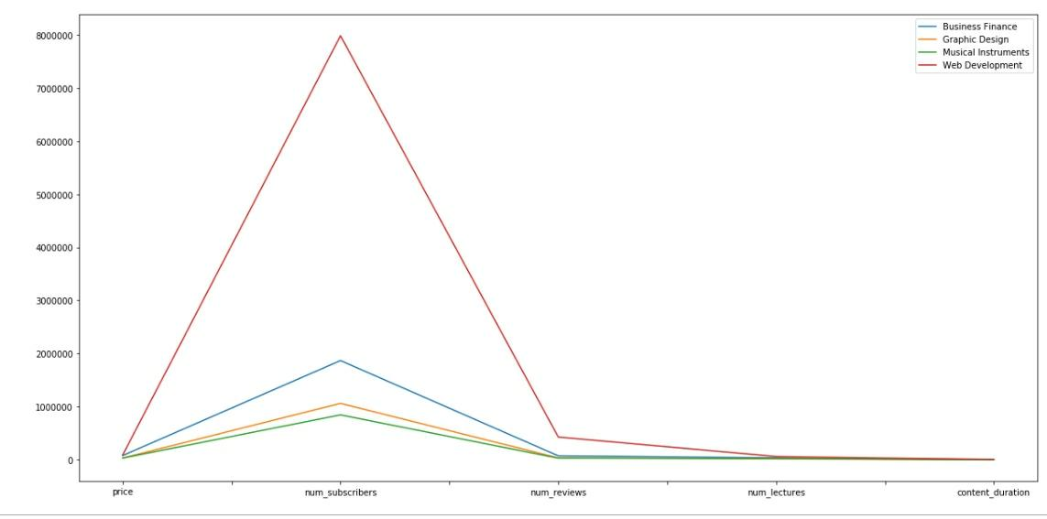
Figure: 6
Among all the subjects for understanding which is popular subject
This graph clearly explained “Web Development” is popular among all the subjects

Slide 8
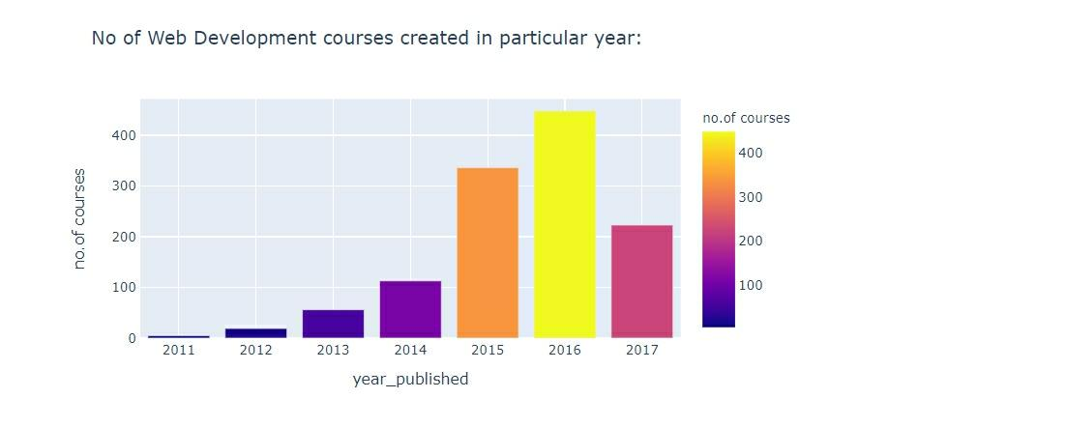
Figure: 7 This picture represents the number of web development courses created in particular year

Slide 9
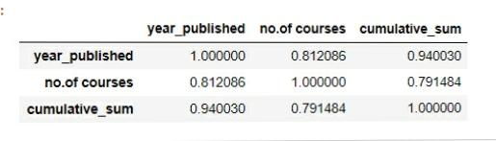
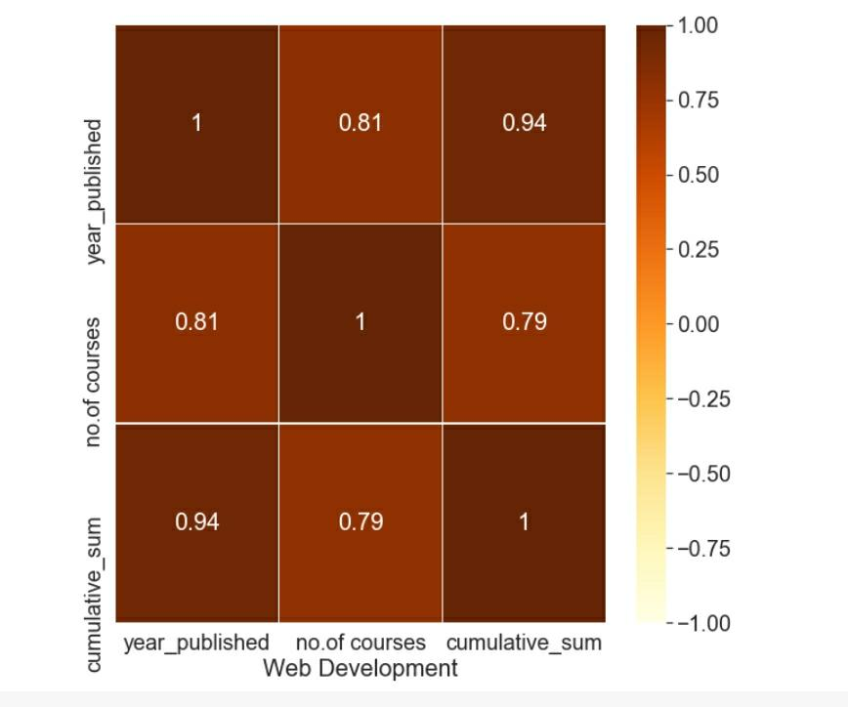
Figure: 8 Using heat map we made corr() function only for web development subject

Slide 10
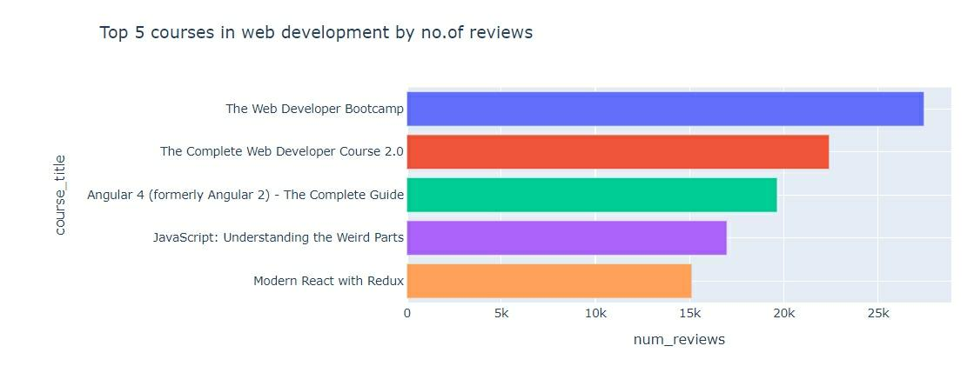
Figure: 9 Top 5 courses in web development by number of reviews

Slide 11
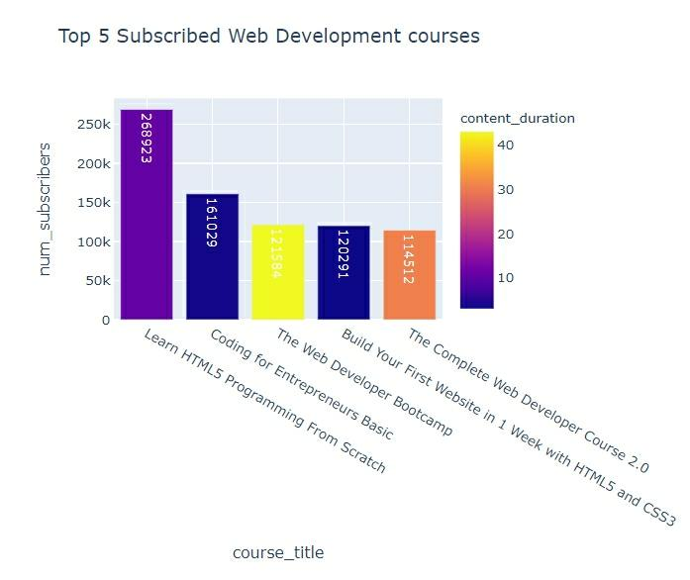
Figure: 10 Top 5 courses in web development by subscribers

Slide 12

Thank you
z

