Slide 1
Lending Club Case
EDA Case Study
06-Sep-2022

Slide 2
Agenda
Introduction
Primary Goals
Data Gathering and Cleansing
Univariant Analysis
Bivariant Analysis
Summary
Team Definition

Slide 3
INTRODUCTION

Slide 4
Introduction
When the company receives a loan application, the company has to make a decision for loan approval based on the applicant’s profile.
Two types of risks are associated with the bank’s decision:
If the applicant is likely to repay the loan, then not approving the loan results in a loss of business to the company.
If the applicant is not likely to repay the loan, i.e. he/she is likely to default, then approving the loan may lead to a financial loss for the company.

Slide 5
PRIMARY GOAL

Slide 6
Primary Goal
When a person applies for a loan, there are two types of decisions that could be taken by the company:
Loan accepted: If the company approves the loan, there are 3 possible scenarios described below:
Fully paid: Applicant has fully paid the loan (the principal and the interest rate)
Current: Applicant is in the process of paying the instalments, i.e. the tenure of the loan is not yet completed. These candidates are not labelled as 'defaulted'.
Charged-off: Applicant has not paid the instalments in due time for a long period of time, i.e. he/she has defaulted on the loan.

Slide 7
Primary Goal Ctd.
Loan rejected: The company had rejected the loan (because the candidate does not meet their requirements etc.). Since the loan was rejected, there is no transactional history of those applicants with the company and so this data is not available with the company (and thus in this dataset)

Slide 8
DATA GATHERING and CLEANSING

Slide 9
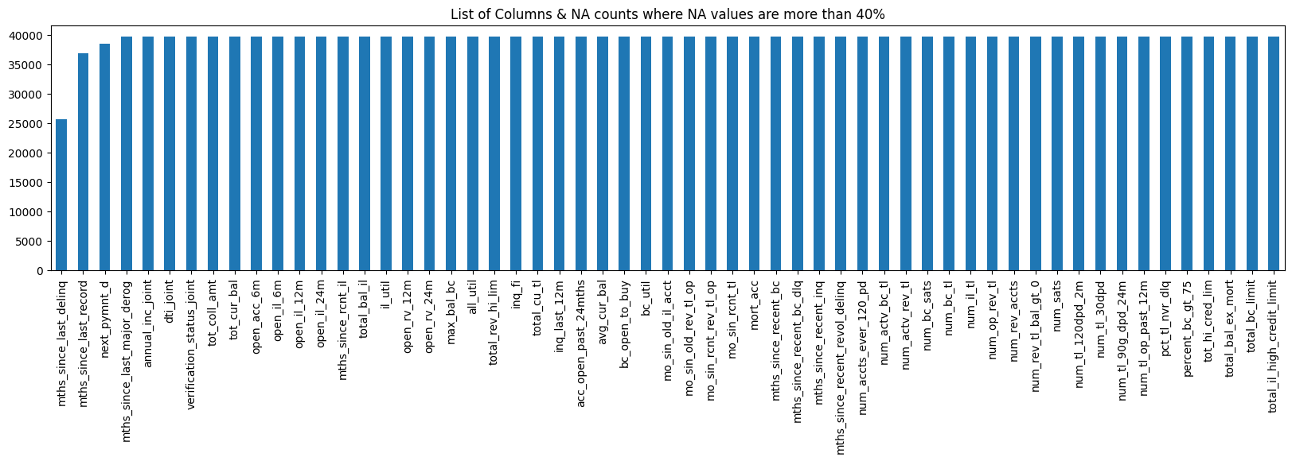
Dataset Details
Data received from Upgrad platform in form of csv file with below details:
- Total No. of rows: 39717
- Total No. of columns: 111
Analysis of data column which has NA or missing values more than 40%.

Slide 10
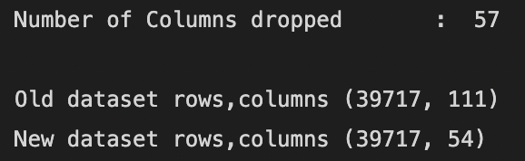
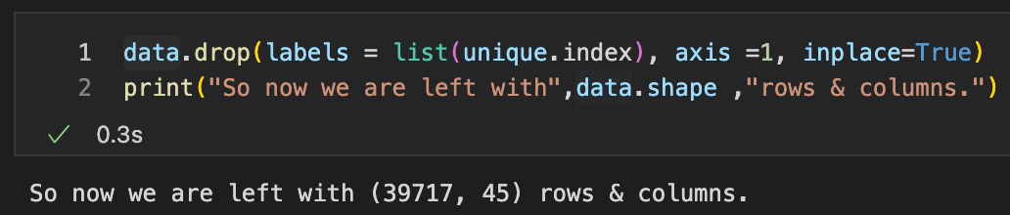
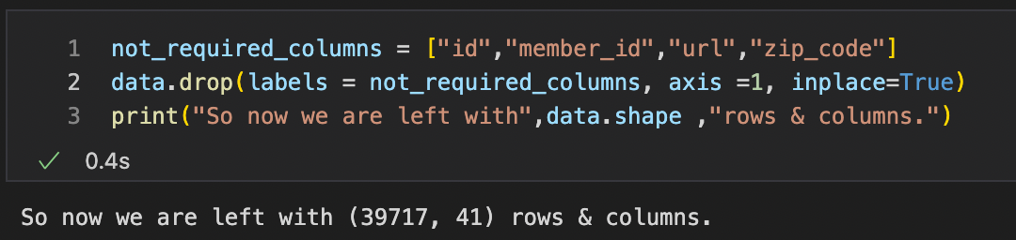
Dataset Cleansing
Removing these columns as it is difficult to impute the missing values.
Removing the columns which has unique value is only 1.
Removing of irrelevant columns.

Slide 11
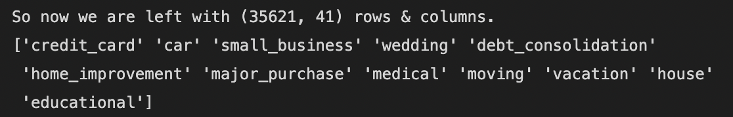
Dataset Cleansing Ctd.
Removing those records are less than 0.75 in purpose of loan.
Creating the bin for defining the range in loan amount, annual income, interest rate.
Cast all continuous variables to numeric so as to find the correlation between them.

Slide 12
UNIVARIANT ANALYSIS

Slide 13
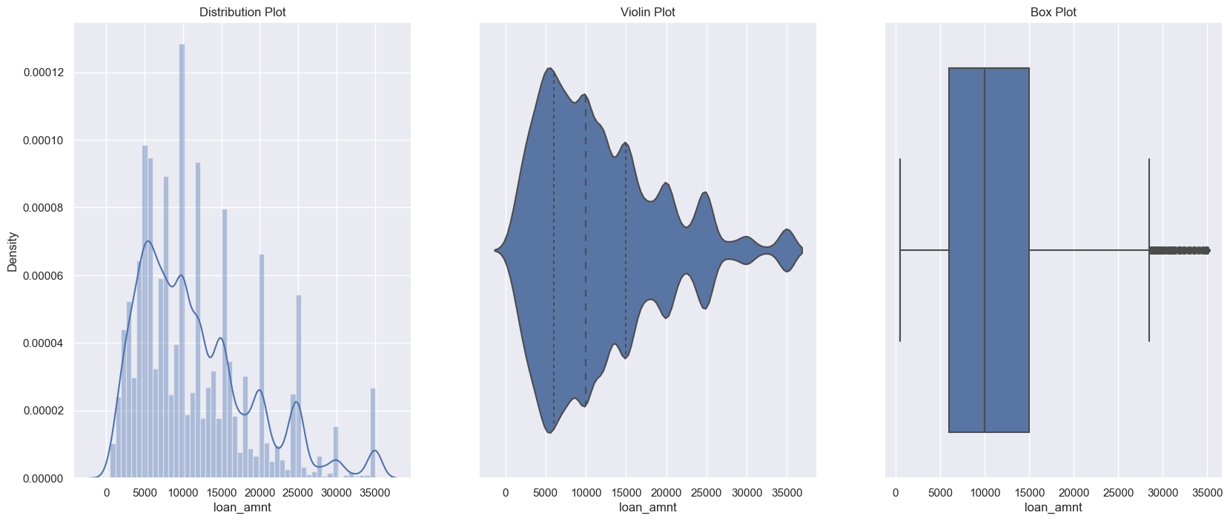
Univariant Analysis
Univariate analysis is the simplest form of analysing data. Uni means one, so in other words the data has only one variable. Univariate data requires to analyse each variable separately.
Analysis for loan amount is given below:

Slide 14
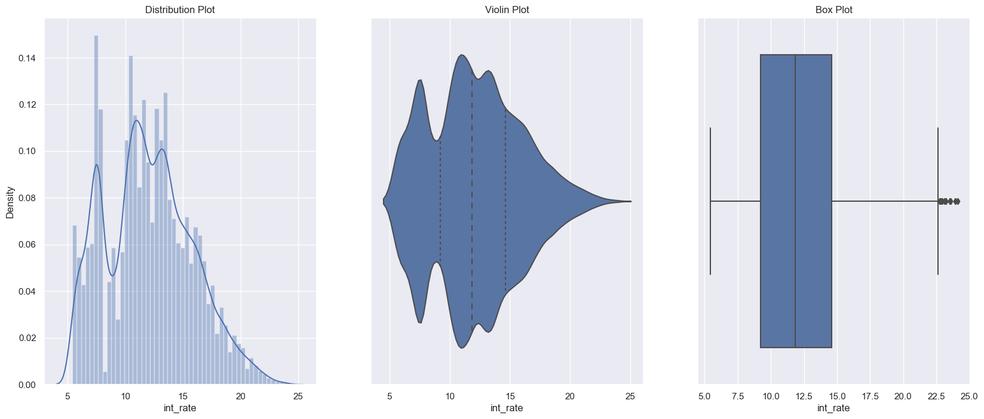
Univariant Analysis Ctd.
Analysis for Interest Rate is given below:
Analysis for Annual Income before and after removing outliers.

Slide 15
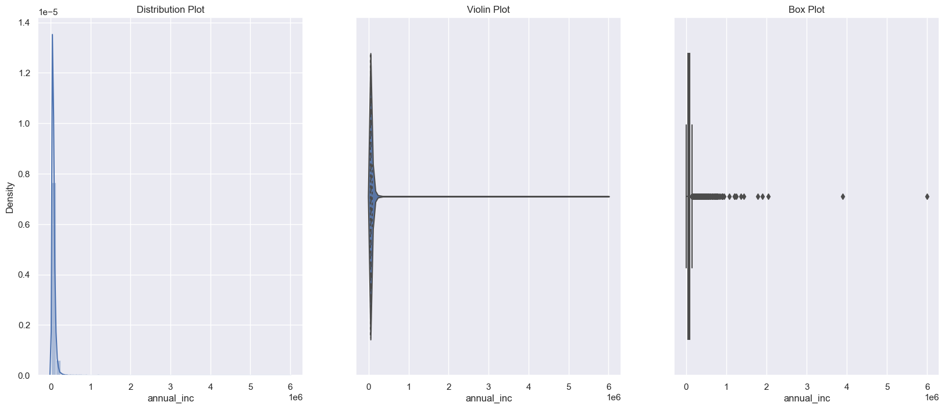
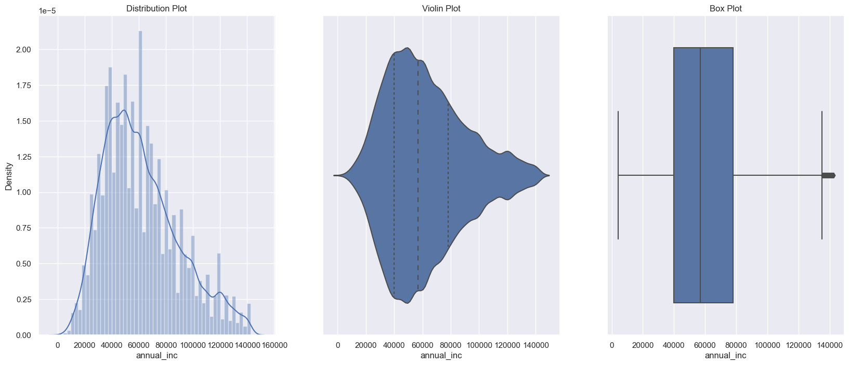
Univariant Analysis Ctd.
Before removing outliers.
After removing outliers.

Slide 16
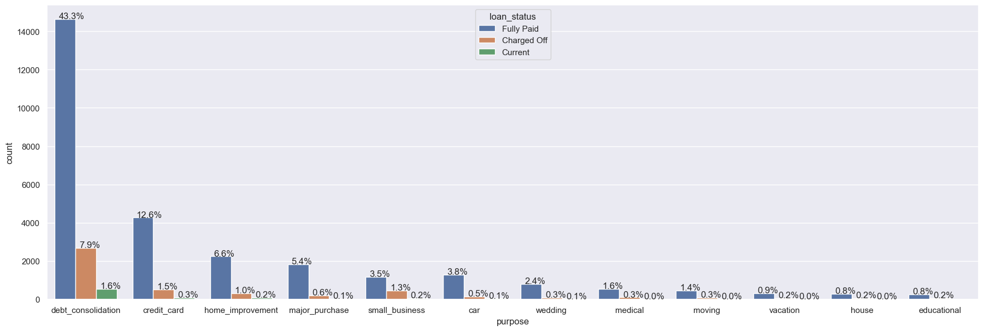
Univariant Analysis Ctd.
Analysis for Purpose of loan is given below:

Slide 17
BIVARIANT ANALYSIS

Slide 18
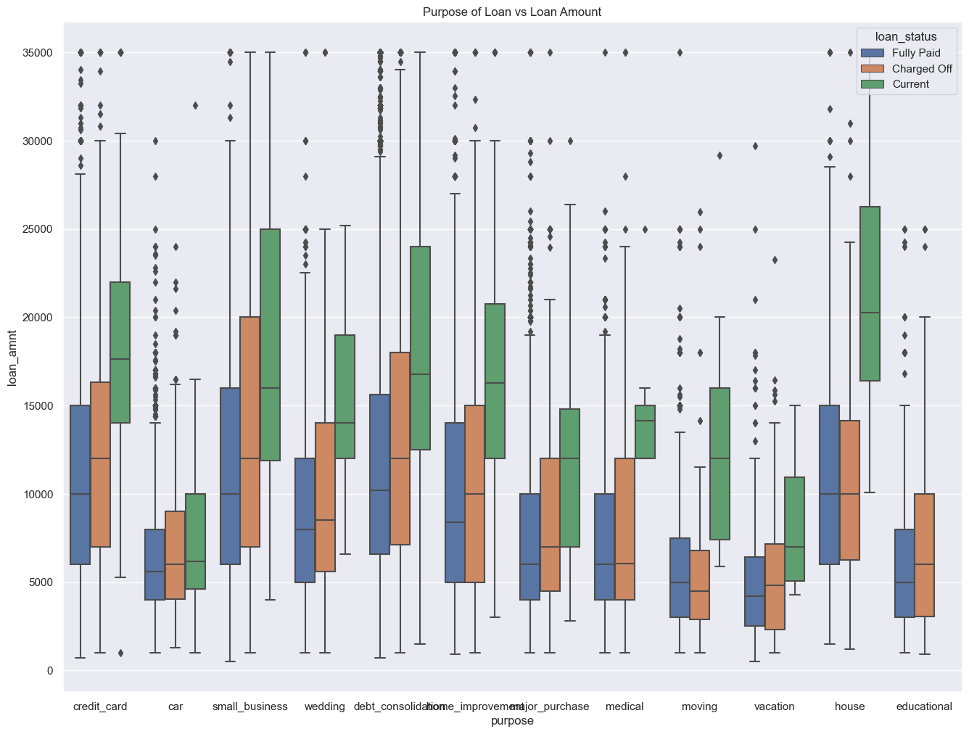
Bivariant Analysis
Bivariate/Multivariate Analysis finds out the relationship between two or more than two variables.
Analysis for purpose of loan and
loan amount is given below:

Slide 19
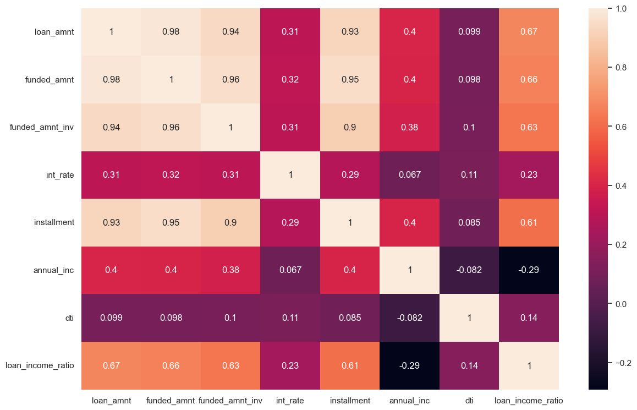
Bivariant Analysis Ctd.
Relation of continuous variables
and heatmap:

Slide 20
SUMMARY

Slide 21
Summary
Most of the loan amounts are distributed between 5000 to 15000 USD.
Most of the loans interest rates are distributed between 8% to 15%.
Most of the applicants earns between 35000 to 80000 USD annually.
Approx. 52% of the applicants applied loan for paying their other loans(Debt Consolidation)
Approx. 48% of applicants are living in rented home whereas 42% applicants were mortgaged their home.
Loan applicants are increasing year on year, approx. 47% of loan applicants received loans in 2011.
Approx. 70% of applicants applied loan for 36 months term period.
Heatmap tell that how 'loan_amnt’, 'funded_amnt' & 'funded_amnt_inv' are closely interrelated.

Slide 22
TEAM DEFINITION

Slide 23
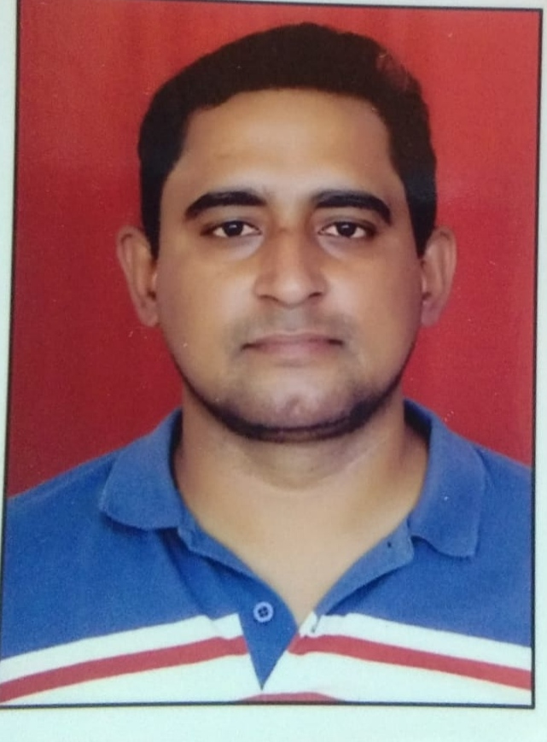

Team Definition
Contact Details
Name | Contact Information | Photo
Himanshu Pandey | Email: himsoftware@gmail.com
Avinash Saraswat | Email: avinash.saraswat93@gmail.com

Slide 24
Thank You!

