Slide 1
Artificial Neural Networks

Slide 2
Artificial Neural Networks
The development of ANN - attempt to replicate the human brain.
ANN – similar to biological neural networks - not identical.
ANN algorithm accepts only numeric and structured data.
Convolutional Neural Networks (CNN) and Recursive Neural Networks (RNN) - accept unstructured and non-numeric data forms such as Image, Text, and Speech.

Slide 3

Artificial Neural Networks

Slide 4
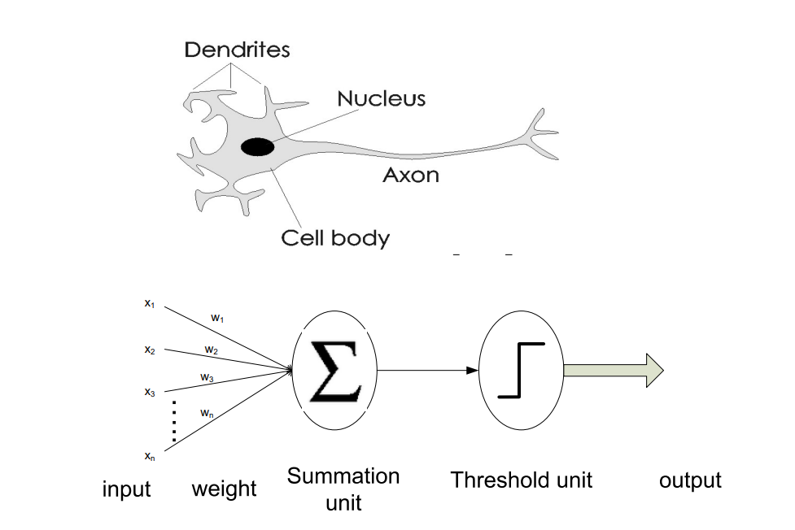

Slide 5
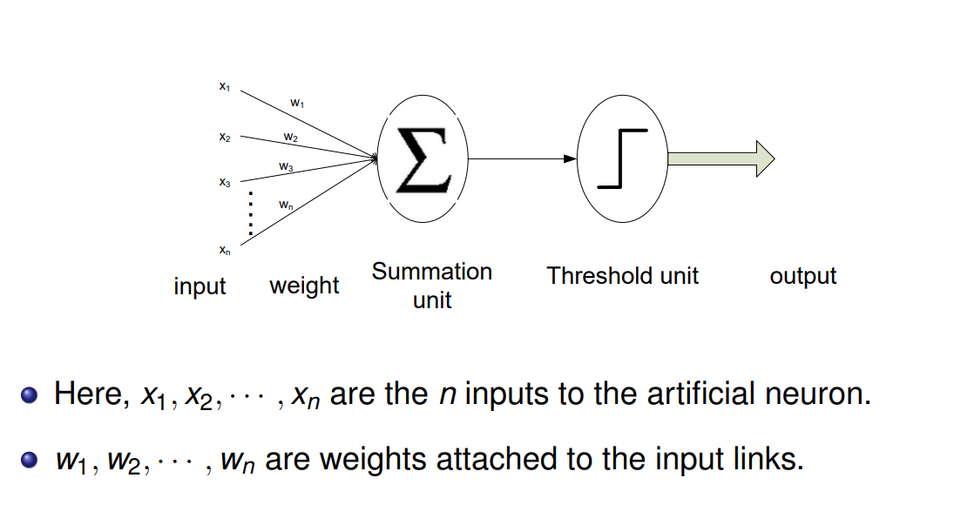

Slide 6
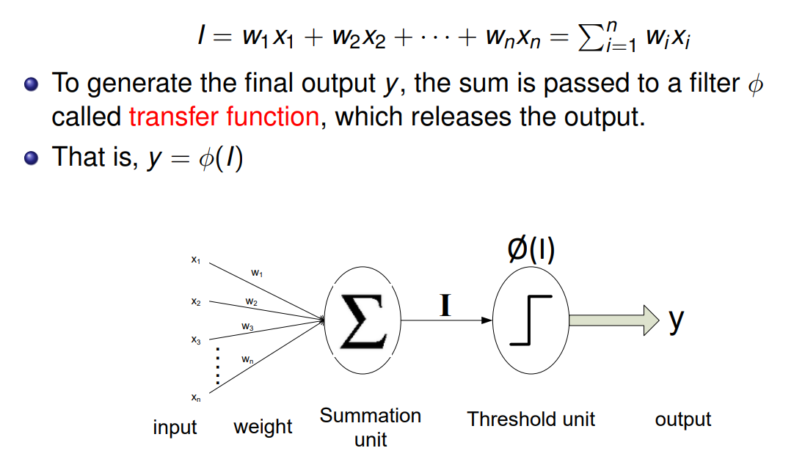

Slide 7
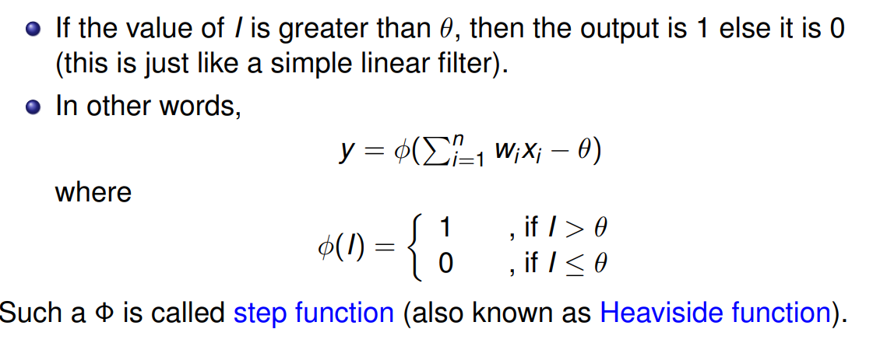

Slide 8
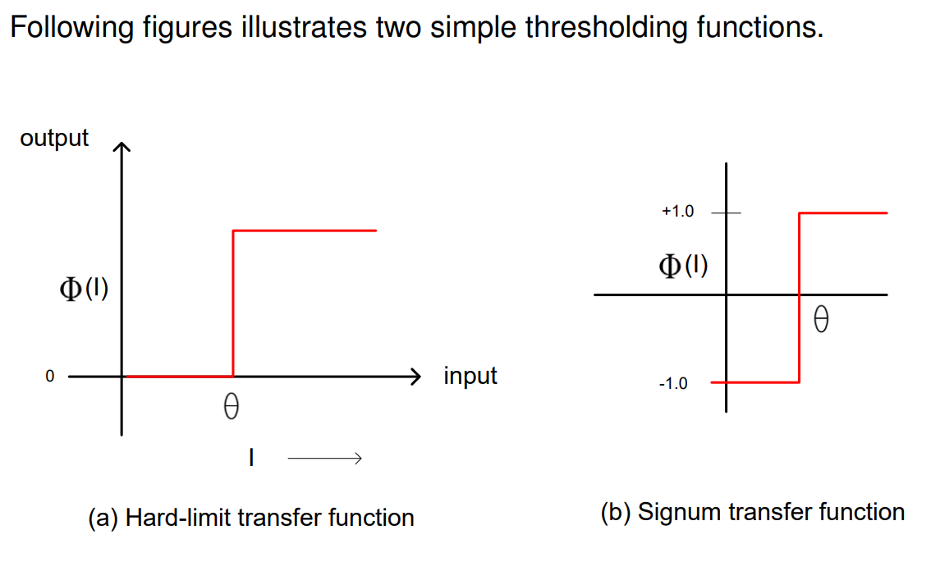

Slide 9
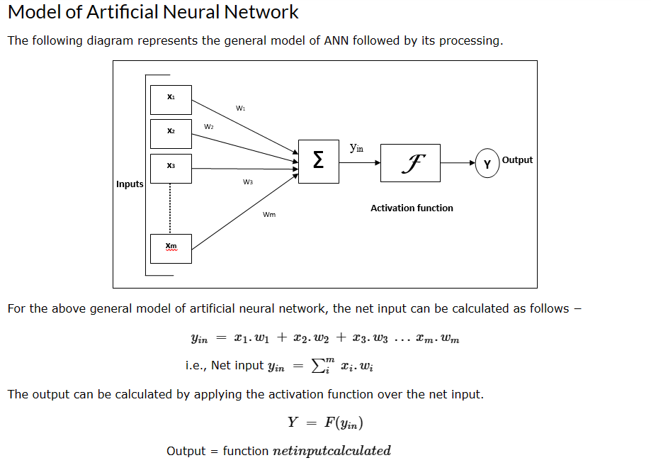

Slide 10


Slide 11
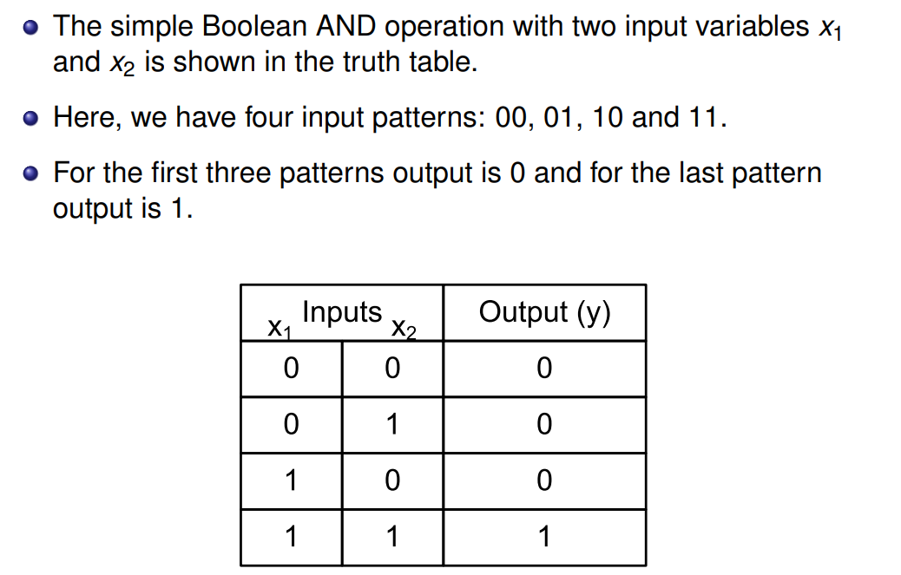

Slide 12
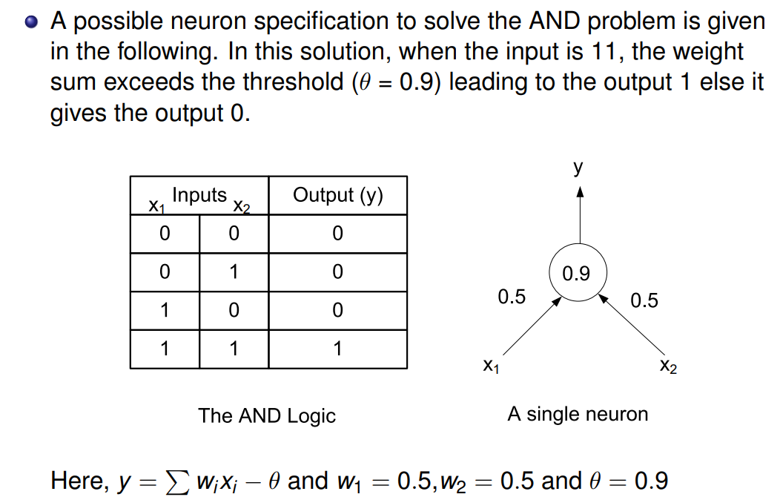

Slide 13
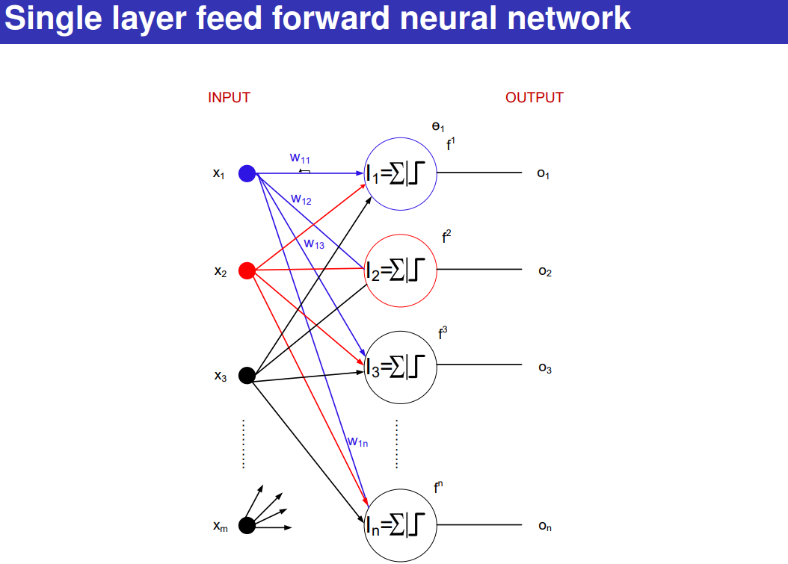

Slide 14
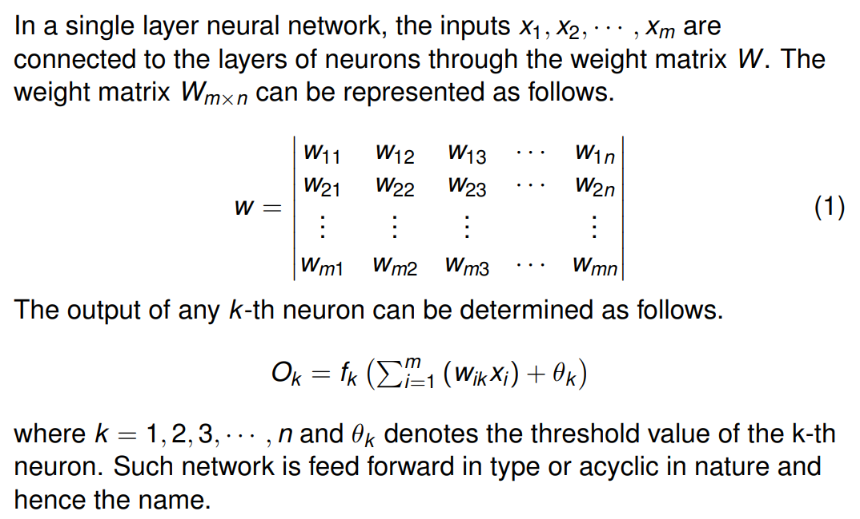

Slide 15
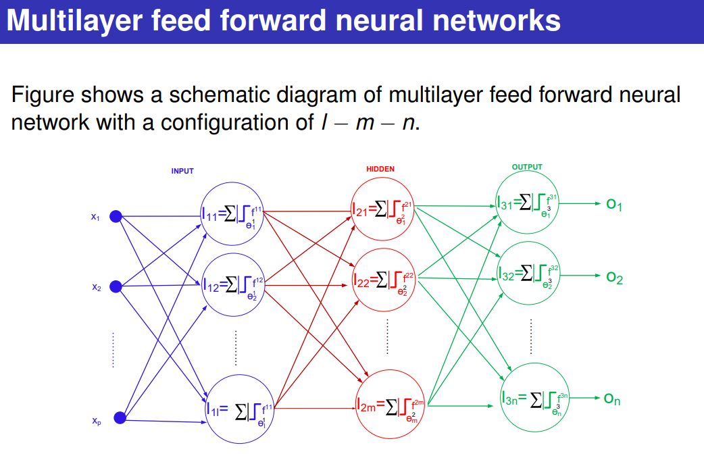

Slide 16
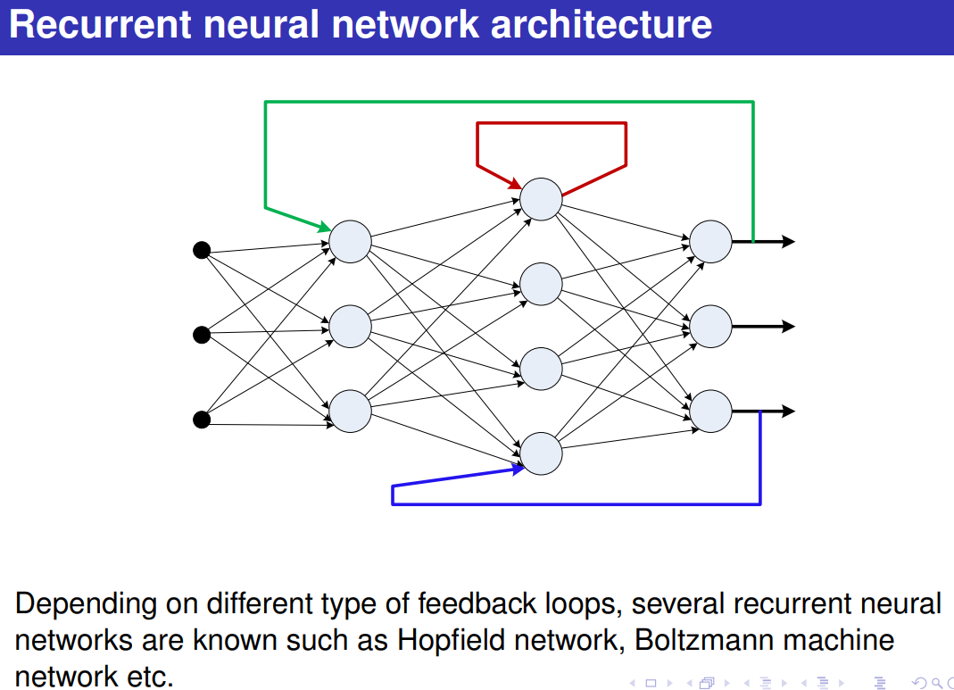

Slide 17
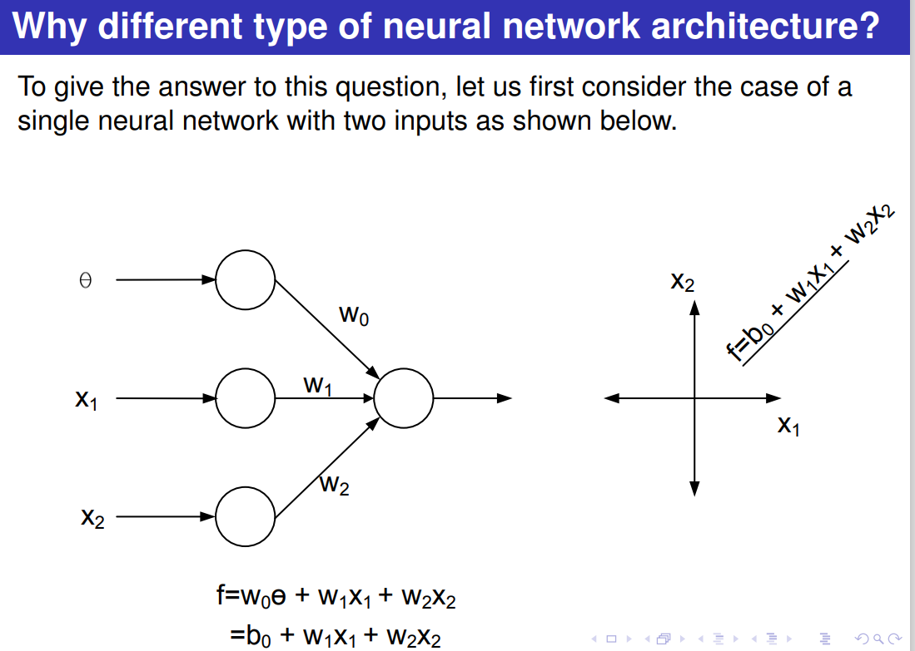

Slide 18
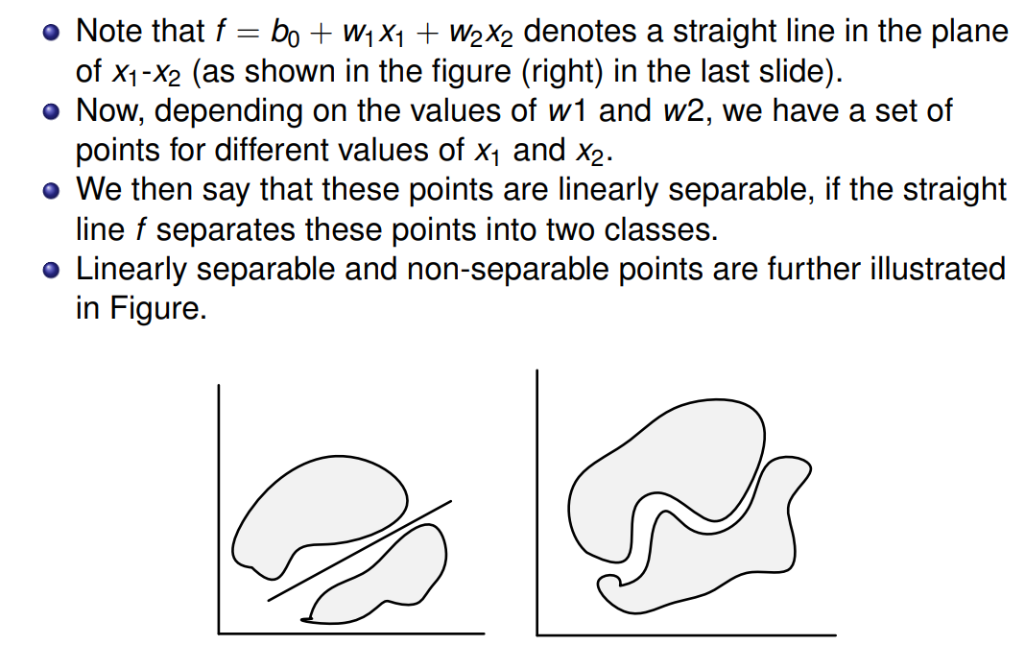

Slide 19
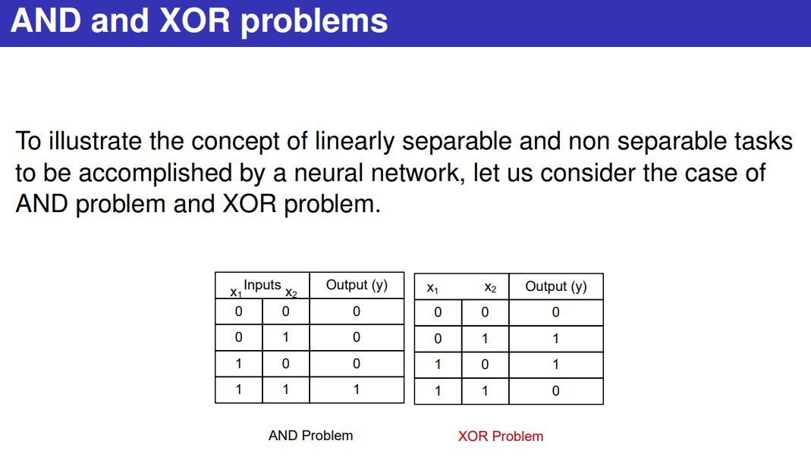

Slide 20
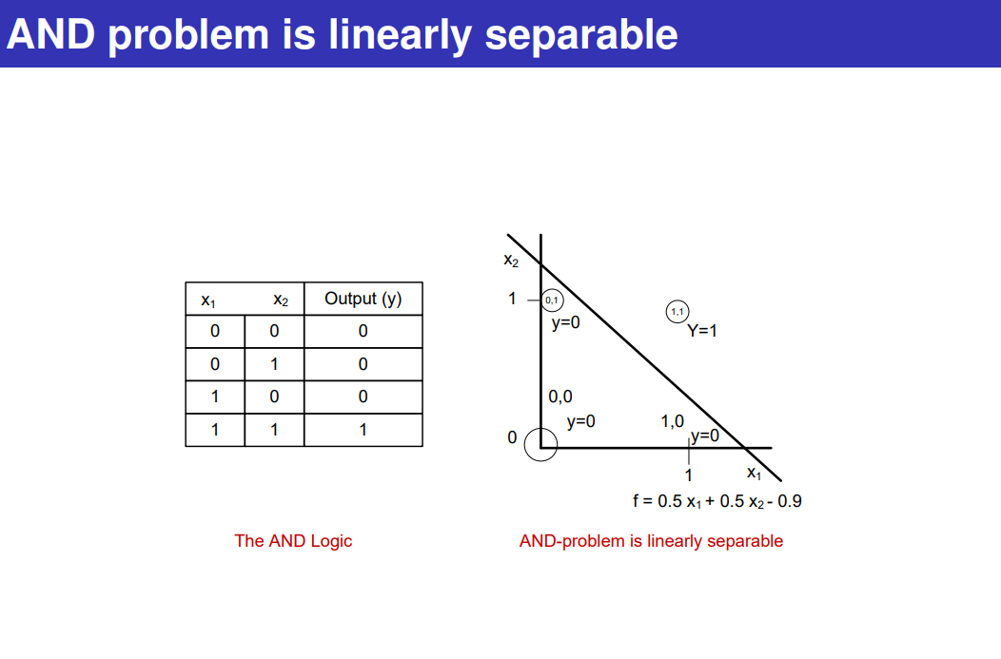

Slide 21
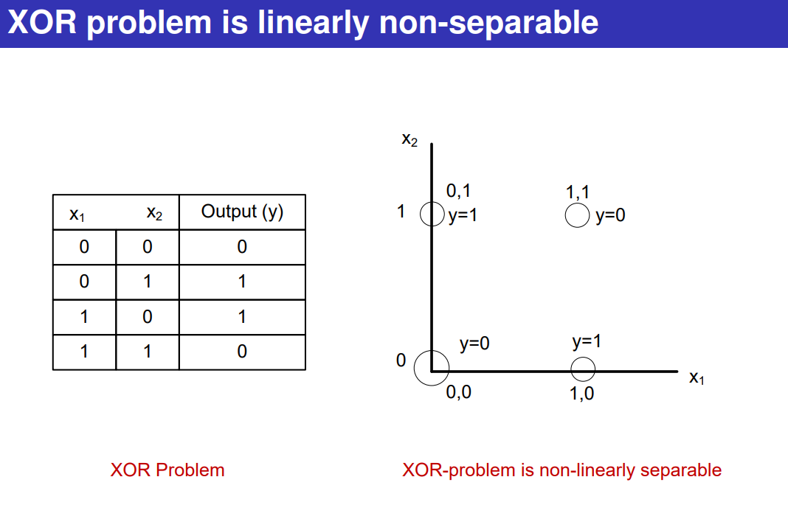

Slide 22
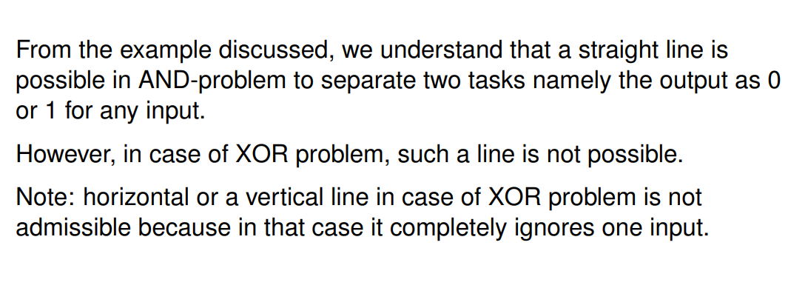

Slide 23


Slide 24
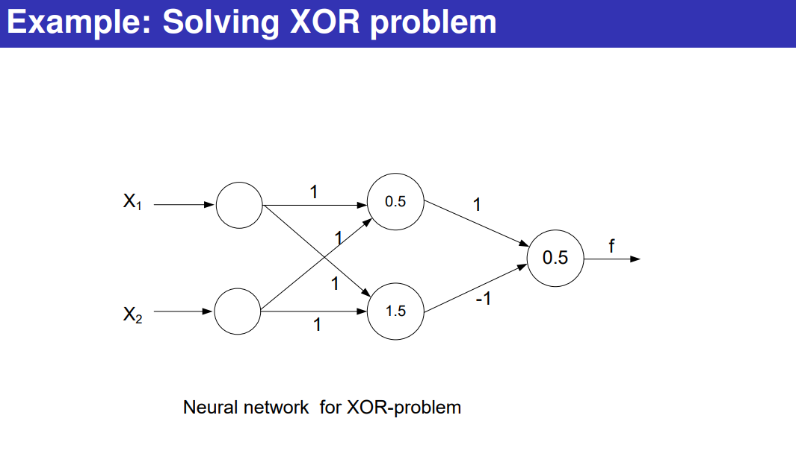

Slide 25
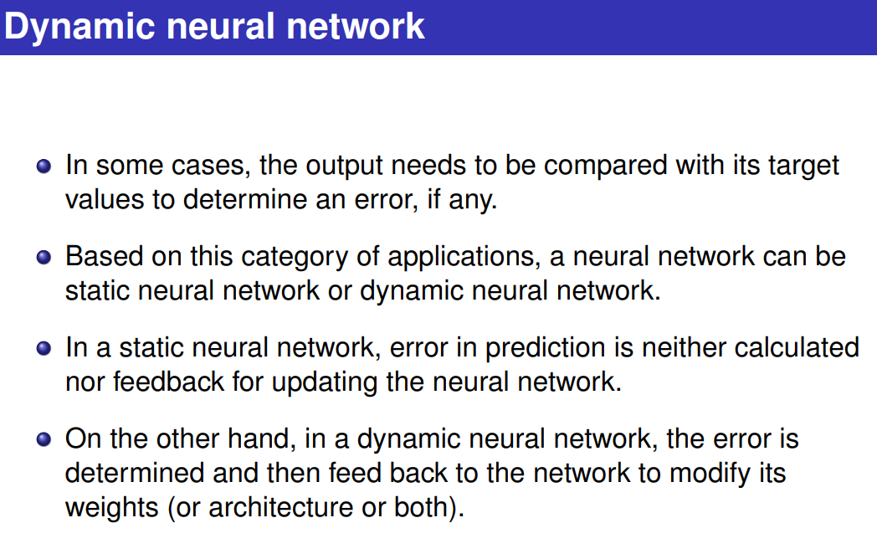

Slide 26
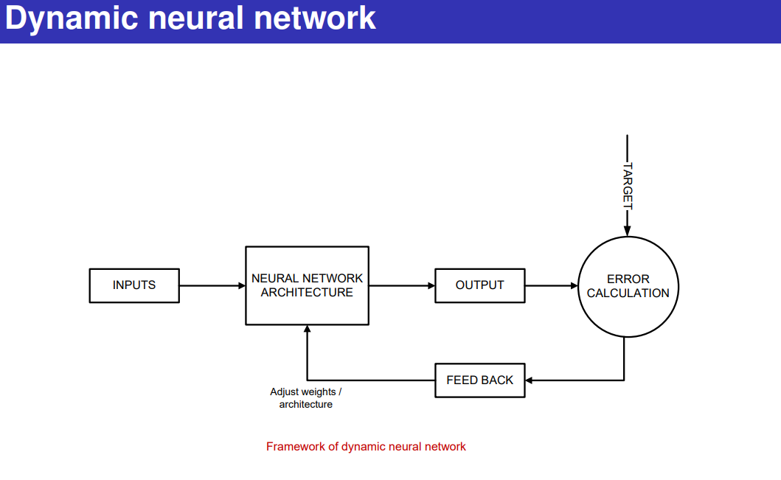

Slide 27
