Slide 1
DFS and IDS in Artificial Intelligence
Depth First Search vs Iterative Deepening Search

Slide 2
Depth-First Search (DFS)
Definition:
DFS explores as far as possible along each branch before backtracking.
Completeness: Not guaranteed in infinite spaces
Time Complexity: O(b^d)
Space Complexity: O(bd)
Optimality: Not optimal

Slide 3
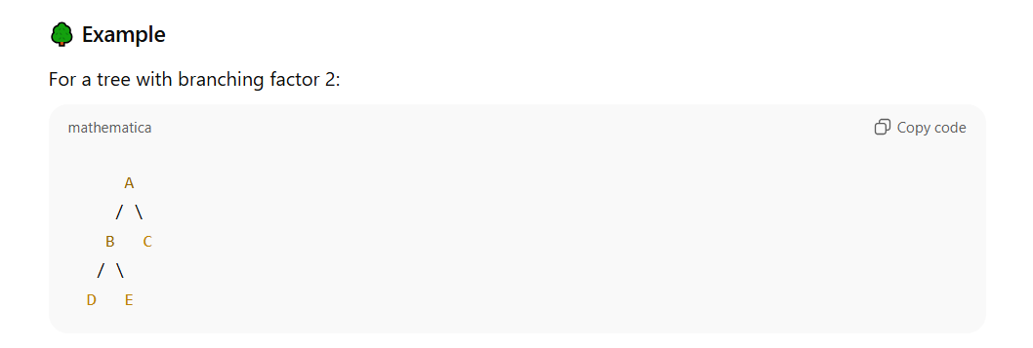
DFS Example
Tree Traversal Example:
Order: A → B → D → E → C

Slide 4
Iterative Deepening Search (IDS)
Definition:
IDS repeatedly runs DFS with an increasing depth limit until goal is found.
Completeness: Yes
Time Complexity: O(b^d)
Space Complexity: O(bd)
Optimality: Yes (with uniform cost)

Slide 5
IDS Example
Search levels expanded step by step:
Depth 0: A
Depth 1: A, B, C
Depth 2: A, B, D, E, C

Slide 6
DFS vs IDS
Comparison:
DFS: Goes deep first, less memory, not always optimal
IDS: Expands shallowest solutions first, optimal, efficient memory

Slide 7
Comparision
Feature | DFS | IDS
Completeness | No (may loop) | Yes
Optimality | No | Yes (with uniform cost)
Time | O(bd)O(b^d) | O(bd)O(b^d)
Space | O(bd)O(bd) | O(bd)O(bd)
Use case | Good for deep but finite trees | Best for large state spaces, unknown depth

