Slide 1
Artificial Intelligence
Text Book
Artificial Intelligence A Modern Approach – Second Edition – Stuart Russell and Peter Norvig – Prentice Hall India ( PHI ).
Reference Book
Artificial Intelligence – Elaine Rich, Kevin Knight-Second Edition – Tata McGraw Hill.

Slide 2

Lecture 1

Slide 3
Introduction
Homo sapiens—man the wise—because our intelligence is so important to us.
Humans - tried to understand how we think and act—that is, how our brain works.
AI, is concerned with not just understanding but also building intelligent entities.

Slide 4
Introduction To AI
Concerned with the design of intelligence in an artificial device.
The term was coined by McCarthy in 1956.
Two Key terms in the definition – Intelligence and Artificial Device.

Slide 5
AI is Fascinating…..
AI – ranked - most interesting and fastest-growing fields.
Already generating over a trillion dollars a year in revenue – projected – US$243.70 bn in 2025.
AI expert Kai-Fu Lee predicts that its impact will be “more than anything in the history of mankind.”
Moreover, the intellectual frontiers of AI are wide open.

Slide 6
AI is Fascinating……
general (learning, reasoning, perception, and so on) to the specific, such as ……
playing chess,
proving mathematical theorems,
writing poetry,
driving a car, or
diagnosing diseases.
AI is relevant to any intellectual task; it is truly a universal field

Slide 7
What is AI?
What is Intelligence ? 4 schools of thoughts !!
School 1 - defined intelligence in terms of fidelity to human performance - Think like human.
School2 - an abstract, formal definition of intelligence called rationality—loosely speaking, doing the “right thing.” - Act Rationally
School3 - consider intelligence to be a property of internal thought processes and reasoning – Think Rationally.
School3 - focus on intelligent behavior, an external characterization – Act like a human.

Slide 8
What is Intelligence – Two Dimensions – Four Combinations
Human Vs Rational.
Thoughts Vs Behavior.

Slide 9
What is Intelligence – Behavior Aspect
A system with intelligence is expected to behave/act as intelligently as a human.
A system with intelligence is expected to behave/act in the best possible manner.

Slide 10
What is Intelligence – Thought Process
Are we looking at the thought process or reasoning ability of the system?
Or are we only interested in the final manifestations of the system in terms of its actions?

Slide 11
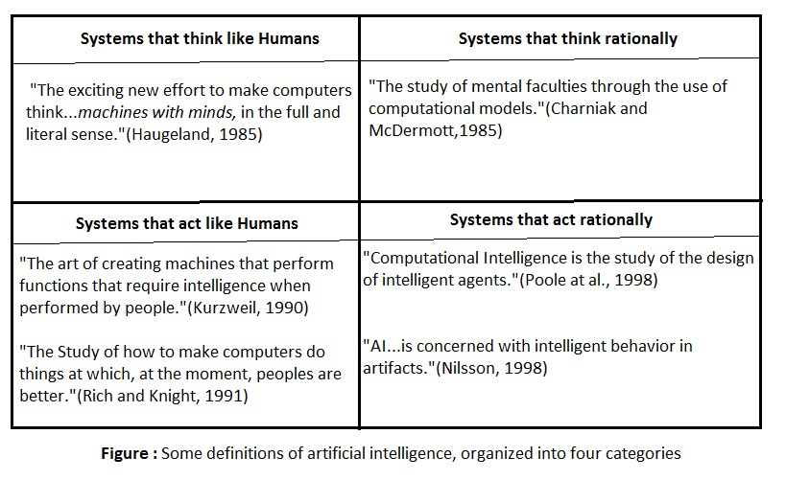
What is Artificial Intelligence

Slide 12
Thinking Humanly : The Cognitive Modeling approach
Understanding human thought and an effort to build machines that emulate the human thought process.
This view is the cognitive science approach to AI.
introspection—trying to catch our own thoughts as they go by;
psychological experiments—observing a person in action;
brain imaging—observing the brain in action.

Slide 13
Thinking Humanly : The Cognitive Modeling approach
Allen Newell and Herbert Simon, who developed GPS, the “General Problem Solver” (Newell and Simon 1961).
Not content merely to have their program solve problems correctly.
They were more concerned with comparing the sequence and timing of its reasoning steps to those of human subjects solving the same problems.
cognitive science - computer models from AI + experimental techniques from psychology - testable theories - human mind.

Slide 14
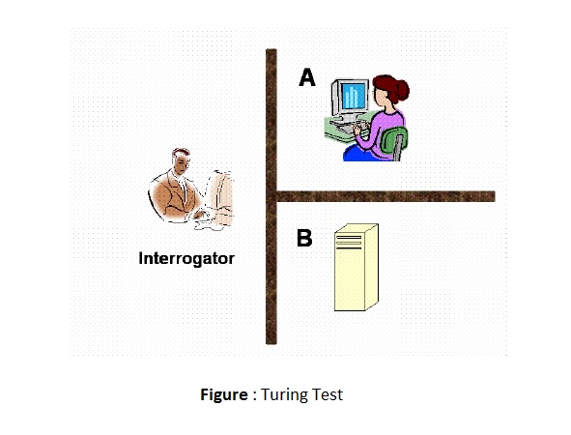
Acting Humanly : The Turing Test Approach

Slide 15
Acting Humanly
natural language processing to communicate successfully in a human language;
knowledge representation to store what it knows or hears;
automated reasoning to answer questions and to draw new conclusions;
machine learning to adapt to new circumstances and to detect and extrapolate patterns.

Slide 16
Acting Humanly
computer vision and speech recognition to perceive the world;
robotics to manipulate objects and move about.

Slide 17
Thinking Rationally : The “laws of thought” approach
studies of ideal or rational thought process and inference.
emphasis on the inferencing mechanism, and its properties.
How the system arrives at a conclusion, or the reasoning is very important.

Slide 18
Thinking Rationally : The “laws of thought” approach.
The soundness and completeness of the inference mechanisms are important – Logic – Syllogisms.
Eg; Socrates is a man, all men are mortal, so Socrates is mortal.
Logic knowledge of the world that is certain.
We simply don’t know the rules of, say, politics or warfare in the same way that we know the rules of chess or arithmetic.
The theory of probability fills this gap, allowing rigorous reasoning with uncertain information.

Slide 19
Acting Rationally : The rational agent approach
Deals with building machines that act rationally.
The focus is on how the system acts and performs, and not so much on the reasoning process.
An agent is just something that acts; operate autonomously, perceive their environment, persist, adapt to change, and create and pursue goals.
A rational agent is one that acts rationally, that is, in the best possible manner.

Slide 20
Typical AI problems
Common Tasks.
Expert Tasks.

Slide 21
Common Tasks
Recognizing people, objects.
Communicating (through natural language).
Navigating around obstacles on the streets.
Other Tasks that are routinely done by humans and animals.

Slide 22
Expert Tasks
Medical diagnosis.
Mathematical problem solving.
Playing games like chess.
Tasks that performed by skilled specialists.

Slide 23
Common Tasks Vs Expert Tasks
Common Tasks – Easily mastered by humans, tough for Computers.
Expert Tasks – Easily mastered by Computers, tough for Humans.

Slide 24
Intelligent Behavior
Perception involving image recognition and computer vision
Reasoning
Learning
Understanding language involving natural language processing, speech processing
Solving problems
Robotics

Slide 25
Practical Impact of AI
AI components are embedded in numerous devices e.g. in copy machines for automatic correction of operation for copy quality improvement.
AI systems are in everyday use for identifying credit card fraud.
for advising doctors, for recognizing speech and in helping complex planning tasks.
Intelligent tutoring systems that provide students with personalized attention

Slide 26
Approaches to AI
Strong AI
Weak AI
Applied AI
Cognitive AI

Slide 27
Strong AI
Aims to build machines that can truly reason and solve problems.
should be self aware and their overall intellectual ability needs to be indistinguishable from that of a human being.
Excessive optimism in the 1950s and 1960s concerning strong AI has given way to an appreciation of the extreme difficulty of the problem.
Strong AI maintains that suitably programmed machines are capable of cognitive mental states.

Slide 28
Weak AI
creation of some form of computer-based artificial intelligence that cannot truly reason and solve problems.
Can act as if it were intelligent.
Weak AI holds that suitably programmed machines can simulate human cognition.

Slide 29
Applied AI
Aims to produce commercially viable "smart" systems.
Eg:A Security system that is able to recognise the faces of people who are permitted to enter a particular building.
Applied AI has already enjoyed considerable success.

Slide 30
Cognitive AI
computers are used to test theories about how the human mind works.
Example : Theories about how we recognize faces and other objects, or about how we solve abstract problems.

Slide 31
Limits of AI Today
Today’s successful AI systems operate in well-defined domains and employ narrow, specialized knowledge.
Common sense knowledge is needed to function in complex, open-ended worlds.
Such a system also needs to understand unconstrained natural language.
These capabilities are not yet fully present in today’s intelligent systems.

Slide 32
What can AI systems do
In Computer vision, the systems are capable of face recognition
In Robotics, we have been able to make vehicles that are mostly autonomous.
In Natural language processing, we have systems that are capable of simple machine translation.
Today’s Expert systems can carry out medical diagnosis in a narrow domain
Speech understanding systems are capable of recognizing several thousand words continuous speech

Slide 33
What can AI systems do
Planning and scheduling systems had been employed in scheduling experiments with the Hubble Telescope.
The Learning systems are capable of doing text categorization into about a 1000 topics
In Games, AI systems can play at the Grand Master level in chess (world champion), checkers, etc.

Slide 34
What can AI systems NOT do yet
Understand natural language robustly (e.g., read and understand articles in a newspaper)
Surf the web.
Interpret an arbitrary visual scene.
Learn a natural language.
Construct plans in dynamic real-time domains .
Exhibit true autonomy and intelligence

Slide 35
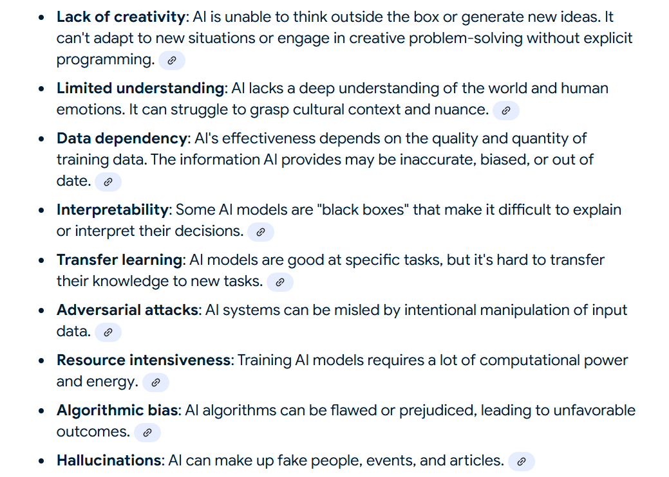

Slide 36
AI History
Aristotle (384-322 BC) developed an informal system of syllogistic logic, which is the basis of the first formal deductive reasoning system.
Early in the 17th century, Descartes proposed that bodies of animals are nothing more than complex machines.
Pascal in 1642 made the first mechanical digital calculating machine.
In the 19th century, George Boole developed a binary algebra representing (some) "laws of thought."

Slide 37
AI History
Charles Babbage & Ada Byron worked on programmable mechanical calculating machines.
Gottlob Frege, Bertram Russell, Alfred North Whitehead, and Kurt Gödel built on Boole's initial logic concepts to develop mathematical representations of logic problems.
In 1943 McCulloch & Pitts developed a Boolean circuit model of brain. They wrote the paper “A Logical Calculus of Ideas Immanent in Nervous Activity”, which explained how it is possible for neural networks to compute.

Slide 38
AI History
Marvin Minsky and Dean Edmonds built the SNARC in 1951, which is the first randomly wired neural network learning machine (SNARC stands for Stochastic Neural-Analog Reinforcement Computer).
It was a neural network computer that used 3000 vacuum tubes and a network with 40 neurons.
In 1950 Turing wrote an article on “Computing Machinery and Intelligence” which articulated a complete vision of AI.

Slide 39
AI History
In 1956 a famous conference took place in Dartmouth. The conference brought together the founding fathers of artificial intelligence for the first time. In this meeting the term “Artificial Intelligence” was adopted.
Between 1952 and 1956, Samuel had developed several programs for playing checkers.
In 1956, Newell & Simon’s Logic Theorist was published. It is considered by many to be the first AI program. In 1959, Gelernter developed a Geometry Engine.

Slide 40
AI History
In 1961 James Slagle (PhD dissertation, MIT) wrote a symbolic integration program, SAINT. It was written in LISP and solved calculus problems at the college freshman level.
In 1963, Thomas Evan's program Analogy was developed which could solve IQ test type analogy problems.
In 1963, Edward A. Feigenbaum & Julian Feldman published Computers and Thought, the first collection of articles about artificial intelligence.

Slide 41
AI History
In 1965, J. Allen Robinson invented a mechanical proof procedure, the Resolution Method, which allowed programs to work efficiently with formal logic as a representation language.
In 1969 the SRI robot, Shakey, demonstrated combining locomotion, perception and problem solving.
In 1974: MYCIN demonstrated the power of rule-based systems for knowledge representation and inference in medical diagnosis and therapy.

Slide 42
AI History
In the 1980s, Lisp Machines developed and marketed.
Around 1985, neural networks return to popularity.
In 1988, there was a resurgence of probabilistic and decision-theoretic methods .

Slide 43
AI History
The 1990's saw major advances in all areas of AI like
machine learning, data mining
intelligent tutoring,
case-based reasoning,
multi-agent planning, scheduling,
uncertain reasoning,
natural language understanding and translation,
vision, virtual reality, games, and other topics.

Slide 44
Famous AI system
ALVINN-Autonomous Land Vehicle In a Neural Network.
The system drove a car from the East Coast of USA to the west coast, a total of about 2850 miles.
Out of this about 50 miles were driven by a human, and the rest solely by the system.

Slide 45
Famous AI system
Deep Blue
In 1997, the Deep Blue chess program created by IBM, beat the, then world chess champion, Gary Kasparov.
Machine translation
Autonomous agents
In space exploration, robotic space probes autonomously monitor their surroundings, make decisions and act to achieve their goals.
eg : NASA’s Mars Rovers.
Internet agents. – to monitor users' tasks, seek needed information, and to learn which information is most useful

