Slide 1
Logical Agents
Chapter 7

Slide 2
Logical Agents
“In which we design agents that can form representations of a complex world, use a process of inference to derive new representations about the world, and use these new representations to deduce what to do.”

Slide 3
Introduction
Humans - know things - helps them do things - not empty statements.
Humans - not by purely reflex mechanism – by reasoning.
AI – Knowledge Based Agents.
Chapter 3 and 4 – Know things in a limited way.

Slide 4
Why Do We Need Logic?
Problem-solving agents were very inflexible: hard code every possible state.
Search is almost always exponential in the number of states.
Problem solving agents cannot infer unobserved information.

Slide 5
Knowledge & Reasoning
To address these issues we will introduce
A knowledge base (KB): a list of facts that are known to the agent.
Rules to infer new facts from old facts using rules of inference.
Logic provides the natural language for this.

Slide 6
Knowledge-Based Agent
The central component - knowledge base (KB).
KB – Set of Sentences.
A Sentence – Assertion about the world
Sentences – expressed – Knowledge Representation Language.
axiom – A given sentence – not a derived one

Slide 7
Knowledge-Based Agent
Adding new sentences – KB – TELL.
Querying the KB – ASK.
Inference – Deriving new sentences from old.
TELL and ASK – may involve - inference

Slide 8
Each time the agent program is called, it does three things.
TELLs the knowledge base what it perceives.
ASKs the knowledge base what action it should perform.
extensive reasoning - the agent program TELLs the knowledge base on which action to choose, and the agent executes the action.

Slide 9

Knowledge-Based Agent
Agents can be viewed at the knowledge level
  i.e., what they know, regardless of how implemented
Or at the implementation level
  i.e., data structures in KB and algorithms that manipulate them

Slide 10
🌍 What is Wumpus World?
The Wumpus World is a classic artificial intelligence (AI) environment used to illustrate how an agent can act intelligently in a world with incomplete knowledge and uncertainty.
It is part of the book “Artificial Intelligence: A Modern Approach” (AIMA by Russell & Norvig) and is mainly used to teach logic-based agents and knowledge representation.
________________________________________
🗺️ The World Setup
• The world is represented as a 4×4 grid.
• The agent starts in the bottom-left square (1,1).
• Inside the grid, there are:
o Pits → deadly traps (if the agent falls, it dies).
o Wumpus → a monster (if the agent enters its square, it gets eaten).
o Gold → the treasure the agent must find and grab.
• Some squares are safe, but the agent doesn’t know which ones in advance.
________________________________________

Slide 11
👀 Agent’s Perceptions
The agent cannot see the whole map, only senses clues:
• Breeze → means there’s a pit in an adjacent square.
• Stench → means the Wumpus is in an adjacent square.
• Glitter → gold is in the current square.
• Bump → agent hit a wall.
• Scream → Wumpus was killed (if agent shoots successfully).
________________________________________
🤖 Agent’s Actions
The agent has actuators (things it can do):
• Move forward
• Turn left/right
• Grab gold
• Shoot arrow (only once)
• Climb out (only at the start square)

Slide 12
🎯 Goal (Performance Measure)
• Safely grab the gold and exit the cave alive.
• Avoid falling into pits or being eaten by the Wumpus.
• Do this with the least number of steps.
• Rewards are often defined as:
o +1000 points for exiting with gold
o -1000 for death
o -1 per move (to encourage efficiency)
o -10 for shooting arrow (to avoid waste)
________________________________________
🧠 Why Important in AI?
• It’s a benchmark problem in AI for reasoning under uncertainty.
• Demonstrates how knowledge-based agents use logic and inference to:
o Deduce safe squares.
o Plan a safe path.
o Balance exploration vs safety.
• Example:
o If there is a breeze at (1,2), the agent infers that a pit is either at (1,3) or (2,2).
o If it later finds no breeze at (2,1), it can eliminate (2,2) as a pit → safe square.

Slide 13

Wumpus World PEAS description
Performance measure
  gold: +1000, death: -1000
  -1 per step, -10 for using the arrow
Environment
  Squares adjacent to wumpus are smelly
  Squares adjacent to pit are breezy
  Glitter iff gold is in the same square
  Shooting kills wumpus if you are facing it
  Shooting uses up the only arrow
  Grabbing picks up gold if in same square
  Releasing drops the gold in same square
Sensors: Stench, Breeze, Glitter, Bump, Scream
Actuators: Left turn, Right turn, Forward, Grab, Release, Shoot

Slide 14
Wumpus world characterization
Fully Observable No – only local perception
Deterministic Yes – outcomes exactly specified
Episodic No – things we do have an impact.
Static Yes – Wumpus and Pits do not move
Discrete Yes
Single-agent? Yes – Wumpus is essentially a natural feature

Slide 15

Exploring a wumpus world

Slide 16
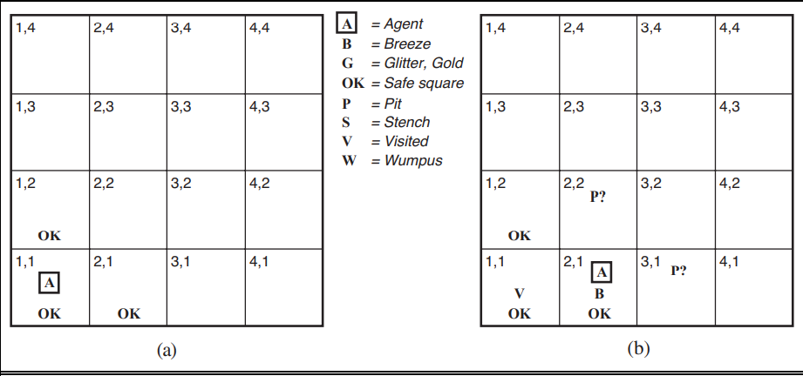
Exploring a wumpus world

Slide 17
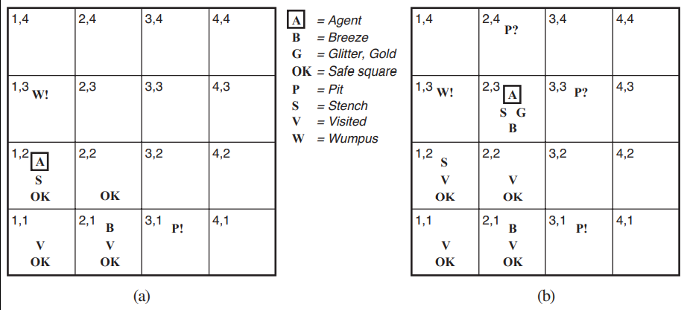
Exploring a wumpus world

Slide 18
Logic
We used logical reasoning to find the gold.
Logics are formal languages for representing information such that conclusions can be drawn
Syntax defines the sentences in the language
Semantics define the "meaning" of sentences;
  i.e., define truth of a sentence in a world
E.g., the language of arithmetic
  “x + y = 4” is a well-formed sentence, whereas “x4y+ =” is not. (syntax)
  x+2 ≥ y is true in a world where x = 7, y = 1
  x+2 ≥ y is false in a world where x = 0, y = 6
semantics

Slide 19
Entailment
Entailment means that one thing follows from another:
KB ╞ α
Knowledge base KB entails sentence α if and only if α is true in all worlds where KB is true

Slide 20

Models
If a sentence α is true in model m, We say m is a model of α.
(or) m satisfies α.
M(α) -> the set of all models of α.
Then KB ╞ α iff M(KB) ⊆ M(α)

Slide 21

Entailment in the wumpus world
Consider possible models for KB assuming only pits and a reduced Wumpus world
Situation after detecting
nothing in [1,1], moving right, breeze in [2,1]

Slide 22

Wumpus models
All possible models in this reduced Wumpus world.

Slide 23

Wumpus models
KB = all possible wumpus-worlds consistent with the observations and the “physics” of the Wumpus world.

Slide 24

Wumpus models
α₁ = "[1,2] is safe", KB ╞ α₁, proved by model checking

Slide 25

Wumpus models
α₂ = "[2,2] is safe", KB ╞ α₂

Slide 26
Inference Procedures
KB ├_{i} α = sentence α can be derived from KB by procedure (inference algo) i -> i derives α from KB.
Soundness: An inference algorithm that derives only entailed sentences is called sound or truth preserving.(no wrong inferences, but maybe not all inferences)
Completeness: an inference algorithm is complete if it can derive any sentence that is entailed. (all inferences can be made, but maybe some wrong extra ones as well)
Grounding - the connection between logical reasoning processes and the real environment in which the agent exists.

Slide 27
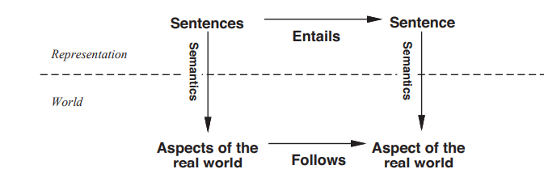
Grounding

Slide 28
Grounding
How do we know that KB is true in the real world?
Agent’s sensors create the connection.
Eg: Wumpus-world agent - smell sensor - agent program – adds a suitable sentence whenever there is a smell.
Then, whenever that sentence is in the knowledge base, it is true in the real world.
belief that wumpuses cause smells in adjacent squares – learning !!

Slide 29
Propositional logic: Syntax
Propositional logic is the simplest logic – illustrates basic ideas
The proposition symbols P₁, P₂ etc are sentences
  If S is a sentence, ¬S is a sentence (negation)
  If S₁ and S₂ are sentences, S₁ ∧ S₂ is a sentence (conjunction)
  If S₁ and S₂ are sentences, S₁ ∨ S₂ is a sentence (disjunction)
  If S₁ and S₂ are sentences, S₁ ⇒ S₂ is a sentence (implication)
  If S₁ and S₂ are sentences, S₁ ⇔ S₂ is a sentence (biconditional)

Slide 30
Propositional logic: Semantics
Each model/world specifies true or false for each proposition symbol
  E.g. P_{1,2} P_{2,2} P_{3,1}
  false true false
  With these symbols, 8 possible models, can be enumerated automatically.
Rules for evaluating truth with respect to a model m:
¬S is true iff S is false
S₁ ∧ S₂ is true iff S₁ is true and S₂ is true
S₁ ∨ S₂ is true iff S₁is true or S₂ is true
S₁ ⇒ S₂ is true iff S₁ is false or S₂ is true
i.e., is false iff S₁ is true and S₂ is false
S₁ ⇔ S₂ is true iff S₁⇒S₂ is true andS₂⇒S₁ is true
Simple recursive process evaluates an arbitrary sentence, e.g.,
¬P_{1,2} ∧ (P_{2,2} ∨ P_{3,1}) = true ∧ (true ∨ false) = true ∧ true = true

Slide 31

Truth tables for connectives
OR: P or Q is true or both are true.
XOR: P or Q is true but not both.
Implication is always true
when the premises are False!

Slide 32
Wumpus world sentences
Let P_{i,j} be true if there is a pit in [i, j].
Let B_{i,j} be true if there is a breeze in [i, j].
  start: ¬ P_{1,1}
  ¬ B_{1,1}
  B_{2,1}
"Pits cause breezes in adjacent squares"
  B_{1,1} ⇔ (P_{1,2} ∨ P_{2,1})
  B_{2,1} ⇔ (P_{1,1} ∨ P_{2,2} ∨ P_{3,1})

Slide 33
Inference by enumeration
Enumeration of all models is sound and complete.
For n symbols, time complexity is O(2^{n})...
We need a smarter way to do inference!
In particular, we are going to infer new logical sentences from the data-base and see if they match a query.

Slide 34

Logical equivalence
To manipulate logical sentences we need some rewrite rules.
Two sentences are logically equivalent iff they are true in same models: α ≡ ß iff α╞ β and β╞ α
You need to
know these !

Slide 35

Validity and satisfiability
A sentence is valid if it is true in all models,
  e.g., True, A ∨¬A, A ⇒ A, (A ∧ (A ⇒ B)) ⇒ B
Validity is connected to inference via the Deduction Theorem:
  KB ╞ α if and only if (KB ⇒ α) is valid
A sentence is satisfiable if it is true in some model
  e.g., A∨ B, C
A sentence is unsatisfiable if it is false in all models
  e.g., A∧¬A
Satisfiability is connected to inference via the following:
  KB ╞ α if and only if (KB ∧¬α) is unsatisfiable
  (there is no model for which KB=true and is false)

