Slide 1


Slide 2
Planning
In which we see how an agent can take advantage of the structure of a problem to construct complex plans of action.
The task of coming up with a sequence of actions that will achieve a goal is called planning.
We will discuss an expressive yet carefully constrained language for representing planning problems, including actions and states.

Slide 3
Planning
We consider only environments that are fully observable, deterministic, finite, static and discrete. These are called classical planning environments.
In contrast, non classical planning is for partially observable or stochastic environments and involves a different set of algorithms and agent designs.

Slide 4
The Planning Problem
Problem with ordinary problem-solving agent using standard search algorithms – Depth-first, A* and so on….
The problem solving agent can be overwhelmed by irrelevant actions.
The next difficulty is finding a good heuristic function.
Problem solver might be inefficient because it cannot take advantage of problem decomposition.

Slide 5
The language of planning problems
The key is to find a language that is expressive enough to describe a wide variety of problems, but restrictive enough to allow efficient algorithms to operate over it.
In this section, we outline the basic representation of classical planners, known as the STRIPS language.

Slide 6
The language of planning problems
Planners decompose the world into logical conditions and represent a state as a conjunction of positive literals.
We will consider propositional literals eg: poor^unknown might represent the state of a agent.
We will also use first order literals
Eg : At( Plane1, Melbourne ) ^ At( Plane2, Sydney ) might represent a state in package delivery problem

Slide 7
The language of planning problems
Literals in first-order state descriptions must be ground and function-free.
Literals such as At( x, y) or
At( Father(Fred),Sydney) are not allowed.
The closed-world assumption is used, meaning that any conditions that are not mentioned in a state are assume d false.

Slide 8
The language of planning problems
Representation of goals. A goal is a partially specified state, represented as a conjunction of positive ground literals., such as Rich ^ Famous or At( P2, Tahiti ). A propositional state ‘s’ satisfies a goal ‘g’ if s contains all of the atoms in g.
Eg : Rich ^ Famous ^ Miserable satisfies the goal Rich ^ Miserable.

Slide 9
The language of planning problems
Representation of actions. An action is specified in terms of the preconditions that must hold before it can be executed and the effects that ensure when it is executed.
Eg : action for flying a plane from one location to another
Action( Fly(p, from, to ),
PRECOND : At(p,from)^Plane(p)^Airport(from)^Airport(to)
EFFECT:
~At(p,from) ^ At( p, to ))

Slide 10
The language of planning problems
This is more properly called as an action schema.
To improve the reliability, some planning systems divide the effect into the add list for positive and the delete list for negative literals.

Slide 11
The language of planning problems
Eg :
At( P1, JFK ) ^ At(P2, SFO) ^ Plane(P1) ^ Plane(P2) ^ Airport(JFK) ^ Airport(SFO)
This satisfies the precondition
At(p , from) ^ Plane( p ) ^ Airport( from ) ^ Airport ( to )
Starting in state s, the result of executing an applicable action a is a state s’ that is same as s expect that any positive literal P in the effect

Slide 12
The language of planning problems
Of a is added to s’ and any negative literal ~P is removed from s’. Thus, after Fly(P1, JFK, SFO), the current state becomes
At( P1, SFO) ^ At(P2, SFO) ^ Plane(P1) ^ Plane(P2)^Airport(JFK)^Airport(SFO)

Slide 13
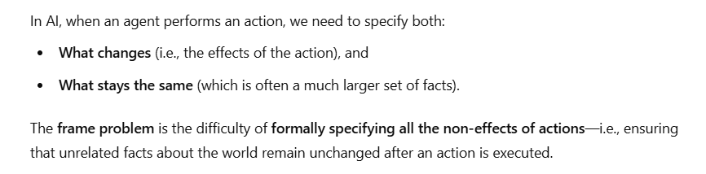


Slide 14
Expressiveness and Extensions
STRIPS is insufficiently expressive for some real domains. As a result, many language variants have been developed.
One important one is ADL( Action Description Language). In ADL, the Fly action could be written as
Action( Fly( p : Plane, from : Airport, to : Airport ),
PRECOND : At(p, from ) ^ ( from = to )
EFFECT : ~ At( p, from ) ^ At( p, to )

Slide 15
STRIPS Language | ADL Language
Only positive literals in states: Poor ^ Unknown | Positive & Negative literals in states: ~Rich ^ ~ Famous
Closed World Assumption: Unmentioned literals are false | Open world Assumption : Unmentioned literals are unknown
Effect P ^ ~Q means add P and delete Q | Effect P ^ ~Q means add P and ~Q and delete ~P and Q.
Only ground literals in goals : Rich ^ Famous | Quantified Variables in goals: £x At(P1, x) ^ At( P2, x) is the goal of having P1 and P2 in the same place.
Goals are conjunctions: Rich ^ Famous | Goals allow Conjunction and disjunction: ~Poor ^ ( Famous V Smart )
Effects are conjunction | Conditional effects allowed: when P : E means E is an effect only if P is satisfied.
No support for equality | Equality predicate is( x=y) is built in
No Support for types | Variables can have types, as in ( p: Plane )

Slide 16
Expressiveness and Extensions
The various planning formalisms used in AI have been systemized within a standard syntax called the Planning Domain Definition Language, or PDDL.
This language allows researchers to exchange benchmark problems and compare results.
PDDL includes sublanguages for STRIPS, ADL etc..
The STRIPS and ADL notations are adequate for many real domains.

Slide 17
Expressiveness and Extensions
Restrictions – Ramification Problem, Qualification Problem.
Ramification Problem – if there are people, packages or dust motes in the airplane, then they too change location when the plane flies..
Qualification Problem – The problem of unrepresented circumstances that could cause a action to fail.

Slide 18
Example- Air Cargo
Init( At( C1, SFO) ^ At( C2, JFK) ^ At( P1, SFO) ^ At( P2, JFK) ^ Cargo( C1) ^ Cargo( C2 ) ^ Plane( P1 ) ^ Plane( P2 ) ^ Airport( JFK ) ^ Airport( SFO )
Goal(At(C1, JFK) ^ At(C2, SFO))
Action( Load(c , p , a,
PRECOND : At(c,a) ^ At(p,a) ^ Cargo( c) ^ Plane( p) ^ Airport( a )
EFFECT : ~At(c,a)^In(c,p))
Action( Unload(c,p,a),
PRECOND : In(c,p)^At(p,a)^Cargo(c) ^ Plane(p) ^Airport(a)
EFFECT : At(c,a)^~In(c,p))
Action(Fly(p, from, to),
PRECOND : At( p, from) ^ Plane( p) ^ Airport( from) ^ Airport(to)
EFFECT : ~At(p,from) ^ At(p, to )

Slide 19
Example- Air Cargo
The following plan is a solution to the problem.
[Load(C1, P1, SFO), Fly(P1, SFO,JFK),
Load(C2, P2, JFK), Fly(P2, JFK, SFO)]

Slide 20
Example : The blocks world
Init(On(A, Table) ^ On( B, Table ) ^ On( C, table) ^ Block( A) ^ Block( B) ^ Block(C)^Clear(A) ^ Clear(B) ^ Clear( C) )
Goal(On(A, B) ^ On( B, C))
Action(Move(b , x , y),
PRECOND : On( b, x ) ^ Clear ( b ) ^ Clear( y ) ^ Block( b ) ^ ( b = x ) ^ ( b = y) ^ ( x = y ),
EFFECT : On( b , y ) ^ Clear ( x ) ^ ~On(b,x) ^ ~ Clear(y))
Action(MoveToTable(b,x),
PRECOND : On(b,x)^Clear(b)^Block(b)^(b=x),
EFFECT : On( b, Table ) ^ Clear(x) ^ ~On(b,x)

Slide 21
Planning with State-Space Search
straight forward approach for planning problems - state space search.
forward from initial state or backward from goal.
goal representation to derive effective heuristics automatically.

Slide 22
Forward State-Space Search
It is also called progressive planning, because it moves in the forward direction.
We start in the problem’s initial state, considering sequence of actions until we find a sequence of actions that reaches a goal state.
The formulation of planning problems as state-space search problems is as follows:

Slide 23
Forward State-Space Search
The initial state of the search is the initial state from the planning problem.
The actions that are applicable to a state are all those whose preconditions are satisfied.
The goal test checks whether the satisfies the goal of the planning problem.

Slide 24
Forward State-Space Search
The goal test checks whether the state satisfies the goal of the planning problem.
The step cost of each action is typically 1. (in STRIPS)
Forward state-space search was too inefficient to be practical.
Forward state does not address the irrelevant action problem.
The approach quickly bogs down without a good heuristic.

Slide 25
Backward State-Space Search
advantage of backward search – it consider only relevant actions.
Eg: the goal in 10-airport air cargo problem is to have 20 pieces of cargo at airport B, or more precisely,
At(C1, B) ^ At( C2, B ) ^……^At(C20,B)
conjuct At(C1, B). Working backwards - Unload(C1, p, B), where plane p is unspecified.

Slide 26
Backward State-Space Search
Searching backwards is sometimes called regression planning.
In addition to insisting that actions achieve some desired literal, we must insist that actions not undo any desired literals.
An action that satisfies this restriction is called consistent.

Slide 27
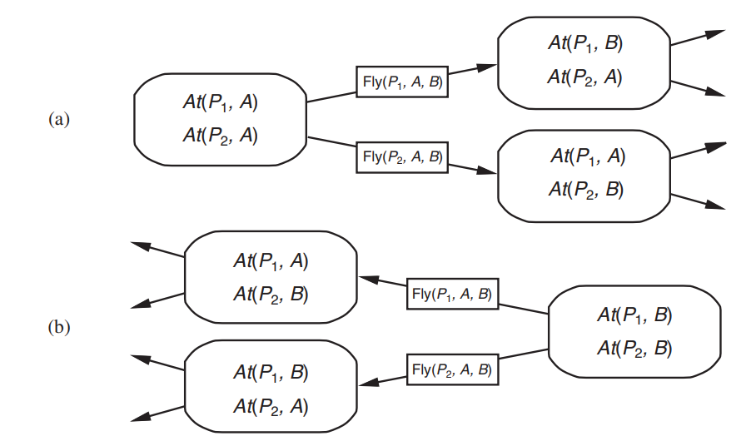
Forward and Backward Search

Slide 28
Heuristics for state-space search
Neither forward nor backward search is efficient without a good heuristic function.
We might also be able to derive an admissible heuristic-one that does not overestimate.
There are two approaches that can be tried. The first is to derive a relaxed problem from the given problem specification.

Slide 29
Heuristics for state-space search
The optimal solution cost for the relaxed problem gives an admissible heuristic for the original problem.
The second approach is to pretend that a pure divide-and-conquer algorithm will work.
This is called subgoal independence assumption: The cost of solving a conjunction of subgoals is approximated by the sum of the costs of solving each subgoal independently.

Slide 30
Ignore Preconditions Heuristic
Drops all preconditions from actions.
Every action becomes applicable in every state.
any single goal fluent can be achieved in one step.
we relax the actions by removing all preconditions and all effects except those that are literals in the goal.
This is an instance of the set-cover problem.

Slide 31
Ignore Delete List
Assume that all goals and preconditions contain only positive literals.
removing the delete lists from all actions (i.e., removing all negative literals from effects).
The relaxed problems leave us with a simplified—but still expensive.
Many planning problems have 10¹⁰⁰ states or more - relaxing the actions does nothing to reduce the number of states.
state abstraction—a many-to-one mapping from states in the ground representation of the problem to the abstract representation.

Slide 32
State Abstraction
The easiest form of state abstraction is to ignore some fluents.
Eg: An air cargo problem with 10 airports, 50 planes, and 200 pieces of cargo.
Each plane can be at one of 10 airports and each package can be either in one of the planes or unloaded at one of the airports.
So there are 50¹⁰ × 200⁵⁰⁺¹⁰ ≈ 10¹⁵⁵ states.

Slide 33
State Abstraction
consider a particular problem in that domain in which it happens that all the packages are at just 5 of the airports, and all packages at a given airport have the same destination.
Now there are only 5 ¹⁰ × 5 ⁵⁺¹⁰ ≈ 10¹⁷ states.
A solution in this abstract state space will be shorter than a solution in the original space.
the abstract solution is easy to extend to a solution to the original problem

Slide 34
Decomposition – Sub Goal Independence
A key idea in defining heuristics is decomposition.
dividing a problem into parts, solving each part independently, and then combining the parts.
The sub goal independence assumption is that the cost of solving a conjunction of sub goals is approximated by the sum of the costs of solving each sub goal independently.

Slide 35
Decomposition – Sub Goal Independence
Suppose the goal is a set of fluents G, which we divide into disjoint subsets G1, . . . , Gn.
We then find plans P1, . . . , Pn that solve the respective sub goals.
each Cost(Pi) as a heuristic estimate.
maximum value, we always get an admissible heuristic. So maxi COST(Pi) is admissible.
But in most cases, in practice the estimate is too low.

Slide 36
Decomposition – Sub Goal Independence
Could we sum the costs instead?
For many problems that is a reasonable estimate, but it is not admissible.
The best case is when we can determine that Gi and Gj are independent.
If the effects of Pi leave all the preconditions and goals of Pj unchanged,
then the estimate COST(Pi) + COST(Pj ) is admissible, and more accurate than the max estimate.

Slide 37
Partial Order Planning
Unlike total order planning, where actions must be executed strictly in a predetermined linear sequence,
partial order planning allows for flexibility in the ordering of actions.

Slide 38
Partial-Order Planning
Forward and Backward state-space search are particular forms of totally ordered plan search.
They explore only strictly linear sequences of actions directly connected to the start or goal.
This means that they cannot take advantage of problem decomposition.
Rather than work on each sub problem separately, they must always make decisions about how to sequence actions from all the subproblems.
We would prefer an approach that works on several subgoals independently, solves them with several subplans, and then combines the subplans

Slide 39
Partial-Order Planning
The general strategy of delaying a choice during search is called a least commitment strategy.
Consider the simple problem of putting on a pair of shoes. We can describe this as a formal planning problem as follows:
Goal(RightShoeOn ^ LeftShoeOn )
init()
Action( RightShoe, PRECOND : RightSockOn, EFFECT : RightShoeOn)
Action(RightSock, EFFECT : RightSockOn)
Action(LeftShoe, PRECOND: LeftSockOn, EFFECT : LeftShoeOn)
Action(LeftSock, EFFECT: LeftSockOn).

Slide 40
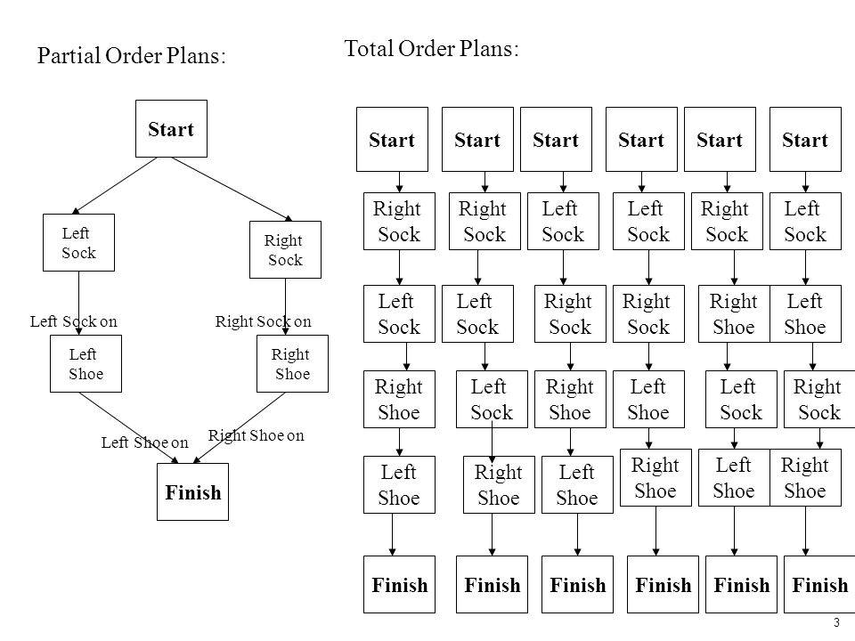
Partial Order Planning

Slide 41
POP
Each plan has four components.
A set of actions that make up the steps of the plan. These are taken from the set of actions in the planning problem.
A set of ordering constraints, Each ordering constraint is of the form A<B, which is read as “ A before B” and means that action A must be executed sometime before action B, but not necessarily immediately before. Any cycle – such as A < B and B < A – represents a contradiction, so an ordering constraint cannot be added to the plan if it creates a cycle.

Slide 42
Partial Order Planning
A set of causal links. A causal link between two actions A and B in the plan is written as .
p
A → B and is read as “A achieves p for B.” for example, the causal link
RightSockOn
RightSock → RightShoe
A set of open preconditions. A precondition is open if it is not achieved by some action.

Slide 43
POP Algorithm
A consistent plan is a plan in which there are no
cycles in the ordering constraints und no conflicts
with the causal links.
A consistent plan with no open preconditions is a
solution.
POP is executed by repeatedly choosing any of the
possible next actions.

Slide 44
POP Example
Init (At (Flat, Axle)^At (Spare, Trunk))
Goal (At (Spare, Axle)
Action (Remove (Spare, Trunk),
PRECOND: At (Spare, Trunk)
EFFECT: ~At (Spare, Trunk) ^ At (Spare, Ground))
Action (Remove (Flat, Axle),
PRECOND: At (Flat, Axle)
EFFECT: ~At (Flat, Axle)^At (Flat, Ground))
Action (PutOn (Spare, Axle),
PRECOND: At (Spare, Ground)^~At (Flat, Axle))
EFFECT: ~At (Spare, Ground)^At (Spare, Axle))
Action (LeaveOvernight,
PRECOND:
EFFECT: ~At (Spare, Ground)^~At (Spare, Trunk)^~At(Spare, Axle)^~At (Flat, Ground)^~At (Flat, Axle))

Slide 45

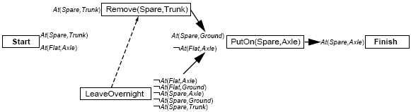
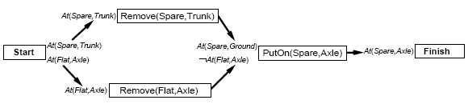
POP Example

Slide 46
Planning graphs
GraphPlan is an algorithm based on planning graph.
Graphplan takes as input a planning problem expressed in STRIPS and produces, if one is possible, a sequence of operations for reaching a goal state.
The name graphplan is due to the use of a novel planning graph, to reduce the amount of search needed to find the solution from straightforward exploration of the state space graph.
In the state space graph:
the nodes are possible states,
and the edges indicate reachability through a certain action.

Slide 47
Planning graphs
On the contrary, in Graphplan's planning graph:
the nodes are actions and atomic facts, arranged into alternate levels,
and the edges are of two kinds:
  from an atomic fact to the actions for which it is a condition,
  from an action to the atomic facts it makes true or false.
Planning graphs are also used as a source of heuristics (an estimate of how many steps it takes to reach the goal).

Slide 48
Planning graphs
Planning graph is an approximation of a complete tree of all possible actions and their results.
Planning graph is organised into levels.
Level S0: initial state, consisting of nodes representing each fluent that holds in S0 Level.
A0: each ground action that might be applicable in S0.
Then alternate Si and Ai. Si contains fluent which could hold at time i.
Ai contains actions which could have their preconditions satisfied at i

Slide 49
Example
Initial state: Have(Cake)
Goal: Have(Cake) ∧ Eaten(Cake)
Eat(Cake):
Precond: Have(Cake)
Effect: ¬Have(Cake) ∧ Eaten(Cake)
Bake(Cake):
Precond: ¬Have(Cake)
Effect: Have(Cake)

Slide 50
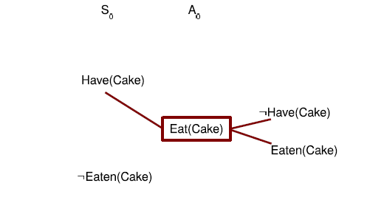
(Incomplete) planning graph example

Slide 51
Building a planning graphs
In addition to ‘normal’ action, persistence action or no-op (no operation): one for each fluent, preserves the fluent’s truth.
Mutex or mutual exclusion links depicted by red semicircles mean that actions cannot occur together.
Similarly there are mutex links between fluents.
Build the graph until two consecutive levels are identical; then the graph levels off.

Slide 52
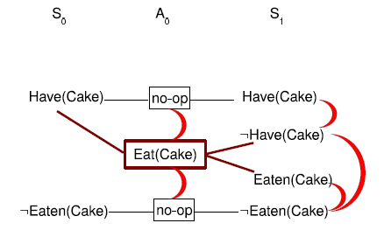
Another incomplete planning graph example

Slide 53
Mutex between actions
Mutex relation holds between two actions at the same level if any of the following three conditions holds.
Inconsistent effects: one action negates an effect of another.
For example, Eat(Cake) and persistence for Have(Cake) have inconsistent effects ( ¬Have(Cake) and Have(Cake))
Interference: one of the effects of one action is the negation of a precondition of the other.
For example Eat(Cake) interferes with the persistence of Have(Cake) by negating its precondition

Slide 54
Mutex between actions
Competing needs: one of the preconditions of one action is mutually exclusive with a precondition of the other.
For example, Eat(Cake) has precondition Have(Cake) and Bake(Cake) has precondition of ¬Have(Cake).

Slide 55
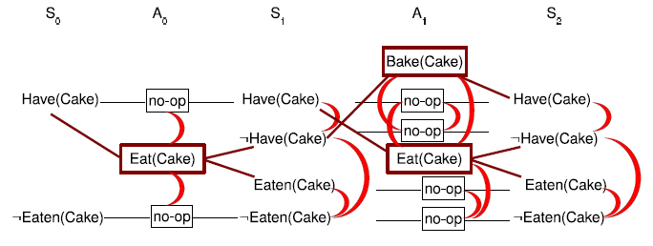
Planning graph example

Slide 56
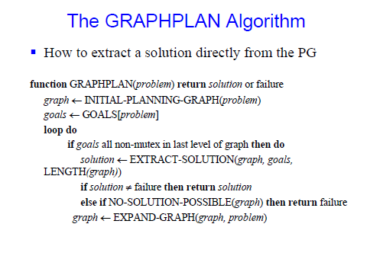

Slide 57
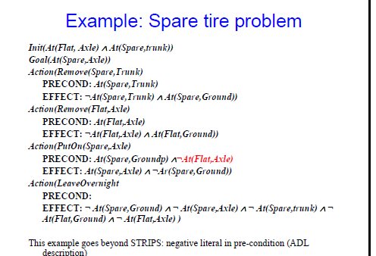

Slide 58
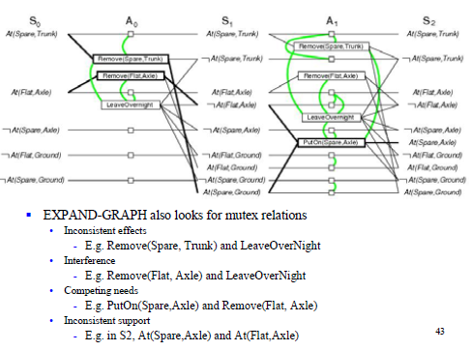
Example Spare Tire Problem

