Slide 1
Uncertainty
In which we see what an agent should do when not all is crystal clear.

Slide 2
Acting Under Uncertainty
Agents may need to handle uncertainty, whether due to partial observability, nondeterminism, or a combination of the two.
An agent may never know for certain what state it’s in or where it will end up after a sequence of actions.

Slide 3
Acting Under Uncertainty
When an gent knows enough facts about its environment, the logical approach enables it to derive plans.
Unfortunately, agents almost never have access to the whole truth about the environment.
Agents must, therefore, act under uncertainty.
Eg : An agent wants drive someone to the airport to catch a flight and is considering a plan A90, that involves leaving home 90 minutes before flight starts and driving at a reasonable speed.

Slide 4
Acting Under Uncertainty
Even though the airport is only 15 miles away, the agent will not be conclude with certainty that “Plan A90 will get us to the airport in time”.
Instead, it reaches the weaker conclusion “Plan A90 will get us to the airport in time as long as my car doesn’t break down, or run out of gas, and I don’t get into an accident and there are no accidents on the bridge, and the plane doesn’t leave early and…..”.
None of these can be deduced, so the plan’s success cannot be inferred.
This is an example of qualification problem.

Slide 5
Acting Under Uncertainty
No pure logic agent will be able to conclude that plan A90 is the right thing to do.
Suppose that A90 is the right thing to do – what does this mean.
It means A90 expected to maximize the performance measure – getting to the airport in time, avoiding long , unproductive wait at the airport.
A120 might increase the agent’s belief that it will get to the airport on time, but also increase the likelihood of long wait.

Slide 6
Acting Under Uncertainty
The right thing to do-the rational decision-therefore depends on both the relative importance of various goals and the likelihood that, and degree to which, they will be achieved.

Slide 7
Handling uncertain knowledge - Dental diagnosis using FOL
Ұp Symptom(p, Toothache) ➔ Disease(p, cavity)
Rule is wrong…not all patients with toothaches have cavities; some of them have gum disease etc…
Ұp Symptom(p, Toothache) ➔ Disease(p, cavity) V Disease( p, GumDisease) V Disease(p, Abcess)…..
To make the rule true…unlimited list of possible causes has to be added.
Ұp Disease(p, Cavity ) ➔ Symptom(p, Toothache)
This is also not right either; not all cavities cause pain.

Slide 8
Handling uncertain knowledge
FOL to cope with domain like medical diagnosis fails for three reasons
Laziness - Too much work to list the complete set of antecedents or consequents.
Theoretical Ignorance – Medical science has no complete theory of the domain.
Practical Ignorance – Even if we know all the rules, not all rules can be run on a patient.
The connection between toothaches and cavities is just not a logical consequence.
The Agents knowledge can at best provide only a degree of belief.
Our main tool for dealing with degree of belief is probability theory.

Slide 9
Handling uncertain knowledge
Eg : 80% chance – that is, a probability of of 0.8 – that the patient has a cavity if he or she has a toothache.
The missing 20% summarizes all the other possible causes of toothache that we are too lazy or ignorant to confirm or deny.

Slide 10
Assigning probability 0 –Unequivocal belief that the sentence is false.
Assigning probability 1 –Unequivocal belief that the sentence is true.
Probabilities between 0 and 1 corresponds to intermediate degrees of belief in the truth of the sentence.
Degree of belief is different from the degree truth.
Degree of truth is the subject of fuzzy logic.

Slide 11
Handling uncertain knowledge
Before the evidence is obtained, we talk about prior or unconditional probability.
After the evidence is obtained we talk about posterior or conditional probability.

Slide 12
Uncertainty and Rational Decisions
The presence of uncertainty radically changes the way an agent makes decisions.
Suppose A90 plan for getting to the airport has 95% chance of succeeding. Does this mean it is a rational choice.
There may be A120 with higher probabilities of success.
What about A1440, a plan that involves leaving home 24hrs in advance?
Decision theory = Probability theory + utility theory
The fundamental idea of decision theory is that an agent is rational if and only if it chooses the action that yields the highest expected utility, averaged over all the possible outcomes of the action. This is called the principle of maximum expected utility (MEU).

Slide 13
What probabilities are about
Like logical assertions, probabilistic assertions are about possible worlds.
In probability theory, the set of all possible worlds is called the sample space.
The possible worlds are mutually exclusive and exhaustive—two possible worlds cannot both be the case, and one possible world must be the case.

Slide 14
What probabilities are about
In probability theory, the set of all possible worlds is called the sample space.
The possible worlds are mutually exclusive and exhaustive—two possible worlds cannot both be the case, and one possible world must be the case.

Slide 15

What probabilities are about
A fully specified probability model associates a numerical probability P(ω) with each possible world.
The basic axioms of probability theory say that every possible world has a probability between 0 and 1 and that the total probability of the set of possible worlds is 1:

Slide 16
What probabilities are about
Probabilities such as P(Total = 11) and P(doubles) are called unconditional or prior probabilities ;
they refer to degrees of belief in propositions in the absence of any other information.
conditional or posterior probability of rolling doubles given that the first die is a 5. This probability is written P(doubles | Die1 = 5),

Slide 17

What probabilities are about
For example, when rolling fair dice, we have P(Total = 11) = P((5, 6)) + P((6, 5)) = 1/36 + 1/36 = 1/18.

Slide 18
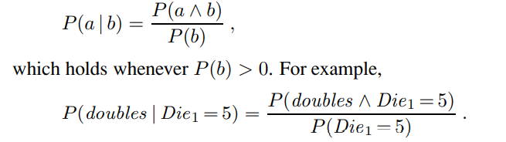
What probabilities are about
Mathematically speaking, conditional probabilities are defined in terms of unconditional probabilities as follows: for any propositions a and b, we have

Slide 19

What probabilities are about
The definition of conditional probability, can be written in a different form called the product rule:

Slide 20
The language of propositions in probability assertion
Variables in probability theory are called random variables.
Eg: Total and Die1 are random variables.
Every random variable has a domain—the set of possible values it can take on.
The domain of Total for two dice is the set {2, . . . , 12} and the domain of Die1 is {1, . . . , 6}.
A Boolean random variable has the domain {true, false}

Slide 21
The language of propositions in probability assertion
proposition that doubles are rolled is Doubles = true.
By convention, propositions of the form A = true are abbreviated simply as a, while A = false is abbreviated as ¬a.
domains can be sets of arbitrary tokens;
Eg: domain of Age {juvenile,teen, adult} and
the domain of Weather might be {sunny, rain, cloudy, snow}.

Slide 22
The language of propositions in probability assertion
Variables can have infinite domains, too—either discrete (like the integers) or continuous (like the reals).
The probability that the patient has a cavity, given that she is a teenager with no toothache, is 0.1” as follows:
P(cavity | ¬toothache ∧ teen) = 0.1
Sometimes we will want to talk about the probabilities of all the possible values of a random variable. We could write:

Slide 23
The language of propositions in probability assertion
P(Weather = sunny) = 0.6
P(Weather = rain) = 0.1
P(Weather = cloudy) = 0.29
P(Weather = snow) = 0.01,
but as an abbreviation we will allow
P(Weather ) = <0.6, 0.1, 0.29, 0.01> ,

Slide 24
The language of propositions in probability assertion
where the bold P indicates that the result is a vector of numbers.
The P notation is also used for conditional distributions:
P(X | Y ) gives the values of P(X = xi | Y = yj ) for each possible i, j pair.

Slide 25
The language of propositions in probability assertion
For continuous variables, not possible to write out the entire distribution as a vector - there are infinitely many values. Instead,
we can define the probability that a random variable takes on some value x as a parameterized function of x.
For example, the sentence
P(NoonTemp = x) = Uniform[18C,26C] (x)

Slide 26
The language of propositions in probability assertion
probability density is uniform from 18C to 26C.
100% chance that the temperature- fall in that 8C-wide region and a 50% chance - it will fall in any 4C-wide region, and so on.

Slide 27
The language of propositions in probability assertion
We write the probability density for a continuous random variable X at value x as P(X = x) or just P(x);
the intuitive definition of P(x) is the probability that X falls within an arbitrarily small region beginning at x, divided by the width of the region:
P(x) = lim dx→0 P(x ≤ X ≤ x + dx)/dx .
For NoonTemp we have

Slide 28
The language of propositions in probability assertion
where C stands for centigrade (not for a constant).
In P(NoonTemp = 20.18C) = 1/ 8C , note that 1 /8C is not a probability, it is a probability density.
The probability that NoonTemp is exactly 20.18C is zero, because 20.18C is a region of width 0.

Slide 29
The language of propositions in probability assertion
we need notation for distributions on multiple variables.
Commas are used for this. For example, P(Weather , Cavity) denotes the probabilities of all combinations of the values of Weather and Cavity.
This is a 4 × 2 table of probabilities called the joint probability distribution of Weather and Cavity.

Slide 30
The language of propositions in probability assertion
P(sunny, Cavity) would be a two-element vector giving the probabilities of a sunny day with a cavity and a sunny day with no cavity.
the product rules for all possible values of Weather and Cavity can be written as a single equation:
P(Weather , Cavity) = P(Weather | Cavity)P(Cavity) ,

Slide 31
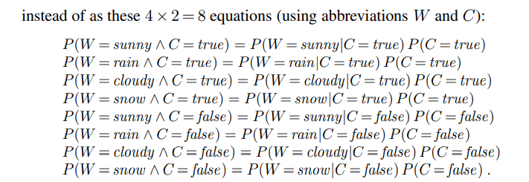
The language of propositions in probability assertion

Slide 32
The language of propositions in probability assertion
As a degenerate case, P(sunny, cavity) has no variables and thus is a one-element vector.
that is the probability of a sunny day with a cavity, which could also be written as
P(sunny, cavity) or P(sunny ∧ cavity).

Slide 33
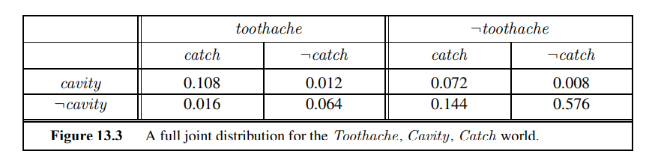
Inference Using Full Joint Distributions
probabilistic inference - the computation of posterior probabilities for query propositions given observed evidence.
We use the full joint distribution as the “knowledge base” from which answers to all questions may be derived.

Slide 34
Inference Using Full Joint Distributions
a domain consisting 3 Boolean variables Toothache, Cavity, and Catch (the dentist’s nasty steel probe catches in my tooth).
The full joint distribution is a 2 × 2 × 2 table.
there are six possible worlds in which cavity ∨ toothache holds:
P(cavity ∨ toothache) = 0.108 + 0.012 + 0.072 + 0.008 + 0.016 + 0.064 = 0.28 .

Slide 35

Inference Using Full Joint Distributions
Adding the entries in the first row gives the unconditional or marginal probability of cavity:
P(cavity) = 0.108 + 0.012 + 0.072 + 0.008 = 0.2 .
This process is called marginalization, or summing out.
following general marginalization rule for any sets of variables Y and Z:

Slide 36


Inference Using Full Joint Distributions
We just used the rule as
A variant of this rule involves conditional probabilities instead of joint probabilities, using the product rule:
This rule is called conditioning

Slide 37
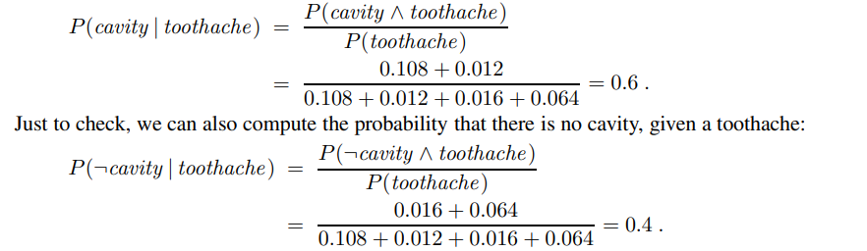
Inference Using Full Joint Distributions
We can compute the probability of a cavity, given evidence of a toothache, as follows:

Slide 38
Independence
Let us expand the full joint distribution by adding a fourth variable, Weather.
The full joint distribution then becomes P(Toothache, Catch, Cavity, Weather ), which has 2 × 2 × 2 × 4 = 32 entries.

Slide 39
Independence
For example, how are P(toothache, catch, cavity, cloudy) and P(toothache, catch, cavity) related?
We can use the product rule:
P(toothache, catch, cavity, cloudy) = P(cloudy |toothache, catch, cavity)P(toothache, catch, cavity) .

Slide 40
Independence
The following assertion seems reasonable:
P(cloudy |toothache, catch, cavity) = P(cloudy).
From this, we can deduce
P(toothache, catch, cavity, cloudy) = P(cloudy)P(toothache, catch, cavity).

Slide 41
Independence
A similar equation exists for every entry in P(Toothache, Catch, Cavity,Weather ).
In fact, we can write the general equation
P(Toothache, Catch, Cavity, Weather ) = P(Toothache, Catch, Cavity)P(Weather ) .

Slide 42
Independence
The property we used is called independence (also marginal independence and absolute independence).
In particular, the weather is independent of one’s dental problems.
Independence between propositions a and b can be written as P(a | b) = P(a) or P(b | a) = P(b) or P(a ∧ b) = P(a)P(b) .

Slide 43
Independence
Independence between variables X and Y can be written as follows (again, these are all equivalent):
P(X | Y ) = P(X) or P(Y | X) = P(Y ) or P(X, Y ) = P(X)P(Y ) .

Slide 44
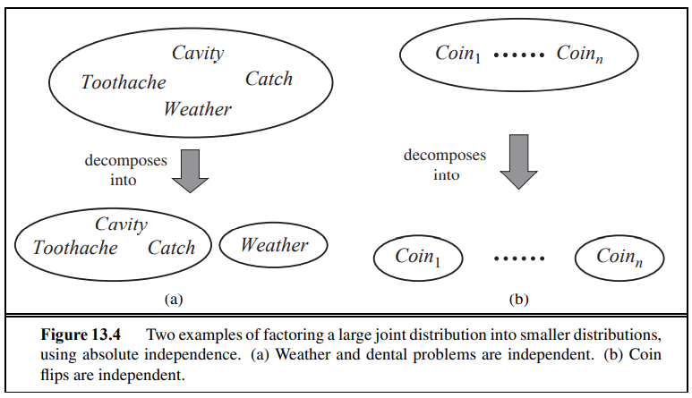
Independence

Slide 45
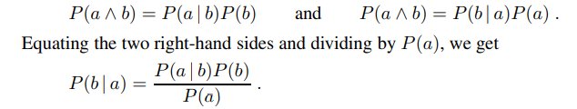
Baye’s Rule and its Use
This equation is known as Bayes’ rule (also Bayes’ law or Bayes’ theorem)

Slide 46
Baye’s Rule and its Use
The more general case of Bayes’ rule for multivalued variables can be written in the P notation as follows:
P(Y | X) = P(X | Y )P(Y ) / P(X)

Slide 47

Applying Bayes’ rule: The simple case

Slide 48
Applying Bayes’ rule: The simple case
The disease meningitis causes stiff neck - 70% of the time.
The prior probability that a patient has meningitis is 1/50,000,
and the prior probability that any patient has a stiff neck is 1%.
s - the proposition that the patient has a stiff neck and
m - the proposition that the patient has meningitis,

Slide 49
Applying Bayes’ rule: The simple case
we have P(s | m) = 0.7
P(m) = 1/50000
P(s) = 0.01
P(m | s) = P(s | m)P(m)/ P(s) = (0.7 × 1/50000)/ 0.01 = 0.0014
That is, we expect less than 1 in 700 patients with a stiff neck to have meningitis.

Slide 50
From a standard deck of 52 cards, a single card is drawn. The probability of drawing a spade is 13/52. Calculate the posterior probability (Ace∣Spade), which is the probability that the drawn spade card is an ace.
80% of spam emails contain the word "Free". Only 10% of non-spam emails contain "Free". If 20% of emails are spam, what is the probability that an email containing "Free" is spam?

