Slide 1
CO2 Emission Analysis Report
Internship Project Presentation
Time Span: 2000–2022

Slide 2
Overview
This report analyzes CO2 emissions by sectors, industries, and countries.
Total Emissions: 3.27 million metric tons.

Slide 3
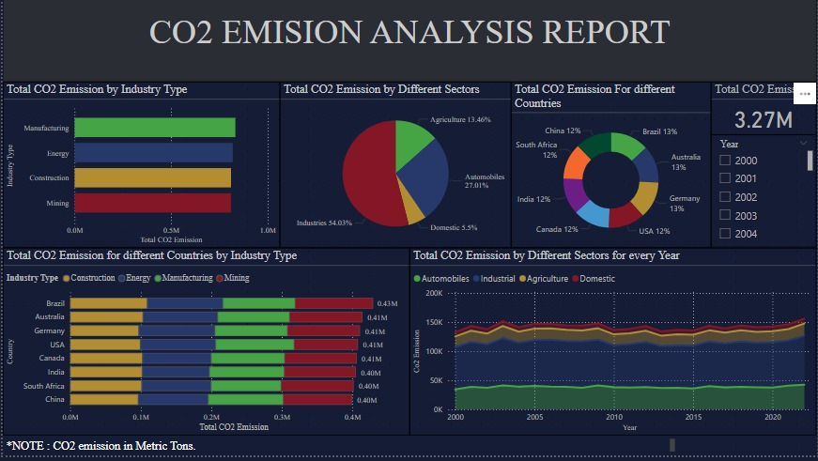

Slide 4
Total CO2 Emission by Industry Type
- Manufacturing: Leading contributor
- Others: Energy, Construction, Mining
- Each nearing 1M metric tons

Slide 5
Total CO2 Emission by Sector
- Industries: 54.03%
- Automobiles: 27.01%
- Agriculture: 13.46%
- Domestic: 5.5%

Slide 6
Total CO2 Emission by Country
Each country contributes ~12–13%:
Brazil, Germany, Australia, China, South Africa, USA, Canada, India

Slide 7
Country-wise CO2 Emission by Industry
- Manufacturing dominates
- Brazil leads with ~0.43M tons
- Mining higher in Brazil

Slide 8
Yearly Emissions by Sector
- General upward trend
- Growth in Automobile & Industrial sectors
- Stable Agriculture & Domestic emissions

Slide 9
Key Insights
- Industries are top emitters
- Focus needed on industrial/automotive regulation
- Global emission responsibility

Slide 10
Note
All values in Metric Tons.
Dashboard includes slicers for year-wise data filtering.

