Slide 1


This report provides a comprehensive understanding of market analysis by deriving the customers behaviour and product trends focusing on orders, reorders and departments
PTID-CDA-JUN-25-545 (Avinash R S)

Slide 2
Slides will cover: Insights On
Product Popularity
Customer Behaviour
Order Trends
Department & Aisles
Reorder & Product Lifecycle
Recommendations
Dashboard

Slide 3
Product Popularity
Top 10 aisles with the highest number of products
Fresh vegetables and fruits have the most products.
Yogurt, cheese, and milk are heavily represented — daily use items.
Snacks like chips and sparkling water are also in the top 10.
Bread and packaged items show large variety — staple and convenience.
Health-focused aisles like lactose-free also appear.
Total products across these 10 aisles exceed 400,000.

Slide 4
Unique Departments
21 unique departments are identified.
Includes produce, dairy, bakery, bulk, international, etc.
A few may overlap in offering similar SKUs (e.g. dairy & breakfast).
Some are niche (pets, international) with fewer SKUs.
Distribution of Products
Produce: 29.6% of total products.
Dairy eggs, snacks, and beverages form the next big segments.
Bulk, alcohol, pets, and “other” are very small.
Some departments account for <1% of total — opportunity to optimize.
Pantry, bakery, frozen are mid-size and steady.
5 departments make up over 70% of the catalog

Slide 5
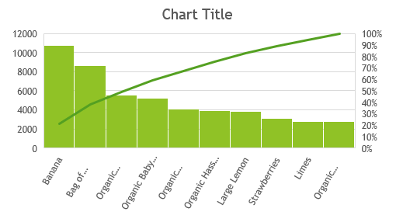
Top 10 products with highest reorders
All are fresh produce → essential daily/weekly buys.
Organic options dominate reorder list → premium loyal buyers.
Banana leads massively → low-cost high-repeat.
No packaged or frozen product in top 10.
7 out of 10 are fruits → freshness matters.
Most are perishables → reordered within short cycles.

Slide 6
Customer Behaviour
63,083 unique users placed orders.
Unknown/missing user IDs were excluded.
Helps benchmark retention if tracked monthly.
High active users support warehouse & logistics optimization.
Avg days between orders
Average: 15.09 days.
Users tend to order every 2 weeks.
Perishable buyers likely have shorter cycles.
Long-tail customers may go up to 30+ days.

Slide 7
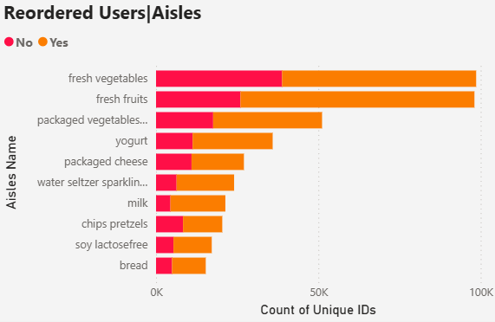
Reorder rate
Total reorders: 540K (60%)
Non-reorders: 363K (40%)
Reorder ratio = strong customer satisfaction.
Some items are naturally single-use or one-time trials.
Reorder insights suggest trust in fresh, daily-use items.
Items with low reorders could be seasonal or wrongly priced.
Aisles with highest reorder rates
Fresh vegetables & fruits have 90K+ reorders.
Yogurt, milk, bread = consistently reordered.
Cheese and sparkling water are mid-tier.
Chips, lactose-free, pretzels are lower.
Products here have short shelf lives.
Reorder rates align with essential food categories.

Slide 8
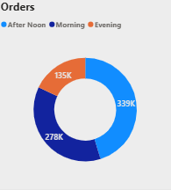
Order Trends
Peak hours of order placement
Highest order volume from 10 AM to 4 PM.
11 AM–2 PM peak hours.
Post-evening drop — fewer orders after 6 PM.
Afternoon has 339K orders, largest share.
Order volume by day of the week
Sunday: Highest order count (~145K).
Monday drops slightly, followed by a weekday slump.
Friday and Saturday show recovery to ~110K.
Mid-week (Tue–Thu) is the lowest engagement.

Slide 9
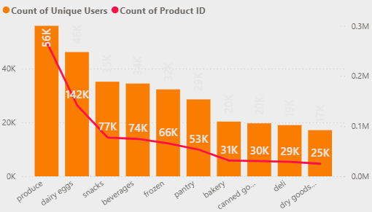
Department & Aisles
Departments with highest number of orders
Produce: Most orders — over 2 million in cart data.
Followed by Dairy Eggs, Snacks, Frozen, Pantry.
Top 5 account for ~70%+ of order traffic.

Slide 10
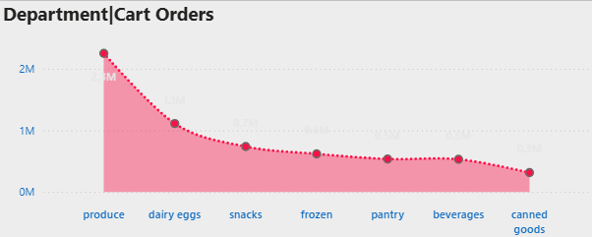
Department-wise cart distribution
Cart volume: Produce > Dairy Eggs > Snacks > Frozen.
Produce alone crossed 2M carts, a huge lead.
Canned goods, Dry goods, Deli fall below 0.5M carts.
Suggests focus on daily fresh needs over packaged staples

Slide 11
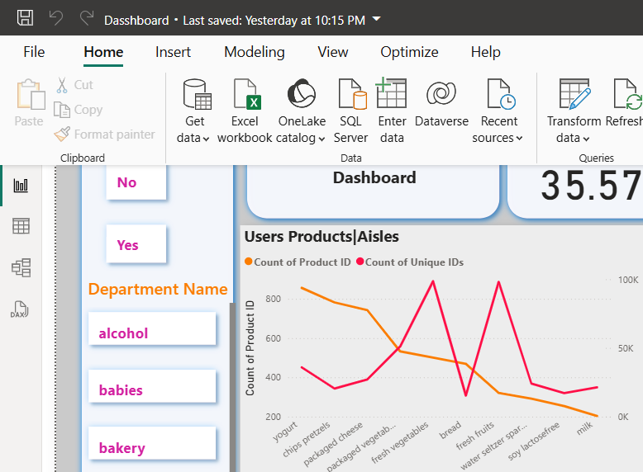
Product and user count by aisle
Most products: Yogurt, Chips Pretzels, Fresh Veg/Fruits.
Most users: Fresh Veg, Packaged Cheese, Bread.
Interesting: Some aisles have high product count but lower user base (Example Soy).
Aisles with highest number of users
Fresh Vegetables, Fresh Fruits dominate again.
Bread, Milk, Packaged Veg/Fruits also see wide user base.
More than 90K users engaged with top aisles.

Slide 12
Reorder & Product Lifecycle
Users who reorder most frequently
Users placing 14.31 orders each, on average.
Some users likely place >30 orders, while others <5.
Power users may belong to families or bulk shoppers.
Departments with lowest reorder rates
Likely: Alcohol, Pets, Other, Bulk.
May be due to infrequent use, low engagement.
Deli, Canned Goods, Dry Goods also lower than fresh categories.

Slide 13
Recommendations
Bundle top reorder products into “Repeat Baskets”.
Highlight reorder frequency in product details.
Use reorder trends to adjust warehouse stocking.
Run “Refill Monday” or “Super Sunday” campaigns.
Increase delivery slots on Sundays.
Midweek campaigns like “Essentials @ 10% off” can bridge the gap.
Push combos from top aisles (bread + cheese).
Monitor shelf space for top aisles in physical stores.
Include “popular in your area” recommendations from top aisles.
Use user-favorite aisles to upsell related products.

Slide 14
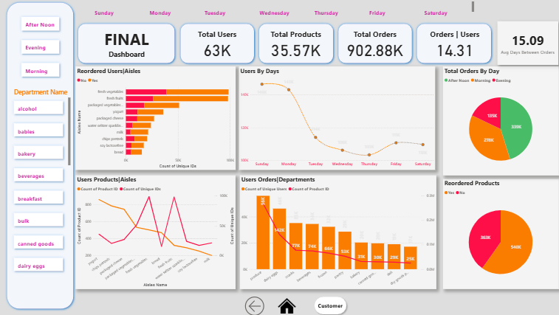
Dashboard Preview
Dashboard
*Click on Dashboard to navigate

