Slide 1
SUBNET MASKING
INTERNET TECHNOLOGIES

Slide 2
ADITYA AMLESH JHA
AVINASH SINGH
ASADULLAH ANSARI
MOHD. AYAN ANSARI

Slide 3
CONTENT
What is IP Address?
Different Classes of IP Address
Subnetting
Subnet Mask

Slide 4
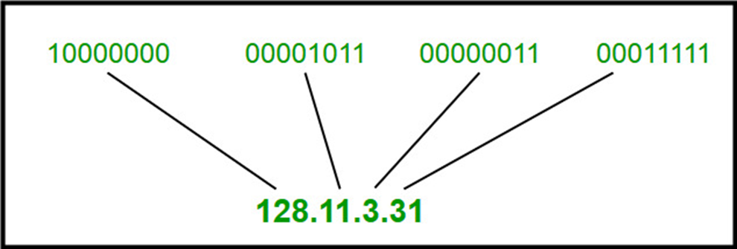
INTRODUCTION TO CLASSFUL IP ADDRESSING
IP Address is an address having information about how to reach a specific host.
It is a 32 bit unique address having an address space of 2^32
Generally there are two notations in which IP address is written, dotted decimal notation and hexadecimal notation

Slide 5
Types of Class Addressing
The 32 bit IP address is divided into five subclasses. These are:
Class A is generally used for big networks such as the ISP networks.
Class B is used for medium to large networks like some big organizations.
Class C addresses are generally used for smaller networks.
Class D addresses are used for Multicasting.
Class E addresses are reserved addresses and they are used for experimental purposes.
Note:
Each of these classes has a valid range of IP addresses
The order of bits in the first octet determine the classes of IP address.

Slide 6
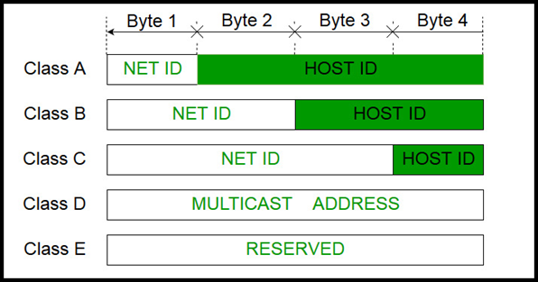
IP Address is divided into two parts:
Network ID
Host ID
Note:
The class of IP address is used to determine the bits used for network ID and host ID and the number of total networks and hosts possible in that particular class. Each ISP or network administrator assigns IP address to each device that is connected to its network.

Slide 7
Note: IP addresses are globally managed by Internet Assigned Numbers Authority(IANA) and regional Internet registries(RIR).
Note: While finding the total number of host IP addresses, 2 IP addresses are not counted and are therefore, decreased from the total count because the first IP address of any network is the network number and whereas the last IP address is reserved for broadcast IP.

Slide 8
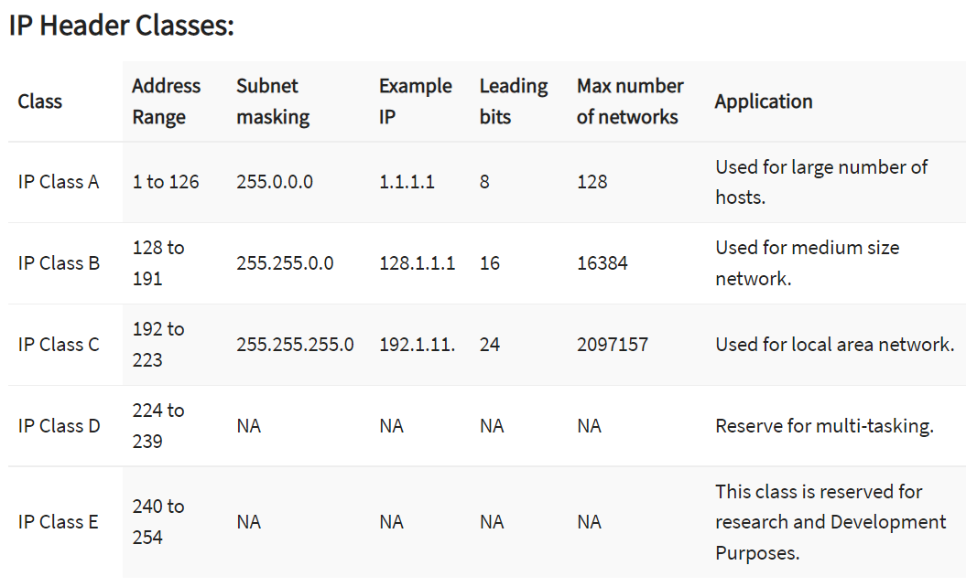

Slide 9
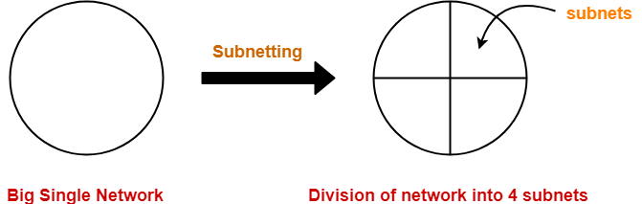
SUBNETTING
Subnetting is a process of breaking large networks in small networks known as subnets.
The sub networks so created are called as subnets.
Allow creating multiple network from a single address block.

Slide 10
WHY SUBNETTING?
Maximise addressing efficiency.
Extend the life of IPV4.
Easy to manage.
Subnetting reduces network traffic by removing collision and broadcast traffic, that overall improve performance.
Subnetting allows you to apply network security policies at the interconnection between subnets.

Slide 11
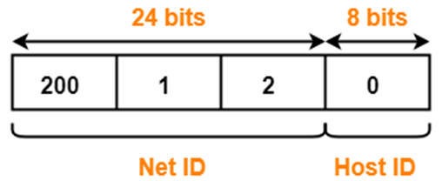
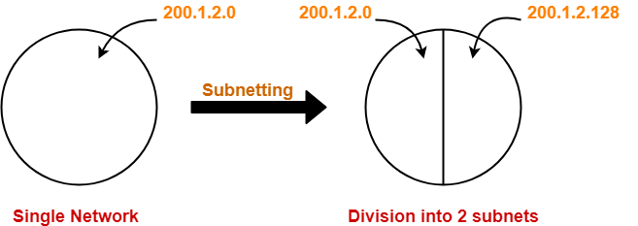
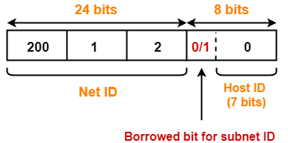
Consider- We have a big single network having IP Address 200.1.2.0.We want to do subnetting and divide this network into 2 subnets.
For creating two subnets and to represent their subnet IDs, we require 1 bit. So, We borrow one bit from the Host ID part. After borrowing one bit, Host ID part remains with only 7 bits.
If borrowed bit = 0, then it represents the first subnet.
If borrowed bit = 1, then it represents second subnet.

Slide 12
SUBNET MASK
A subnet mask is a 32-bit number that acts as a counterpart to the IP address. Each bit in the mask corresponds to its counterpart bit in the IP address. Logical ANDing is applied to the address and mask. If a bit in the IP address corresponds to a 1 bit in the subnet mask, the IP address bit represents a network number. If a bit in the IP address corresponds to a 0 bit in the subnet mask, the IP address bit represents a host number.

Slide 13
Consider an IP address 206.175.162.21. We want to find its network id.
This IP belongs to Class C which has a subnet mask 255.255.255.0. The network id of the destination IP can be calculated as follows:
Convert destination IP to Octal, 206.175.162.21 = 11001110.10101111.10100010.00010101
Convert Subnet Mask to Octal, 255.255.255.0 = 11111111.11111111.11111111.00000000
Perform Logical And & Operation between the two : Subnet Mask(Octal) & IP Address(Octal)
= 11001110.10101111.10100010.00000000
= 206.175.162.0 which is the network id.

Slide 14
THANKYOU!

Slide 15
References:
Geeks for Geeks: https://www.geeksforgeeks.org/introduction-of-classful-ip-addressing/
Javatpoint.
Tutorials point
IPv4 Addressing > CCNP 1: Advanced IP Addressing Management | Cisco Press

