Slide 1
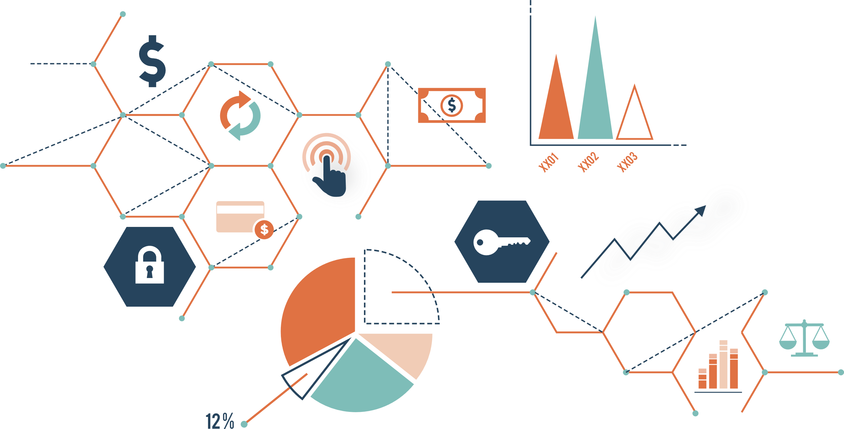
BANKING CASE STUDY
Predictive modelling to understand which
of there existing customer are likely to
invest in a term deposit
Problem Statement :
“Who will subscribe to the term deposit?”
A Portuguese Banking Institution needs to understand
which of their existing customers are most likely to
invest in a term deposit. They launched a tele-marketing
campaign to run an experiment on approx.. 41000 customers
and analyse the differences between the ones who do opt for
a TD and the ones who do not.

Slide 2

Obtaining Data
Obtaining the data from the client and importing the libraries
That are required for the analysis.
Analysis
Analysing the data such as cleaning and exploring the data and find out the inference.
Obtaining Data
Analysis
Bank Case Study
Modelling
Building the predictive model.
Model
Inference
Inference
Giving the inference that we found out from the analysis.

Slide 3
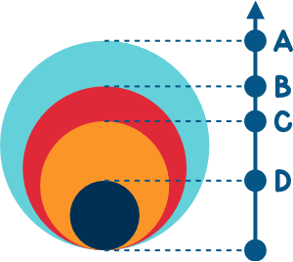
Need for Analysis:
With the help of the given data we can analyse different features and give our insights which can intern help the bank to
make Decision to increase the subscription of the term deposit. The inference can be with respect to job, age, education.
What is expected:
Perform a data-driven analysis to discover the profile of customers who are most likely to buy the Term Deposit. The profile can be discovered by investigating the features available either one at a time i.e. univariate analysis or with multiple features being visualized together i.e bi-variate analysis. Stories and story points can be used as an effective way for presenting the findings

Slide 4
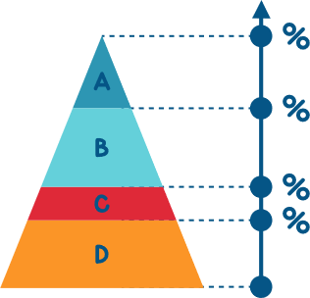
Data Description
Independent Features/ Variables:
'age','job','marital','education','housing','loan','contact','month','day_of_week','duration','campaign','pdays’,
'previous','poutcome','emp.var.rate','cons.price.idx','cons.conf.idx','euribor3m','nr.employed’.
dependent Features/ Target Variable:
Y = ‘yes’, Positive class
y = ‘no’, Negative class
Shape of the dataset:
Total 41188 rows 20 columns including the target feature.
Missing and duplicated Values:
There were no missing and duplicated observation’s in the data

Slide 5
Subscribed V.S Not Subscribed
Inference:
We can say that the data is not balanced from the
Pie chart.
So we have to balance the data for better analysis
Else it would be biased.

Slide 6
Subscribed V.S AGE
Inference: This is bit unusual. Here's what I found.
Usually people above age of 40 and 50 take deposits but in our
case people above age 60 i.e. Elderly are the ones with highest
subscribed rate 45 %
Surprisingly teens who are above 18 and below 25 are the ones subscribing than Adults and Seniors 19 % which is not common.

Slide 7
Subscribed V.S JOB
Inference: Here's what I found from job feature.
It's common that retired people are the one with highest
subscription with 23 %.
What's uncommon is the students are the second highest in
subscription rate with 22 % which is very uncommon.

Slide 8
Subscribed V.S Education
Inference: Here's what I found.
From the below data we can't say that the education column is having good relationship with the dependent variable.
But as expected people with higher education are the ones
taking the term subscription.
So education might not a good variable to take a decision on or
Worth considering.

Slide 9
Model building
As this is a Binary classification problem the model’s are done with Logistic Regression, Decision Tree,
Random Forest, Naïve Bayes and KNN algorithms and then finally based on different evaluation metrics
I have compared these models.
Model | Roc_Auc_Score
Logistic Regression(Stats Model) | 0.649
Logistic Regression(Sklearn) | 0.635
Decision Tree | 0.612
Random Forest | 0.632
Adaboosting | 0.521

Slide 10

Model evaluation
According to the problem statement we must focus more on recall .so maximizing the correct predication for the
class should be the goal. So basically if the model with higher roc_auc score is the best model.
Model Evaluation:
Among all the models logistic regression is giving the highest roc score after doing hyper parameter tuning and the accuracy is
also good in comparison to other models.
Out of total predictions 97% of the predictions are accurately done by this model. Hence accuracy is high.
here we can also consider the fact that with logistic regression we will get to know the predicted probabilities.
Class – Imbalance had been done in order to remove the biasness in the model.

Slide 11

Inference
Possible Solution:
1) We can increase the interest rate that is being given to the seniors and adults so that
it would make them take the term deposit.
2) May be giving different interest rate to different job category might encourage
Them to take the term deposit.

Slide 12
Thank you

