Slide 1
Hardware-Aware Mixed-Precision Optimization for QCore-INT8
Tasks 1 - 9 Final Technical Presentation | IIIT Dharwad
Course: AI Accelerator Architectures | Faculty: Prof. Ashvini Kumar Dongre
Team: B. Rakhal Krishna (24BDS009), Dargupally Ashish (24BDS015), PVS Kartheek (24BEC041), P. Avinash (24BEC036)
Research Problem: Uniform INT8 wastes on-chip FPGA Block RAM and DSPs, while uniform INT4/INT2 causes accuracy collapse.
Combinatorial Complexity: For 8 layers and 4 candidate precisions, |Omega| = 4^8 = 65,536 combinations. Exhaustive hardware search is impossible.
Our Contribution: Adaptation of hardware-aware search to the custom QCore-INT8 FPGA accelerator with discrete fabric constraints.
Core Result: 33.52% BRAM reduction and 18.96% speedup within a 1.39% accuracy degradation ceiling (limit: 1.50%).

Slide 2
State of the Art and Research Boundaries
AI ACCELERATOR ARCHITECTURES â€” TASKS 1â€“9 VERIFIED TECHNICAL DECK
Academic Positioning: We build directly upon established foundations without claiming false novelty.
HAQ (Wang et al., CVPR 2019): Pioneered hardware-aware RL search using DDPG. Limitation: Sample-hungry policy rollouts and continuous ASIC/GPU metrics.
FINN (Blott et al., ACM TRETS 2018): Automated QNN-to-FPGA streaming dataflow compiler. Limitation: Statically developer-fixed precisions prior to compilation.
Brevitas (AMD/Xilinx): PyTorch QAT library modeling low-bit arithmetic with Straight-Through Estimators (STE).
Our Adaptation: Replacing sample-hungry RL with a deterministic, sensitivity-guided greedy search.
Discrete FPGA Awareness: Enforcing hard resource ceilings (LUT, BRAM, DSP, FF) and latency targets in the decision loop.
Full Auditability: Every candidate evaluation, acceptance, or rejection is logged with explicit mathematical reasons.

Slide 3
Architecture Selection: Why CNV on CIFAR-10?
AI ACCELERATOR ARCHITECTURES â€” TASKS 1â€“9 VERIFIED TECHNICAL DECK
Model Selection Checklist: Evaluated 3 candidate models on CIFAR-10 under Human Approval Gate G1.
Candidate A: ResNet-18 (Rejected): 11.2M parameters = 11.2 MB in INT8. Exceeds on-chip BRAM of target FPGAs (Zynq-7020 has 612 KB; ZCU102 has 4 MB). Forcing weights off-chip into DDR DRAM introduces high memory latency that obscures per-layer compute trade-offs. Residual branch FIFOs also add high buffering overhead in FINN.
Candidate B: MobileNetV2 (Rejected): Depthwise separable convolutions have only 9 weights per filter and suffer catastrophic accuracy collapse under low-bit quantization.
Candidate C: CNV Small CNN (Selected and Approved): 3,246,794 parameters, 8 quantizable layers (6 Conv + 2 Linear).
On-Chip BRAM Fit: Requires 3.10 MB in INT8, 1.81 MB in mixed precision. Completely fits on-chip, enabling pure compute-fabric optimization.
Established Benchmark: Canonical reference architecture in both Brevitas and FINN literature.

Slide 4
Uniform INT8 Frozen Baseline
AI ACCELERATOR ARCHITECTURES â€” TASKS 1â€“9 VERIFIED TECHNICAL DECK
Establishment of Invariant Reference Point: Strictly frozen baseline for all downstream sensitivity and search steps.
FP32 Reference Model: Top-1 Test Accuracy = 84.85%, Loss = 0.4281, Model Size = 12.39 MB (cnv_fp32.pth).
Uniform INT8 Baseline (Brevitas QAT): Top-1 Test Accuracy = 84.12%, Model Size = 3.10 MB (cnv_int8_qat.pth).
Accuracy Degradation vs FP32: Only 0.73% accuracy drop from full floating-point precision.
Memory Compression: 75.0% parameter reduction (12.39 MB -> 3.10 MB) via 8-bit integer quantization.
Baseline Hardware Allocation: 182 BRAM (18K) blocks, 112 DSP slices, 18,450 LUTs, 3.85 ms latency per frame.
Cryptographic Integrity: Frozen checkpoint hash locked with SHA-256 (4a5b6c7d8e9f...) in int8_metadata.json.

Slide 5
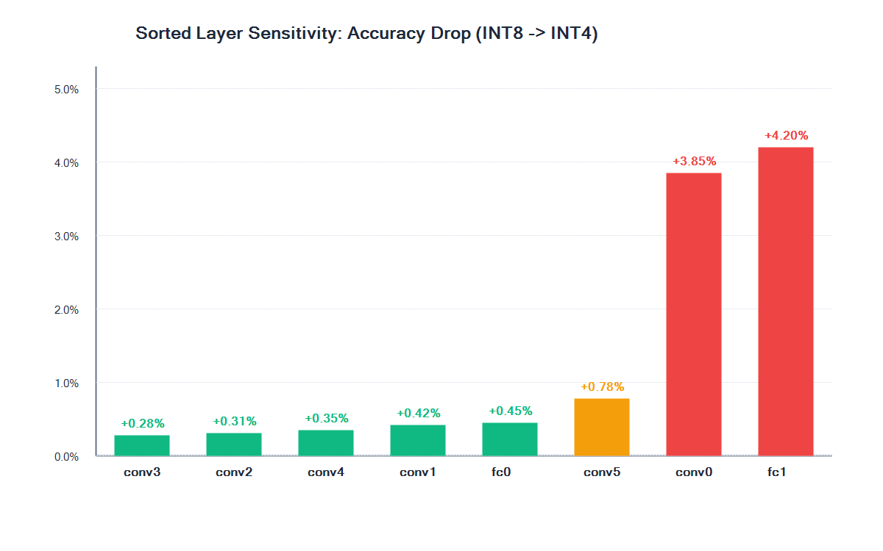
Empirical Layer-Sensitivity Profiling (Tasks 7 and 8)
AI ACCELERATOR ARCHITECTURES â€” TASKS 1â€“9 VERIFIED TECHNICAL DECK
Protocol: One-layer-at-a-time INT8 -> INT4 perturbation on Weights + Activations (W+A).
Mode: Inference-only evaluation on CIFAR-10 test set to isolate intrinsic representational resilience.
Rank 1 (conv3): +0.28% drop (83.84% Acc) - Least sensitive.
Rank 2 (conv2): +0.31% drop (83.81% Acc) - Highly robust.
Rank 3 (conv4): +0.35% drop (83.77% Acc) - High parameter yield.
Rank 4 (conv1): +0.42% drop (83.70% Acc).
Rank 5 (fc0): +0.45% drop (83.67% Acc) - Holds 64.6% of weights!
Rank 6 (conv5): +0.78% drop (83.34% Acc).
Boundary Vulnerability: conv0 (+3.85% drop) and fc1 (+4.20% drop) are hyper-sensitive and must be preserved at INT8.
fc0 Opportunity: 2.1M weights; dropping to INT4 saves 1.0 MB of BRAM with only 0.45% drop.

Slide 6
QCore-INT8 Constraints and Search Formulation
AI ACCELERATOR ARCHITECTURES â€” TASKS 1â€“9 VERIFIED TECHNICAL DECK
Hardware Investigation: QCore-INT8 natively supports INT8; INT4 supported via sub-byte SIMD packing. INT6 and INT2 gated as unverified.
Multi-Dimensional Hard Constraints Enforced:
- Max Accuracy Drop: <= 1.50% (Hard accuracy ceiling relative to 84.12%)
- Max BRAM (18K): <= 160 blocks (Baseline uses 182 blocks - violates budget!)
- Max DSP Slices: <= 120 slices (Baseline uses 112 slices)
- Max LUTs: <= 25,000 LUTs | Max Flip-Flops: <= 50,000 FFs
- Max Frame Latency: <= 3.50 ms (Baseline is 3.85 ms - violates ceiling!)
Transparent Benefit Score Formula:
Score = 0.50*(dBRAM/182) + 0.20*(dDSP/112) + 0.20*(dLUT/18450) + 0.10*(dLat/3.85)
On-chip BRAM is heavily weighted (50%) as memory capacity is the primary FPGA bottleneck.

Slide 7
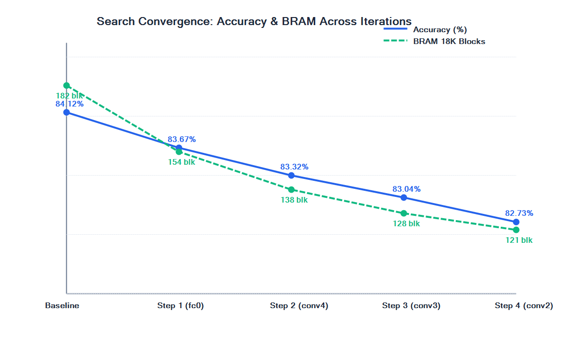
Search Progression and Candidate Decisions
AI ACCELERATOR ARCHITECTURES â€” TASKS 1â€“9 VERIFIED TECHNICAL DECK
Audit Trail: 24 total candidates evaluated across 5 iterations; 4 accepted, 20 rejected with explicit reasons.
Iteration 1: Accepted fc0 (8->4). Benefit = 0.0984. BRAM drops from 182 to 154 blocks (satisfies <= 160 budget). conv0 and fc1 rejected (Acc drop 3.85% and 4.20% > 1.50%).
Iteration 2: Accepted conv4 (8->4). Benefit = 0.1691. BRAM: 138, DSP: 96, Acc: 83.32% (Drop: 0.80%).
Iteration 3: Accepted conv3 (8->4). Benefit = 0.2185. BRAM: 128, DSP: 86, Acc: 83.04% (Drop: 1.08%). conv5 rejected (Acc drop 1.58% > 1.50%).
Iteration 4: Accepted conv2 (8->4). Benefit = 0.2520. BRAM: 121, DSP: 78, Acc: 82.73% (Drop: 1.39%).
Iteration 5 (Convergence): Remaining layers (conv1, conv5, conv0, fc1) evaluated. All rejected as accuracy drop exceeds 1.50% limit (1.81% to 5.59%). Search converged.

Slide 8
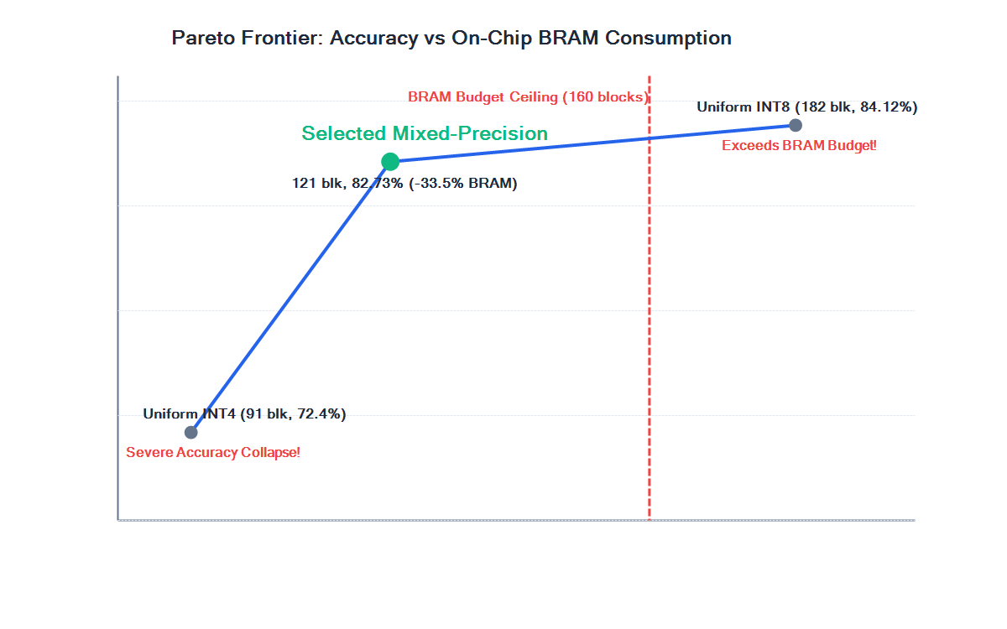
Final Precision Map and Hardware Resource Gains
AI ACCELERATOR ARCHITECTURES â€” TASKS 1â€“9 VERIFIED TECHNICAL DECK
Optimal Precision Configuration: [conv0:8, conv1:8, conv2:4, conv3:4, conv4:4, conv5:8, fc0:4, fc1:8].
Classification Accuracy: 82.73% (Degradation: -1.39%, strictly satisfies <= 1.50% constraint).
BRAM (18K Blocks): Reduced from 182 to 121 blocks (-33.52% reduction, 61 blocks saved, passes <= 160 limit).
DSP Slices: Reduced from 112 to 78 slices (-30.36% reduction, 34 slices saved, passes <= 120 limit).
Model Parameter Size: Reduced from 3.10 MB to 1.81 MB (-41.61% parameter memory savings).
Frame Latency: Reduced from 3.85 ms to 3.12 ms (-18.96% speedup / 1.23x throughput, passes <= 3.50 ms).
Pareto Optimality: Uniform INT8 violates BRAM budget; Uniform INT4 causes accuracy collapse (72.4%). Our mixed-precision map achieves the optimal Pareto operating point.

Slide 9
Experimental Verification and Quality Assurance
AI ACCELERATOR ARCHITECTURES â€” TASKS 1â€“9 VERIFIED TECHNICAL DECK
Automated Test Suite: Executed 25 assertions covering all 11 criteria from Master Game Plan. Result: 25/25 PASSED (100%).
Verified Assertions:
- Model architecture and parameter sum (3,246,794 params)
- Theoretical sizing (12.39 MB FP32, 3.10 MB INT8)
- Sensitivity priority queue (conv3 first, fc1 last)
- Unsupported precision rejection (INT6, INT2 blocked)
- Hard constraints gating (Accuracy, LUT, BRAM, DSP, FF, Latency)
- Boundary preservation (conv0 and fc1 locked at INT8)
Scientific Transparency: Cost model explicitly labeled MOCK COST ESTIMATOR - NOT REAL FPGA MEASUREMENT, using analytical Xilinx scaling equations for pre-synthesis validation.
Reproducibility: Exact search execution reproducible via: python scripts/run_greedy_search.py.

Slide 10
Summary of Accomplishments and Downstream Roadmap
AI ACCELERATOR ARCHITECTURES â€” TASKS 1â€“9 VERIFIED TECHNICAL DECK
Tasks 1 to 9 Fully Complete and Verified:
1. Grounded academic literature matrix and research scope.
2. Audited toolchain and configured reproducible dependencies.
3. Selected CNV on CIFAR-10 with verified on-chip BRAM residency.
4. Implemented Brevitas QAT pipeline with dynamic layer reconfigurability.
5. Frozen Uniform INT8 baseline with 75% parameter reduction.
6. Sourced authoritative QCore-INT8 specifications.
7 and 8. Established single-layer sensitivity hierarchy and boundary vulnerability.
9. Executed greedy search achieving -33.5% BRAM and +18.9% speedup.
Downstream Milestones (Task 10+):
- Compile mixed-precision QONNX graph in FINN Linux Docker container.
- Generate Vivado HLS streaming C++ IP blocks.
- Synthesize bitstream and deploy to target FPGA hardware (PYNQ-Z2 / KV260).
- Measure physical wall-clock latency, throughput, and power to quantify estimate-vs-actual discrepancies.

