Slide 1

LUXE
INTELLIGENCE
End-to-End Analytics & AI Ecosystem
F. Schumacher & Co. · Trade Analytics · Full Year 2025
1,983,549
27,374
$10,680
0.926
76.6%
Total Transactions
Trade Accounts
Champions Avg Rev
XGBoost AUCPR
Revenue Concentration
Avinash Patnaik · CSA Research Italy · 2025

Slide 2
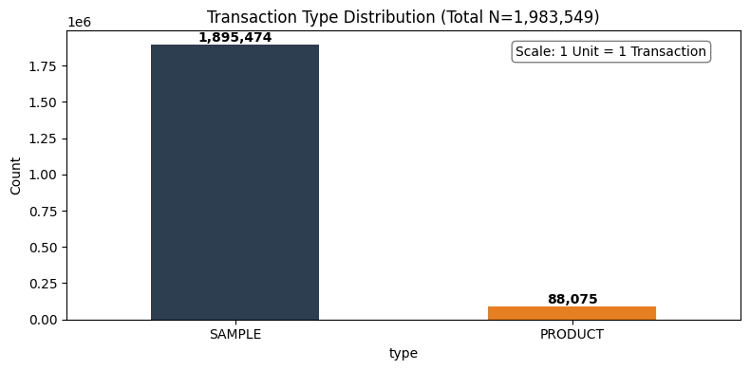
Project Objective & Data Audit
SECTION 01
MISSION STATEMENT
DATA FOUNDATION
To transform high-volume transactional and behavioural data into a 360° Designer Intelligence Suite — bridging the gap between sample intent and purchase reality to optimise conversion velocity, personalise the luxury customer journey, and equip the sales team with predictive tools that drive measurable revenue growth.
Transactions
1,983,549
9 columns
Item Master
16,064
10 columns
Customer Master
29,691
4 columns
🔁 Conversion Optimisation
Quantify sample-to-sale lag
and funnel bottlenecks
🎯 Precision Segmentation
RFM + K-Means clustering
for hyper-personalised CRM
🤖 Propensity Scoring
XGBoost lead scoring:
AUCPR 0.926
💡 AI Recommendation
ChromaDB + Vision AI
curated designer selections
LuxeIntelligence | F. Schumacher & Co. | 2025 | Avinash Patnaik, CSA Research Italy

Slide 3
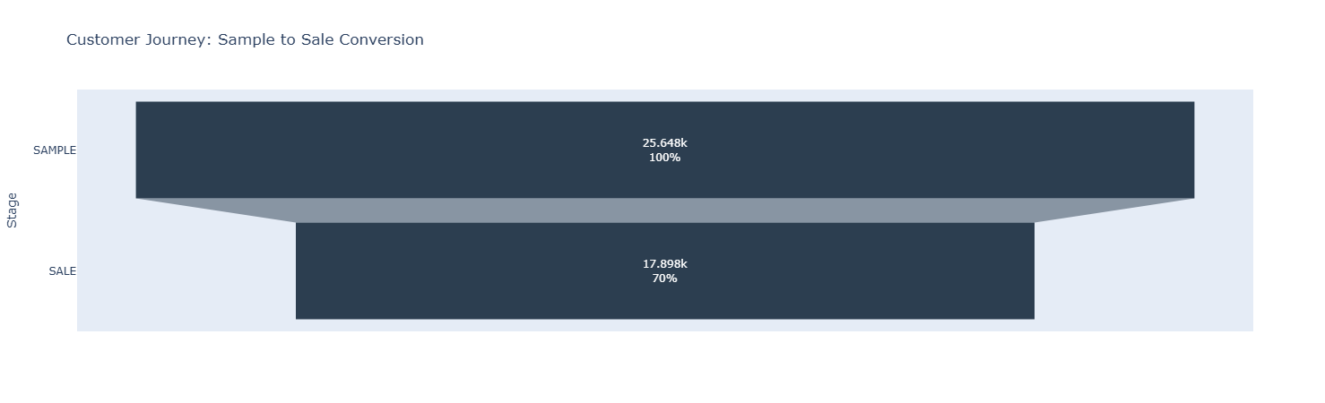
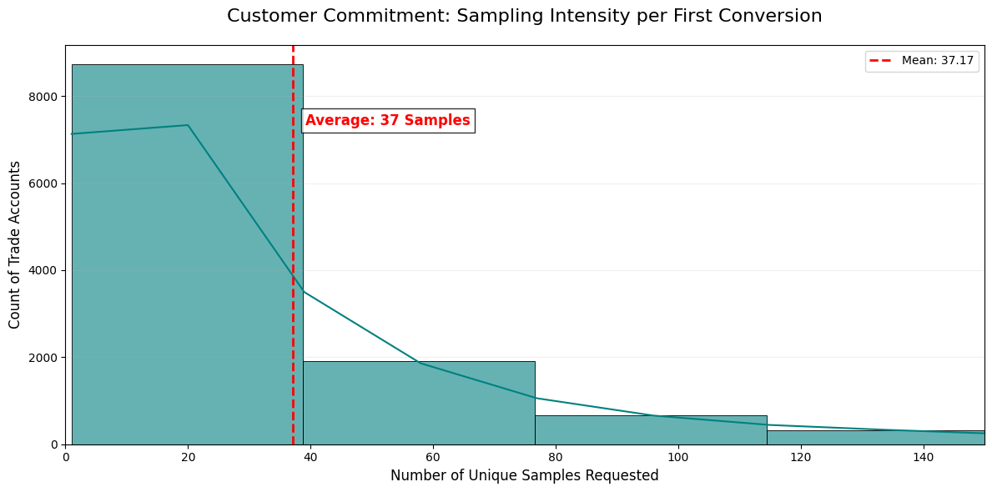
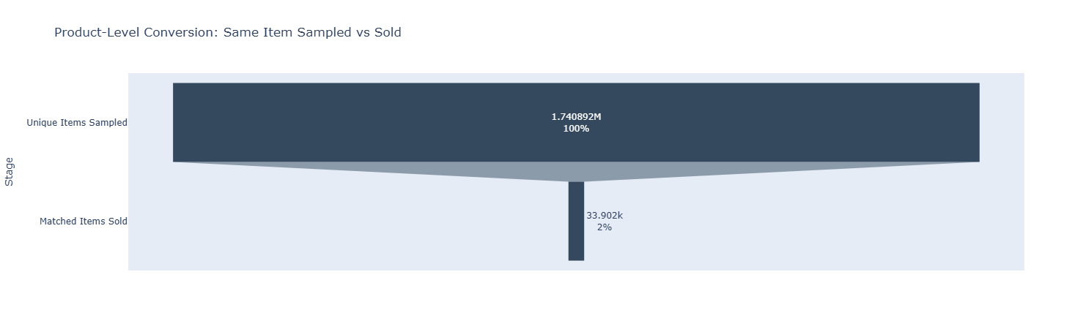
Conversion Funnel Analysis — The Halo Effect
SECTION 02
THE HALO EFFECT: A sample request is a high-intent signal. Even when the specific SKU is not purchased, the account remains 70% likely to buy an alternative. Item-level conversion: 2%. Account-level conversion: 70%.
37
70%
Avg Samples to First Sale
Account Conversion
Customer Acquisition Cost in physical goods
Halo effect rate
LuxeIntelligence | F. Schumacher & Co. | 2025 | Avinash Patnaik, CSA Research Italy

Slide 4
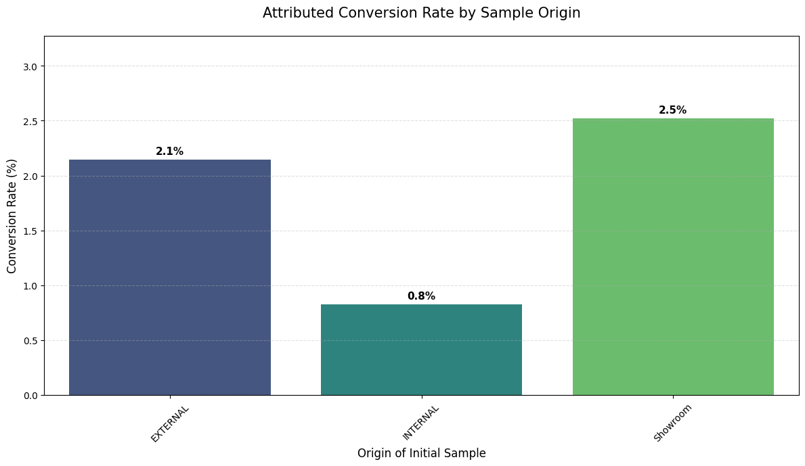
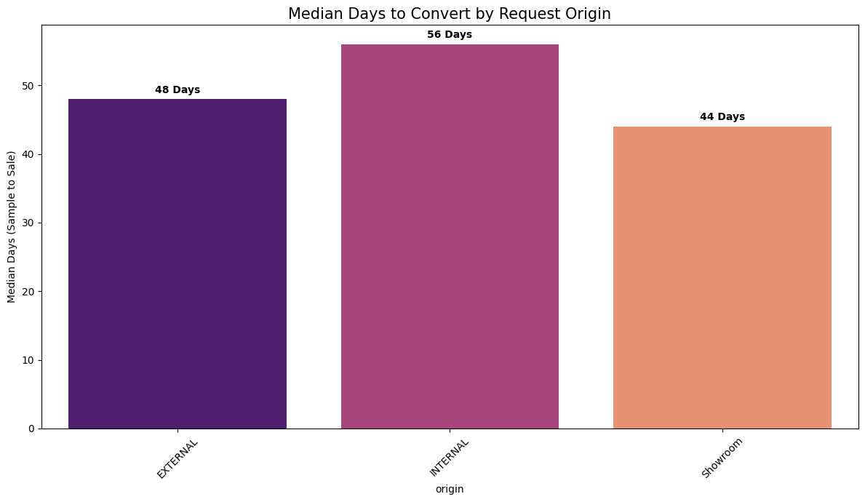
Channel Efficiency & Sales Velocity
SECTION 02
Attributed Conversion Rate by Origin
Showroom Champion
Converting 1 in 5 leads in just 44 days — the most efficient channel in the portfolio. Validates continued investment in physical showroom infrastructure.
The Web Gap
Web leads convert at only 13.6% and take 7+ more days than Showroom. Represents the largest single opportunity for a digital "White Glove" upgrade.
Median Days to Convert by Origin
Customer Commitment
Successful sales are preceded by an average of 2.5 unique sample requests, signalling high buyer focus and intentionality once the process begins.
Human Touch Premium
Strong correlation between human interaction and both conversion speed and probability. Recommendation: increase touchpoint frequency for mid-tier leads.
LuxeIntelligence | F. Schumacher & Co. | 2025 | Avinash Patnaik, CSA Research Italy

Slide 5
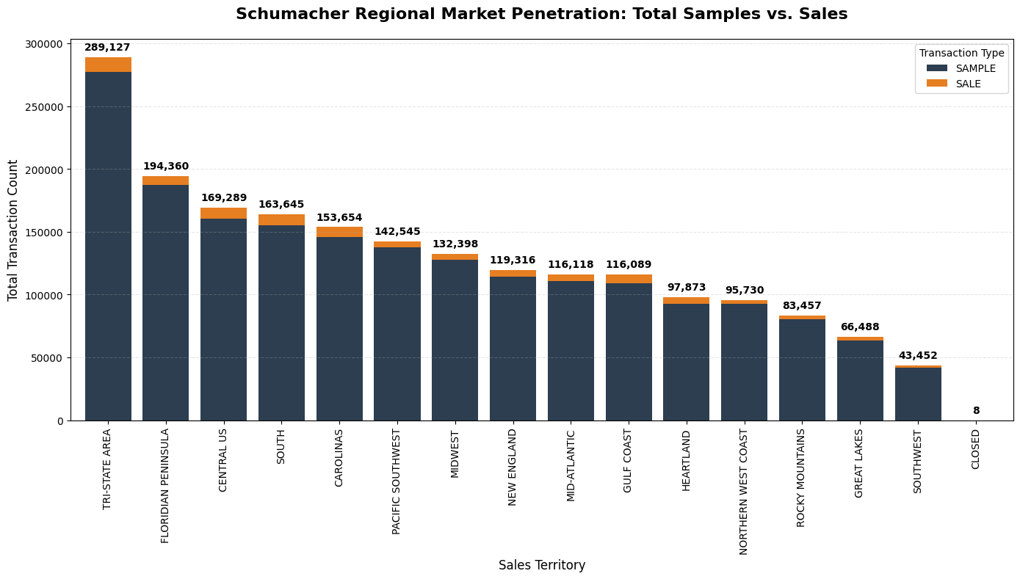
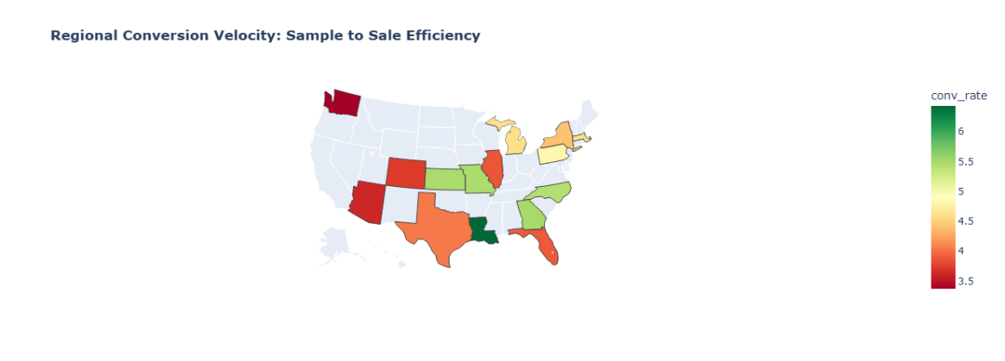
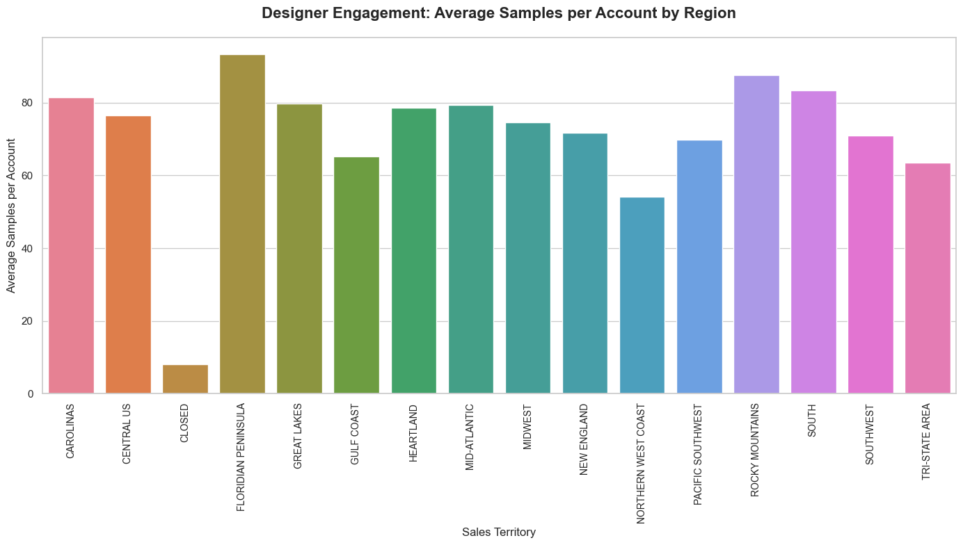
Regional Market Penetration & Conversion Velocity
SECTION 02
Total Samples vs. Sales by Territory
Conversion Velocity Map
Big Three
Tri-State (289K txns), Florida (194K), Central US (169K) dominate volume
Designer Engagement: Avg Samples per Account
High-Velocity
Gulf Coast & Heartland — highest sample-to-sale efficiency. Prioritise rep staffing here
Low-Velocity
Pacific Northwest, Southwest, Tri-State — high churn. Targeted CRM intervention needed
Floridian Insight
90+ samples/account — 1.5× the Tri-State rate. Deeper project engagement, higher commitment
LuxeIntelligence | F. Schumacher & Co. | 2025 | Avinash Patnaik, CSA Research Italy

Slide 6
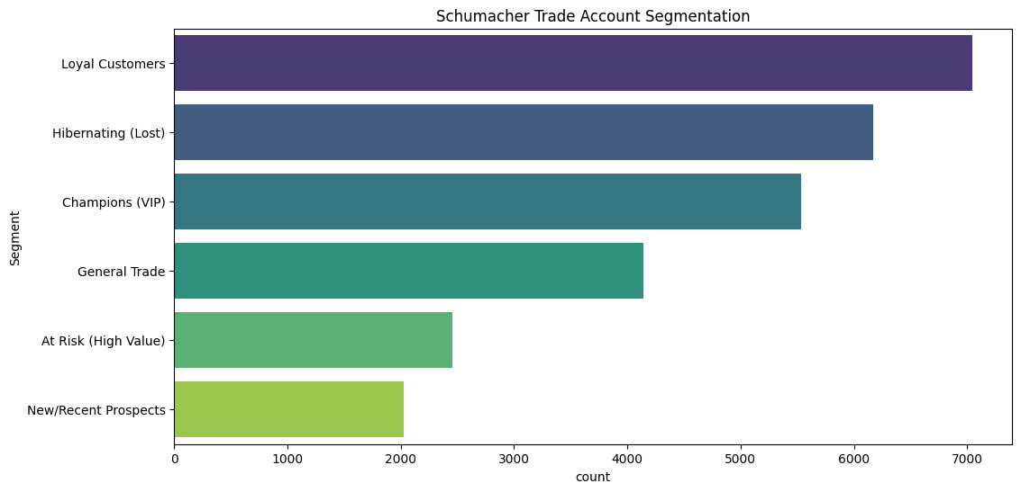
RFM Analysis & Strategic Segmentation
SECTION 03
R
Recency
F
Frequency
M
Monetary
Days since last order
→ Snapshot date − max(shipped_dt)
Unique orders placed
→ COUNT DISTINCT order_id
Total net revenue
→ SUM(netrevenue)
Trade Account Segmentation Distribution
Segment
Score Logic
Business Profile
Champions (VIP)
R≥4, F≥4, M≥4
Most valuable, active, loyal designers
Loyal Customers
R≥3, F≥3
Consistent purchasers, business backbone
New/Recent Prospects
R≥4, F≤2
Recently joined; first small purchase
At Risk (High Value)
R≤2, M≥4
Former big spenders drifting away
Hibernating
R≤2, F≤2
Inactive, near-zero lifetime value
General Trade
All others
Standard mid-tier customer base
LuxeIntelligence | F. Schumacher & Co. | 2025 | Avinash Patnaik, CSA Research Italy

Slide 7
K-Means Implementation — Bug Discovery & Correction
SECTION 03 · CRITICAL FIX
During final code review, a critical methodological error was identified in cluster assignment. Every account was being labelled with its LEAST similar cluster — the exact inverse of correct assignment.
❌ ORIGINAL (INCORRECT)
✅ CORRECTED (fit_predict)
rfm['Cluster'] = kmeans.fit_transform(rfm_scaled)
.argmax(axis=1)
rfm['Cluster'] = kmeans.fit_predict(rfm_scaled)
Why this is correct:
Why this is wrong:
fit_predict() directly returns the NEAREST centroid label for each sample
Standard sklearn interface — assigns accounts to the cluster they are CLOSEST to
Corrected Champions: 8,103 accounts — cleaner, purer high-value segment
Revealed MORE extreme Pareto: 29.6% of accounts → 76.6% of revenue
Additional typo fixed: date_to_scale → data_to_scale
fit_transform() returns a DISTANCE MATRIX (n_samples × n_clusters) — NOT cluster labels
.argmax() selects the index of the MAXIMUM distance = the cluster each account is FARTHEST from
Result: every account assigned to its LEAST similar cluster — inverted logic
Old 'Champions' cluster: ~12,030 accounts (contaminated with misassigned lower-value accounts)
Preprocessing: log(RFM + 1) → StandardScaler → KMeans(k=4, elbow method) → fit_predict() → 4 clean, geometrically valid clusters
LuxeIntelligence | F. Schumacher & Co. | 2025 | Avinash Patnaik, CSA Research Italy

Slide 8
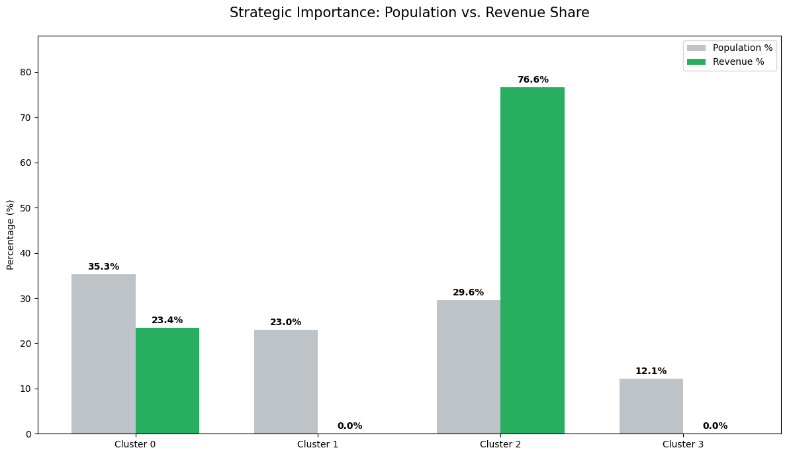
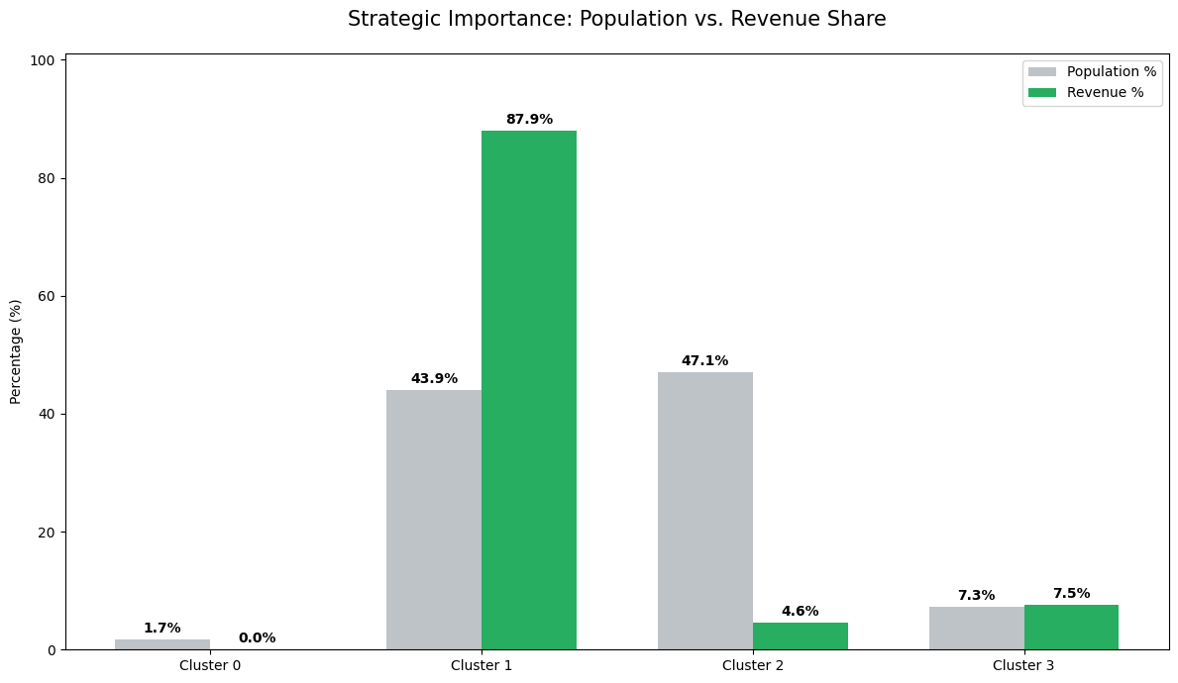
Corrected Cluster Profiles — fit_predict() Outcomes
SECTION 03
C2
Champions
C0
At-Risk / Lapsed
C3
New Prospects
C1
Hibernating / Lost
8,103 accounts | $10,680 avg rev | Recency: 25 days | 22.8 orders
9,655 accounts | $2,737 avg rev | Recency: 126 days | 4.9 orders
3,316 accounts | $14 avg rev | Recency: 36 days | 4.8 orders
6,300 accounts | $1 avg rev | Recency: 181 days | 2.3 orders
29.6% of accounts → 76.6% of revenue
White-glove retention: dedicated reps + early access
Highest-value designers in the ecosystem
Proven buyers drifting — highest win-back ROI
Personalised outreach + time-limited trade incentives
Re-target with new arrivals aligned to past purchases
Sampling actively — pre-conversion behaviour
37-sample threshold before first sale (normal)
Flag near-threshold accounts for rep outreach
0.0% revenue contribution despite 23% of base
2–3 touch automated re-engagement only
Redirect effort to Clusters 0 and 2
Population vs. Revenue Share (Corrected)
KEY FINDING: Champions (29.6% of accounts) drive 76.6% of total revenue — a more extreme Pareto concentration than the buggy implementation revealed.
Before fix (argmax) vs. After fix (fit_predict)
Buggy (argmax)
Corrected (fit_predict)
LuxeIntelligence | F. Schumacher & Co. | 2025 | Avinash Patnaik, CSA Research Italy

Slide 9
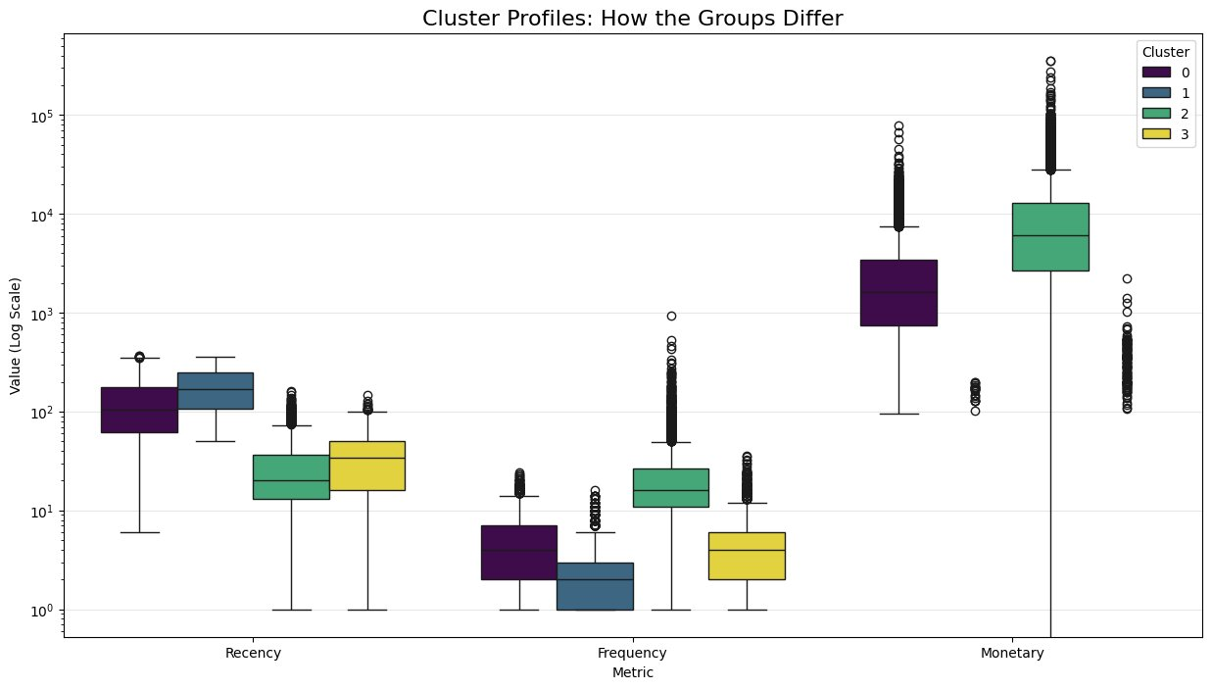
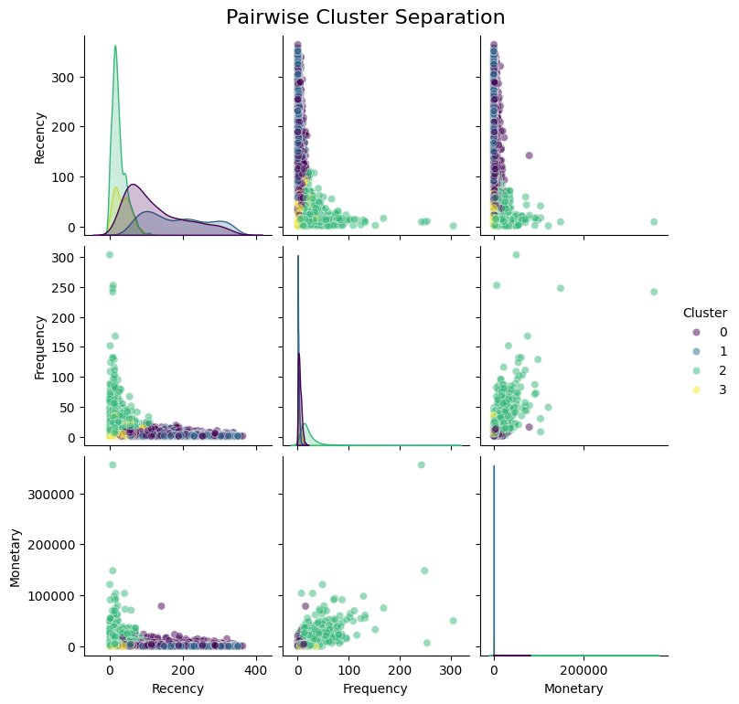
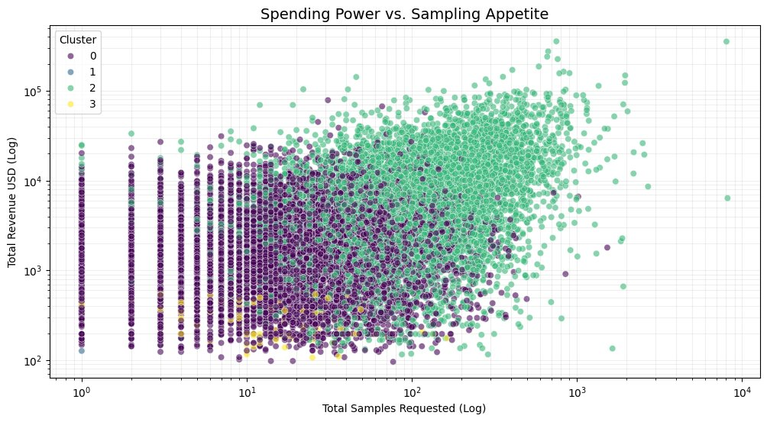
Cluster Visualisation — RFM Distribution & Separation
SECTION 03
RFM Distribution by Cluster (Log Scale)
Pairwise Cluster Separation
Spending Power vs. Sampling Appetite
Sampling = Revenue Engine
Cluster 2 (Champions) occupies the upper-right quadrant exclusively: high sampling volume → high revenue. This relationship does not exist in any other cluster. Restricting sample access to Champions would directly reduce revenue.
LuxeIntelligence | F. Schumacher & Co. | 2025 | Avinash Patnaik, CSA Research Italy

Slide 10
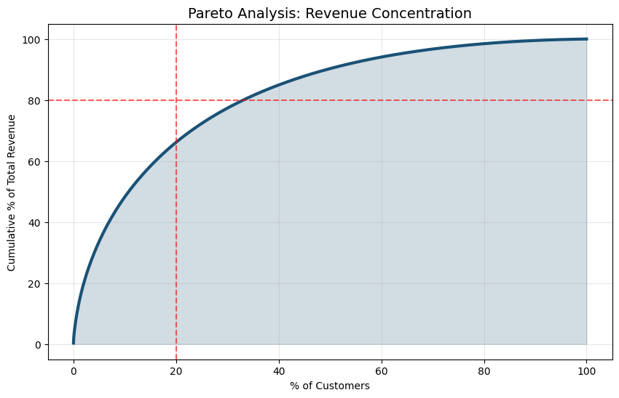
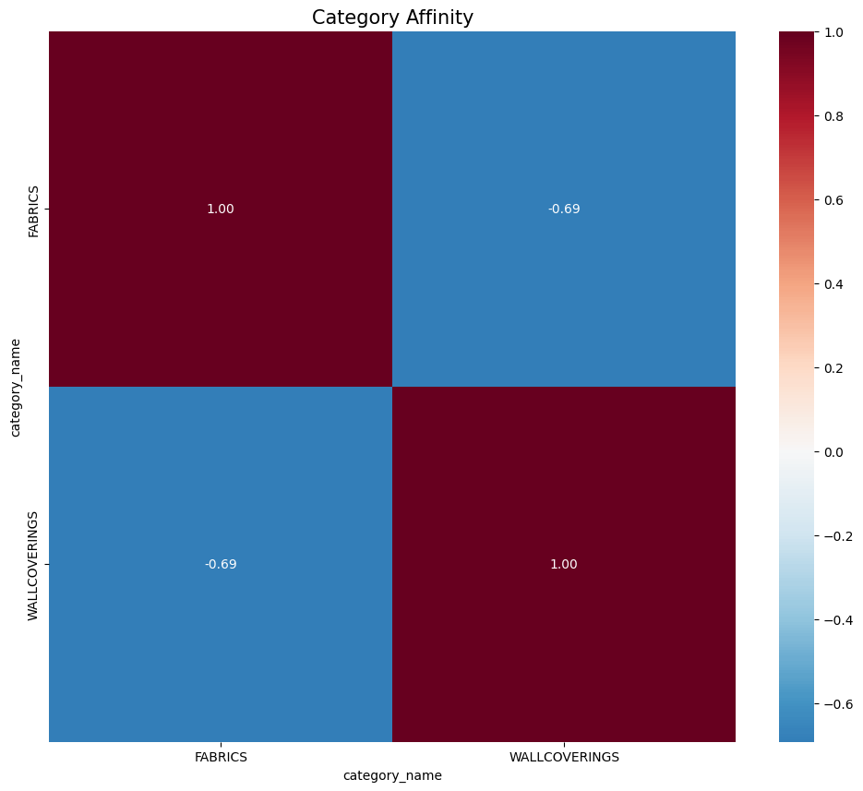
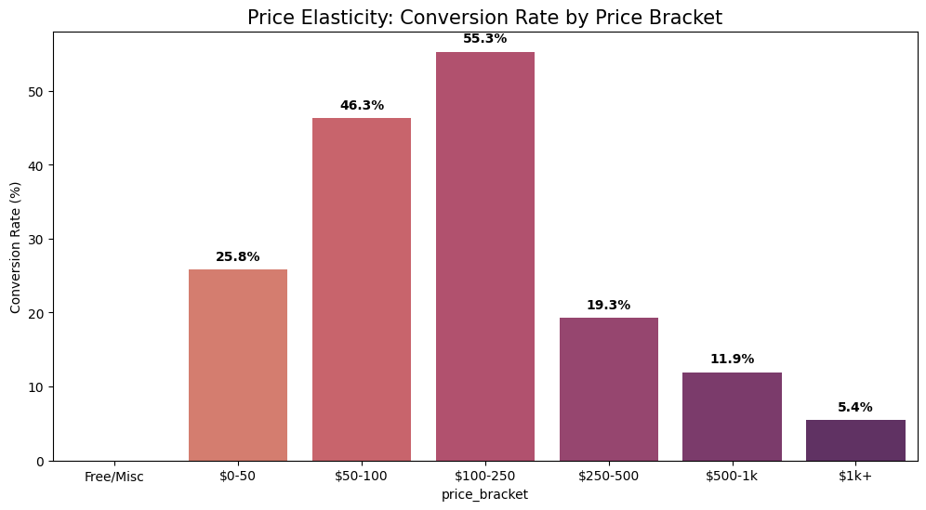
Product Affinity & Pricing Intelligence
SECTION 04
Pareto: Revenue Concentration
Category Affinity Heatmap
Price Elasticity: Conversion by Bracket
Goldilocks Zone ($100–$250)
Pareto Confirmed
Resistance Threshold ($250+)
Category Divide
Peak conversion at 55.3% — optimal price-to-trust balance. Focus sampling programme budget here.
Top 20% of customers drive ~80% of net revenue. Champions concentration mirrors RFM findings.
60%+ conversion cliff — requires rep-assisted sales cycle, not self-checkout digital journey.
Fabrics & Wallcoverings show −0.69 correlation. Separate funnels needed; avoid joint promotions.
LuxeIntelligence | F. Schumacher & Co. | 2025 | Avinash Patnaik, CSA Research Italy

Slide 11
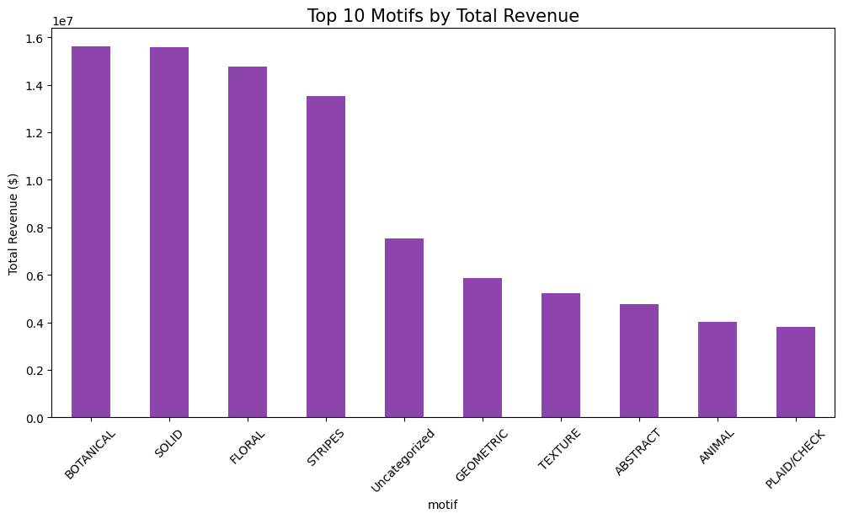
Product Motif Revenue Performance
SECTION 04
Botanical & Floral Dominance
Botanical + Floral = 2 of top 3 revenue drivers (~$14–16M each). Classic luxury aesthetic preference confirmed.
Solid as Entry Point
Solid/Plain drives high attachment rates — designers start with a neutral base, then add patterned accent pieces.
Texture Premium
Texture's strong performance signals growing market preference for tactile luxury — weave > pattern print.
Design Persona Signal
Motif sequence predicts Designer Persona: Botanical → Traditionalist; Geometric → Modernist. Enables personalised next-best-action.
AI Recommendation Hook
Top motifs serve as Style Anchors in the Vector DB — secondary motif selection post-solid predicts full design intent.
LuxeIntelligence | F. Schumacher & Co. | 2025 | Avinash Patnaik, CSA Research Italy

Slide 12
Propensity Modelling & Lead Scoring — XGBoost Architecture
SECTION 05
TWO-MODEL ARCHITECTURE · Model 1: Will this account ever convert? · Model 2: Will this account buy in the next 30 days?
MODEL 1 — General Propensity
MODEL 2 — Temporal 30-Day Prediction
Features
The Temporal Split — Why This Is Correct
total_samples (highest SHAP importance)
unique_motifs (breadth of aesthetic exploration)
avg_item_price (quality signal — note: leakage risk)
showroom_share (channel engagement ratio)
days_since_first_sample (tenure signal)
observation_date = max_date − 30 days
Features ← before cutoff | Labels ← sales after cutoff
A random split allows the model to train on future data — artificially inflating scores. The temporal split ensures the model only sees historical behaviour, exactly as in production.
Configuration
Features
n_estimators
1,000 (early stopping: 50 rounds)
recency_days · sample_velocity_30d
max_depth
4
Output: Hot List
learning_rate
0.02
Accounts with purchase_probability > 0.80 extracted as daily-refreshable sales call priority list. Top accounts: 0.808–0.960 probability range.
scale_pos_weight
1.88 (imbalance: 0.53 ratio)
eval_metric
AUCPR
Halo Effect Momentum
Best Round
782
A spike in sample_velocity_30d is the single strongest leading indicator of near-term purchase. Accounts with high recent sampling frequency should be prioritised immediately.
AUCPR: 0.926 — 92.6% precision-recall balance (far above no-skill baseline)
LuxeIntelligence | F. Schumacher & Co. | 2025 | Avinash Patnaik, CSA Research Italy

Slide 13
Lead Scoring Output — Priority Tiers & SHAP Explainability
SECTION 05
TIER 4
Immediate White-Glove
TIER 3
High Priority
TIER 2
Nurture
TIER 1
Standard
98th+ percentile
90th–98th percentile
70th–90th percentile
0–70th percentile
Recommended Action:
Recommended Action:
Recommended Action:
Recommended Action:
Same-day personal outreach from senior rep
Rep follow-up within 48 hrs
Targeted email sequence
Automated nurture only
Highest-probability converters. Trigger CRM priority flag and initiate direct call within hours.
Strong conversion signal. Personalised email sequence + direct call scheduled within 2 business days.
Moderate signal. Automated personalised email with curated product recommendations.
Low conversion probability. Include in general newsletter and seasonal campaigns.
⚠️ Known Issues (Flagged for next iteration): (1) avg_item_price derived from all transactions incl. sales → potential data leakage; retrain with SAMPLE-only avg. (2) Top-10 accounts by score show total_samples=0 — driven by high avg_item_price outlier, reinforcing leakage concern.
SHAP Feature Importance (TreeExplainer — Model 1)
total_
samples
avg_
item_
price
days_
since_
first_
sample
unique_
motifs
showroom_
share
92%
74%
55%
38%
22%
LuxeIntelligence | F. Schumacher & Co. | 2025 | Avinash Patnaik, CSA Research Italy

Slide 14
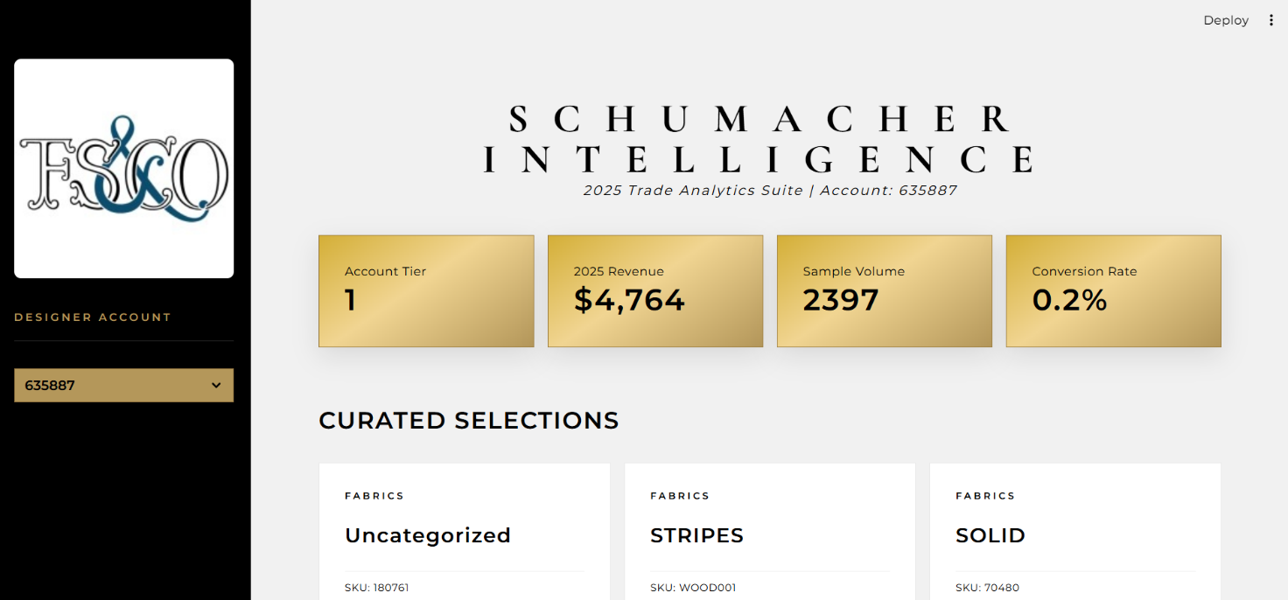
AI Recommendation Engine — ChromaDB + Vision + NLP
SECTION 06
Cluster Identification
01
Look up account K-Means cluster → Champions receive fundamentally different recommendations than General Trade accounts
Persona Aggregation
02
Products ranked by unique_buyers within cluster (not raw qty) → prevents single large orders from skewing recommendations
Motif & Category Metadata
03
category_name + motif carried forward → UI explains WHY each item is recommended (trust + transparency)
TECH STACK
De-duplication Filter
04
All item_numbers already purchased excluded → drives discovery, not repurchase
Python + Pandas
XGBoost + SHAP
ChromaDB (Vector DB)
Streamlit UI
Power BI Dashboard
PyTorch VisionMatcher
Hugging Face Embeddings
Vision + Text AI
05
Hugging Face embeddings + PyTorch VisionMatcher → semantic similarity search across full 16K product catalogue
LuxeIntelligence | F. Schumacher & Co. | 2025 | Avinash Patnaik, CSA Research Italy

Slide 15
Strategic Recommendations & Commercial Roadmap
SECTION 07
R1
Protect Champions
R2
Win Back At-Risk
R3
Activate Propensity Scores
Cluster 2 - 76.6% revenue concentration
Cluster 0 - Highest near-term ROI
XGBoost - AUCPR 0.926
Dedicated senior rep assignment
Early new collection access
Exclusive trade pricing tiers
Proactive pre-season outreach before major buying cycles
Personalised outreach referencing past purchase categories
Time-limited trade incentives to create urgency
Re-sample new arrivals aligned to historical motif preferences
Target accounts with historical spend > $5,000 first
Deploy Model 1 tiers as CRM workflow triggers
Daily-refresh Model 2 hot list for sales calls
10–15% projected improvement in conversion efficiency
Resolve avg_item_price leakage before production push
R4
Affinity Merchandising
R5
Regional Reallocation
R6
Future AI Roadmap
Product Intelligence - $100–$250 Zone
High-Velocity vs. Low-Velocity Territories
CLIP + TFT + RLHF
'Complete the Look' recommendations on product PDPs
Focus sample programme budget in the Goldilocks Zone
Pre-packed sample kits based on affinity correlation pairs
Separate Fabrics / Wallcovering funnels (−0.69 correlation)
Power BI real-time conversion velocity dashboard
Redirect spend: Low-Velocity → High-Velocity regions
Gulf Coast & Heartland prioritised for rep headcount
Pacific Northwest / Southwest: digital-first strategy
CLIP fine-tuning on Schumacher catalogue for visual search
Temporal Fusion Transformers for demand forecasting
RLHF feedback loop (click → sample → sale) for rec engine
ChromaDB / Pinecone HNSW for sub-millisecond vector search
LuxeIntelligence | F. Schumacher & Co. | 2025 | Avinash Patnaik, CSA Research Italy

Slide 16
THANK YOU
LuxeIntelligence — F. Schumacher & Co. Trade Analytics 2025
1,983,549
27,374
76.6%
Transactions Analysed
Trade Accounts Profiled
Revenue in Champions Cluster
0.926
37
70%
XGBoost AUCPR Score
Avg Samples to First Sale
Account Conversion Rate
Avinash Patnaik · CSA Research Italy · avinash@csaresearch.it

