Slide 1

LuxeIntelligence End-to-End Analytics & AI Ecosystem

Slide 2
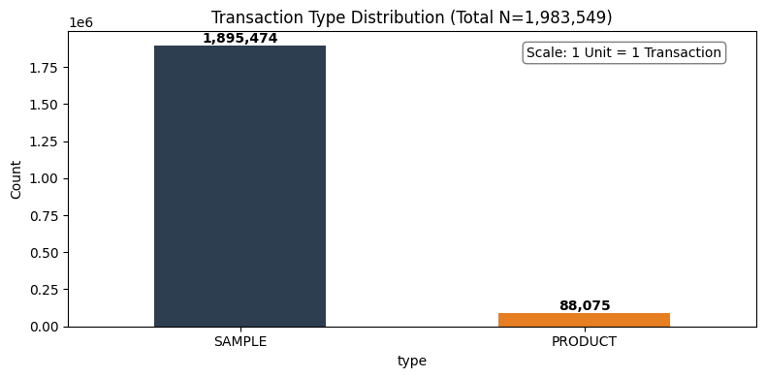
Objective & Data Foundation (Data Audit)
Objective: To transform high-volume transactional and behavioural data into a 360 Designer Intelligence Suite. By bridging the gap between sample intent and purchase reality, this project aims to optimize conversion velocity, personalize the luxury customer journey, and provide the sales team with predictive tools to drive measurable revenue growth.
Table | Row Count | Column Count
Transactions | 1,983,549 | 9
Item_master | 16,064 | 10
Customer_master | 29,691 | 4

Slide 3
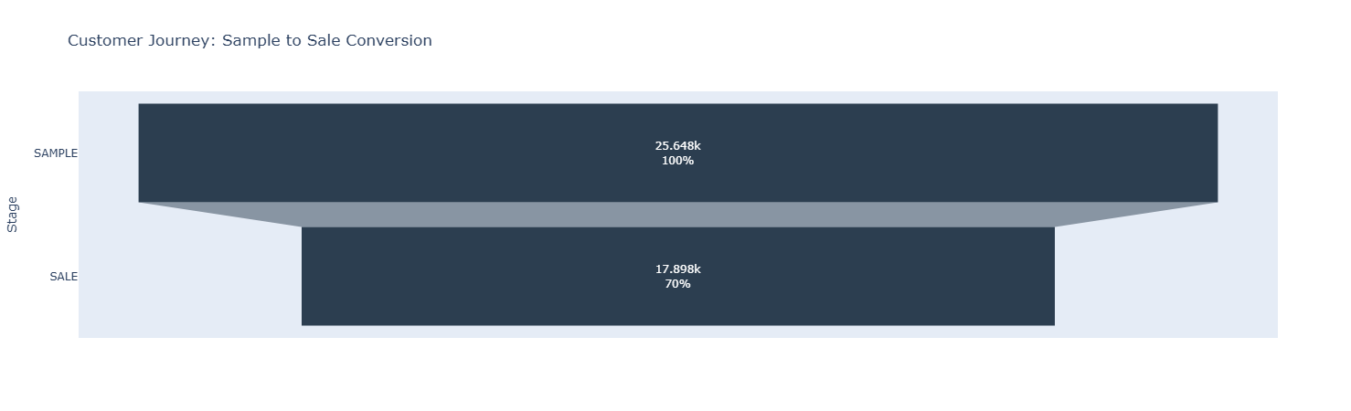
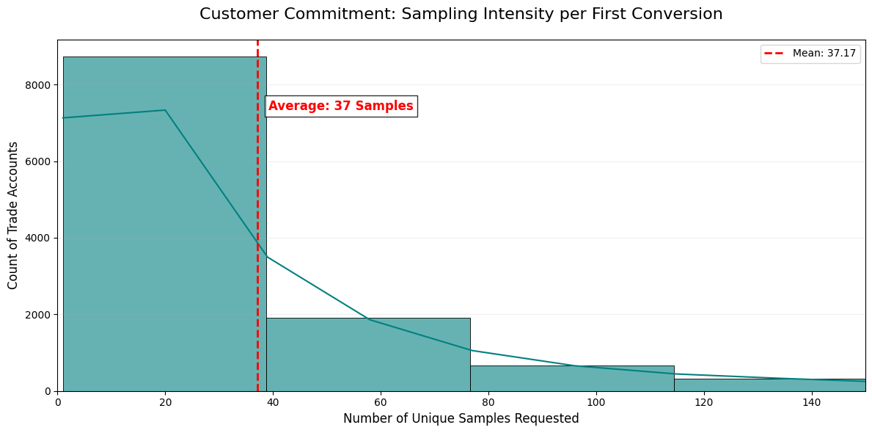
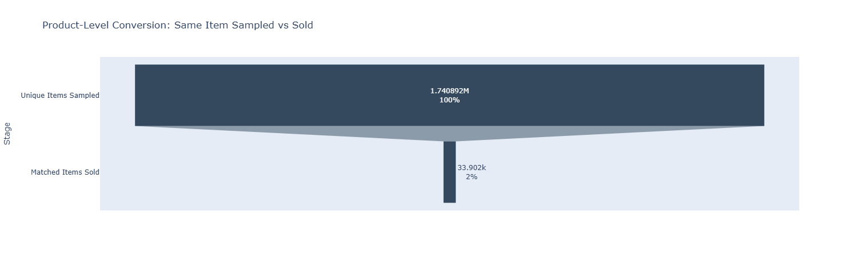
Conversion Funnel Analysis
"Halo Effect" : a sample request is a high-intent signal that a design project is active. Even if the specific sampled SKU is not selected (conversion at the item level), the account remains highly likely to purchase an alternative product from the brand (conversion at the account level).
On average, a new account requires approximately 37 samples to convert into the successful transaction.

Slide 4
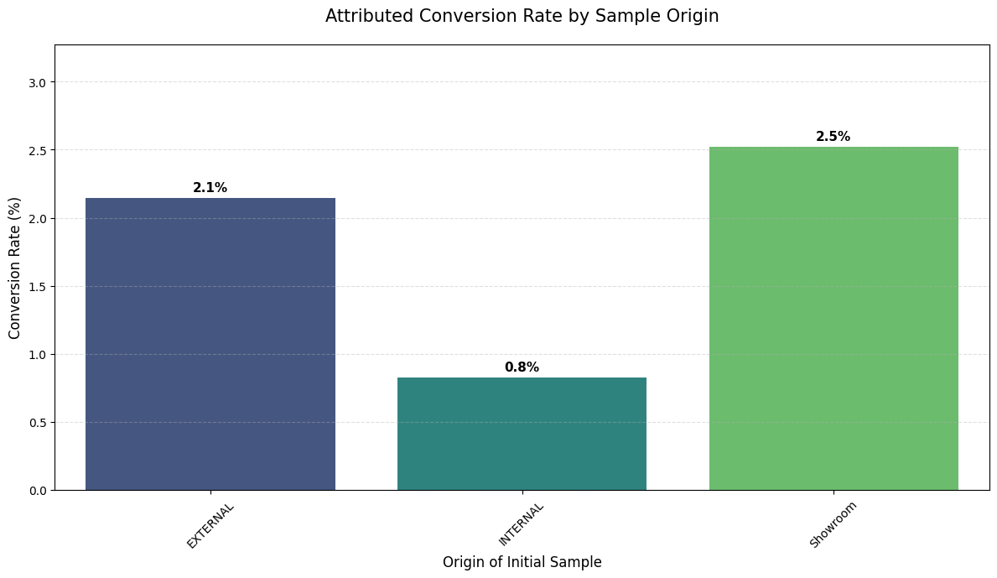
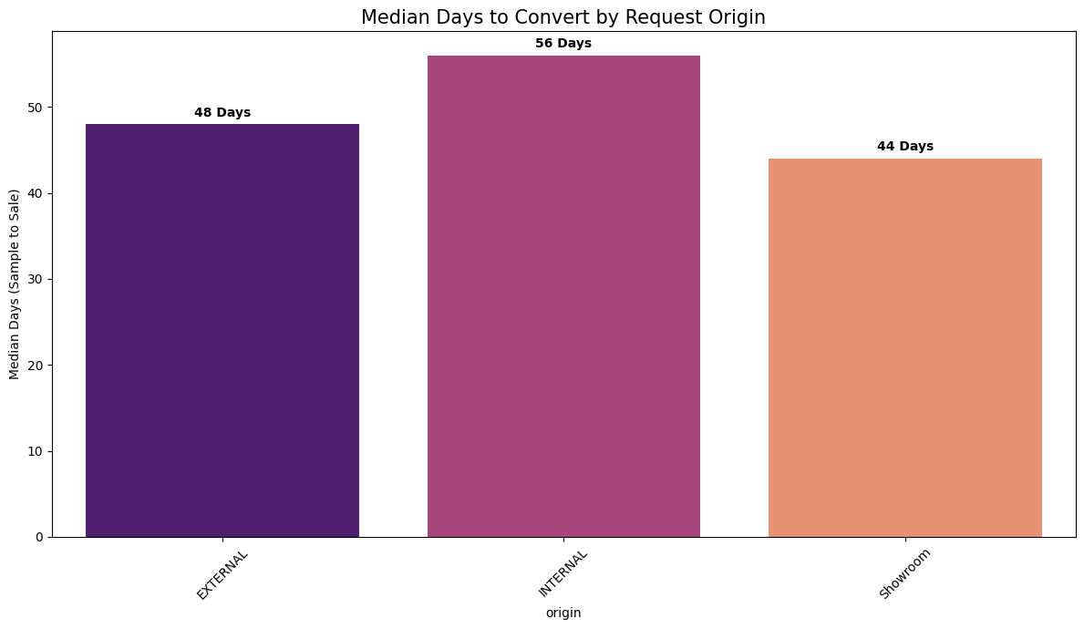
Channel Efficiency & Sales Velocity
Key Finding: There is a strong correlation between Human Interaction and both Speed and Probability of sale.
Showroom Strength: The Showroom is our most efficient channel, converting nearly 1 in 5 leads in just 44 days.
The Web Gap: Web leads have the lowest conversion (13.6%) and take nearly a week longer to close than showroom leads. This represents a significant opportunity to implement digital "White Glove" services to close the gap.
Customer Commitment: On average, a successful sale is preceded by 2.5 unique samples, suggesting that our customers have a high degree of focus once they start the sampling process.

Slide 5
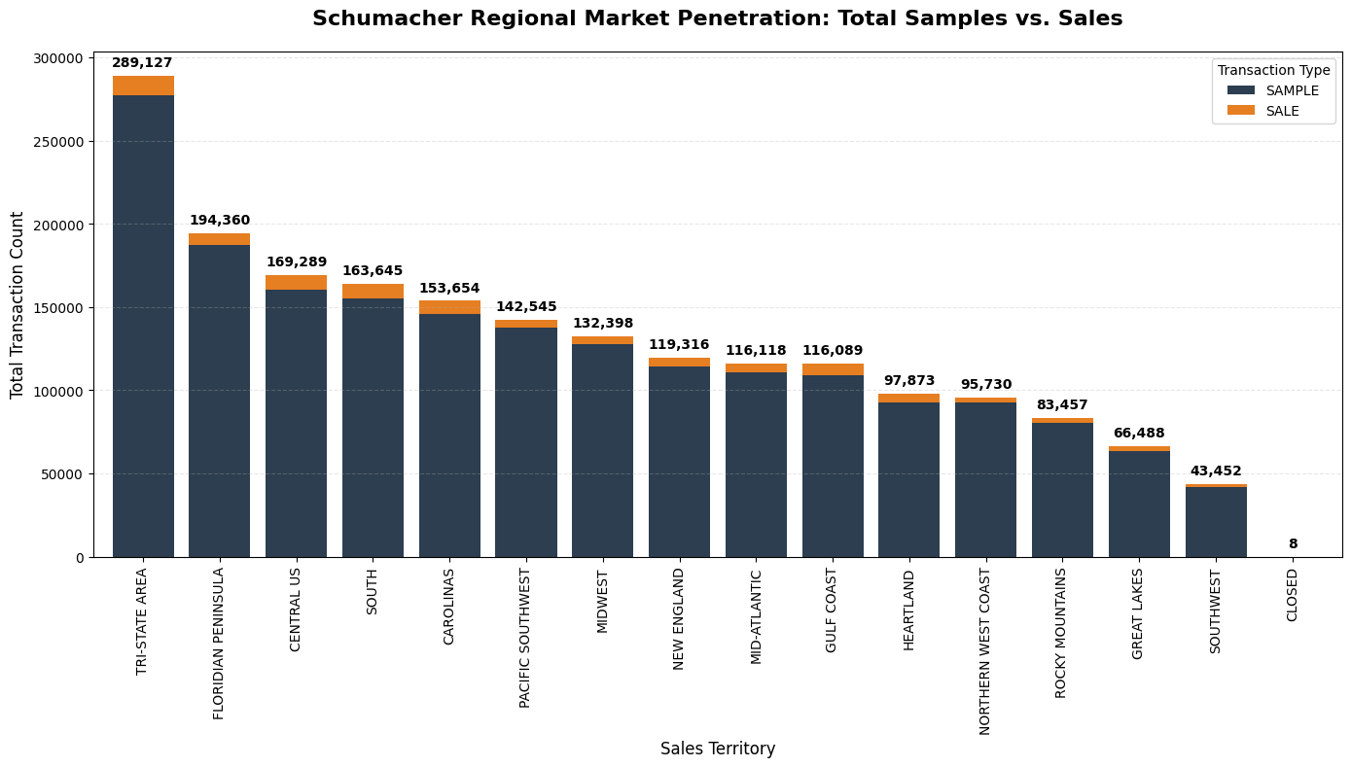
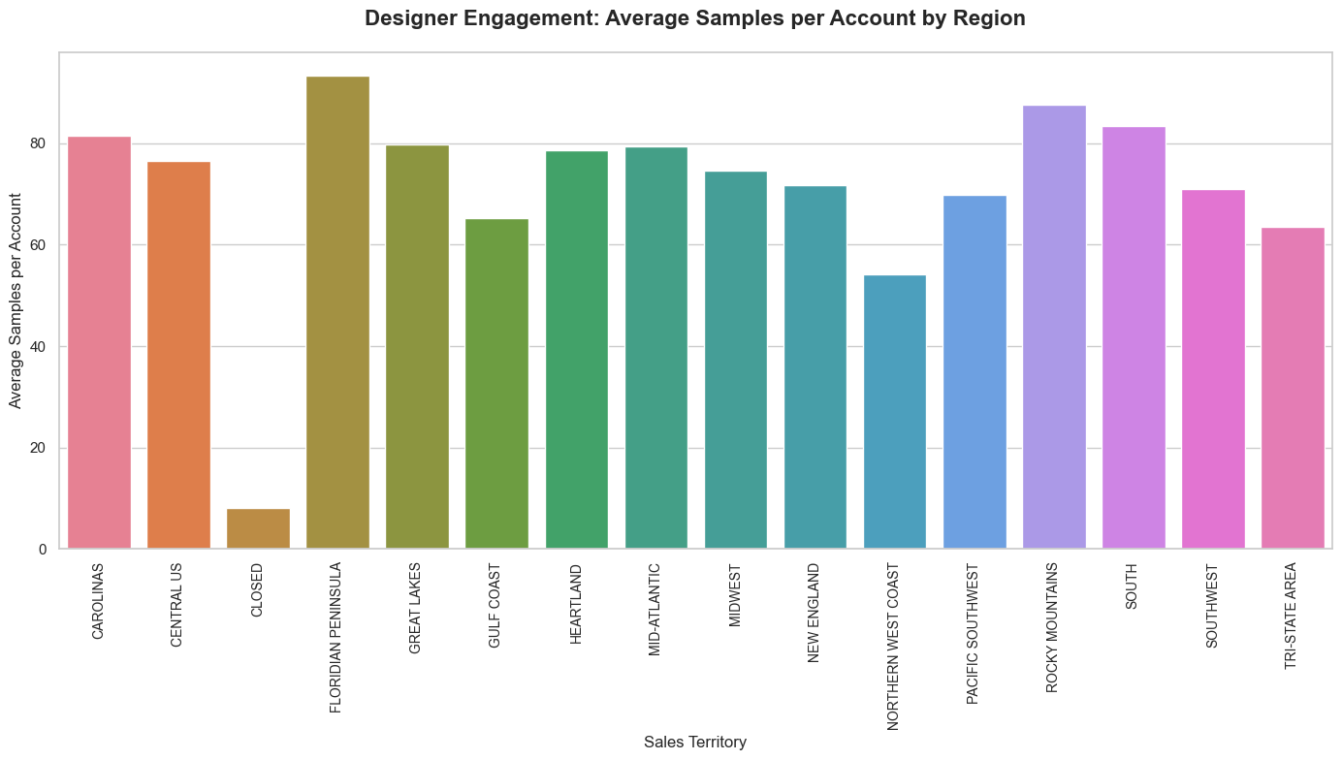
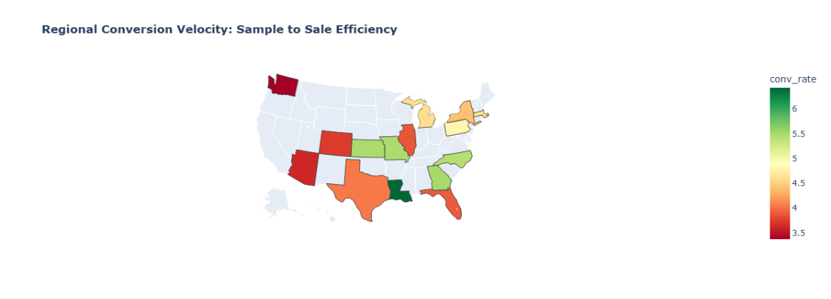
REGIONAL ANALYSIS

Slide 6
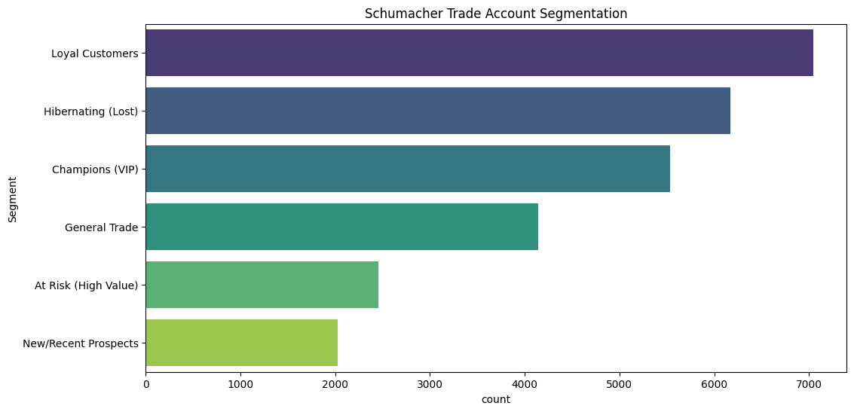
RFM Analysis & Segmentation
Recency (R): Days since the last order.
Frequency (F): Total number of unique orders placed.
Monetary (M): Total net revenue generated.
Segment | Criteria (R, F, M Scores) | Business Description
Champions (VIP) | R >= 4, F >= 4, M >= 4 | Your most valuable, active, and loyal designers.
Loyal Customers | R >= 3, F >= 3 | Consistent purchasers who keep the business steady.
New Prospects | R >= 4, F >= 2 | Recently joined or made their first small purchase.
At Risk (High Value) | R >= 2, M >= 4 | Former big spenders who haven't ordered recently.
Hibernating | R >= 2, F >= 2 | Inactive accounts with low lifetime value.
General Trade | All Others | The standard "middle" of the customer base.

Slide 7
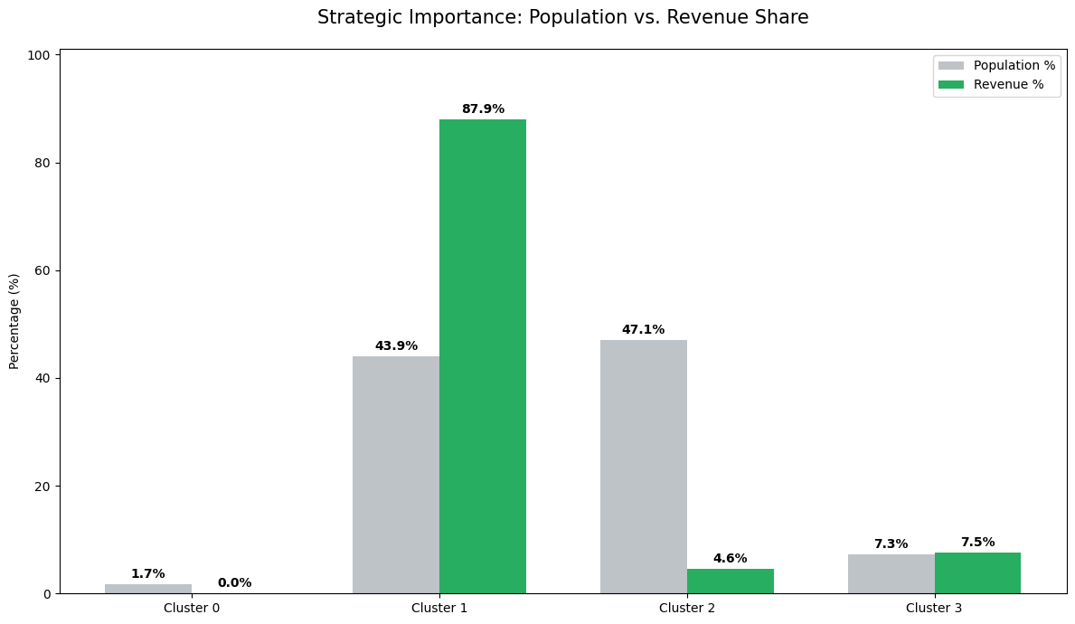
KNN IMPLEMENTATION
features = ['Recency', 'Frequency', 'Monetary']
kmeans = KMeans(n_clusters=4, random_state=42, n_init=10)
rfm['Cluster'] = kmeans.fit_transform(rfm_scaled).argmax(axis=1)
Cluster 1 (Premier Trade): Exhibits the highest median Frequency and Monetary values. The tight interquartile range (IQR) in Recency indicates a consistent, high-velocity purchasing pattern.
Cluster 2 (High-Intent Samplers): Displays a disproportionately high Sample_Count relative to current Monetary value. This represents a prime conversion opportunity for the sales team.
Cluster 3 (Dormant/Low-Value): Characterized by a significantly higher median Recency and lower Monetary density, indicating churn risk or one-off residential purchasers.

Slide 8
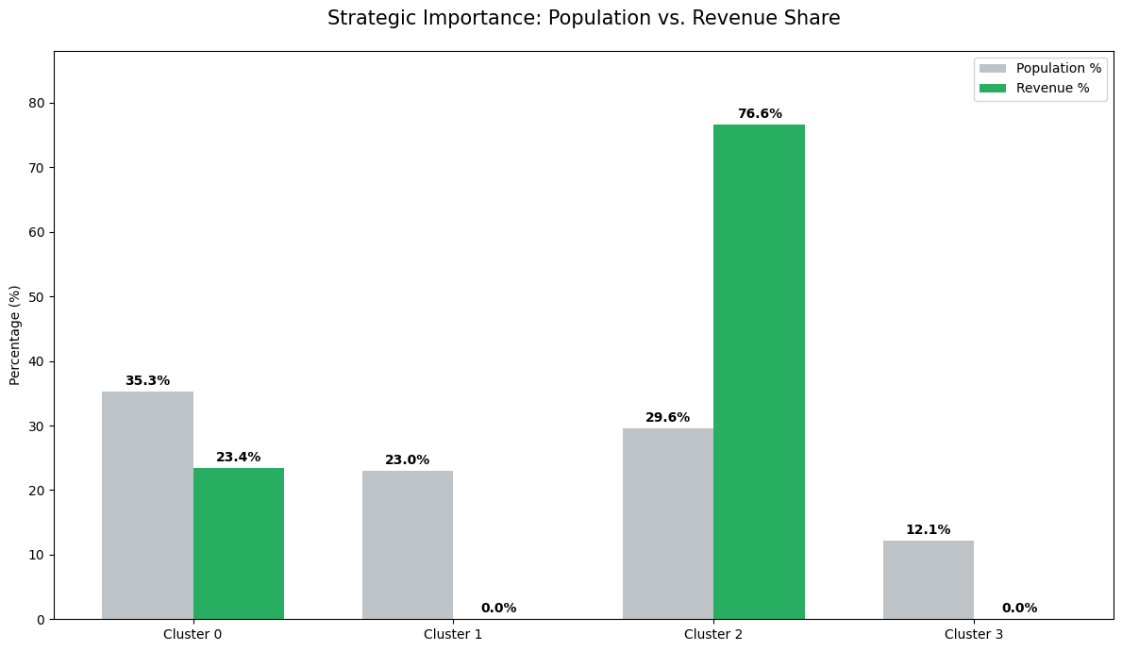
KNN IMPLEMENTATION (Bug fix implemented)
kmeans = KMeans(n_clusters=4, random_state=42, n_init=10)
rfm['Cluster'] = kmeans.fit_predict(rfm_scaled)
Cluster 2 — Champions
8,103 accounts | $10,680 avg revenue | Active within 25 days
Highest-value designers, top revenue drivers
22.8 orders on average — frequent, high-spend buyers
White-glove treatment: dedicated reps, early collection access, loyalty perks
Cluster 0 — At-Risk / Lapsed
9,655 accounts | $2,737 avg revenue | Inactive for ~4 months
Proven buyers drifting away — highest win-back ROI
Personalized outreach referencing past purchases
Targeted sampling of new arrivals + time-limited trade incentives
Cluster 3 — New Prospects
3,316 accounts | $14 avg revenue | Active within 36 days
Sampling actively, not yet converting — normal pre-purchase behavior
Average of 37 samples needed before first sale
Nurture with product education; flag near-threshold accounts for outreach

Slide 9
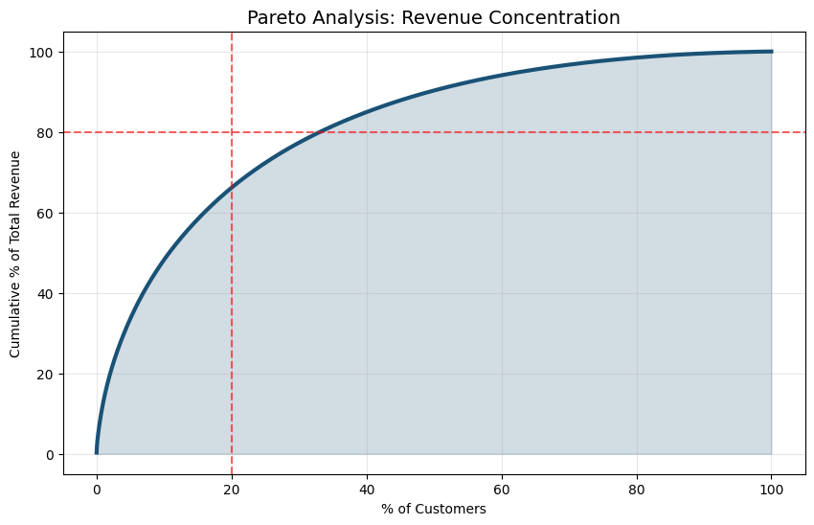
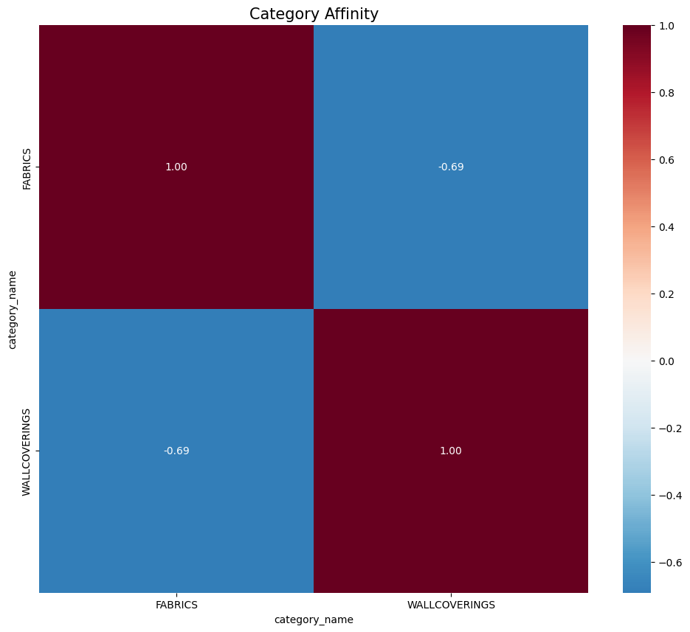
PRODUCT AFFINITY AND PRICING
Distinct Segmentation: Strong negative affinity (-0.69) suggests "Fabric-first" vs. "Wallcovering-first" buyer profiles rather than a shared basket.
Strategic Opportunity: High resistance to traditional cross-selling; requires bundled promotions or targeted "bridge" campaigns to capture total wallet share.
Approximately 20% of customers contribute to roughly 80% of the total net revenue.

Slide 10
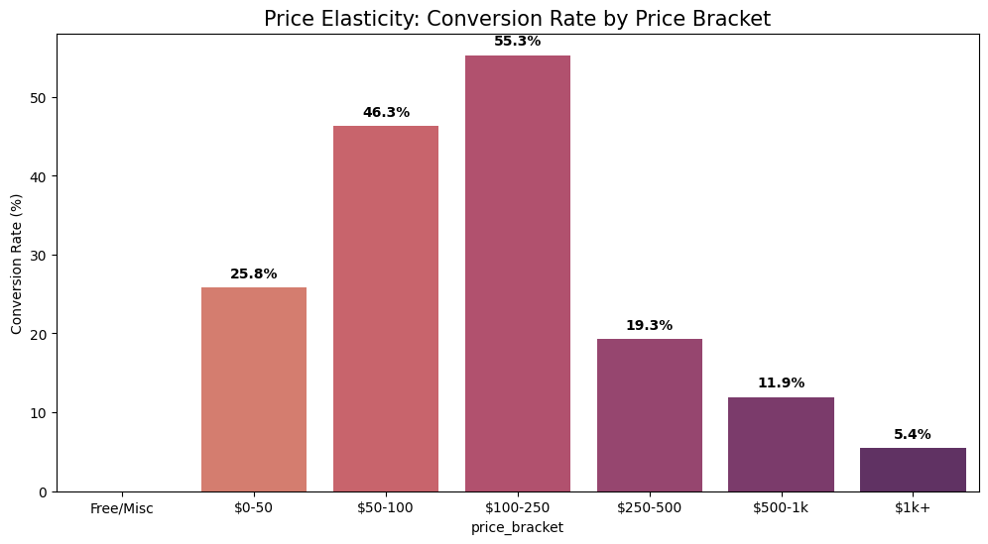
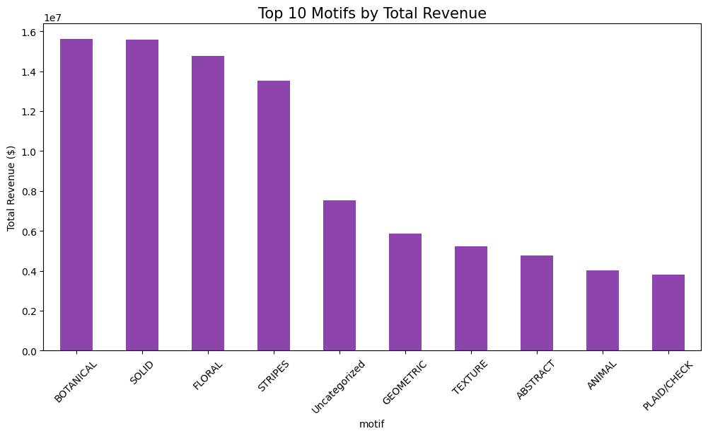
Goldilocks Zone ($100–250)
Positive Momentum ($0–100)
The Resistance Threshold ($250+)
High-Ticket Friction ($1k+)
The revenue analysis reveals a clear market preference for classic patterns, with Botanical, Solid, and Floral motifs emerging as the primary revenue drivers, each generating nearly double the individual revenue of mid-tier categories like Geometric or Texture.

Slide 11
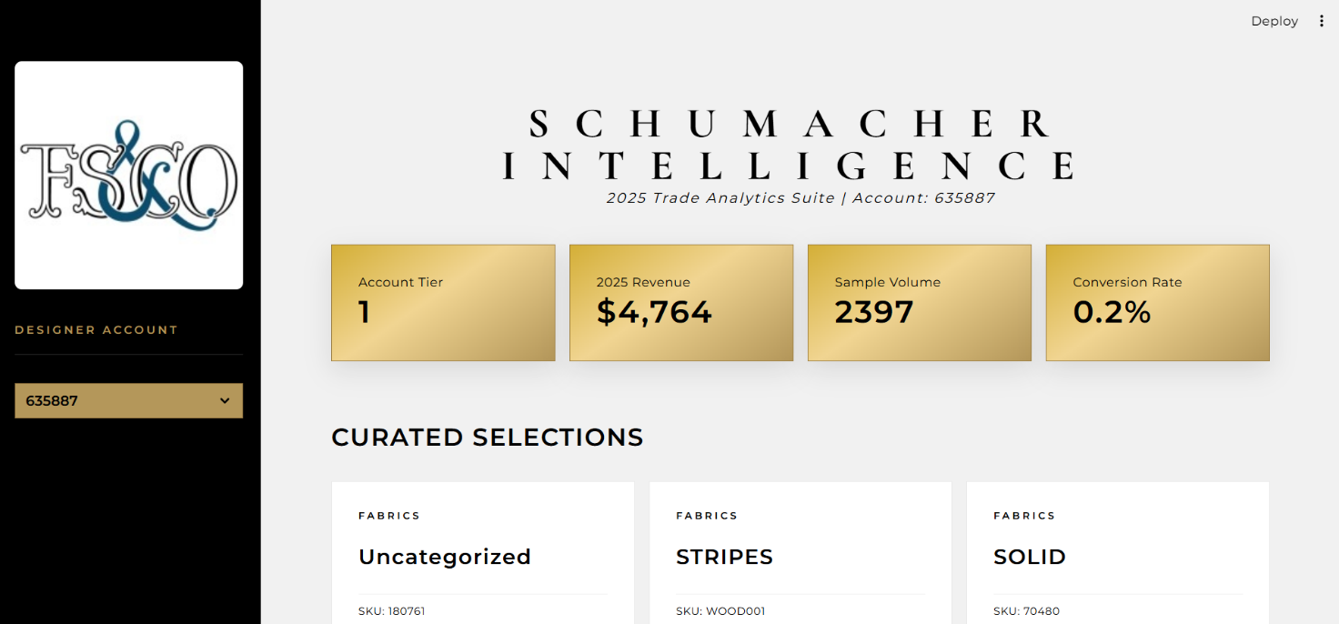
Recommendation engine (AI – NLP, CV/TORCH)
Our Streamlit powered recommendation engine integrates Vision and Text AI via Hugging Face embeddings to deliver hyper-personalized curated selections, directly converting high-intent sampling into measurable revenue growth.

Slide 12
Recommendations
Precision Sales & Lifecycle Management
Predictive Lead Scoring: Deploy a Propensity-to-Buy Model that analyzes request origin and historical account velocity to assign a "Lead Score" to every sample.
Automated CRM Alerts: Trigger high-priority notifications for leads with a score > 0.8, targeting a 10-15% increase in conversion efficiency.
Dynamic Retention: Use K-Means clustering to identify "At-Risk" accounts, triggering automated API calls for personalized inspiration outreach.
Affinity-Based Intelligence
Cross-Category Penetration: Utilize the Apriori algorithm to map statistical co-occurrences between motifs and subclasses, such as wallpaper and fabric trimmings.
"Complete the Look": Implement automated recommendations on digital Product Detail Pages (PDP) to drive Average Order Value (AOV).
Regional ROI & Future-State AI
Resource Allocation: Redirect marketing spend to "High-Velocity" regions (e.g., Gulf Coast) identified via geospatial analysis and real-time Power BI monitoring.
Vision Matcher & Forecasting: Scale the AI engine to allow designers to find motifs via room photos and use time-series analysis to predict demand surges for color families.

Slide 13


