Slide 1
Segment Anything Model 2 (SAM 2)
It is a foundation model designed to address promptable visual segmentation in both images and videos.
The model extends its functionality to video by treating images as single-frame videos. Its design, a simple transformer architecture with streaming memory, enables real-time video processing.
A model-in-the-loop data engine, which enhances the model and data through user interaction, was built to collect the SA-V dataset, the largest video segmentation dataset to date. SAM 2, trained on this extensive dataset, delivers robust performance across diverse tasks and visual domains.

Slide 2
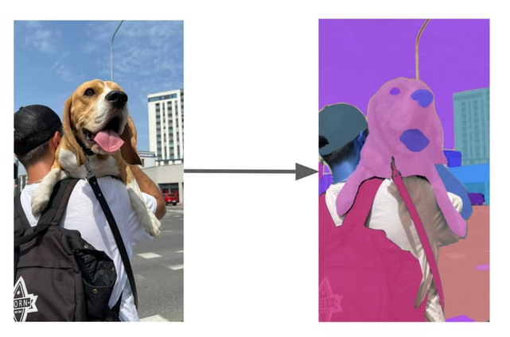
SAM 2 FOR IMAGE:

Slide 3
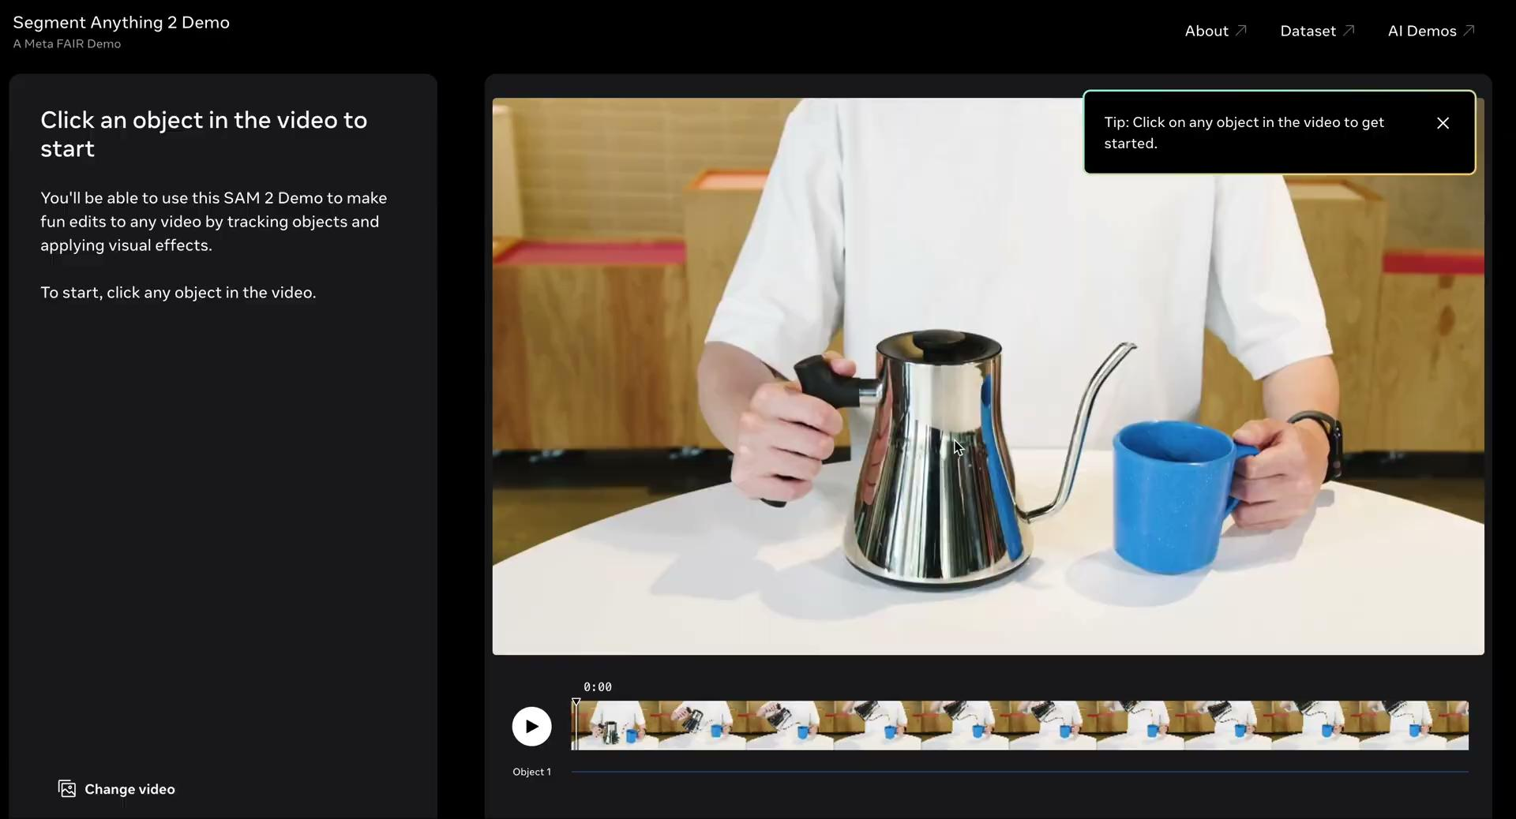
SAM 2 FOR VIDEO:

Slide 4
There are two ways you can run SAM 2:
Using the automatic mask generator, that segments all objects in an image or video and generates corresponding masks, or;
By using a point prompt.
The automatic mask generator is ideal if you want to segment all objects. Using a prompt, on the other hand, allows you to be more specific in your segmentation.
To identify the location of an object, you need to provide a “prompt”. A prompt can be:
A specific point or series of points that correspond with the object you want to segment;
A box that surrounds the object you want to segment.

Slide 5
Segment Anything 2 Dataset
SAM 2 was trained on the Segment Anything Video dataset (SA-V), which includes 51,000 videos and 643,000 segmentation masks. The SA-V dataset is licensed under a CC 4.0 license. SA-V has “~53x more annotations than the largest existing video segmentation dataset”.
This dataset was labeled using a human-in-the-loop approach. SAM 2 was used to interactively annotate videos by human labelers. This annotated data was then used to improve the underlying SAM 2 model.

Slide 6
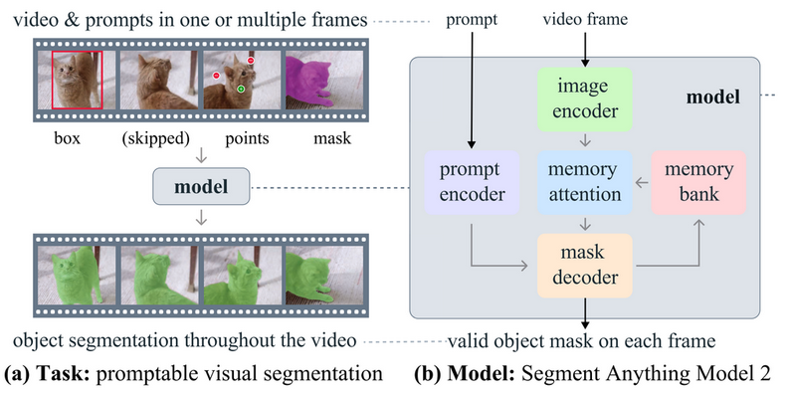
DATA PREPROCESSING:

Slide 7
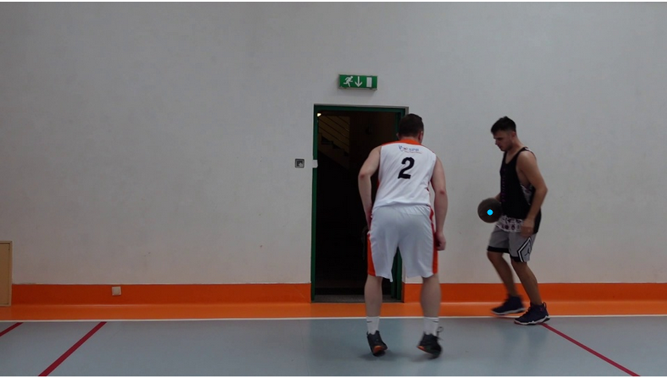
Example
The positive point-prompt is marked with a filled circle.

Slide 8
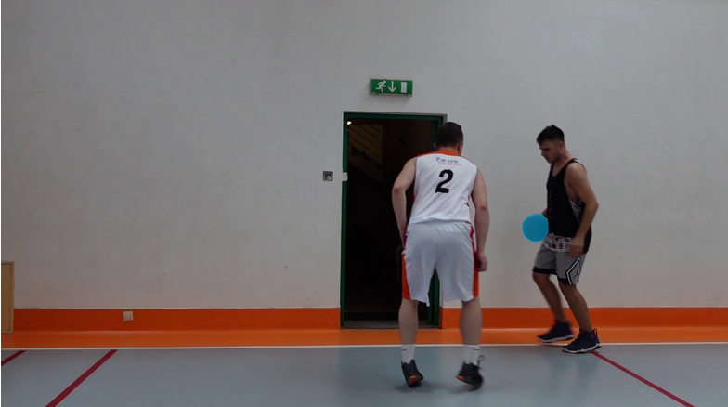
Segment Anything 2 result for the above single-object prompt.

Slide 9


