Slide 1


Introduction to Git, GitHub, and Integration with VS Code

Slide 2
What is Git?
Distributed Version Control
Collaboration Made Easy
It allows multiple developers to work on the same project simultaneously without overwriting each other's contributions.
Created by Linus Torvalds in 2005, Git is a powerful system that tracks changes in source code.
Project Snapshots
Git stores snapshots of your project's entire history, providing a complete record of every change, not just file differences.

Slide 3

What is GitHub?
Cloud-Based Hosting
GitHub provides a robust, cloud-based platform for hosting Git repositories, accessible from anywhere.
Powerful Collaboration Tools
It offers features like pull requests, issue tracking, and code reviews to facilitate team cooperation.
Global Code Sharing
Share your code publicly or privately with development teams around the world, fostering open source and private projects.
Seamless VS Code Integration
GitHub integrates directly with Visual Studio Code, creating a smooth and efficient development workflow.

Slide 4
Essential Git Commands You Should Know
1
git init
Initializes a new local Git repository in your project folder.
git clone
2
Creates a local copy of a remote repository from GitHub or another source.
git status
3
Displays the state of the working directory and staging area, showing changes and branch information.
git add
4
Stages changes for the next commit, preparing them to be saved in the repository history.

Slide 5
Essential Git Commands You Should Know
git commit
5
Records staged changes to the repository with a descriptive message, creating a new version.
git push
6
Uploads your local commits to the remote repository on GitHub, sharing your work.
git pull
7
Fetches changes from the remote repository and merges them into your current local branch.

Slide 6



Working with GitHub in VS Code: Setup & Integration
Setting up your development environment by creating a GitHub repository and linking it with VS Code is a foundational step for efficient version control and collaboration.
Open Project in VS Code
Clone to Your Local System
Once cloned, change your terminal's directory into the new project folder (e.g., cd my-project). Type code . to open the folder directly in Visual Studio Code, or use File > Open Folder from within VS Code.
Create New GitHub Repository
On your GitHub repository page, copy the clone URL (HTTPS or SSH). Open your local terminal, navigate to your desired directory, and execute git clone [repository URL]. This downloads the entire project to your computer.
Go to GitHub.com, click 'New' to create a new repository. Name your project, choose visibility (public/private), and consider initializing it with a README file. This establishes your project's central remote location.

Slide 7

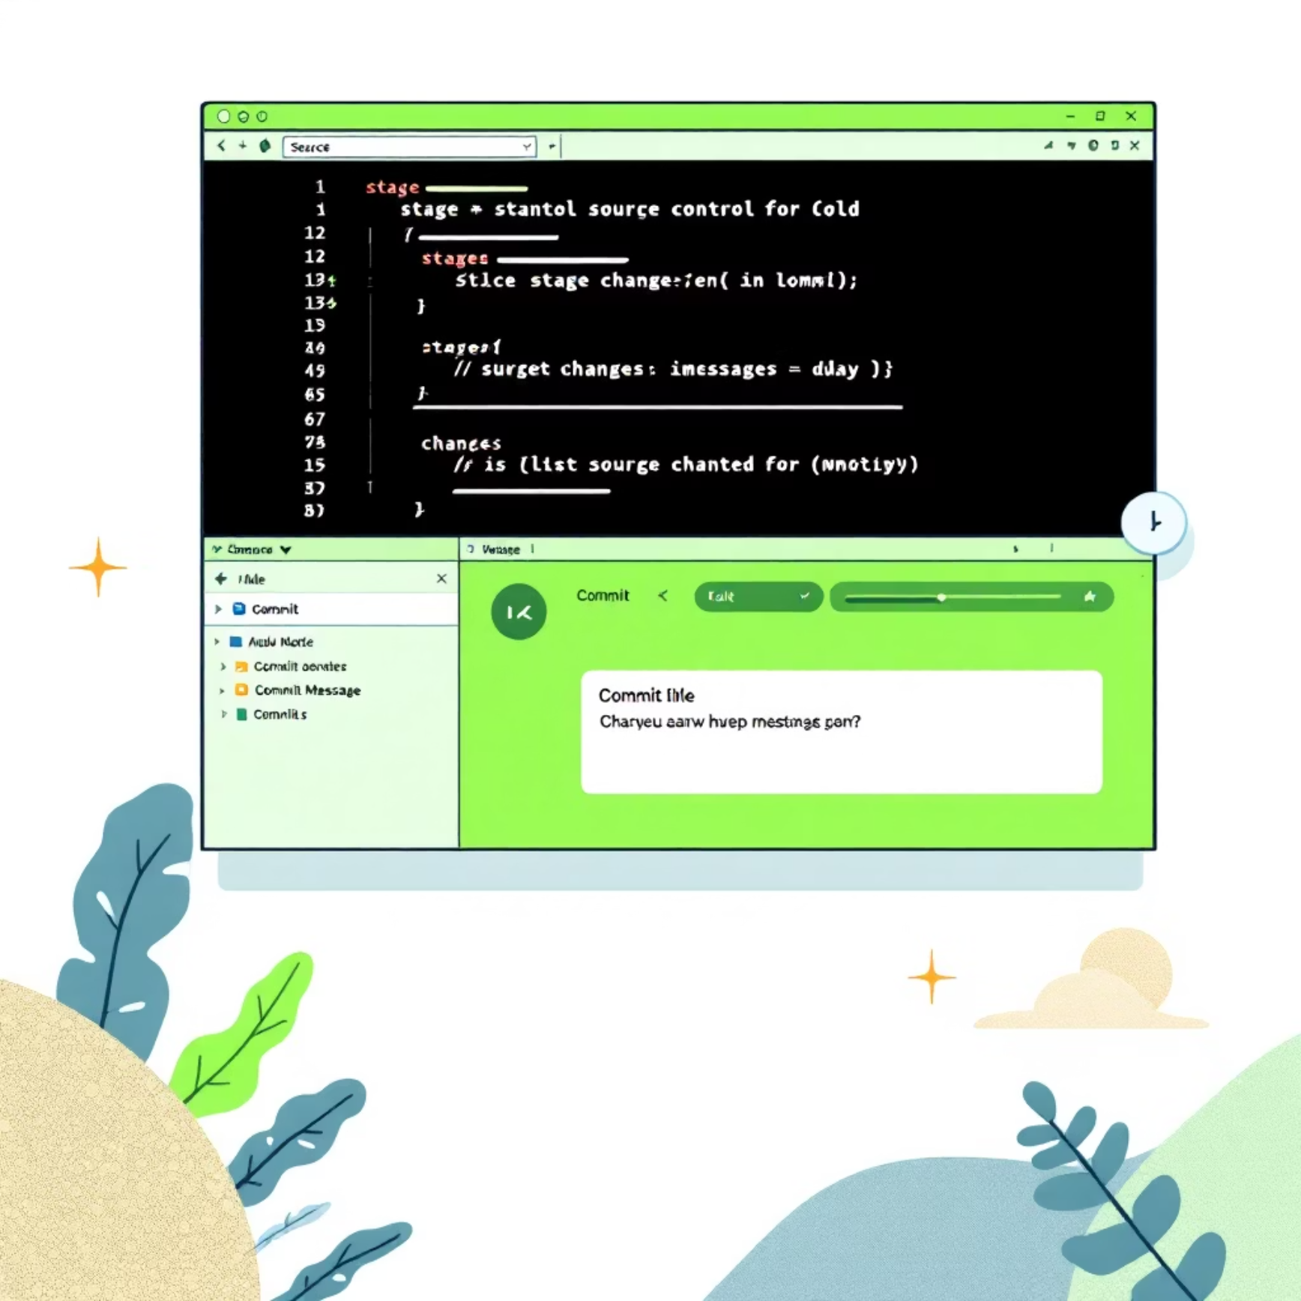




Staging, Committing, and Pushing Changes in VS Code
Track Changes
The Source Control sidebar clearly displays all modified, added, or deleted files with status indicators.
Stage Files
Stage individual files using the plus icon or stage all changes at once, preparing them for the next commit.
Commit with Message
Craft clear commit messages in the designated box, then click the checkmark to save your staged changes.
Push to GitHub
Upload your committed changes to the remote GitHub repository using the push button or command palette.
Synchronize
Pull remote changes or synchronize your local branch with the remote with a single click for up-to-date code.

Slide 8
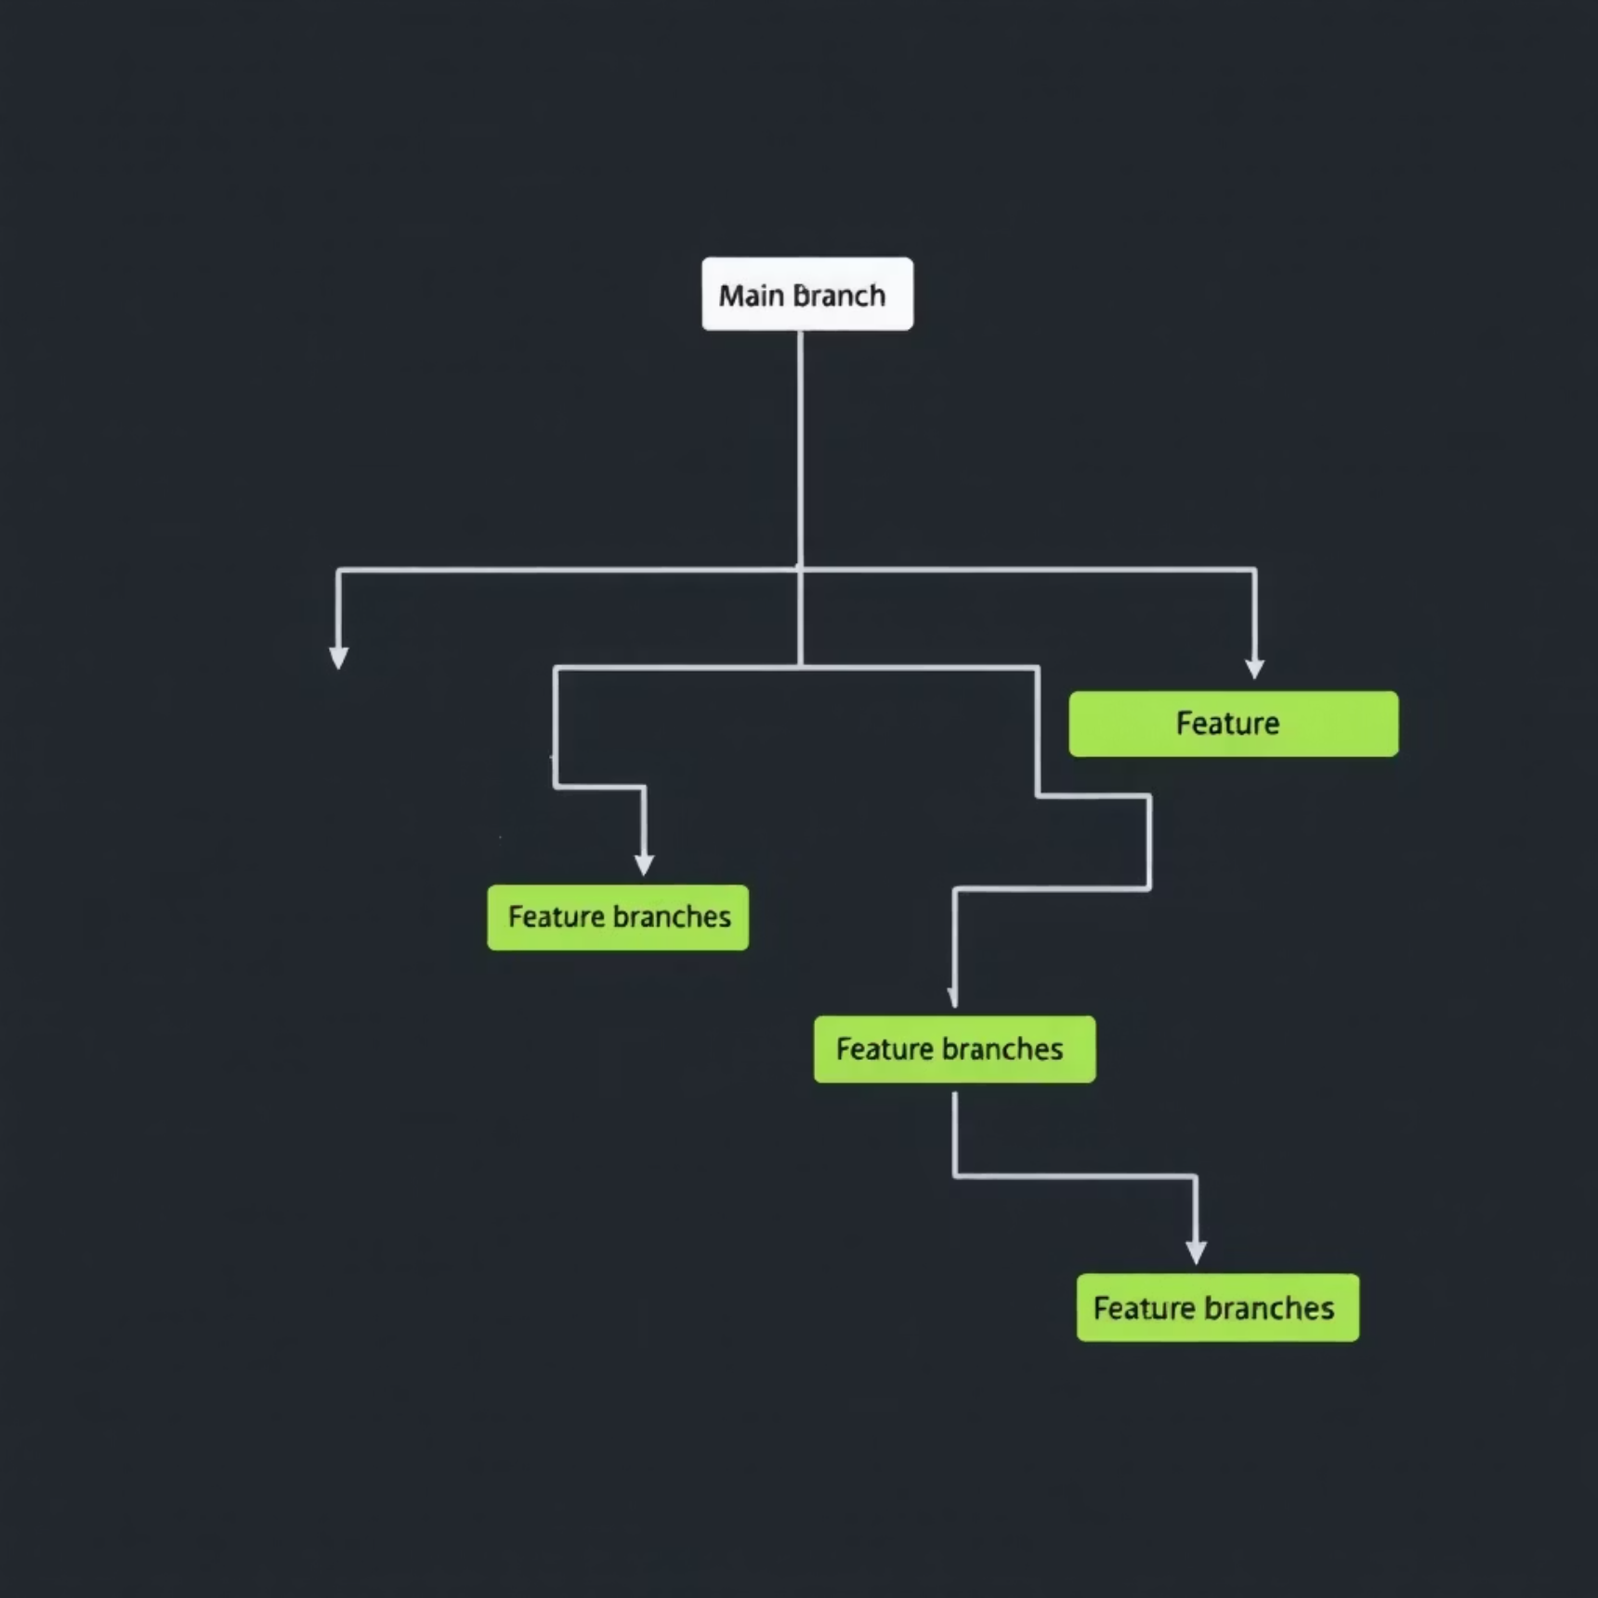

Understanding Branches in Git
Independent Workflows
Branches allow you to develop new features or fix bugs in isolation without affecting the main codebase.
Main vs. Feature Branches
For example, the main branch typically holds stable, production-ready code, while a feature/login branch can be used for developing a new login module.
Switching Context
Easily navigate between different lines of development using git checkout .
Merging Work
Once a feature is complete, integrate it back into the main branch using git merge .
Lightweight Pointers
Branches are essentially lightweight pointers to commits, enabling efficient parallel development.

Slide 9
Creating and Managing Branches in VS Code
01 Branch Selection
Click the current branch name in the bottom-left status bar to view all available branches.
02 New Branch Creation
Select Create New Branch and provide a clear, descriptive name for your feature or fix.
03 Instant Switching
Switch between branches quickly and smoothly using the same intuitive menu.
04 Visual History
The Source Control panel visually displays branch history, making it easy to track commits and progress.
05 Integrate with Issues
Use the GitHub Pull Requests extension to create branches directly from issues, keeping work perfect

Slide 10

Handling Merge Conflicts and Pull Requests in VS Code
Identify Conflicts
Resolve with Editor
Commit Resolution
VS Code automatically highlights merge conflicts in the Source Control panel under "Merge Changes".
Use the integrated merge editor to compare conflicting changes side-by-side and choose the desired code.
After resolving all conflicts, commit the merge to finalize the integration of changes.
Create Pull Requests
Review & Merge In-Editor
Initiate pull requests directly from VS Code to propose your changes for review and merging into main branches.
Review code, add comments, and merge pull requests all without ever leaving your VS Code environment.

Slide 11
Summary & Next Steps
Key Takeaways:
Git & GitHub: Essential for collaborative, efficient code management
.
VS Code Integration: Simplifies everyday Git and GitHub workflows.
Branching: Master this to safely develop features and fixes in parallel.
Seamless Collaboration: Use GitHub integration for streamlined code reviews.

