Slide 1

A NON INVASIVE METHOD FOR DETECTION OF ANEMIA IN CHILDRENS BY USING EYE-CONJUNCTIVA IMAGES
TEAM MEMBERS | REGISTRATION NUMBERS
Gorsipati Avinash | 99230040556
G.Viswa Datta Reddy | 99230040557
M.Sumalatha | 99230040677
Matam Vandana | 99230040665
GUIDED BY:
Dr. T. DHILIPHAN RAJKUMAR
DEPARTMENT OF COMPUTER SCIENCE
AND ENGINEERING(KARE)
GROUP-03

Slide 2
OBJECTIVE:
To Detect Anemia in Children with Eye-Conjunctiva Images using Convolutional Neural Network(CNN).
To provide an alternative to blood tests and minimizing discomfort and risk for children.
To analyze eye-conjunctiva images as an indicator of conjunctival pallor (a symptom of anemia).

Slide 3
OBJECTIVE
INTRODUCTION
PROBLEM STATEMENT
COMMUNITY IMPACT
LITERATURE SURVEY
METHODOLOGY
SOFTWARE COMPONENTS
ALGORITHM
IMPLEMENTATION
MODEL ARCHITECTURE
EXPERIMENTAL RESULTS AND DISCUSSION
CONCLUSION
REFERENCES
OVERVIEW OF THE PROJECT:

Slide 4
INTRODUCTION:
Iron deficiency is most commonly the cause of anemia and results in fatigue, weakness, and impaired mental development.
Early diagnosis is necessary to avoid long-term health complications.
Conventional methods of diagnosis depend on invasive blood tests, which are painful, expensive, and need trained operators.
A non-invasive, fast, and friendly-to-children alternative for screening anemia is needed.
The conjunctiva of the eye (the interior of the lower lid) exhibits visible pallor in anemic patients.
These signs can be identified using technology through image-based analysis of the conjunctiva.
New technologies in computer vision and machine learning provide new means for automating this detection.
This project seeks to utilize these technologies to construct an efficient and non-invasive anemia diagnosis tool for children.
Anemia is a common health condition among children, particularly in underdeveloped nations.

Slide 5
PROBLEM STATEMENT:
There are Invasive methods to detect anemia like…(Blood Test, Bone Marrow Biopsy)
But using those methods for children's is risky and painful. So a NON-INVASIVE method is needed.

Slide 6
COMMUNITY IMPACT:
This community service project aims to detect anemia in children 6 years and below 6 years by analyzing images of their eye conjunctiva.
Early identification of anemia is crucial for preventing health complications and promoting the overall well-being of young children of age 6 years.

Slide 7
LITERATURE SURVEY:
PAPER DETAILS | PAPER DESCRIPTION
Justice Williams Asare, William Leslie Brown-Acquaye ,et.al "Application of machine learning approach for iron deficiency anemia using conjunctiva images",Informatics in Medicine Unlocked , Elsevier, 19 January 2024. | Work: In this work, we used images of the conjunctiva of the eyes to examine how well convolutional neural network, k-nearest neighbor, decision tree, Naive Bayes, & SVM performed in detecting anemia. Algorithm: Machine learning algorithms like CNN, Decision Tree. Advantages : Machine learning models can process images quickly, enabling rapid screening of large populations for IDA. Disadvantages: The accuracy of Machine learning models heavily relies on the quality and consistency of the images used for training.
Kasthuri.E, S.Subbalakshmi, Rajasree Sreedharan, “Insightful clinical assistance for anemia prediction with data analysis and explainable AI” Science direct, Elsevier, 2024. | Work: Developed an Explainable AI-based system to predict anemia causes using machine learning and data preprocessing techniques. Algorithm: Used LGM Boost (Light Gradient Boosting Machine) with LIME (Explainable AI) for transparent and accurate anemia prediction. Advantages: High accuracy (91%), interpretable results, identifies main contributing features, and aids clinical decision-making Disadvantages: Limited dataset diversity, potential overfitting without preprocessing, and requires computational resources for explainable analysis.

Slide 8
Justice Williams Asare, Peter Appiahene, et.al,"Detection of anemia using medical images: A comparative study of machine learning learing algorithm-A systematic literature review", Informatics in Medicine Unlocked , Elsevier, 26 May 2023. | Work: This implies that it is crucial to prevent anemia in adolescent girls and women before and during pregnancy as a part of programs to eliminate stunting in children. Algorithm: Random forest, XG Boost. Advantages: The review can highlight gaps in current knowledge, helping to direct future research efforts and interventions in maternal and child health. Disadvantages: The variability in study designs, populations, and methodologies can complicate the synthesis of results and affect the reliability of conclusions.
Peter Appiahene, Kunal Chaturvedi ,et.al,”A conjunctival pallor dataset and benchmark for anemia detection in children”, Elsevier, 27 May 2023. | Work: Developed a large conjunctival pallor image dataset (CP-AnemiC) and a deep neural network model for anemia detection and hemoglobin estimation in children. Algorithm: Used a joint deep learning framework combining classification (anemia detection) and regression (Hb level estimation) with architectures like ResNet50, VGG16, DenseNet121, ViT, and ConvNeXtBase. Advantages: Non-invasive, accurate, dataset-balanced, and effective in both classification and regression tasks. Disadvantages:Ethnically limited dataset, costly and time-consuming data collection, and dependency on high-quality image capture.

Slide 9
Sana Maidoumi, Charif Radouan Ouaziz, et.al, "Iron deficiency and cognitive impairment in children with low blood lead levels", Toxicology Reports , Elsevier, 23 August 2022. | Work: After extracting the relevant emotions from the collected tweets, we attempted to determine the types of emotions that are associated with anemia. The main emotions of anger, fear, sadness, and joy were extracted from both anemia & non-anemia groups. Algorithm: Naïve Bayes Advantages: Twitter provides a continuous stream of real-time data, allowing for timely identification of discussions and trends. related to anemia, which can facilitate early recognition of potential outbreaks or awareness needs. Disadvantages: Social media data can be noisy and unstructured, leading to challenges in accurately identifying relevant posts and determining the context of discussions around anemia.
Tuba Karagul Yildiz, Nilufer Yurtay, Birgul Onec,"Classifying anemia types using artificial learning methods", Engineering Science and Technology , an international journal, Elsevier, 7 January 2021. | Work: The present work proposes a system that will enable the recognition of anemia under general clinical practice conditions for this system. Algorithm: Artificial neural network(ANN) Advantages: Artificial learning methods,especially advanced techniques like deep learning, can improve the accuracy of anemia classification by analyzing complex patterns in large datasets that may not be evident to human experts. Disadvantages: Models may overfit the training data, meaning they perform well on known data but poorly on unseen data, which can limit their real-world applicability.

Slide 10
Sarah J.Hart, Kanecia Zimmerman, Corinne M. Linardic, et.al "Detection of iron deficiency in children with Down syndrome", Genetics in Medicine, Nature Publishing Group, February 2020. | Work: We provide evidence to support that a CBC and ferritin be obtained routinely for children over 1 year old with DS rather than hemoglobin alone for detection of ID. Algorithm: Decision tree. Advantage: Iron is essential for muscle development, immune function, and growth Detecting deficiencies early can prevent stunted growth and frequent infections. Disadvantage: Routine screening for iron deficiency may lead to overdiagnosis, resulting in unnecessary treatments such as iron supplementation. Over-supplementation can lead to side effects like constipation, stomach pain, or, in severe cases, iron overload (hemochromatosis), which can damage organs.
Olufunke Odunlade, Olugbenga Adeodu, et.al "Iron deficiency, still a rarity in children with sickle cell anemia in ILe-Ife, Nigeria", Hematology, Transfusion and Cell Therapy, Elsevier , 28 March 2019. | Work: In this study, children with sickle cell anemia were evaluated for iron deficiency. Serum ferritin and free erythrocyte protoporphyrin free erythrocyte protoporphyrin (FEP) levels, mean corpuscular volume mean corpuscular volume (MCV) and mean corpuscular hemoglobin mean corpuscular hemoglobin (MCH) were used in determining their iron status. Algorithm: Regression. Advantages: In SCA, hemolysis (the breakdown of red blood cells) leads to increased iron recycling in the body, making iron deficiency rare. Disadvantages: While iron deficiency is rare in children with SCA, it is not impossible. A focus on the rarity of iron deficiency might lead to neglect in diagnosing and treating those few cases that do exist, leaving some children with undiagnosed deficiencies.

Slide 11
Fu-Ping lai,Yao-Jong Yang,"The prevalence and characteristics of cows milk protein allergy in infants and young children with iron deficiency anemia",Taiwan pediatric association,30 June 2018 | Work:The study identified CMPA as a cause of IDA in 13.7% of young children through elimination diet and iron supplementation. Algorithm: Naïve bayes Advantage:Effective non-invasive diagnostic approach using elimination diet and iron supplementation. Disadvantage:Risk of over-diagnosis without confirmatory food challenge.
Byung Ok Kwak, Kyungmin Kim,et.al,"Relation ship between iron deficiency anemia and febrile seizures in children",Elsevier,14 September 2017 | Work:This meta-analysis of 17 studies (2,416 children with febrile seizures and 2,387 controls) found a significant association between iron deficiency anemia (IDA) and febrile seizures, with a pooled odds ratio of 1.98. Algorithm: Random forest Advantage:Provides strong pooled evidence for IDA as a risk factor for FS using meta-analysis. Disadvantage:Cannot establish causality due to observational study design and confounding factors.

Slide 12
Methodology:-
User Input Eye Image
Web Interface HTML/CSS/JS
Image Input Acquisition
File Upload Handler
Image Preprocessing Resize + Normalization
Input Validation & Error Handling
CNN Model Conv2D + MaxPool2D + Dense Layers
Feature Extraction GlobalAveragePooling2D
Prediction Engine Keras Model.predict()
Binary Classification Sigmoid Activation
Confidence Calculation Threshold > 0.5
JSON Response Result + Confidence
Evaluation metrics

Slide 13
Software components:
Data gathering
Pre-processing
Feature extraction
Deep learning model(CNN)
Model training
Classification(Binary)
User interface
For compilation:-
VS-Code
Trae

Slide 14
Algorithm:
User Input → Upload eye image via web interface.
Validation → Check file format & handle errors.
Preprocessing → Resize , Normalize pixels.
CNN Model → Conv2D + Max Pooling + Dense (Sigmoid AF).
Classification → Output: Normal / Anemic.
Confidence Score → Threshold > 0.5.
Result → JSON Response → Display on UI.

Slide 15
Implementation:-
Conv2D layers for feature extraction using multiple filters.
MaxPooling2D layers to down sample spatial dimensions.
Global Average Pooling2D to minimize overfitting and reduce parameters
Dense layers for fully connected learning with Sigmoid activation function for binary classification.

Slide 16
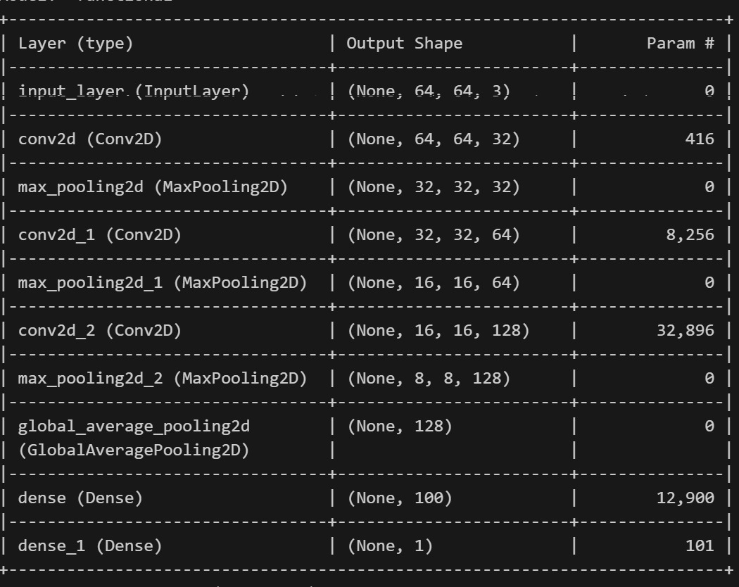
MODEL ARCHITECTURE:-

Slide 17
EXPERIMENTAL RESULTS AND DISCUSSION:
EXISTING WORK:
RESEARCH NAME | METHODOLOGY | DATASET | RESULTS
Agarwal (2021) | ResNet,MobileNetV2. | Medical fundus image | Accuracy-62.3%
Peksi et.al (2021) | NAIVE BAYES | Nails and Palms | Accuracy-90%
Dimauro (2022) | K-Means clustering | Digital images of palms | Accuracy-87%
OUR WORK:-
METRICES | SCORE
F1-SCORE | 75.6
RECALL | 75.9
PRECISION | 75.4
METHODOLOGY | DATASET | RESULTS
Convolutional Nural Network | Eye-Conjunctiva Images | Accuracy-83.2

Slide 18
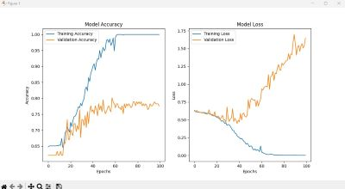
MODEL GRAPH:-

Slide 19
Conclusion:
This study introduces a CNN-based, non-invasive method for exploiting eye-conjunctiva pictures to diagnose anemia in infants early. The method's combination of online integration and deep learning yields high accuracy and usability. The model provides a scalable and moral substitute for blood-based diagnostics, and its robust performance confirms its promise for real-time community healthcare screening.
Future extensions include Explainable AI (XAI) for transparency and multi-modal integration combining image and physiological data for improved diagnostic reliability.

Slide 20
REFERENCES:
[1]Justice Williams Asare, William Leslie Brown-Acquaye ,et.al "Application of machine learning approach for iron deficiency anemia using conjunctiva images",Informatics in Medicine Unlocked , Elsevier, 19 January 2024.
[2] Kasthuri.E, S.Subbulakshmi , Rajasree Sreedhan , “ Insightful Clinical Assistance for Anemia Prediction with Data Analysis and Explainable AI”, Procedia ScienceDirect , Elsevier , 2024.
[3] Justice Williams Asare, Peter Appiahene, et.al,"Detection of anemia using medical images: A comparative study of machine learning learing algorithm-A systematic literature review", Informatics in Medicine Unlocked , Elsevier, 26 May 2023.
[4] Sana Maidoumi, Charif Radouan Ouaziz, et.al, "Iron deficiency and cognitive impairment in children with low blood lead levels", Toxicology Reports , Elsevier, 23 August 2022.
[5] Tuba Karagul Yildiz, Nilufer Yurtay, Birgul Onec,"Classifying anemia types using artificial learning methods", Engineering Science and Technology , an international journal, Elsevier, 7 January 2021.
[6] Sarah J.Hart, Kanecia Zimmerman, Corinne M. Linardic, et.al "Detection of iron deficiency in children with Down syndrome", Genetics in Medicine, Nature Publishing Group, February 2020.
[7] Olufunke Odunlade, Olugbenga Adeodu, et.al "Iron deficiency, still a rarity in children with sickle cell anemia in ILe-Ife, Nigeria", Hematology, Transfusion and Cell Therapy, Elsevier , 28 March 2019.
[8] Dr.V.Geetha, Dr.C.K.Gomathy, Kommuru Keerthi, et.al "Diagnostic Approach To Anemia in Adults Using Machine Learing ", Pharmaaceutical Negative Results , Original Article , 2022.
[9] Fu-Ping Lai, Yao-Jong Yang, "The prevalence & characteristics of cow’s milk protein allergy in infants & young children with iron deficiency aneamia", ScienceDirect, Elsevier Taiwan Pediatric Association, 30 June 2017.

Slide 21
[10] Byung Ok Kwak, Kyungmin Kim,et.al,"Relation ship between iron deficiency anemia and febrile seizures in children",Elsevier,14 September 2017
[11] Peter Appiahene, Justice williams Asare et.al , "Detection of iron deficiency anemia by medical images: a comparative study of machine learning algorithms " Open Access , 2023
[12] Sabrina Challa, Junaid Maqbool , et.al " International conference on machine learning and data engineering semantic segmentation of palpebral conjunctiva using predefined deep neural architectures of Anemia detection" Procedia computer science, Elsevier, 2023
[13] Amin, S. U., Islam, M. M., & Uddin, M. Z. (2022). "A CNN-based system for non-invasive anemia detection in children using conjunctival pallor assessment." Artificial medicine,128,102311.
[14] Peter Appiahene.Kunal chaturvedi,et.al"A conjunctival pallor dataset and benchmark for anemia detection in children", Medicine in novel technology and devices,27 May 2023
[15] Joshi, S. K., Thakur, R., & Sharma, M. (2017). "A deep learning-based non-invasive system for anemia prediction using conjunctiva images." Medical & Biological Engineering&Computing,55(4),639-647.

Slide 22
THANK YOU !

