Slide 1
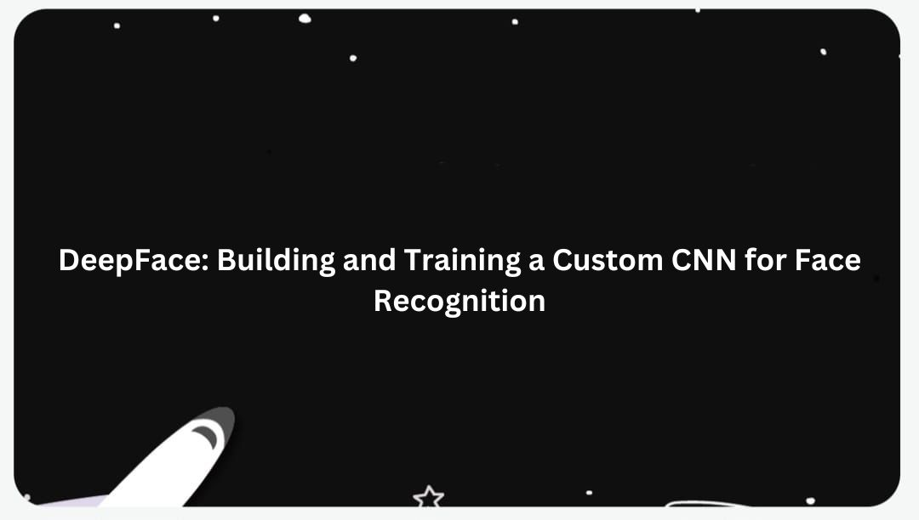

Slide 2

DeepFace: Building and Training a Custom CNN for Face Recognition
Team Members :
Avinash

Slide 3
Introduction
In this project, we aim to create a custom face recognition system using CNN.
The CNN will be trained to solve one shot learning problem which is most common problem in this systems. To solve this problem we will be using Siamese Network technique.

Slide 4

Problem Statement
Enhanced Accuracy
Minimizing false positives and negatives with industry-leading accuracy.
Efficient Processing
Optimizing speed and efficiency with real-time facial recognition algorithms
Robustness to Conditions
Ensuring accuracy in varying conditions, such as lighting and occlusion.

Slide 5
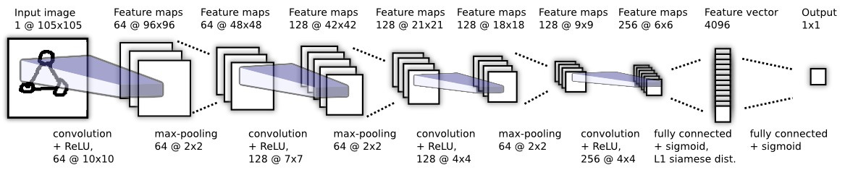
System architecture

Slide 6
Features
Real Time Recognition
Improved Accuracy

Slide 7
Challenges
Data Limitations
Overfitting
Hyperparameter Tuning
Data Limitations

Slide 8
Technology
Python
NumPy
CNN (Convolutional Neural Network)
Tensorflow
Keras
OpenCV

Slide 9
Applications and Use Cases:
Physical Access Control
Device Unlocking
Border Control
Criminal Identification
Surveillance
Financial Services
Online Authentication
Workplace Attendance
Academic Institutions
Retail
Hospitality
Patient Identification
Medical Diagnosis
Targeted Advertising
Customer Feedback
Photo Tagging
Gaming and Entertainment

Slide 10
Thank You!
.

