Slide 1
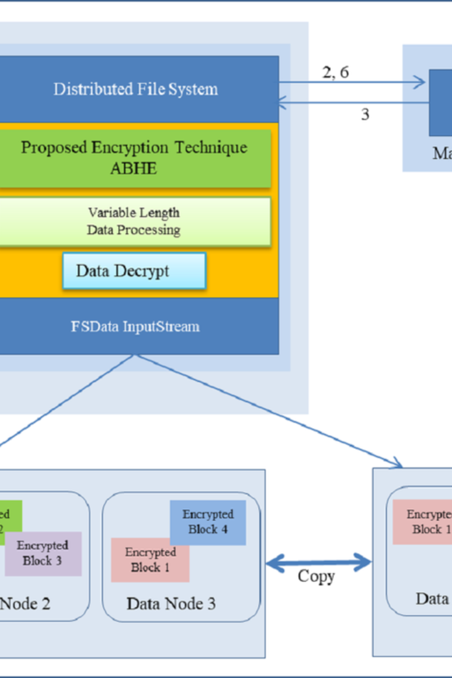


Exploring HDFS: A Deep Dive into Storage Management
The Hadoop Distributed File System (HDFS) is a distributed, scalable, and portable filesystem designed to work with the Hadoop framework. It provides high-throughput access to application data and is suitable for applications with large datasets. Let's take a deep dive into the storage management aspects of HDFS.
by Avinash Gudikandula

Slide 2
Creating Directory Structure in HDFS
Command to Create Directory in HDFS
Command to Move File from Local to HDFS
The first step in HDFS storage management is creating a well-structured directory. Use the command hadoop fs -mkdir /user/your_username/directory_name to create a new directory in HDFS.
After creating the directory, you can use the hadoop fs -copyFromLocal local_file_path hdfs_directory_path command to move files from the local file system to the Hadoop distributed filesystem.

Slide 3
Viewing Data Contents, Files, and Directories
Command to See Contents of Files in HDFS
Command to See Contents of Files in HDFS Directory
To view the contents of a specific file in HDFS, use the command hadoop fs -cat hdfs_file_path.
For a comprehensive view of the contents within a specific directory in HDFS, utilize the hadoop fs -ls hdfs_directory_path command.

Slide 4
Getting Files Data from HDFS to Local Disk
Command to Copy File from HDFS to Local File System
To retrieve files from HDFS and transfer them to the local file system, use the hadoop fs -copyToLocal hdfs_file_path local_directory_path command.

Slide 5
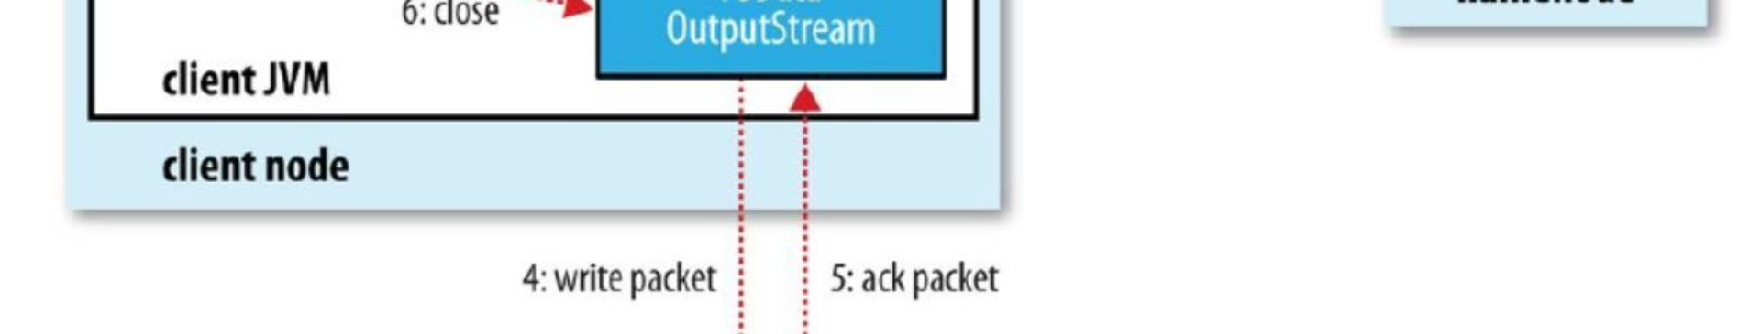
Understanding the Significance
1
Moving Data to HDFS for Processing
2
Leveraging HDFS Commands
Interacting seamlessly with the Hadoop Storage File System through commands is a key aspect of unlocking the full potential of Hadoop's distributed computing capabilities.
Advancing data to HDFS is a pivotal stage in the Hadoop ecosystem, enabling distributed storage and parallel processing.

Slide 6
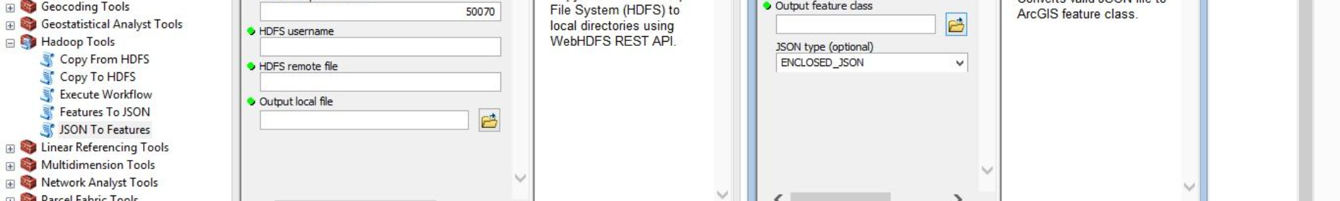
Lab Instructions
1
Objective: Utilizing HDFS Commands for Data Processing
Engage in a hands-on exploration of HDFS commands to gain practical experience in data processing within the Hadoop ecosystem.
2
Step-by-Step Guide
Follow a structured guide encompassing directory creation, file movement, content inspection, and data retrieval in HDFS.
3
Reminder: Data Processing Begins with HDFS
Reinforce the foundational role of HDFS in effective data processing, ensuring a strong understanding of its significance and functionality.

Slide 7
Best Practices and Tips
Organize Data Hierarchically
Regularly Monitor Storage Usage
Structured directory arrangements enhance efficiency in data retrieval and processing within HDFS.
Keep a keen eye on storage consumption to prevent resource limitations and optimize storage utilization in HDFS.
Backup Strategies
Use Compression Wisely
Implement robust backup mechanisms to safeguard against potential data loss scenarios in HDFS.
Strategically apply compression techniques to conserve storage space in HDFS, especially for large files.

Slide 8
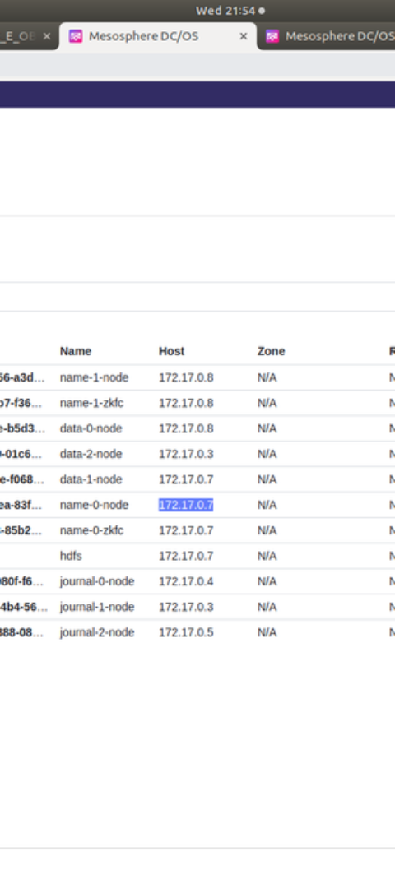
Conclusion
1
Gateway to Effective Data Management
2
Empowerment through Command Mastery
HDFS commands play a key role in facilitating effective data management within the Hadoop ecosystem.
Mastery of HDFS commands empowers users to seamlessly navigate and manipulate the Hadoop Storage File System.
3
Hands-On Learning Opportunities
The provided lab instructions offer real-world applicability, reinforcing theoretical knowledge with practical experience of HDFS functionality.

